Slide 1
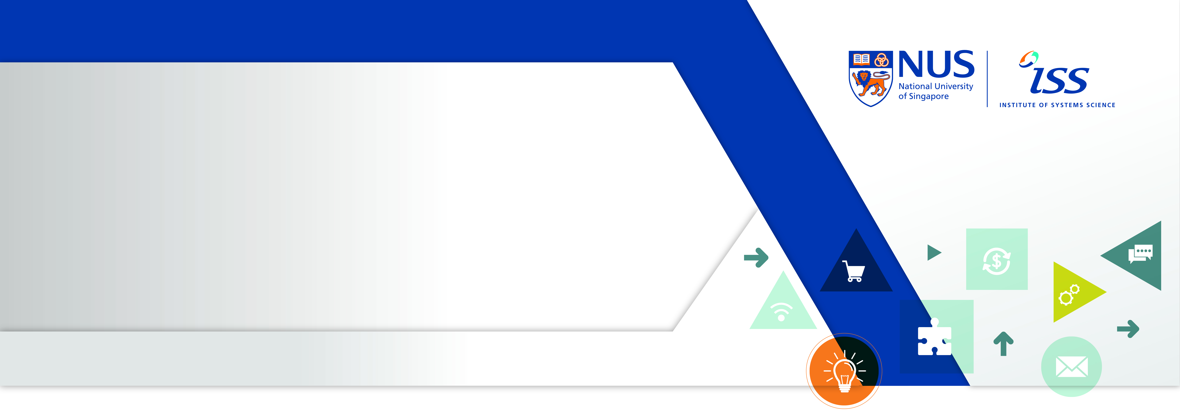
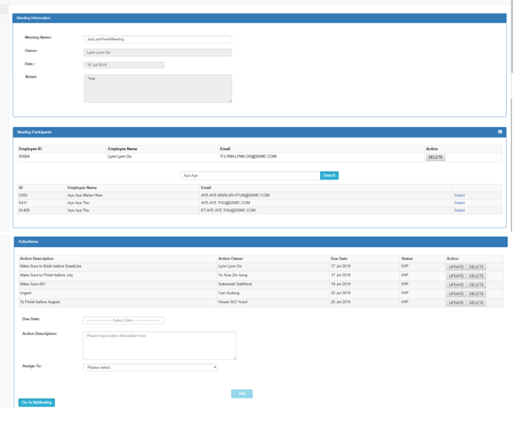
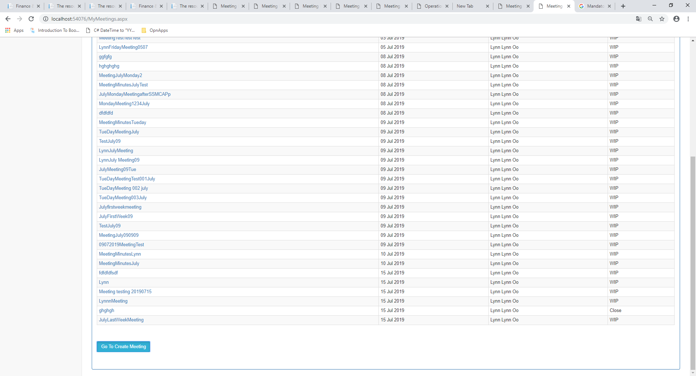
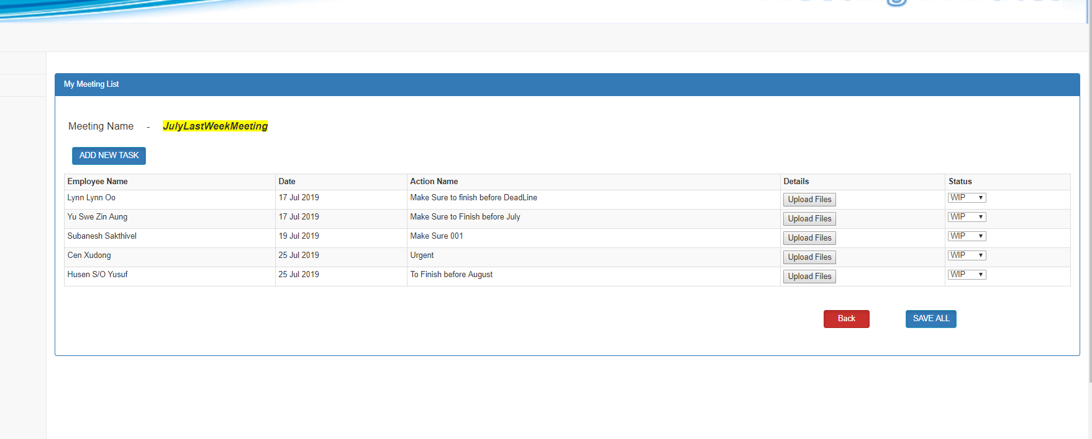
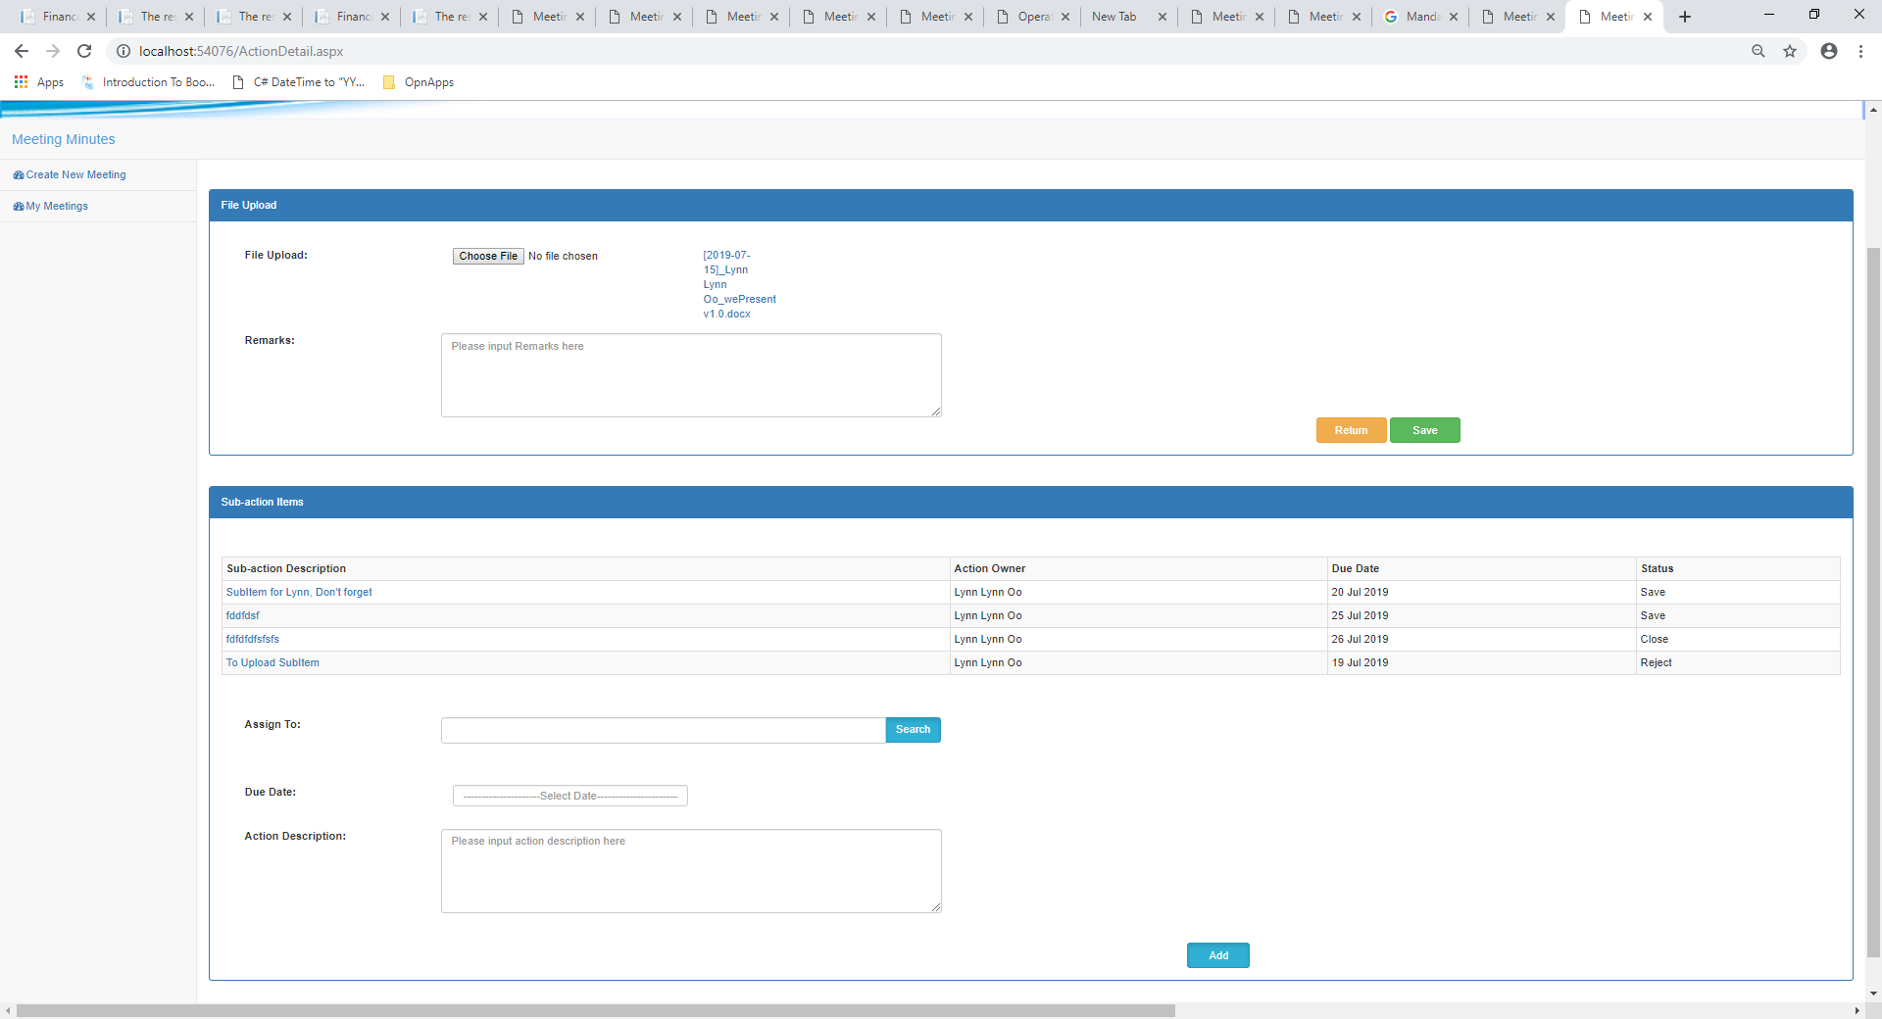
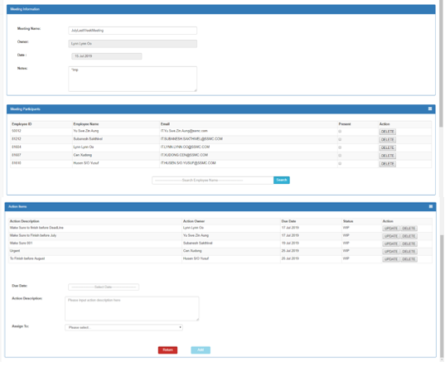
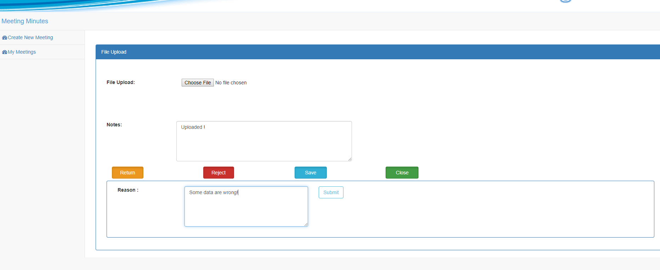
Graduate Diploma in Systems Analysis
Meeting Minutes App
By: Lynn Lynn Oo @ S.Mor.Sangeetha (A0186875H)
Every day, important meetings take place in every office. Numerous, non-formalized meetings typically produce varying styles of meeting minutes. This lack of structure negatively impacts organizations, hindering the decision making process. In some instances it can bring a project to a screeching halt.
Decisions made in these meetings may involve a lot of time, money and can even change people’s careers. With important things at stake in meetings, it’s no wonder meeting minutes are considered of great value. Meeting minutes serve as a record of what was discussed and decided in a meeting, what actions must be taken, who must take them and when.
Using an application like Meeting Minutes App can help bring order to the chaos, assisting organizations in formalizing minutes and streamlining meeting procedures.
Objective
Using an Meeting Minutes Application will be saved resources like time, human effort, cost of the paper and can perform all actions in one place so that can be easily capture discussions and decisions, distribute minutes to attendees, save as online archiving of meeting minutes and to minimizes the struggles of trying to capture all relevant information.
Solution
The Meeting Minutes Application is designed on Web Application Platform including JavaScript, Ajax and used the ADO.net data Access technology that is remarkable and scalable architecture. The use of stored procedure in this application provides better security to data. The UI are designed by using HTML5 and bootstrap so that the screen can be compactible with all device due to its responsive.
Technical Challenges
Coding part is longer than expectation.
Scalability is a difficult thing to manage.
Ajax Toolkit library have security vulnerabilities that need updating.
Design Control Problem.

