Slide 2




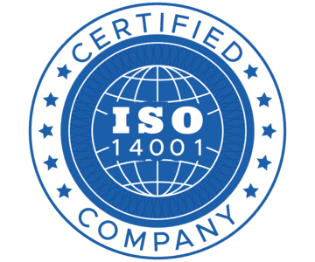

Provides comprehensive electronics solutions including product design, manufacturing services, and turnkey systems.
Services mission-critical end-user industries such as Defense, Space, Aerospace, Medical, and Transportation.
Operates a massive manufacturing footprint with 350,000 sq. ft of production area in Bangalore and facilities in France.
Employs a global workforce of over 2,300 professionals, with approximately 51% dedicated to core Engineering departments.
Utilizes flexible engagement models including build-to-spec, consulting, and fixed-price projects for global B2B clients.
A leading high-technology electronics solutions provider specializing in defense, aerospace, and space sectors.
Operates globally with a proven track record of delivering mission-critical electronics and advanced passenger systems since 1994.
Strategic Electronics & Space Solutions: Customized subsystems for defense, satellite bus systems, and EW payloads.
Electronics Manufacturing Solutions (EMS): High-precision system integration, PCBA, test services, and environmental screening.
Engineering & Design Services: End-to-end design engineering, embedded software, FPGA development, and mechanical design for complex industrial systems.

Slide 3

FINANCIAL PERFORMANCE AND MARGINS
REVENUE GROWTH
The pie chart details a balanced Equity Shareholding Pattern as of the latest reporting period.
Promoters retain a significant 47% stake, ensuring long-term strategic alignment and stability.
The high percentage of Non-Promoter holdings indicates healthy institutional interest and market liquidity.
Significant investors include HDFC Trustee Company and specialized equity funds, reflecting confidence in the business model.
EQUITY STRUCTURE
The bar chart illustrates a consistent upward trajectory in Revenue From Operations over a three-year period.
A notable 18% year-on-year growth was achieved in FY24, driven by high-margin strategic contracts.
Projections for FY25 indicate sustained growth as the company executes its massive INR 1,675 crore order book.
Revenue growth is complemented by improving operational efficiency and higher utilization of the 350,000 sq. ft manufacturing footprint.

Slide 4

High Entry Barriers (Capex): Capital-intensive operations with specialized 350,000 sq. ft facility and advanced R&D capabilities.
Market Tailwinds: Ideally positioned to capture India's ER&D export market growth, projected to reach $170B by 2030.
Critical Supplier Status: Tier-1 strategic partner to defense organizations (DRDO) and aerospace leaders like Thales and Key Management.
Global Technical Expertise: Multi-decade track record in mission-critical systems with proprietary IP and semiconductor switch patents.
Robust Revenue Visibility: Secured order book of INR 1,675 crore as of December 2024 providing stable mid-term growth.
Operating Leverage: Demonstrated margin improvement with PBILDT expanding to 12.65% alongside a significant revenue surge.

