Slide 2


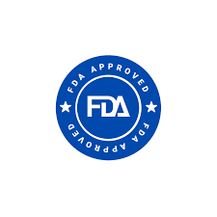

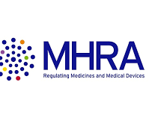
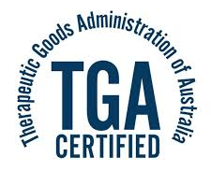
The Company is a research-driven pharmaceutical entity focusing on Product Segments like APIs, Phyto-Chemicals, and finished formulations.
Serves critical End-User Industries across 45 countries with a diverse portfolio of over 100 drug molecules.
Maintains a robust Manufacturing Footprint with WHO-GMP certified facilities in Punjab, Jammu, and Himachal Pradesh.
Core competencies in R&D are supported by DSIR-approved centers registered with the USFDA for complex chemistry.
Operating through multiple divisions including Noble, Nova, and Ethical, ensuring deep market penetration.
Leading Indian pharmaceutical manufacturer with over 35 years of expertise in APIs, formulations, and herbal products.
Global footprint spanning 45 countries with marquee regulatory approvals from USFDA, TGA-Australia, and MHRA-UK.
Ethical & Generic Divisions: Comprehensive range of formulations across therapeutic areas like CNS, Cardiovascular, and Respiratory systems.
API & Global Business Unit: High-scale manufacturing and export of Active Pharmaceutical Ingredients to major international markets.
Noble & Nova Divisions: Specialized therapeutic segments focusing on high-growth niche medical requirements and institutional supplies.

Slide 3


FINANCIAL PERFORMANCE AND MARGIN ANALYSIS
REVENUE GROWTH
Strong Promoter holding of 55.6% ensures stability and long-term strategic focus.
Substantial 44.4% Non-Promoter stake indicates a healthy secondary market presence.
Increasing FII interest suggests rising institutional confidence in the API and generic model.
Ownership structure remains balanced to support future equity-based capital raising.
SHAREHOLDING STRUCTURE
Revenue scaled significantly to ₹5,022.48M in FY2024.
Consistently increasing turnover reflects expanding Global Business Unit contributions.
Strategic shift towards high-value formulations is driving top-line momentum.
The Company targets 40% growth in sales following current capacity expansions.

Slide 4
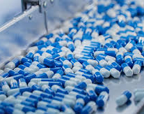
Excellent Compliance Track Record with multiple plant approvals from USFDA, EDQM, and ANVISA.
Advanced R&D Capabilities recognized by DSIR with dedicated centers for innovative formulations.
Specialized expertise in Complex Chemistry for the production of varied therapeutic molecules.
Planned ₹100 Crore Expansion to triple manufacturing capacity in the next nine months.
Strong Molecule Pipeline addressing chronic conditions in CNS, Gastrointestinal, and Diabetic care.
Preferred vendor status for global leaders including TEVA, Mylan, and Key Management.

