Slide 1
Thermodynamic feasibility of a solar-powered EV charging station
An hourly First- and Second-Law analysis in Jodhpur, Bengaluru and Guwahati
Rehan Mallik · CL207 Thermodynamics · IIT Bombay
Notes:
Introduce the project: one fixed station design, three Indian climates, an hourly First and Second Law simulation over three years of satellite weather.

Slide 2
Three questions about one fixed station
1 Coverage
How much of a fixed 222 kWh/day EV demand can solar cover, hour by hour?
2 Second Law
Where is the work potential (exergy) of the sunlight destroyed, and how does climate change that?
3 Economics
Does the economic verdict follow the thermodynamic one?
Same design in all three cities. Only weather, tariff and grid emission factor differ.
Jodhpur
26.3°N · hot, arid, beam-rich
Bengaluru
13.0°N · mild, two monsoons
Guwahati
26.2°N · humid, heavy monsoon
Notes:
State the three questions. Stress that the design is held fixed so climate is the only physical variable. This is a feasibility study: dispatch is a fixed priority rule and economics is a reporting layer.

Slide 3
Answer: 70–80 % coverage; the sunniest city has the lowest ψ_PV
79.7 %
Jodhpur solar coverage
74.3 %
Bengaluru
70.4 %
Guwahati
≈ 98 %
of exergy destroyed in the PV cell
Second Law result: in cloudy weather η_PV falls but ψ_PV rises, because diffuse light carries only 0.67–0.80 of its energy as exergy (beam 0.93). Jodhpur, the sunniest city, has the lowest ψ_PV: 24.8 % vs 25.9 % in Bengaluru.
Robustness: all rankings hold in all three weather years and in 100 % of 200 paired Monte Carlo draws, but the coverage ranking flips on ERA5 reanalysis data.
Economics: PV alone generates below the tariff everywhere. Adding the battery makes NPV negative in every city; the tariff, not the climate, sets the ranking.
Notes:
Lead with the answer. Coverage 80/74/70. The PV cell destroys about 98 percent of the exergy. The Second Law result: diffuse light carries less exergy, so cloudy weather raises psi_PV even as eta_PV falls. Jodhpur has the lowest psi. Battery NPV is negative everywhere. Mention the ERA5 caveat early.

Slide 4
Station and input data
One fixed design · three years of satellite weather · measured EV timing
Notes:
Section: what the station is and what data drives it.

Slide 5
How the station works: every flow meets at one AC bus
PV array
80 × 620 W = 49.6 kWp
Battery
104 LFP cells · 93.2 kWh
Grid
import / export
EMS rule
Sun: EV first → battery → export.
Shortfall: battery → grid.
Battery charges from PV only.
PV inverter
DC → AC · 0.97
Battery PCS
two-way · 0.97 each way
Meter
counts both ways
AC bus (415 V three-phase): power in = power out, every instant
EV chargers
222 kWh/day
Notes:
Walk the electricity from the sun to the car. PV makes DC, the inverter converts it to AC. Battery on its own two-way converter (AC-coupled). Grid as backstop through a two-way meter. The EMS sets the flows each hour. At the AC bus, power in equals power out every instant: the First Law at a node.

Slide 6
Fixed design, built from datasheets
Item | Value | Source / basis
PV module | Trina NE19R 620 W TOPCon · 2.701 m² · η_ref 22.95 % · β −0.29 %/K · NOCT 43 °C | Datasheet DT-M-0093-B
PV array | 80 modules = 49.6 kWp · 216 m² · 20° tilt · due south | 81,030 kWh/yr ÷ 1,630 kWh/kWp ≈ 49.7 kWp
Battery | 104 × REPT 280 Ah LFP in series (1P104S) · 93.2 kWh · 333 V · 31.2 mΩ | REPT brochure; 2 × Y52 modules
Battery limits | SOC 10–90 % (74.6 kWh usable) · 0.5C = 46.6 kW · 8,000 cycles to 70 % | Brochure; SOC window assumed
Converters | PV inverter 0.97 · battery PCS 0.97 per direction | Brief: 96–98 %
DC wiring | 2 % lumped ohmic + mismatch | PVsyst ≈ 0.8 %/yr + PVWatts mismatch 2 %
EV load | 222 kWh/day at the AC bus · hourly shape from measured sessions | Design value; timing measured
EMS | PV → EV → battery → export; deficit ← battery ← grid | Priority rule, not optimised
20° tilt costs only 0.40–0.86 % of plane irradiance against each city's optimum (14° / 28°)
Notes:
Every number comes from a datasheet or a stated design rule. Array sized so annual yield equals annual demand at a typical Indian 1,630 kWh/kWp. Battery is two standard REPT Y52 modules; 0.5C matches the PV peak. 20 degree tilt checked: under 1 percent loss versus optimum.

Slide 7
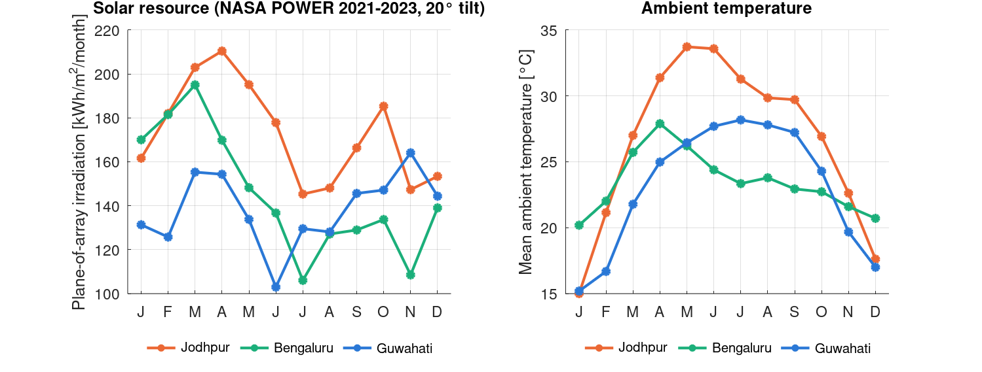
Weather: NASA POWER satellite data, ERA5 as cross-check
POA irradiation [kWh/m²/yr] | Jodhpur | Bengaluru | Guwahati
NASA POWER 2021 | 2,086 | 1,703 | 1,669
NASA POWER 2022 | 2,110 | 1,704 | 1,605
NASA POWER 2023 | 2,030 | 1,826 | 1,714
NASA POWER mean (main case) | 2,076 | 1,745 | 1,662
PVGIS-ERA5 2023 (cross-check) | 1,598 | 1,774 | 1,300
Diffuse + ground share | 37 % | 52 % | 48 %
Horizontal GHI/DNI/DHI → tilted plane with Hay–Davies (circumsolar + isotropic sky) and albedo 0.2
Hour stamps checked: daily irradiance centre sits 0.42–0.51 h before solar noon (hour means)
Monthly irradiation and ambient temperature, NASA POWER 2021–2023 mean
POWER is the main case: satellite-based, ≈ 0 bias vs BSRN ground stations, matches long-term maps
Notes:
Main case: NASA POWER hourly 2021 to 2023, CERES satellite irradiance, transposed to the 20 degree plane with Hay-Davies and albedo 0.2. Three years run back to back. ERA5 reanalysis reads 21 percent low in Jodhpur and 24 percent low in Guwahati; at clear January noons it shows about 400 W/m2 where 900 to 1000 is expected.

Slide 8
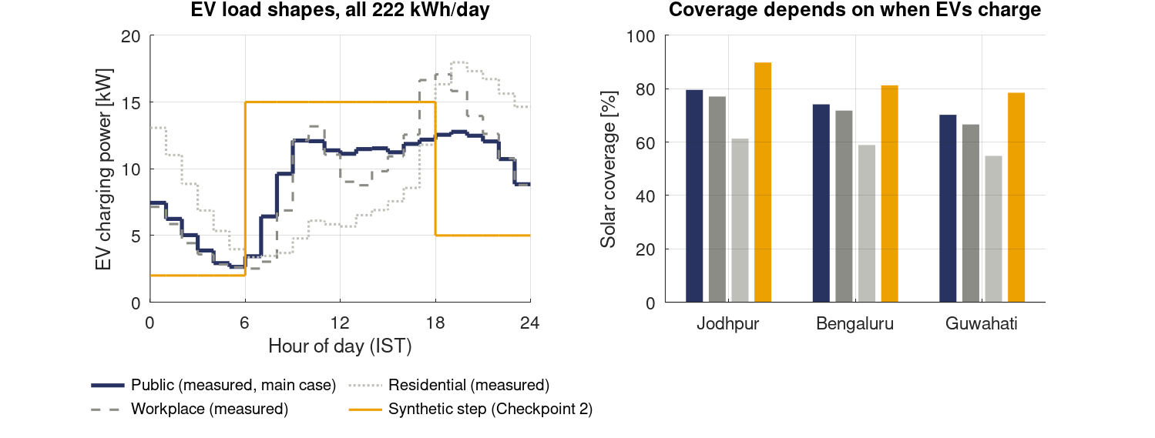
EV load: measured timing, fixed daily energy
Source
72,856 sessions, 2,119 chargers, South Korea 2022 (Scientific Data 2024, CC BY 4.0). Public groups: 24,285 sessions.
Shape
56 % of energy 06–18 h (synthetic: 81 %). Peak 12.8 kW at 19:00.
Effect
Measured timing cuts coverage 7–10 points vs synthetic; residential timing would cut 15–18 more.
Notes:
The Checkpoint 2 profile was an assumption with 81 percent of energy in daylight. It is replaced by the hourly shape of 24,285 public-charging sessions from an open Korean dataset; there is no open Indian session-level dataset. Only the timing comes from data; the daily energy stays 222 kWh. The evening peak is what limits coverage.

Slide 9
Model
First Law and Second Law for every subsystem, every hour
Notes:
Section: the physics, subsystem by subsystem.

Slide 10
Hourly pipeline with three control volumes
load_weather
POA, T_a, wind
26,280 h × 3 cities
pv_model
G_eff, T_c, η, P,
Ex_in, Ex_dest
ems_dispatch
PV → EV → battery
→ export / import
battery_model
I²R, SOC, T_b,
S_gen, ageing
postprocess
sums of hourly
outputs
economics
LCOE, NPV, CO₂
(reporting)
CV1 · PV laminate
Radiation in, electricity out, heat to air and sky. Steady-state energy balance per hour; exergy split into optical, heat and internal.
CV2 · Battery pack
Lumped I²R, coulomb counting, lumped thermal mass; Gouy–Stodola entropy generation; Arrhenius ageing.
CV3 · Electronics + wiring
Fixed efficiencies 0.97 / 0.97 / 0.98. Electricity is pure exergy, so loss = exergy destroyed (ψ = η).
Hourly First-Law and exergy balances are asserted to close: max residual 5.7 × 10⁻¹⁴ kWh
Notes:
Three control volumes: PV laminate, battery pack, power electronics and wiring. Sun, grid, EV and ambient are boundary conditions. Every annual figure is a sum of hourly outputs; weather is never averaged first, because efficiency and exergy are nonlinear (Jensen's inequality).

Slide 11
Cell temperature: an energy balance, calibrated to the datasheet
αG_eff − η(T_c)G_eff = 2h(v)(T_c − T_a) + ε_f σ(T_c⁴ − T_sky⁴) + ε_b σ(T_c⁴ − T_a⁴)
h = h_free + 3.0 v, v = v₁₀ (3/10)^(1/7), T_sky = 0.0552 T_a^1.5
Parameter | Value | Source
Absorptance α | 0.90 | Duffie & Beckman (τα ≈ 0.9)
Emissivity glass / backsheet | 0.84 / 0.89 | Literature range 0.84–0.91
Sky temperature | 0.0552 T_a^1.5 | Swinbank 1963
Wind slope | 3.0 W/m²K per m/s | Watmuff et al. 1977
h_free | 5.55 W/m²K | Calibrated to NOCT 43 °C
Calibration at NOCT (800 W/m², 20 °C, 1 m/s, P = 0)
Absorbed 720 − radiation 326.7 = 393.3 W/m² → h = 393.3/46 = 8.55 → h_free = 8.55 − 3.0 = 5.55
Jodhpur noon, 900 W/m², 35 °C
T_c = 49.7 °C at 3 m/s; 56.7 °C nearly calm. Producing power at NOCT conditions: 36.9 °C, not 43 °C.
The NOCT formula ignores wind, sky and electrical cooling: cells 6–9 K too hot, yield 1.8–2.8 % too low
Notes:
There is no closed-form T_c formula. Steady energy balance with convection on both faces and long-wave radiation, coupled to the efficiency, solved by Newton iteration each hour. h_free is not assumed: it is solved so the balance gives exactly the datasheet NOCT. The plain NOCT formula is this balance linearised at one test point; it runs cells 6 to 9 K hot.

Slide 12
Efficiency and power: temperature, weak light, reflection
G_eff = G_b·[1 − 0.05(1/cos θ − 1)] + 0.95 G_d + 0.65 G_r
η = η_ref · f_low(G') · [1 − β (T_c − 25)], f_low = 1 + k₁ ln G' + k₂ (ln G')²
P_DC = η A G_eff, P_AC = P_DC × 0.98 × 0.97
25 °C is a reference
STC cell temperature at which η_ref and β were measured. Bracket = 1 at 25 °C, < 1 hotter, > 1 colder. Air temperature enters only through T_c.
Weak light (Huld 2011)
k₁ = −0.017237, k₂ = −0.040465 (PVGIS-5 c-Si). f_low = 1.00 at 1000, 0.98 at 400, 0.92 at 200 W/m². Losses 1.5–2.4 %/yr.
Reflection (IAM)
Beam: ASHRAE, b₀ = 0.05 (PVsyst default). Sky: 0.95 (Martin & Ruiz). Ground: 0.65, under 1 % of light at 20°.
Annual losses: temperature 5.0 / 3.2 / 3.8 %, weak light 1.5 / 2.2 / 2.4 % (J / B / G)
Notes:
Efficiency combines the datasheet temperature coefficient referenced to 25 C STC with the irradiance terms of the Huld 2011 model (PVGIS-5 coefficients). Huld temperature terms are dropped because they were fitted to older modules: describe it as a hybrid. Reflection is applied per component before anything else. P_DC is just the definition of efficiency rearranged; losses multiply.

Slide 13
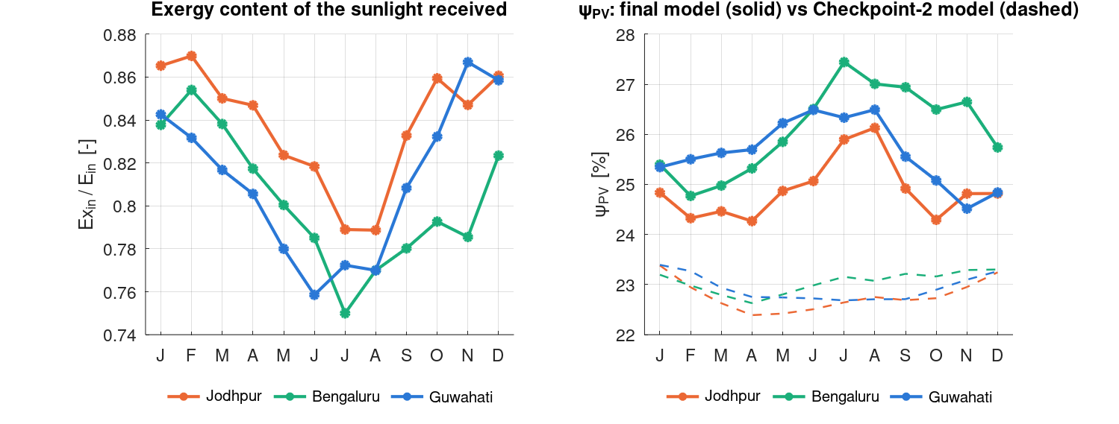
Exergy of sunlight: beam 0.93, diffuse light only 0.67–0.80
ψ_P = 1 − (4/3)(T₀/T_s) + (1/3)(T₀/T_s)⁴ = 0.931 (T₀ = 300 K, T_s = 5778 K)
ψ(ε) = 1 − (4/3)(T₀/T_s) X(ε), X(ε) = 45/(4π⁴ε) ∫ x²[(1+n)ln(1+n) − n ln n] dx, n = ε/(eˣ−1)
Ex_in = A [ G_b ψ_P + G_d ψ(ε_d) + G_r ψ(ε_r) ]
What this changes
Annual exergy content 0.81–0.84, monsoon 0.77–0.81. All-Petela input (Checkpoint 2) overstated Ex_in by 11–15 %.
Notes:
Petela gives the exergy of undiluted blackbody radiation, which describes the direct beam: 0.931. Diffuse sky and ground light have the solar spectrum spread over a far larger solid angle: diluted radiation with more entropy per joule. Landsberg and Tonge give psi of epsilon. Each irradiance component gets its own factor. The dead state is hourly ambient.

Slide 14
PV exergy balance and the identity behind the main result
Ex_opt = A Σ G_k (1 − α IAM_k) ψ_k Ex_Q = Q_heat (1 − T₀/T_c)
Ex_int = Ex_in − P − Ex_opt − Ex_Q = T₀ S_gen,int ≥ 0
ψ_PV = P / Ex_in = η_PV / (Ex_in / E_in)
Annual | η_PV | Ex_in/E_in | ψ_PV = η / (Ex/E)
Jodhpur | 20.83 % | 0.839 | 24.83 %
Bengaluru | 20.94 % | 0.808 | 25.92 %
Guwahati | 20.82 % | 0.814 | 25.57 %
Read it this way
η is nearly identical in all three cities. ψ differs because the denominator, the exergy content of the light, differs.
Ex_in < A·G, so ψ_PV > η_PV always (Checkpoint 2 stated ψ < η: corrected)
Notes:
The PV loss splits into optical, heat and internal parts. Internal is T0 times entropy generated, asserted non-negative every hour. The identity psi equals eta divided by the exergy content of the light drives the main Second Law result. Because Ex_in is less than AG, psi is always above eta. Checkpoint 2 said the opposite; that was wrong and is corrected.

Slide 15
Battery, converters and dispatch
I = P / V_nom, E(t+1) = E(t) + (P_c − P_d − I²R)Δt, m c_p dT_b/dt = I²R − UA(T_b − T_a)
S_gen = Q/T_b + Q(1/T₀ − 1/T_b) = Q/T₀ ⇒ Ex_dest = T₀ S_gen = I²R
Battery
Charge/discharge limits solve P ∓ kP² = room or energy / Δt, so the SOC window holds with losses.
Fade 3.75 × 10⁻⁵ per cycle, Arrhenius E_a = 31.7 kJ/mol.
Cell R 0.30 mΩ (AC); MC 0.30–0.90.
Converters + wiring
Ex_dest = (1 − ν) P for the inverter and each PCS pass; wiring 2 % of module output.
ψ = η for every electrical subsystem.
AC→AC battery round trip ≈ 0.93.
Why series 1P104S
Cell I²R = P²R_c/(N_s N_p V_c²): same for any layout with 104 cells.
Series puts 333 V in the PCS window and halves cable current. 140 A = 0.5C rating.
Only the PV cell has ψ ≠ η, so "PV dominates destruction" is largely structural
Notes:
Battery is a lumped model: I squared R loss, coulomb counting with the loss included in the limits, a lumped thermal mass, Arrhenius cycle ageing. Gouy-Stodola: Joule heat generated at T_b ends at T0, total entropy generation Q over T0, so exergy destroyed equals I squared R. Converters and wiring: electricity in and out are pure exergy, so loss equals destruction.

Slide 16
Validation: internal checks pass; one external check open
Check | Result | Status
Hourly First-Law / exergy closure, 26,280 h × 3 cities | max 5.7 × 10⁻¹⁴ kWh | Pass (asserted)
PV internal exergy destruction ≥ 0 every hour | min 0 (night) | Pass (asserted)
Computed sun elevation vs PVGIS H_sun | mean −0.2°, max 1.2° | Pass
Cell-temperature model at NOCT test conditions | 43.0 °C | Pass (by construction)
Peak cell temperature, Jodhpur | 67.1 °C | 55–70 °C field range
Specific yield / performance ratio | 1,508–1,883 kWh/kWp / 0.86–0.87 | Indian range; PR high (no soiling)
X(ε) table vs direct integration | 4 decimals, ε = 1 … 10⁻⁷ | Pass
Re-transposition at 20°; loss vs optimum tilt | reproduces POA; 0.4–0.9 % | Pass
ψ_PV vs literature 10–20 % | 24.8–25.9 % (22.8–23.0 % all-Petela) | Explained: 23 % module + diffuse split
PVGIS PVcalc yield comparison | not run | Open
Notes:
All internal checks pass for both weather sources and all three years. Specific yield and performance ratio sit in the Indian range; PR is high because soiling is not modelled. psi_PV is above the 10 to 20 percent literature band because the module is a 23 percent TOPCon and most papers use Petela for all light. The PVGIS PVcalc comparison is the open external check.

Slide 17
Results
NASA POWER 2021–2023 mean · Monte Carlo 5–95 % ranges
Notes:
Section: PV performance, exergy destruction, coverage, sensitivity, uncertainty, economics.

Slide 18
Headline results
3-year mean (Monte Carlo 5–95 %) | Jodhpur | Bengaluru | Guwahati
POA irradiation [kWh/m²/yr] · diffuse share | 2,076 · 37 % | 1,745 · 52 % | 1,662 · 48 %
Exergy content of sunlight Ex_in/E_in | 0.839 | 0.808 | 0.814
Energy-weighted / max cell temperature [°C] | 42.1 / 67.1 | 36.1 / 57.8 | 37.9 / 62.5
η_PV | 20.83 % | 20.94 % | 20.82 %
ψ_PV | 24.83 % (24.1–25.5) | 25.92 % (25.2–26.7) | 25.57 % (24.9–26.3)
Solar coverage (direct + via battery) | 79.7 % (49.8 + 29.9) | 74.3 % (48.5 + 25.7) | 70.4 % (45.0 + 25.4)
Grid dependency · export | 20.3 % · 22.5 MWh | 25.7 % · 13.4 MWh | 29.6 % · 12.7 MWh
PV share of exergy destroyed | 97.8 % | 97.7 % | 97.7 %
LCOE PV / PV + battery vs tariff [INR/kWh] | 3.48 / 7.14 vs 6.00 | 4.12 / 8.45 vs 4.50 | 4.34 / 8.92 vs 8.72
NPV PV / PV + battery [lakh INR] | +8.0 / −17.0 | −2.5 / −31.8 | +11.6 / −8.8
CO₂ avoided [t/yr] | 61.8 | 52.2 | 49.5
Notes:
One table to anchor everything that follows. Note that eta_PV is almost the same in all three cities while psi_PV differs by a full point. PV-only NPV is negative in Bengaluru despite LCOE below tariff, because about half of its PV output is exported at 3 rupees per kWh.

Slide 19
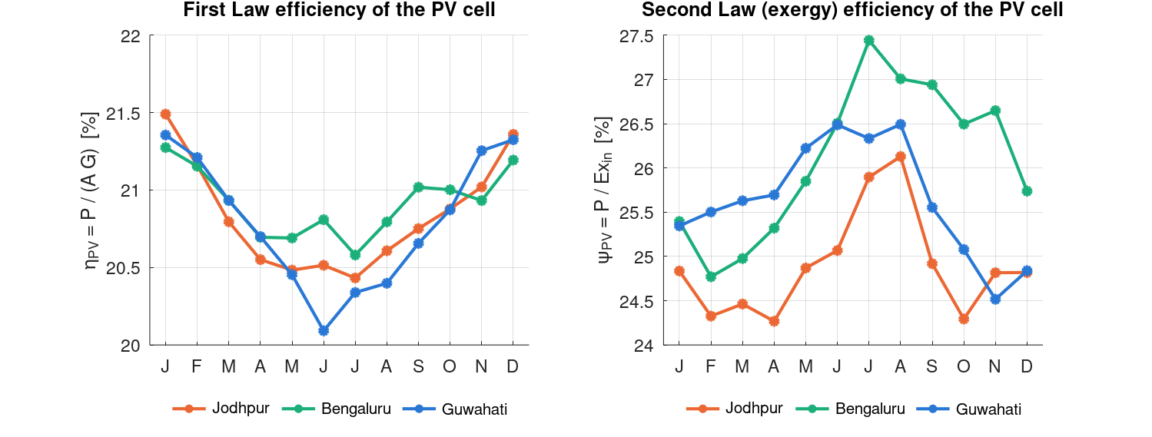
Monsoon: energy efficiency falls, exergy efficiency rises
Season | Diffuse | Ex/E | η_PV | ψ_PV
Jodhpur winter | 27 % | 0.866 | 21.33 | 24.64
Jodhpur monsoon | 49 % | 0.809 | 20.58 | 25.45
Bengaluru winter | 38 % | 0.840 | 21.21 | 25.26
Bengaluru monsoon | 67 % | 0.773 | 20.81 | 26.94
Guwahati winter | 36 % | 0.845 | 21.30 | 25.21
Guwahati monsoon | 63 % | 0.779 | 20.40 | 26.17
Why: exergy per kWh of light falls 7–8 %, electricity per kWh falls only 2–4 %. By ψ = η/(Ex/E), ψ must rise.
Meaning: the cell wastes a smaller share of a smaller, lower-grade input. It is not better performance, and it is not a bug.
Only the Second Law sees this: energy analysis just says cloudy hours produce less
Notes:
The key Second Law finding. In the monsoon eta_PV falls by 0.4 to 0.9 points from weak light and warm air. psi_PV rises by 0.8 to 1.7 points. Held in all three years and in 100 percent of Monte Carlo draws. Across cities psi follows diffuse share, not sunshine.

Slide 20
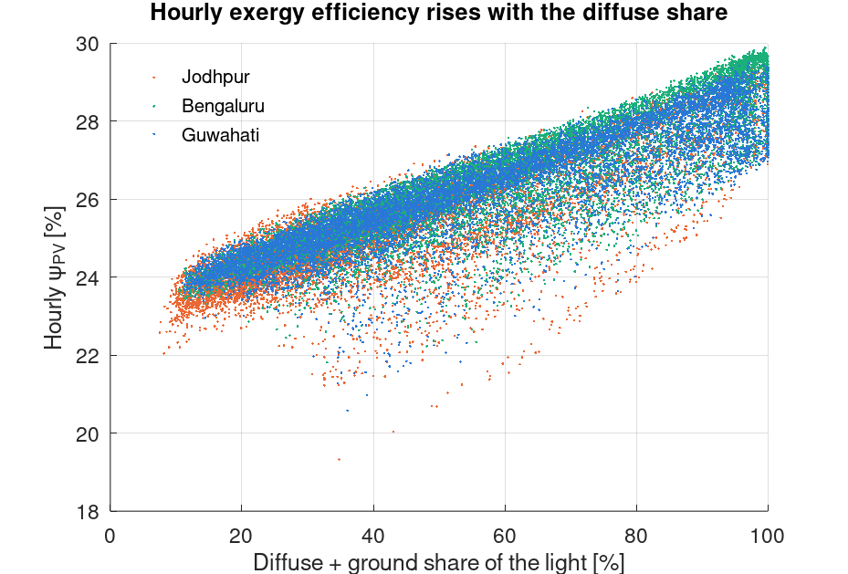
Hour by hour, ψ_PV tracks the diffuse share
Clear sky (15–20 % diffuse)
ψ_PV ≈ 24 %: beam-rich light worth 0.93 per joule
Full overcast
ψ_PV ≈ 29 %: diffuse light worth 0.67–0.80 per joule
City ranking follows diffuse share
Bengaluru 25.92 % (52 %) > Guwahati 25.57 % (48 %) > Jodhpur 24.83 % (37 %, hottest cells)
Notes:
Each dot is one producing hour. psi_PV climbs from about 24 percent under clear skies to about 29 percent under full overcast. Points below the band are low-sun hours with weak light and steep incidence. This is why Bengaluru, the most diffuse climate, has the highest annual psi and Jodhpur the lowest.

Slide 21
What each model change did
Annual ψ_PV [%] | Jodhpur | Bengaluru | Guwahati | City spread
Checkpoint 2 (Petela for all light, no low-light) | 22.75 | 23.03 | 22.94 | 0.3 pt
+ split beam / diffuse exergy only | 25.22 | 26.52 | 26.21 | 1.3 pt
+ low-light efficiency only | 22.40 | 22.50 | 22.38 | 0.1 pt
Final (both) | 24.83 | 25.92 | 25.57 | 1.1 pt
Specific yield, CP2 → final [kWh/kWp] | 1,913 → 1,883 | 1,629 → 1,591 | 1,546 → 1,508 | −1.5 to −2.4 %
Why both matter
The split changes the exergy result; the low-light term changes the energy result.
Correction to Checkpoint 2
"Climate does not affect conversion quality" was an artefact of the old model.
Notes:
Running the Checkpoint 2 model beside the final one. The diffuse split raises psi by 2.5 to 3.5 points and opens a 1.1 point spread between cities that the old model hid. The low-light factor lowers yield by 1.5 to 2.4 percent. The earlier claim that climate leaves conversion quality unchanged came from the old model's assumptions.

Slide 22
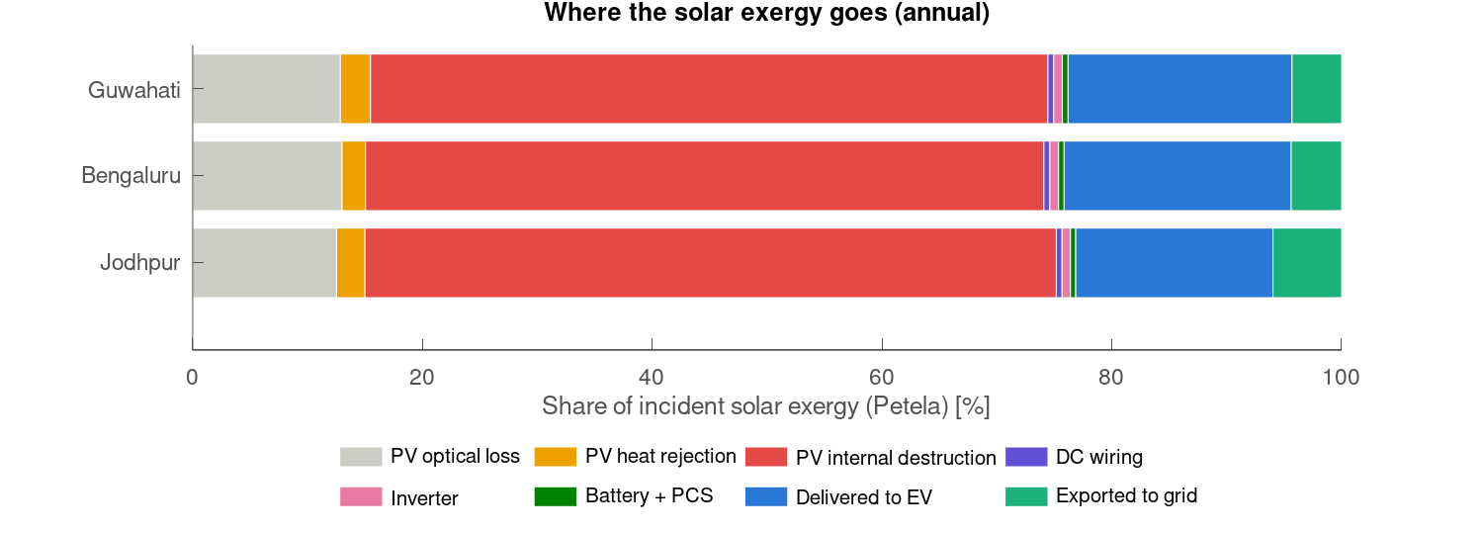
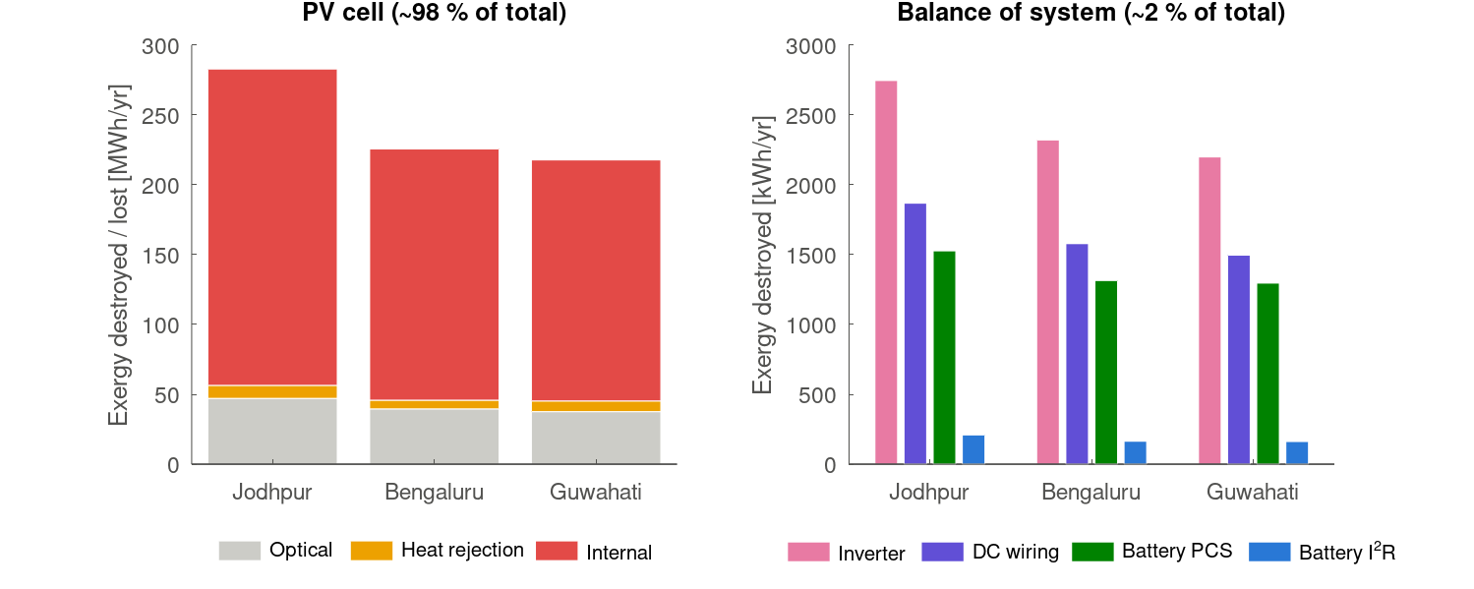
Where the exergy goes: about 98 % is destroyed in the PV cell
kWh/yr | PV internal | PV optical | PV heat | Inverter | Wiring | PCS | Battery I²R
Jodhpur | 226,411 | 47,103 | 9,325 | 2,746 | 1,868 | 1,527 | 209
Bengaluru | 179,819 | 39,589 | 6,224 | 2,321 | 1,579 | 1,314 | 164
Guwahati | 172,515 | 37,620 | 7,650 | 2,199 | 1,496 | 1,296 | 162
Rejected heat is only 3 % of PV loss (7–19 K above T₀): cooling helps through β, not heat recovery
Notes:
About 23 to 24 percent of incident solar exergy reaches the EV, the grid or the battery. Of what is destroyed or lost, 98 percent is in the PV cell. Inside that: about 80 percent internal, 17 percent optical, 3 percent rejected heat. The ranking among the small terms is the same in every city.

Slide 23
The hypothesis holds, but the informative part is inside the cell
Structural, not surprising
Electronics: ψ = η ≈ 0.97–0.98. Only the PV cell converts non-work input to work, at ≈ 25 %.
Inside the PV term
≈ 80 % internal (thermalisation, recombination, resistance) · 17 % optical · 3 % heat.
Small terms, same order everywhere
Inverter > wiring > PCS ≫ battery I²R. Inverter destroys 13–14× the cells' I²R.
0.07 %
battery I²R share of all exergy destroyed (162–209 kWh/yr)
≤ 6.9 K
battery temperature rise above ambient
0.9–1.3 %
capacity fade per year (Jodhpur highest, 268 cycles/yr)
Notes:
Be upfront: PV dominance is close to guaranteed by structure because electrical components have psi equal to eta near 0.97. The battery is a near-reversible store: 0.07 percent of destruction. Its losses sit in the two PCS passes. All-Petela input would overstate PV destruction by 14 to 20 percent.

Slide 24
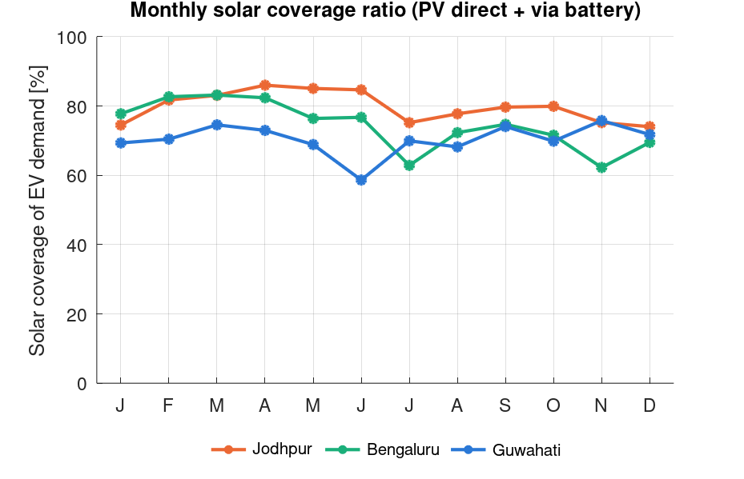
Coverage: each city has a different weak season
Coverage [%] | Jodhpur | Bengaluru | Guwahati
Winter (DJF) | 76.6 | 76.4 | 70.5
Pre-monsoon (MAM) | 84.7 | 80.6 | 72.1
Monsoon (JJAS) | 79.3 | 71.6 | 67.7
Post-monsoon (ON) | 77.6 | 67.0 | 72.8
Weakest month | Dec 74.0 | Nov 62.2 | Jun 58.6
CoV of monthly SCR | 0.055 | 0.095 | 0.063
Limit is the evening and night load: even the best month reaches only 86 %
Notes:
Annual coverage 79.7, 74.3, 70.4 percent. About half of demand met by PV directly, a quarter through the battery. Each city has a different weak season. Jodhpur, not Bengaluru, has the flattest year. No month reaches 90 percent: with measured timing the limit is the evening and night load, not sunshine.

Slide 25
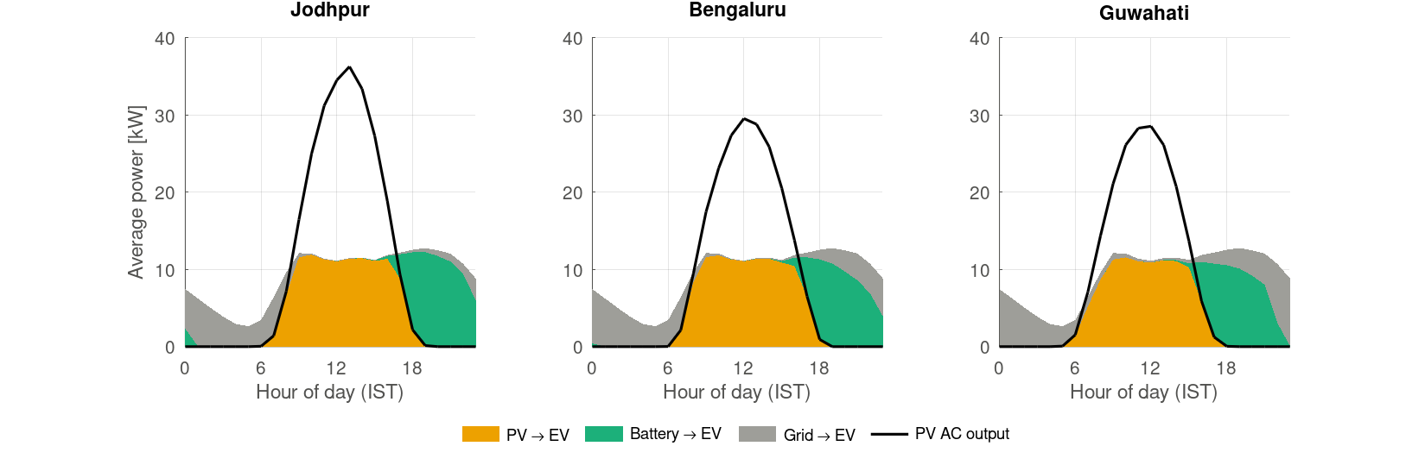
A typical day: PV for daytime, battery for evening, grid for night
75–82 % of PV output used on site; exports 12.7–22.5 MWh/yr
Notes:
PV covers roughly 8 to 16 h with a midday surplus that fills the battery. The battery carries the 17 to 22 h peak. The grid supplies the night and the morning ramp once the battery hits its 10 percent floor. In Jodhpur the battery lasts to about midnight; in Guwahati it runs out around 21 h.

Slide 26
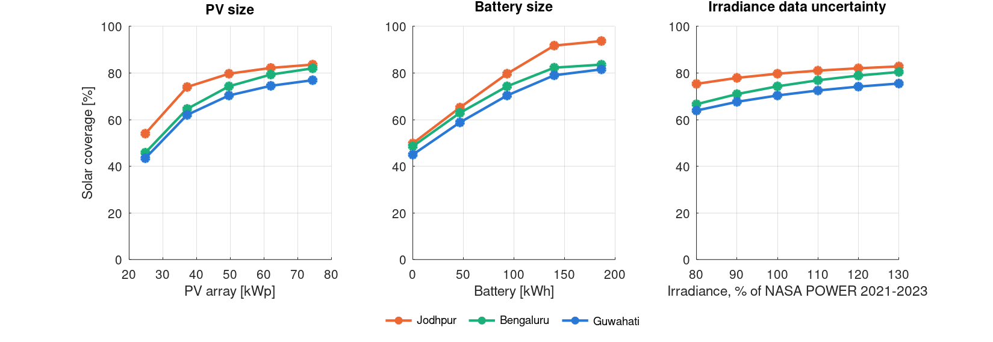
Sensitivity: the weather source matters most
Change | Effect
Weather: ERA5 2023 | Coverage 71.8 / 76.6 / 61.7 % (J/B/G): Bengaluru first. Monsoon ψ still above winter ψ
EV timing: workplace / residential / synthetic | Residential −15 to −18 points; synthetic +7 to +10. City order unchanged
Battery 0 → 186 kWh | +25–30 pts to 93 kWh, +8–12 more at 140 kWh, then +1–3: knee ≈ 140 kWh
Irradiance 80 → 130 % | Coverage only ±12–14 pts over the whole range; ψ_PV ≤ 0.2 pt
NOCT formula · battery R × 3 | Yield −1.8 to −2.8 % · coverage −0.2 pt
Notes:
One factor at a time. The coverage ranking survives every change except the weather source; the exergy results survive all of them. With realistic timing coverage is set by the evening load the battery can carry, so battery size and EV timing matter more than the last 10 percent of sunshine.

Slide 27
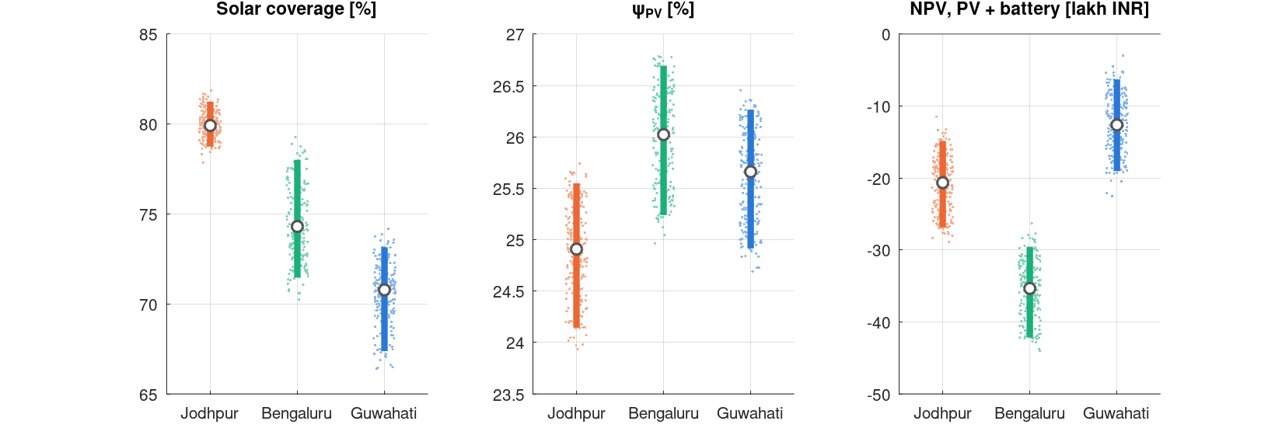
Uncertainty: three years and 200 paired Monte Carlo draws
Input | Range | Basis
Irradiance | 0.93–1.07 | POWER ≈ 0 bias vs BSRN
Module η_ref | ±3 % | Datasheet tolerance
NOCT | 41–45 °C | Datasheet 43 ± 2
Inverter, PCS | 0.96–0.98 | Brief
Cell R | 0.30–0.90 mΩ | DC 2–3× AC
Battery price | 16–25k INR/kWh | 2026 quotes
Weather year | 2021/22/23 | Equal odds
Share of 200 draws | Result
Coverage Jodhpur > Bengaluru > Guwahati | 100 %
ψ_PV monsoon > winter, every city | 100 %
ψ_PV of Jodhpur lowest | 100 %
PV + battery NPV > 0, any city | 0 %
Caveat
Holds within NASA POWER only. Years: Bengaluru and Guwahati swing 3.5 pts; 2023 was their best year.
Notes:
Each draw picks one weather year and samples six inputs uniformly within defensible ranges; the same draw is applied to all three cities, so shared errors cancel in the comparison. Not sampled on purpose: EV profile, tariffs, exergy model, weather dataset. Every ranking holds in 100 percent of draws; NPV is never positive.

Slide 28
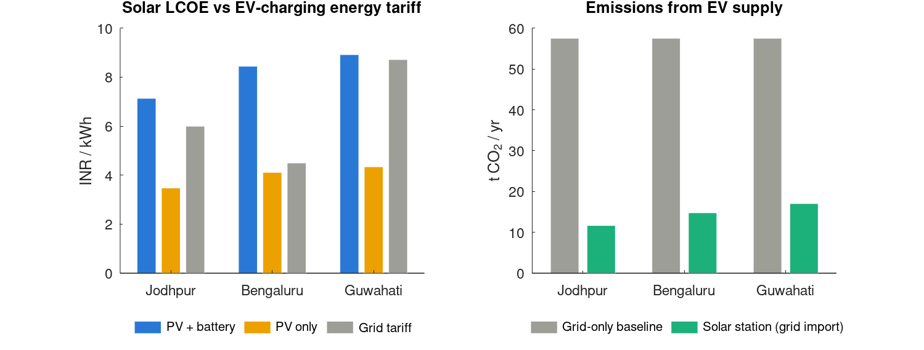
Economics: PV pays, the battery does not
 | Jodhpur | Bengaluru | Guwahati
Tariff [INR/kWh] | 6.00 | 4.50 | 8.72
LCOE PV only | 3.48 | 4.12 | 4.34
LCOE PV + battery | 7.14 | 8.45 | 8.92
NPV PV only [lakh] | +8.0 | −2.5 | +11.6
NPV PV + batt [lakh] | −17.0 | −31.8 | −8.8
Payback PV / +batt [yr] | 7.7 / 18.5 | 12.4 / never | 7.0 / 12.8
CO₂ avoided [t/yr] | 61.8 | 52.2 | 49.5
Capex 49.8 lakh: PV 19.8 · battery 16.8 · converters 6.7 · installation 6.5
8 % real, 25 yr, O&M 1.5 %/yr, battery replaced at yr 15 at 60 %, export 3 INR/kWh, CEA 0.710 t/MWh
The battery is thermodynamically cheap (0.07 % of destruction) and economically expensive (doubles LCOE)
Notes:
Reporting layer. Capex 49.8 lakh with battery, 26.2 lakh PV only; the battery is 34 percent of capex. PV-only LCOE below tariff everywhere, but PV-only NPV is negative in Bengaluru because about half of output is exported at 3 rupees. Guwahati has the least sun and the best economics because of its 8.72 tariff. Battery NPV negative in every draw.

Slide 29
Discussion
What held, what reversed, and how each assumption is defended
Notes:
Section: expectations vs findings, assumptions, limitations, conclusion.

Slide 30
Checkpoint-2 expectations vs findings
Expected | Found (NASA POWER 2021–2023) | Verdict
Coverage J > B > G | 80 > 74 > 70 %, every year and draw; ERA5 puts Bengaluru first | Supported; source-sensitive
ψ: Jodhpur highest, Guwahati lowest with monsoon drop | B 25.9 > G 25.6 > J 24.8 %; ψ rises in the monsoon everywhere | Reversed
PV cell dominates exergy destruction | 97.7–97.8 % in all cities | Supported (structural)
Guwahati monsoon dip; Jodhpur heat hit; Bengaluru flattest | Guwahati weakest in monsoon; Jodhpur hottest cells; Jodhpur flattest | Partly
Grid dependency, cost, CO₂ opposite to coverage | Grid dependency and CO₂ yes; cost no (tariff decides) | Partly
No single national verdict | Rankings differ by metric; EV timing moves coverage as much as climate | Supported
Notes:
Three expectations supported, two partly, one reversed. The reversal is the most interesting result: monsoon cloud was expected to degrade Second Law performance and it does the opposite.

Slide 31
Assumptions and defence (1/2): design, data, thermal
Assumption | Value | Defence | Weak spot
Fixed design | 49.6 kWp / 93.2 kWh | Climate is the only variable | Not cost-optimal per city
Tilt / azimuth | 20° / south | Loss 0.4–0.9 % vs optimum (checked) | Inherited, not chosen
Weather | NASA POWER 2021–23 | Satellite, ≈ 0 bias vs BSRN | ERA5 flips coverage ranking
EV timing | Korean public sessions | Only open session-level data | Not Indian; same every day
α / ε_f / ε_b | 0.90 / 0.84 / 0.89 | Literature ranges; absorbed by NOCT calibration | Uncited in params.m
Wind / sky | Watmuff 3.0 v · Swinbank | Standard correlations | Only Watmuff slope reused
h_free | 5.55 W/m²K | Calibrated: reproduces NOCT exactly | High for pure free convection
Low-light k₁, k₂ | PVGIS-5 c-Si | Published fit (Huld 2011) | PVGIS-6 values ≈ 40 % smaller
Ground IAM | 0.65 | Ground light < 1 % at 20° | No direct source
Notes:
Go through the assumptions an examiner is likely to probe. For each: where it comes from and why it is acceptable, and where the defence is weak.

Slide 32
Assumptions and defence (2/2): electrical, exergy, cost
Assumption | Value | Defence | Weak spot
Wiring + mismatch | 2 % | PVsyst ≈ 0.8 %/yr ohmic + PVWatts 2 % mismatch | Constant, not ∝ I²
Inverter / PCS | 0.97 each | Brief 96–98 %; ≈ 1 pt below datasheets | No datasheet cited; no part-load curve
Diffuse exergy | Grey-diluted, isotropic | Landsberg & Tonge; direction robust | Real sky bluer; size uncertain
Dead state | T₀ = hourly T_a | Standard convention | —
Cell resistance | 0.30 mΩ (MC 0.30–0.90) | Propagated; × 3 → coverage −0.2 pt | AC value
EV demand boundary | 222 kWh/day at AC bus | Like-for-like | Charger losses (≈ 5 %) outside
Prices, finance | 8 % real, 25 yr | Indicative; battery price propagated | Drives NPV magnitude
Export credit | 3 INR/kWh | APPC-level, conservative | Sets Bengaluru PV-only NPV sign
Emission factor | 0.710 t/MWh | CEA v21 national grid | No state factors
Notes:
Continue the register. The wiring 2 percent combines ohmic and mismatch: PVsyst gives about 0.8 percent annual ohmic, PVWatts and Aurora use 2 percent mismatch. Do not cite the MNRE 2017 rule: it is for 60 V DC systems.

Slide 33
Limitations and next steps
Weather source
POWER vs ERA5 differ by 21–24 % in north India and flip the coverage ranking. Next: NSRDB or Meteosat-IODC.
EV timing
Korean sessions, identical every day. Indian highway/fleet charging may be more daytime-heavy.
Diffuse exergy
Grey, isotropic approximation; environment term debated. Direction robust, magnitude not.
Not modelled
Soiling (2–5 %/yr in Rajasthan), inverter part-load, spectral effects, calendar ageing. PR 0.86 is optimistic.
Statistics
Three years, not a climatology. Uniform independent MC ranges: bounds, not calibrated probabilities.
Next checks
PVGIS PVcalc yield comparison; PVGIS-6 low-light coefficients; per-city PV and battery sizing vs tariff.
Notes:
The largest remaining uncertainties are the weather source, the EV timing and the treatment of diffuse light, not the station model.

Slide 34
Conclusion
One fixed station covers 70–80 % of a measured-timing EV load; evening demand and battery size limit it more than sunshine.
The PV cell destroys ≈ 98 % of the exergy; the rest of the chain is nearly reversible.
Diffuse light lowers the quantity and the quality of solar input: ψ_PV rises in cloudy weather, and the sunniest city has the lowest exergy efficiency.
Economics follow the tariff: PV pays everywhere, the battery nowhere at current prices. Size per city.
Notes:
Close with the three-part conclusion and invite questions.

Slide 35
Questions
Code, data and figures: thermo_project · run main (≈ 25 min) · source = 'ERA5'; main for the cross-check
Notes:
Backup slides follow: derivations, design checks, sources, corrections.

Slide 36
Backup: Petela derivation and the diluted-radiation factor
Blackbody at T: E = σT⁴, S = (4/3)σT³; environment: E₀ = σT₀⁴, S₀ = (4/3)σT₀³
Ex = (E − E₀) − T₀(S − S₀) = σT⁴ − (4/3)σT₀T³ + (1/3)σT₀⁴
Ex/E = 1 − (4/3)(T₀/T) + (1/3)(T₀/T)⁴ = 1 − 0.06923 + 0.0000024 = 0.9308
Diluted (radiance εB_ν(T_s)): S = (4/3)εσT_s³ X(ε), E = εσT_s⁴ ⇒ ψ = 1 − (4/3)(T₀/T_s)X(ε)
ε_d = G_d / [σT_s⁴ (1+cos β)/2] ≈ 10⁻⁶ – 10⁻⁵ ⇒ ψ ≈ 0.67 – 0.71
X(1) = 1 recovers Petela; X rises as light is spread over more solid angle (more entropy per joule)
Petela environment term (< 10⁻⁵) omitted for diluted light, where it is not well defined
Notes:
Derivation of Petela from blackbody energy and entropy fluxes, and the dilution extension.

Slide 37
Backup: design checks (tilt, series layout, wiring loss)
City | Optimum tilt | POA optimum | POA at 20° | Loss
Jodhpur 26.3°N | 28° | 2,090 | 2,076 | 0.67 %
Bengaluru 13.0°N | 14° | 1,752 | 1,745 | 0.40 %
Guwahati 26.2°N | 28° | 1,677 | 1,662 | 0.86 %
Layout | V | I at 46.6 kW | R_pack | Cell I²R
1P104S (used) | 333 V | 140 A | 31.2 mΩ | 611 W
2P52S | 166 V | 280 A | 7.8 mΩ | 611 W
Wiring + mismatch 2 %
Ohmic: design keeps DC voltage drop < 1 % ideally, ≤ 2 %; PVsyst 1.5 % at STC → ≈ 0.8 % annual.
Mismatch: PVWatts derate 0.98; Aurora default 2 %.
Sum 1.8–2.8 %. Do not cite MNRE 2017 (60 V DC systems).
Battery paths
PV → EV direct: 0.98 × 0.97 = 0.951.
PV → battery → EV: ≈ 0.87.
AC→AC round trip in simulation ≈ 0.93 (PCS 0.97² × cells ≈ 0.99).
Notes:
Supporting numbers for design questions.

Slide 38
Backup: corrections made during preparation
Earlier statement | Correct version
Cell temperature uses T_c = T_a + (NOCT − 20)G/800 | Main model is the convection + radiation balance calibrated to NOCT; NOCT formula is a sensitivity case
Solar exergy uses Petela (0.93) for all light | Beam 0.93; diffuse and ground light diluted, 0.67–0.80
Checkpoint 2: ψ_PV < η_PV | ψ_PV > η_PV always, since Ex_in < A·G
Jodhpur noon cells ≈ 60–64 °C | ≈ 50–57 °C depending on wind; annual peak 67.1 °C
PV-only NPV positive in every city | PV-only LCOE < tariff everywhere; PV-only NPV −2.5 lakh in Bengaluru
Huld 2011 in "Solar Energy 85" | Sol. Energy Mater. Sol. Cells 95, 3359–3369
"Climate leaves conversion quality unchanged" | Artefact of the all-Petela model; ψ spread is 1.1 pt
Notes:
Statements that were made in earlier drafts or preparation and their correct versions. Useful so they are not repeated in the viva.

Slide 39
Backup: sources
Petela (1964) J. Heat Transfer 86, 187–192 · Landsberg & Tonge (1979) J. Phys. A 12, 551–562
Huld et al. (2011) Sol. Energy Mater. Sol. Cells 95, 3359–3369 · Chatzipanagi et al. (2025) Prog. Photovolt. 33, 905–917
Duffie & Beckman, Solar Engineering of Thermal Processes (4th ed.) · Hay & Davies (1980) · Martin & Ruiz (2001) Sol. Energy Mater. Sol. Cells 70
Jones & Underwood (2001) Solar Energy 70, 349–359 · Swinbank (1963) QJRMS 89 · Watmuff, Charters & Proctor (1977) COMPLES 2
Bejan, Advanced Engineering Thermodynamics · Wang et al. (2011) J. Power Sources 196, 3942–3948
NASA POWER hourly API (CERES SYN1deg, MERRA-2) · PVGIS-ERA5 · EV sessions: Scientific Data 2024, doi:10.6084/m9.figshare.22495141
Trina NE19R datasheet DT-M-0093-B · REPT ESS brochure · CEA CO₂ Baseline Database v21 · APDCL, KERC, RERC EV tariffs
PVsyst ohmic-loss help · PVWatts v5 manual (Dobos 2014)
Notes:
Key references; full list in the report.

