Slide 1
Project Aurora
Steering Committee — Integration Status Report
Reporting date: 01-07-2026 · Sources: 3 file(s)
Prototype output — requires Senior Manager review before distribution to stakeholders.

Slide 2
2 critical risk(s) require management attention
Executive summary
• Overall integration progress stands at 82% across 3 reporting source(s).
• 11 tracked tasks, 10 open; 6 owner(s) carry assignments.
• 3 risks logged, 2 rated high or critical — mitigation owners are assigned in the risk log.
• 1 cross-source inconsistency/inconsistencies detected: 1 decided by the user.
Prototype output — requires Senior Manager review before distribution to stakeholders.

Slide 3
Status at a glance — 6 of 6 workstream(s) reporting
Overall integration status
Overall progress
51%
Open critical risks
2
Overdue tasks
0
Day 1 readiness
1/1
Decisions required
0
Unresolved conflicts
0
Prototype output — requires Senior Manager review before distribution to stakeholders.

Slide 4
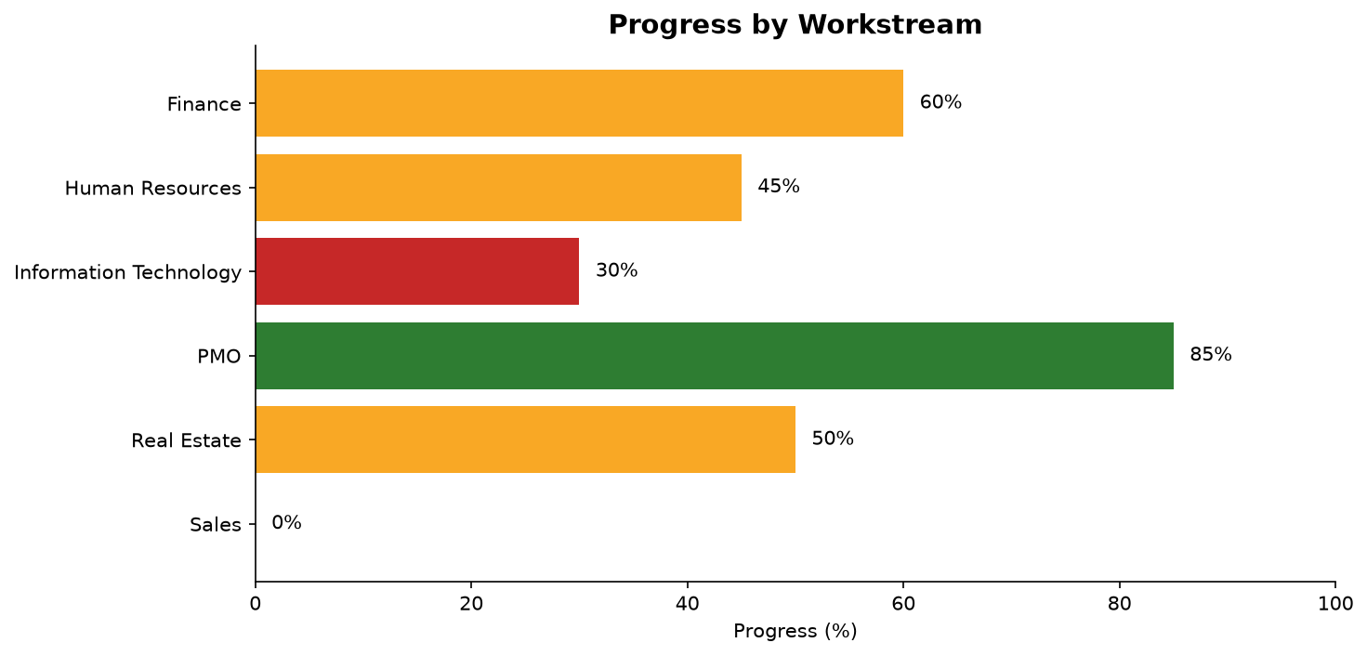
3 workstream(s) are below 50%: Human Resources, Information Technology, Sales
Prototype output — requires Senior Manager review before distribution to stakeholders.

Slide 5
All milestones are on plan
Key milestones
Milestone | Planned | Forecast/Actual | Delay | Status | Owner
Day-1 legal close | 01-06-2026 | — | on plan | Completed | Anna Schmidt
Day-100 review | 20-08-2026 | — | on plan | In Progress | Anna Schmidt
ERP go-live | 01-10-2026 | — | on plan | At Risk | Jonas Weber
Prototype output — requires Senior Manager review before distribution to stakeholders.

Slide 6
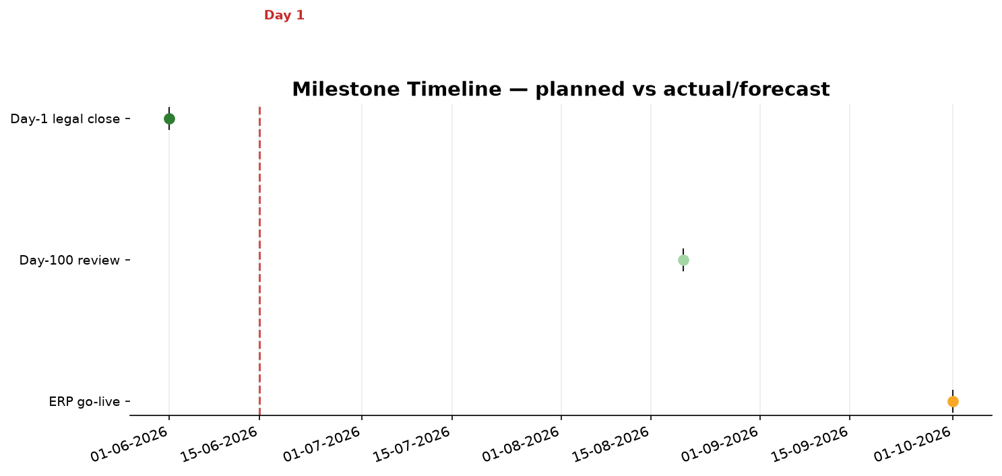
Milestone timeline — planned vs forecast
Prototype output — requires Senior Manager review before distribution to stakeholders.

Slide 7
2 critical risk(s) are open and mitigated
Critical risks and issues
ID | Risk | Rating | Score | Owner | Mitigation | Source
R002 | ERP cutover slips past Q3 | High | 15 | Jonas Weber | Weekly cutover war-room; fallback to parallel run | integration_tracker.xlsx
R001 | Key engineer attrition in target company | High | 12 | Lisa Chen | Retention bonus program approved by SteerCo | integration_tracker.xlsx
R003 | Customer churn during rebranding | Medium | 6 | Sofia Ivanova | Proactive top-50 account outreach | integration_tracker.xlsx
Prototype output — requires Senior Manager review before distribution to stakeholders.

Slide 8
Integration spend is within budget
Synergy and financial status
Budget
Not Reported
Actual
2,320,000
Forecast
Not Reported
Synergy target
Not Reported
Synergy realized
Not Reported
Currency
EUR
Prototype output — requires Senior Manager review before distribution to stakeholders.

Slide 9
No decisions are currently pending Steering Committee approval
Decisions required
No open decisions were found in the uploaded files. If a decision is expected this period, it is not recorded in any source provided.
Prototype output — requires Senior Manager review before distribution to stakeholders.

Slide 10
Upcoming milestones before the next Steering Committee
Next steps
Milestone | Due | Owner | Workstream
Day-100 review | 20-08-2026 | Anna Schmidt | —
ERP go-live | 01-10-2026 | Jonas Weber | —
Prototype output — requires Senior Manager review before distribution to stakeholders.

Slide 11
Data quality and limitations
How this report was produced
• Data-quality score: 86/100 (29 items from 29 traceable source reference(s)).
• 1 cross-source conflict(s) were detected and resolved (0 by source priority, 1 by the user).
• 9 completeness issue(s) detected.
• 1 mathematical issue(s) detected.
• 1 temporal issue(s) detected.
• Gaps: 1 task(s) with no owner; 4 task(s) with no due date; 4 budget line(s) with no forecast.
Prototype output — requires Senior Manager review before distribution to stakeholders.

