Slide 1

Domino launcher user guide School classification

Slide 2
1
Purpose and scope of this guide
2
Log in to Domino with your SSO
3
Open the Launchers section
4
Select the right launcher
5
Fill in the launcher fields
6
Choose the run mode
7
Follow your job and read the logs
8
Retrieve the output files

Slide 3
Purpose of this guide
Everything you need to run the school classification model without writing a single line of code.
Why this guide exists
It walks you step by step through Domino and the inference launcher, so that every team member produces results the same way, with the same settings.
What the model does
Two tasks. Normalisation rewrites raw school names into a clean, standard form. Typology assigns each school a category: university, business school, engineering school, and so on.
What you need before starting
Access to the Domino project, your input file available in the project, and the exact name of the column and of the Excel sheet to process.

Slide 4
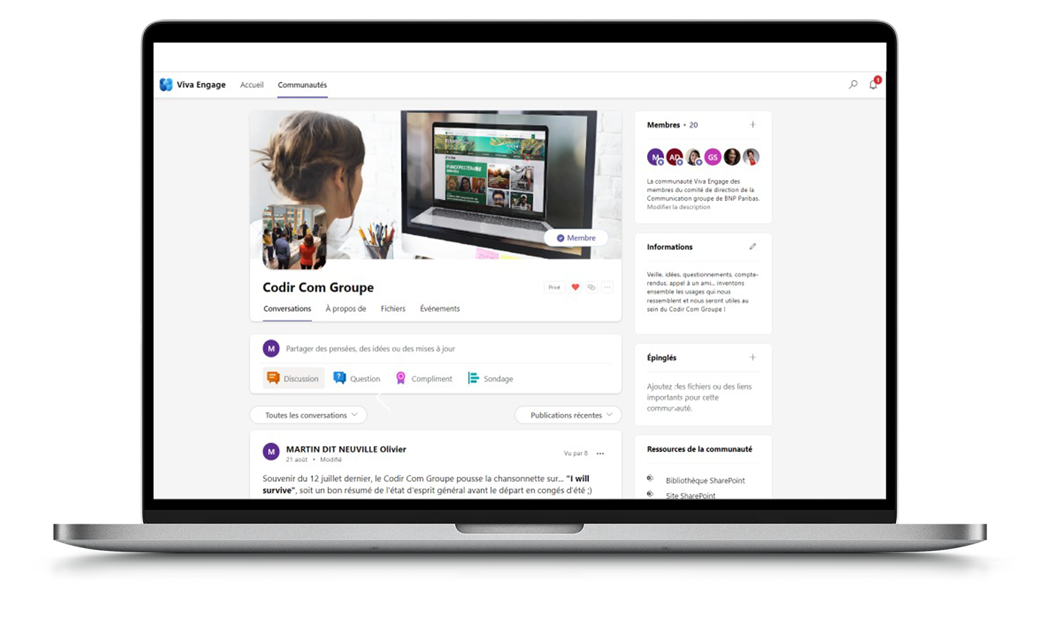
Step 1 – Log in to Domino with SSO
Domino runs behind the group SSO: no separate account, no extra password.
Open the project link
Project URL: [paste the Domino project link here]. Open it from your BNP Paribas workstation, on the internal network or through the VPN.
Insert screenshot here
Domino SSO login page and project home
Authenticate
Choose Log in with SSO and use your usual credentials. You are redirected straight back to the project.
Check where you landed
The project name appears at the top of the left-hand menu. If it is not the right one, open the link again.

Slide 5
Step 2 – Open the Launchers section
A launcher is a ready-made form that runs the model for you: you never touch the code.
Find the left-hand menu
From the project home page, look at the navigation menu on the left of the screen.
Insert screenshot here
The Launchers entry in the project menu
Click Launchers
Open the Launchers entry. The page lists every launcher published in the project, with its name and its description.
Nothing else to start
No workspace and no manual run are needed. The launcher takes care of the environment and of the hardware.

Slide 6
Step 3 – Select the right launcher
Two launchers are published in this project. Pick the one that matches what you want to run.
[Launcher name 1]
[One line on what this launcher does and when to use it.] This is the launcher described in the rest of this guide.
Insert screenshot here
The two launchers listed in the project
[Launcher name 2]
[One line on what this launcher does and when to use it.]
Open it
Click the launcher card to open its parameter form. Nothing runs until you have filled the fields and clicked Run.

Slide 7
Step 4 – Fill in the launcher fields
Four fields to complete. The first three describe your input file; the fourth is on the next slide.
1 – Input file
Select the file to process from the drop-down list. It shows the files already available in the project.
Insert screenshot here
The launcher parameter form
2 – Column name
Type the exact name of the column holding the raw school names. Spelling, spacing and case must match your file.
3 – Sheet name
Type the exact name of the Excel sheet holding that column. Watch out for trailing spaces in tab names.

Slide 8
Step 5 – Choose the run mode
The fourth field decides which part of the pipeline is executed.
FULL
NORMALISATION
TYPOLOGIE
Normalisation, then typology. The two stages run one after the other in a single job: names are cleaned first, then classified from the cleaned version. Use it when you start from raw data.
Cleaning only. Raw school names are rewritten into a single standard form. Use it when you only need a clean, consistent list of school names.
Classification only. Each school is assigned a category: university, business school, engineering school, and so on. Use it when your names are already clean.

Slide 9
Step 6 – Follow your job and the logs
Once you click Run the job is queued, and you can follow it live or come back later.
Running jobs
Open the Jobs tab in the left-hand menu. Your run appears at the top of the list, with its status and its start time.
Insert screenshot here
Jobs tab: running job, history and logs
Live logs
Click your job, then open the logs tab to follow the execution in real time and spot any error message.
Past runs
The same list keeps the history of previous runs. Open an older job to check the parameters it was launched with.

Slide 10
Step 7 – Retrieve the output files
Results are written to the project data folder as soon as the job status turns to Succeeded.
Where to look
In the left-hand menu go to Data, then run_data, then output. Every launcher run writes its result files there.
Insert screenshot here
Data > run_data > output folder
Identify your run
Files are listed with their creation date and time. Match them with the start time shown for your job.
Download and share
Select the file and download it to your workstation. You can then open it in Excel and share it as usual.

Slide 11
Checklist and common issues
Most failed runs come from a column or a sheet name that does not match the file.
Before you click Run
Your input file is available in the project
The column name matches the file header exactly
The sheet name matches the Excel tab exactly
The run mode matches what you actually need
You know where the output will be written
If something goes wrong
Job fails immediately: check the column and sheet names
Empty output: the selected column holds no school names
Nothing in the output folder: the job is not finished yet
Typology looks off: re-run in FULL so names are normalised first
Still stuck: open the logs and share them with the team

