Slide 1
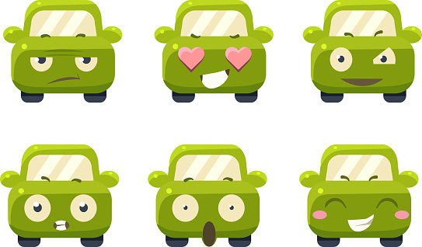
HOLA!
How are you feeling today?
JARVIZ After Hackathon!

Slide 2
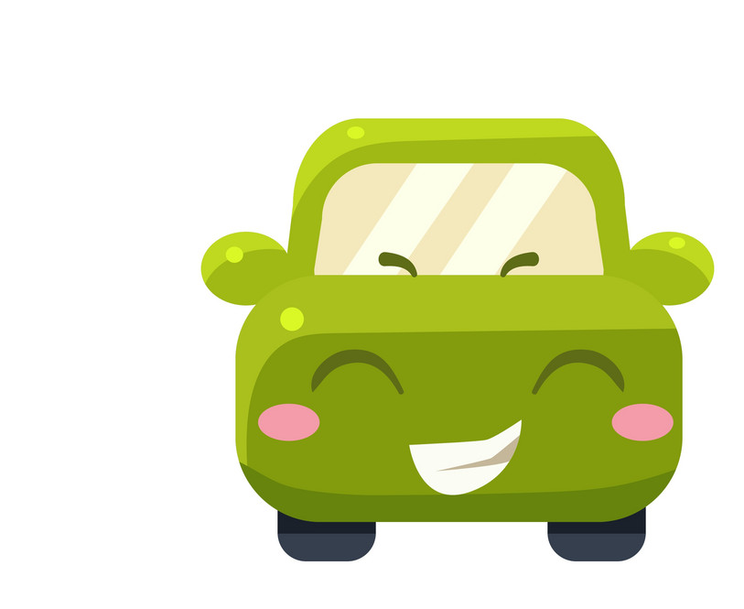
JARVIZ powers
E.C.O | Emotionally Connected Optimization

Slide 3

Imagine your car truly
understanding you
Where Your Car Understands You and cares about the Environment ​

Slide 4
What is e.c.o?
Driver Mood
Weather Condition
Battery SOC
Emotionally Connected Optimization
We are proud to deliver
Unique Automotive Experience
Align with Customer's emotional Well-being
Environmental Consciousness

Slide 5
WhY e.c.o?
Energy Aware
Personalized
Adaptable
Energy-aware drives that bring positive impact to the environment.
Personalized drive adapts to mood, weather and energy for your personal and planet's well-being.
Adaptable E.C.O model for all vehicle classes.

Slide 6
What will you experience?
Car takes Intuitive Voice Commands
Opens the doors, trunks
Sit back after the door opens
ECO will detect your mood
Based on mood, in-vehicle experience is enhanced
External Experience
Internal Experience

Slide 7
Modes of E.c.o
Full Spectrum
Balanced Harmony
Eco-Pulse

Slide 8
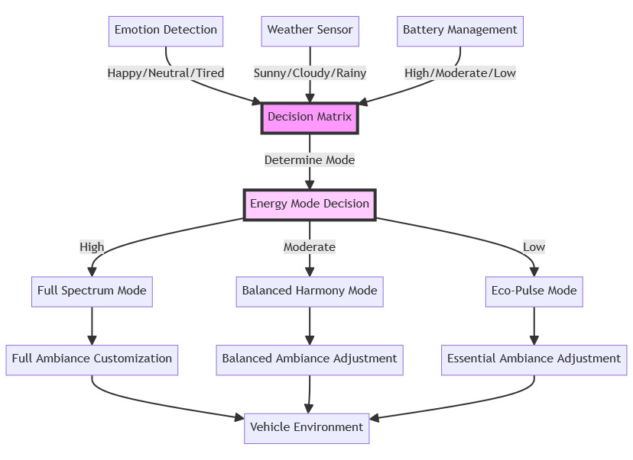
How does ECO work?
Notes:
ECO detects your emotion, combines it with the current weather conditions to decide a suitable car experience for you.
Parallelly, the battery consumption levels are taken into consideration to decide which Driving Mode needs to be activated.
Modes -
Full Spectrum Mode: Maximizes comfort and sensory experience in high battery and positive mood scenarios.
Balanced Harmony Mode: Provides a harmonious and pleasant environment for moderate battery levels and neutral moods.
Eco-Pulse Mode: Prioritizes energy conservation while maintaining a calming atmosphere in low battery or tiredness situations.
Experience your car like never before.

Slide 9
Let’s Check E.C.O out!

Slide 10
Conclusion
E.C.O's versatility allows it to be integrated into various vehicle models, seamlessly blending emotional awareness with eco-friendly approach, no matter where you are in the world.
E.C.O can be scaled across automotive models and continents or countries.
When E.C.O is scaled largely, the customers together create an impact towards a sustainable future.
Emotionally Aware
ECO - Conscious
Scalable Across Car Variants
Scalable Across World

Slide 11
Thank you from JARVIZ

Slide 12
Contacts
Vikneshwara Kumar
Vikneshwara.kumar@gmail.com
+4915730242100
Karthik Rajendran
karthik.bengaluru95@gmail.com
+491746508289
Mandar Kharde
mandarkharde13@gmail.com
+4915753688716
Chandrashekar Rathod
chandrathod88@gmail.com
+4915753127927
Sai Deepika Indraganti
saideepika.indraganti@gmail.com
+4917685973547

Slide 13
Future scope
Integration with personal calendars and schedules
Sync the vehicle's system with personal calendars to anticipate and prepare for the driver’s upcoming trips or schedules.
Mood-based route suggestions
Offer route suggestions based on the driver's mood, such as scenic routes for leisurely drives or the most efficient routes when the driver is in a hurry.
Customizable Exterior Greetings
Use exterior lighting and display panels for customizable greetings or expressions, personalizing the vehicle's interaction with its environment.
ECO is thus a forward-thinking solution, perfectly aligning with the evolving needs of customers who seek a harmonious blend of emotional connectivity and eco-conscious driving.

