Slide 1
print("Python")
For those seeking a simpler way of life...

Slide 2
What is Python?
Released in 1991
Python is an object-oriented programming language (OOP)
Beginner-friendly due to its simpler syntax - write programs with fewer lines of code
Not only used by software engineers - also by mathmatecians, data analysts, scientists, accountants and network engineers
One of the most popular programming languages in the world!

Slide 3


Are you ready to RUUUMBLE?! - Python vs JavaScript
Naming Conventions

Slide 4
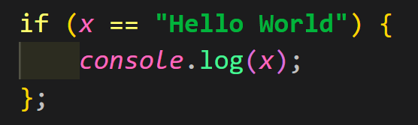
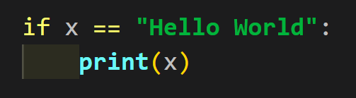
Are you ready to RUUUMBLE?! - Python vs JavaScript
Code Blocks

Slide 5


Are you ready to RUUUMBLE?! - Python vs JavaScript
Defining Variables

Slide 6
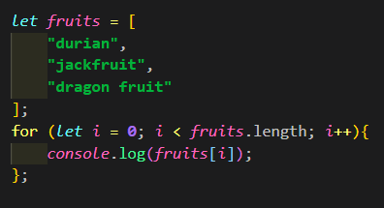
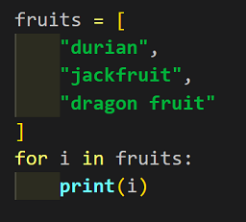
Are you ready to RUUUMBLE?! - Python vs JavaScript
FOR Loops

Slide 7
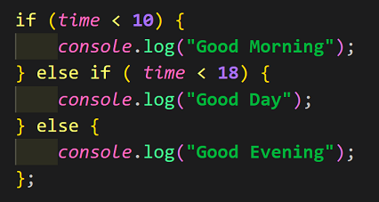
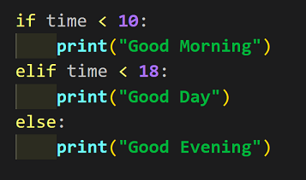
Are you ready to RUUUMBLE?! - Python vs JavaScript
if/else Statements

Slide 8
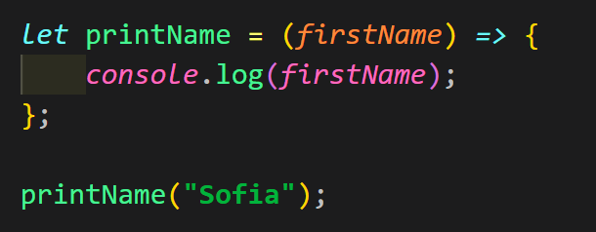
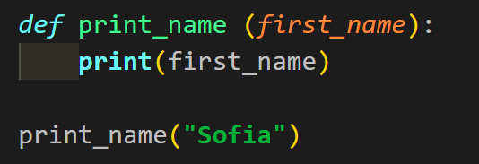
Are you ready to RUUUMBLE?! - Python vs JavaScript
Functions

Slide 9
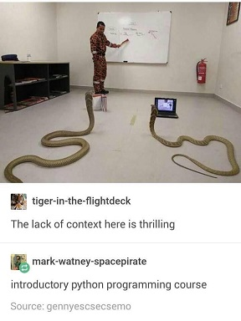
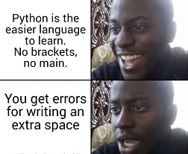
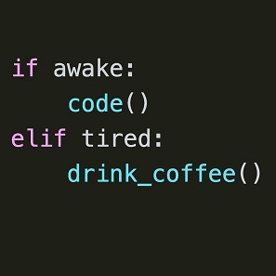
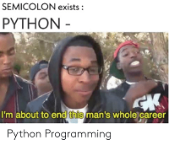
And now, for something completely different...

