Slide 1
Proiect structuri de date
Sofei Andrei-Adrian

Slide 2
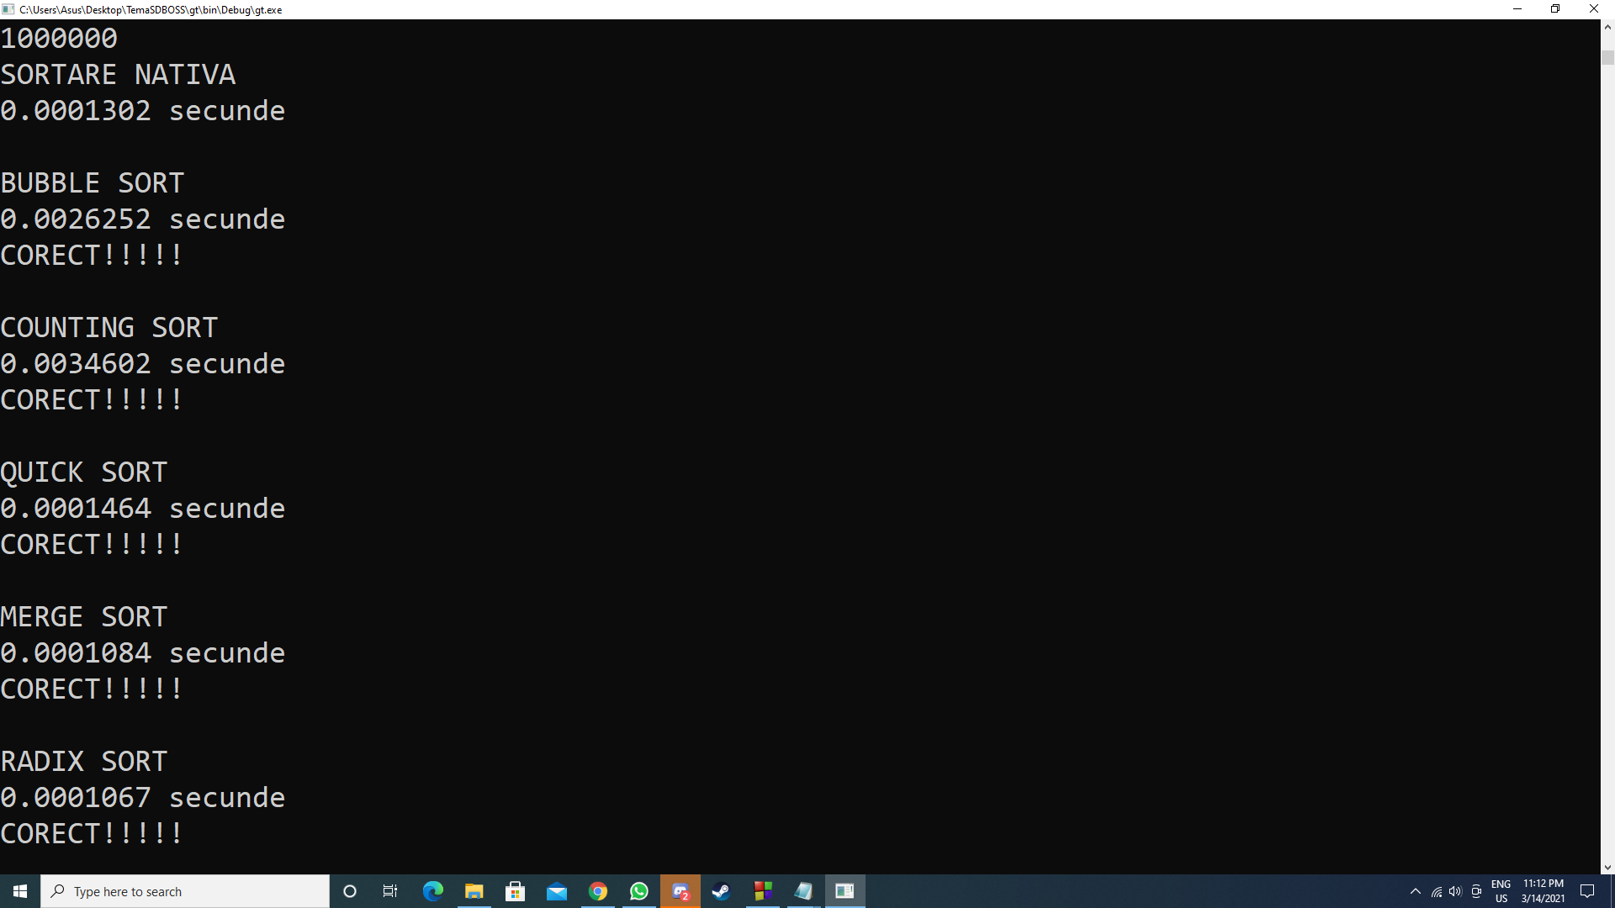
N=10^3, max=10^6, Numere generate random

Slide 3
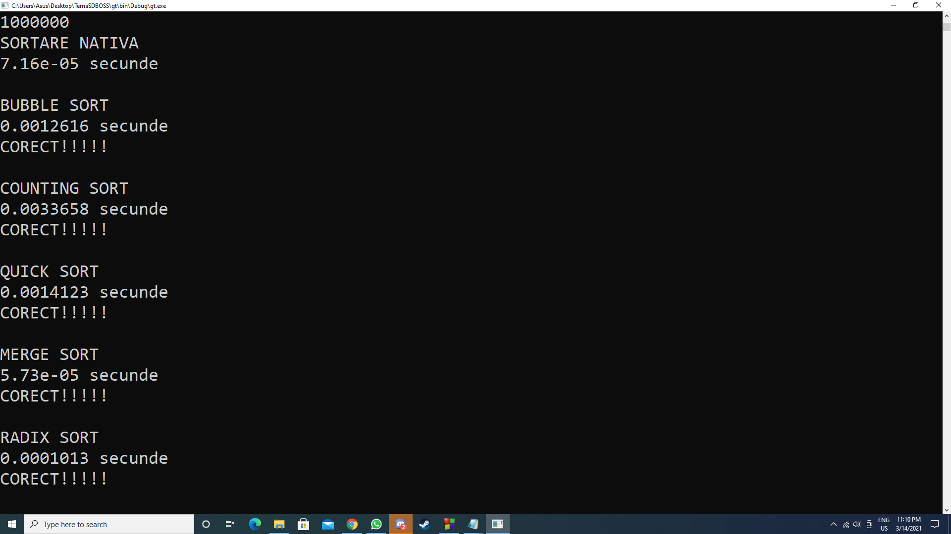
N=10^3, max=10^6, Vector constant

Slide 4
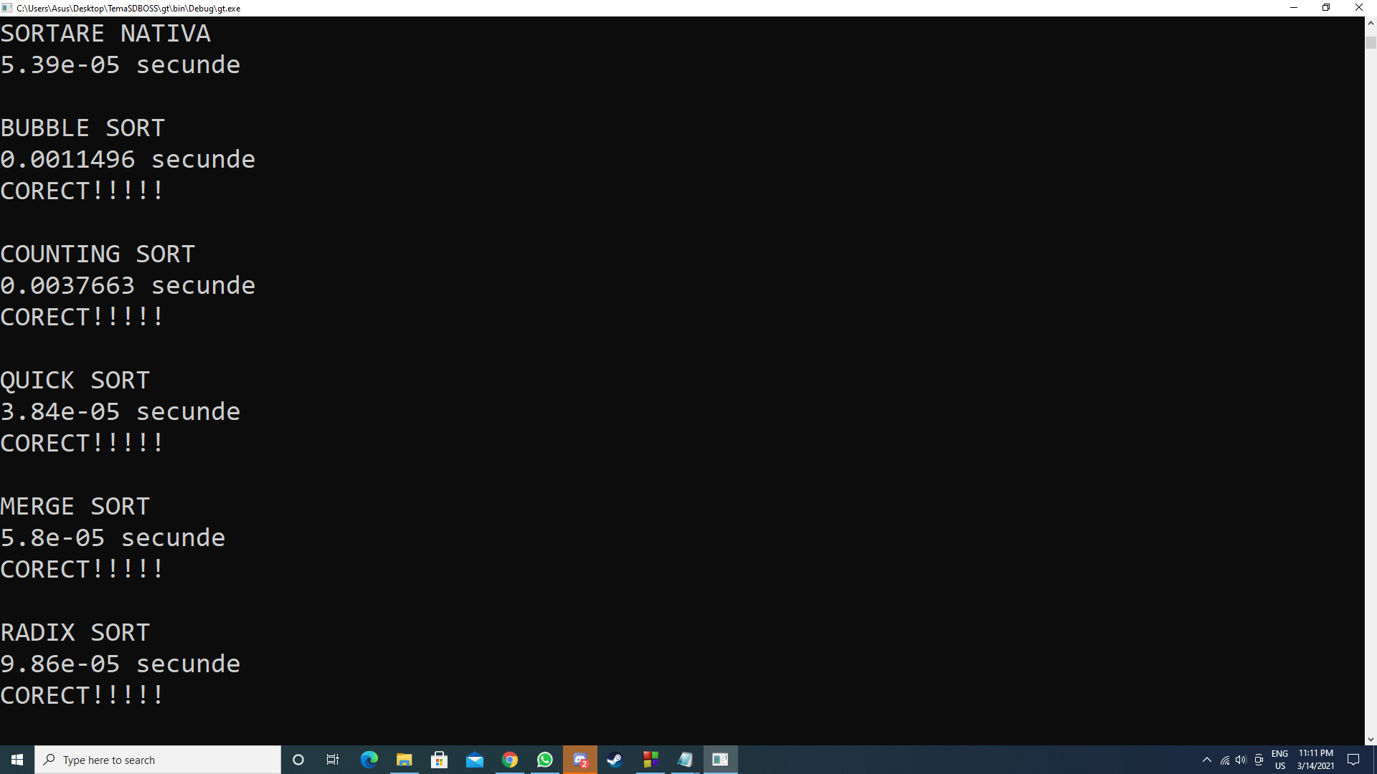
N=10^3, max=10^6, Vector crescator

Slide 5

N=10^3, max=10^6, Vector descrescator

Slide 6
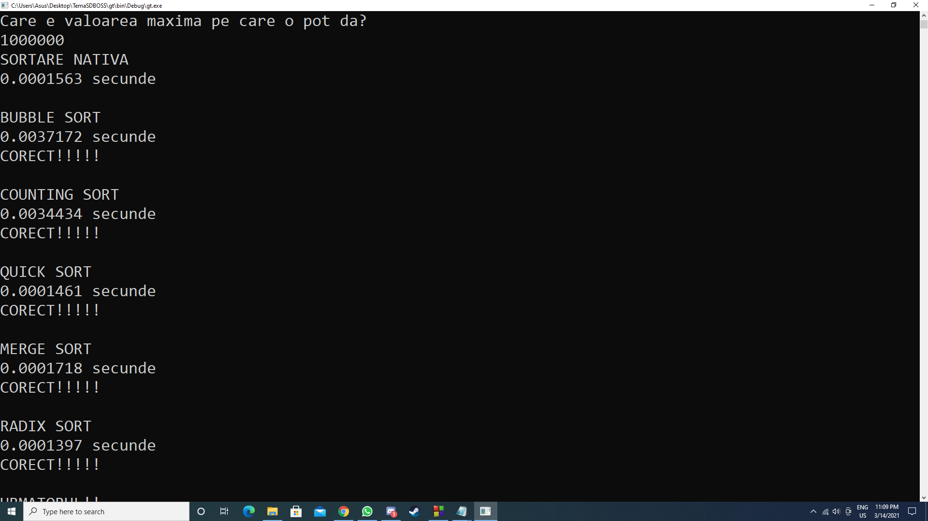
N=10^3, max=10^6, Vector aproape crescator

Slide 7
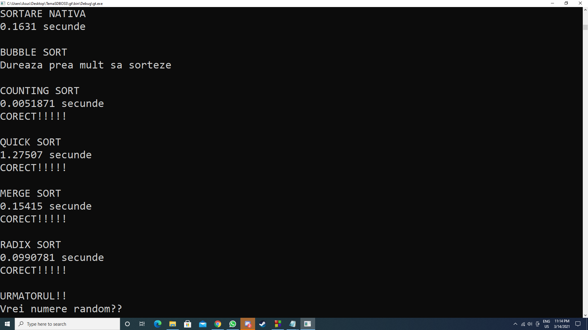
N=10^6, max=10^3, Numere generate random

Slide 8
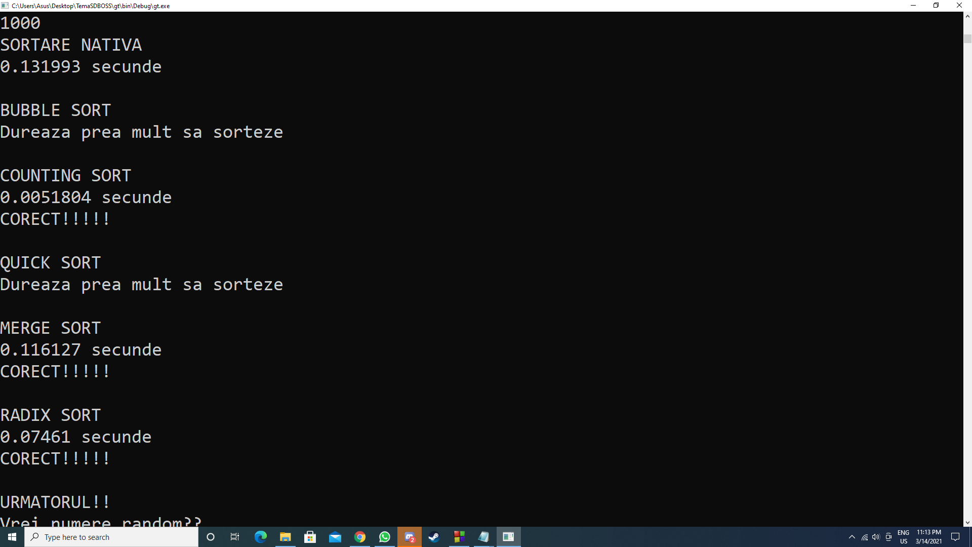
N=10^6, max=10^3, Vector constant

Slide 9
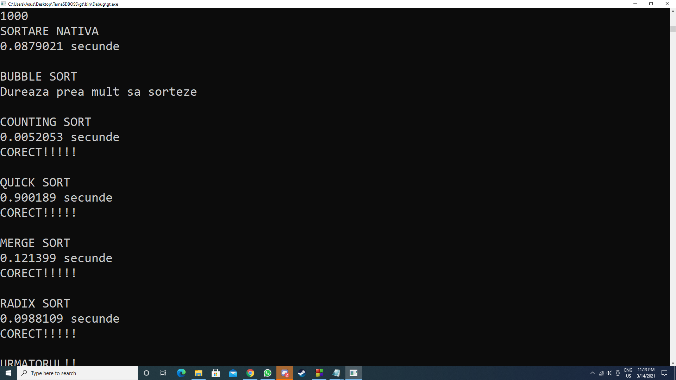
N=10^6, max=10^3, Vector crescator

Slide 10
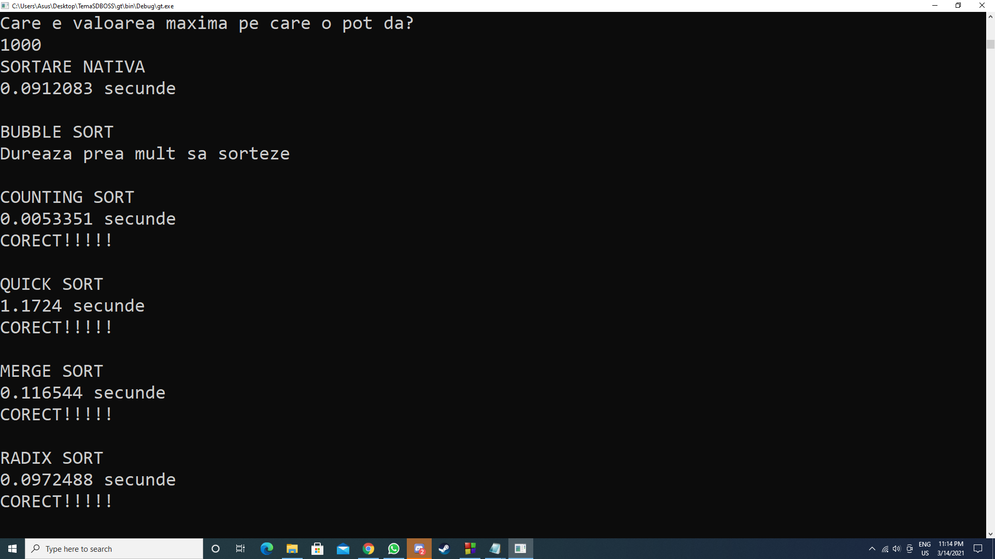
N=10^6, max=10^3, Vector descrescator

Slide 11
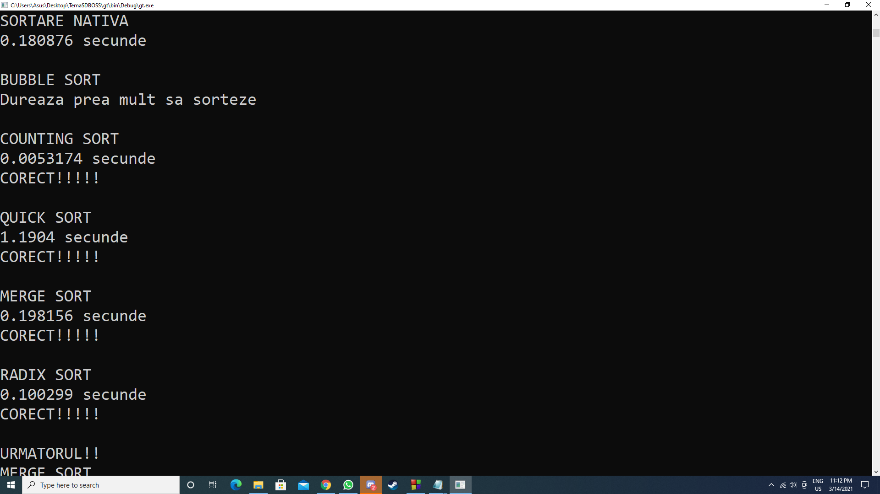
N=10^6, max=10^3, Vector aproape crescator

Slide 12
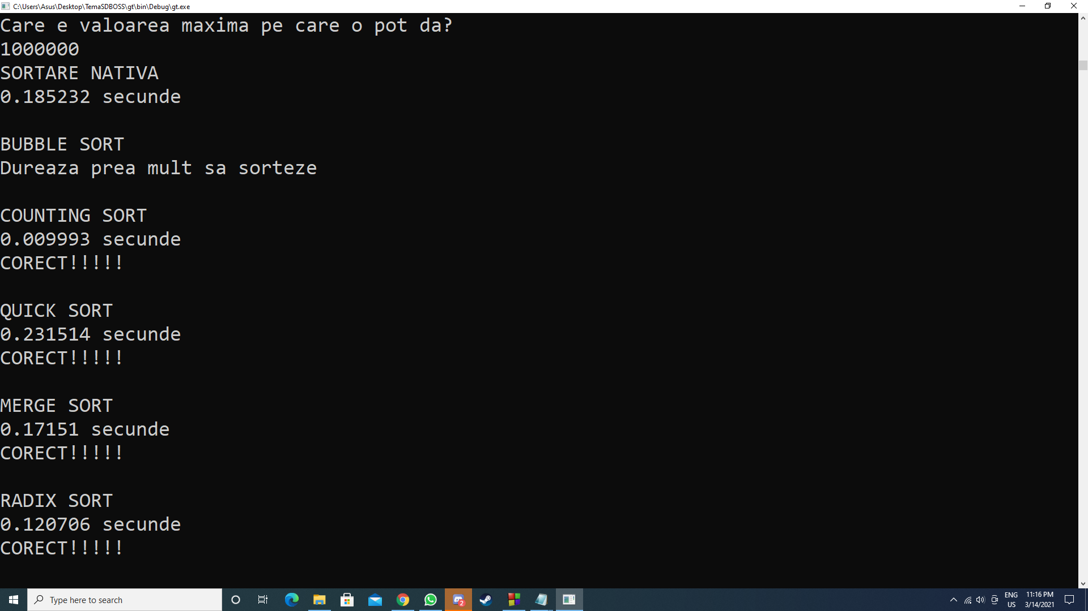
N=10^6, max=10^6, Numere generate random

Slide 13
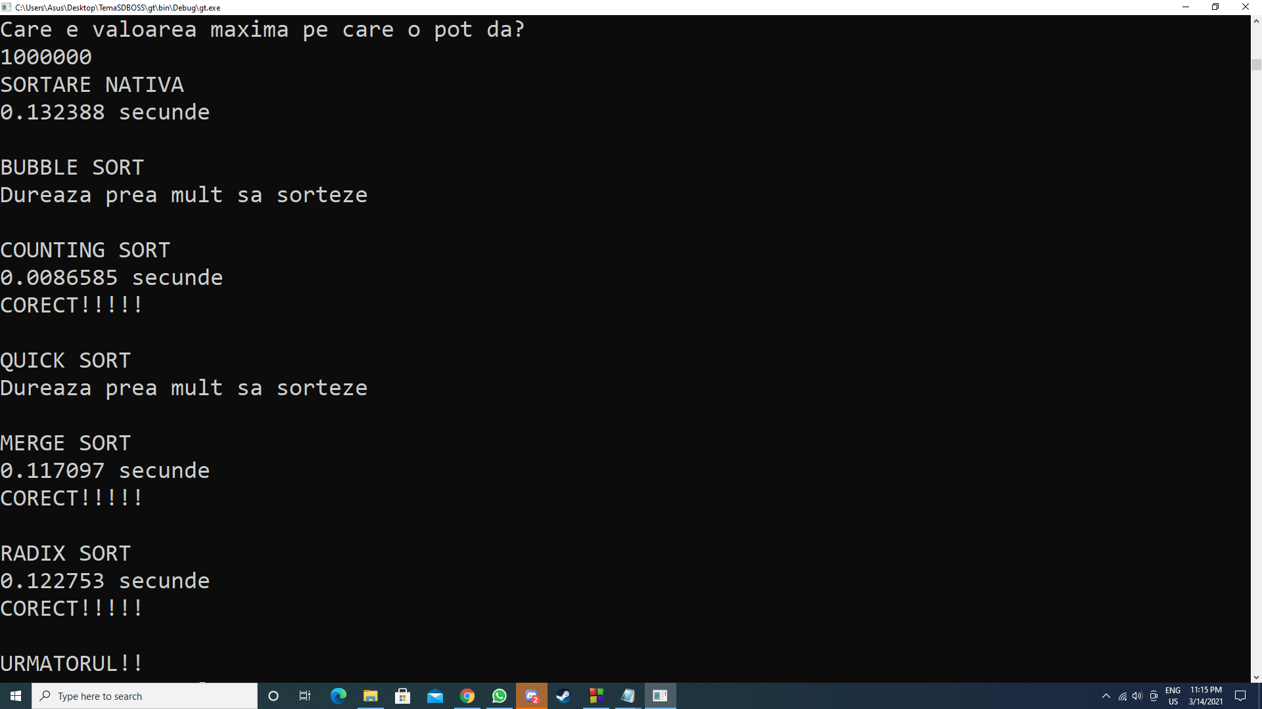
N=10^6, max=10^6, Vector constant

Slide 14
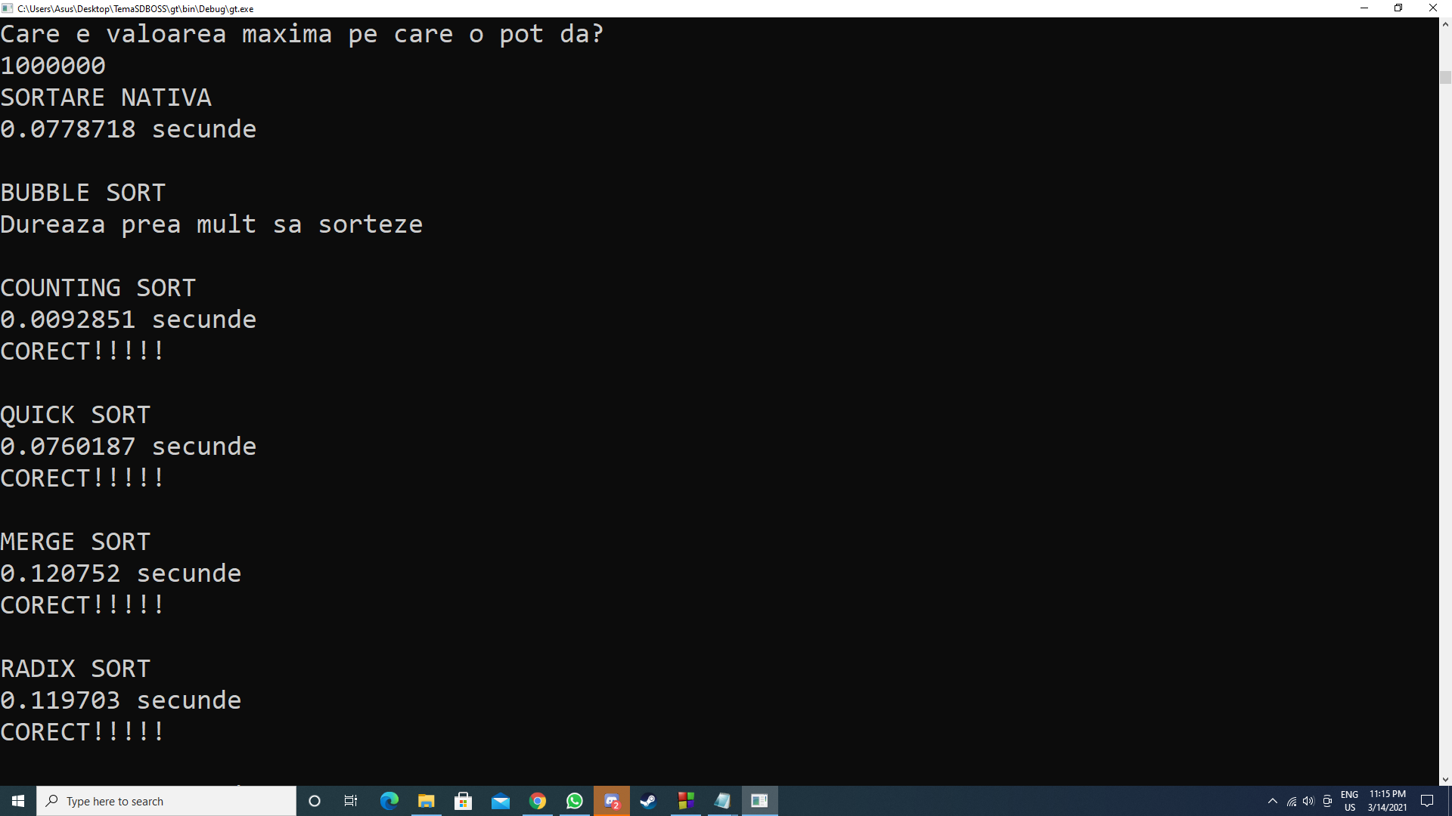
N=10^6, max=10^6, Vector crescator

Slide 15
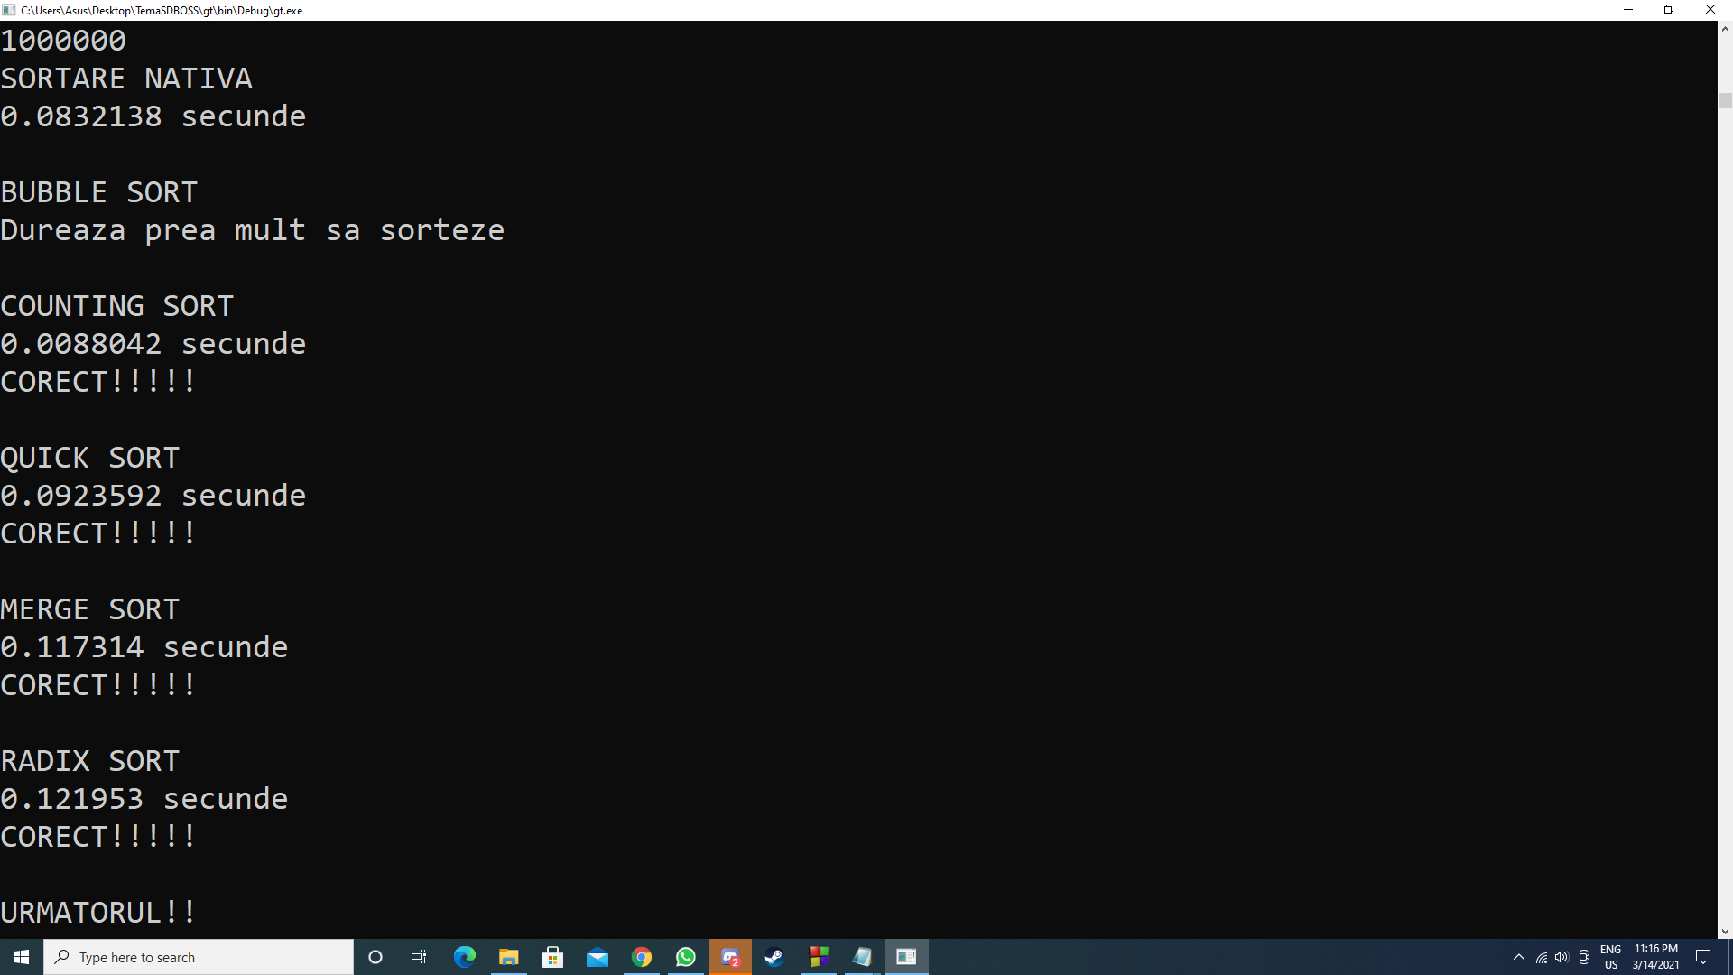
N=10^6, max=10^6, Vector descrescator

Slide 16

N=10^6, max=10^6, Vector aproape crescator

Slide 17
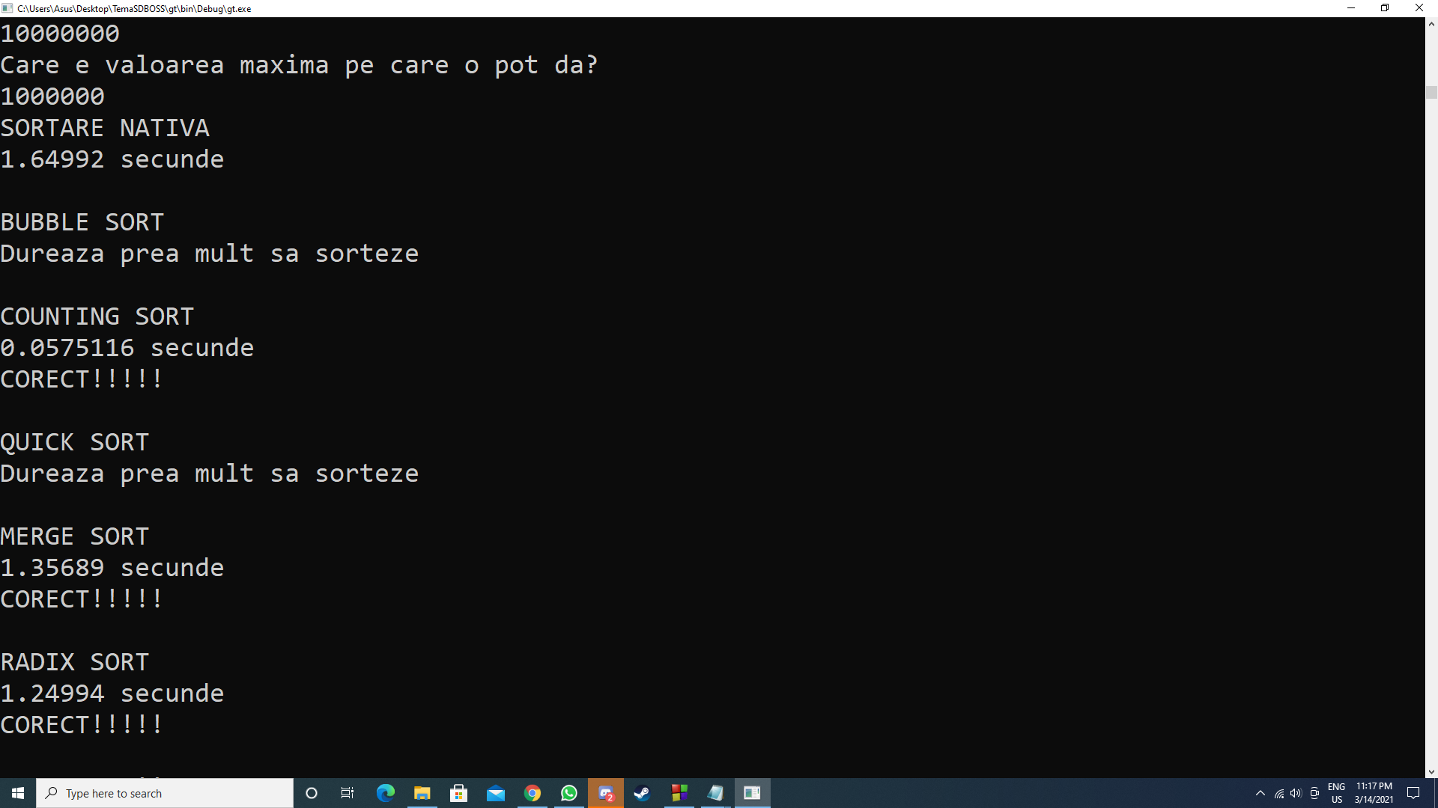
N=10^7, max=10^6, Numere generate random

Slide 18
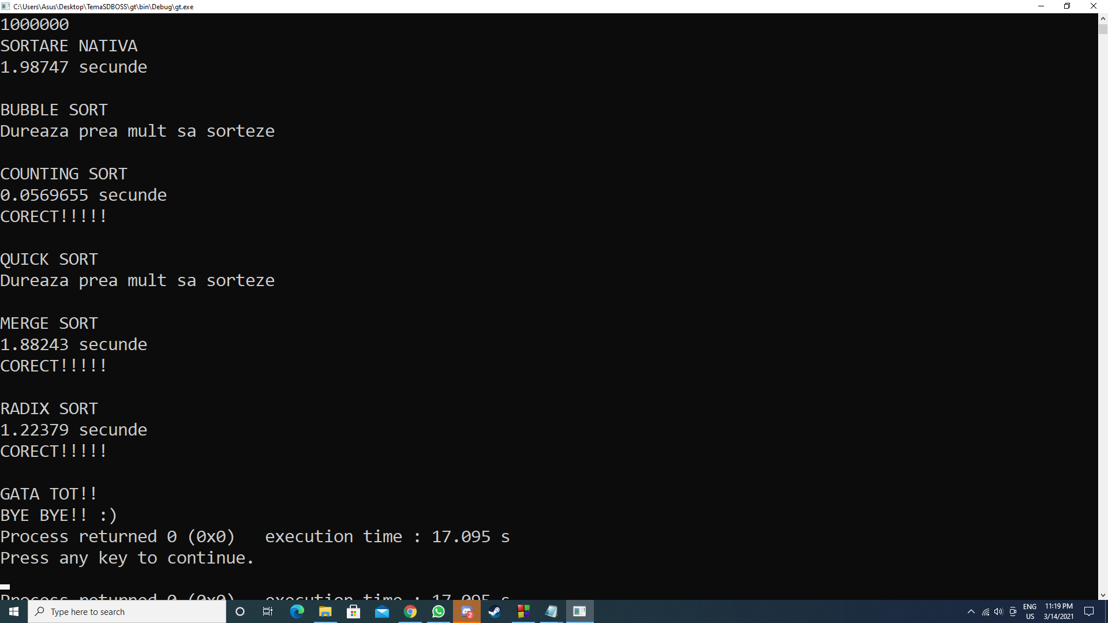
N=10^7, max=10^6, Vector constant

Slide 19
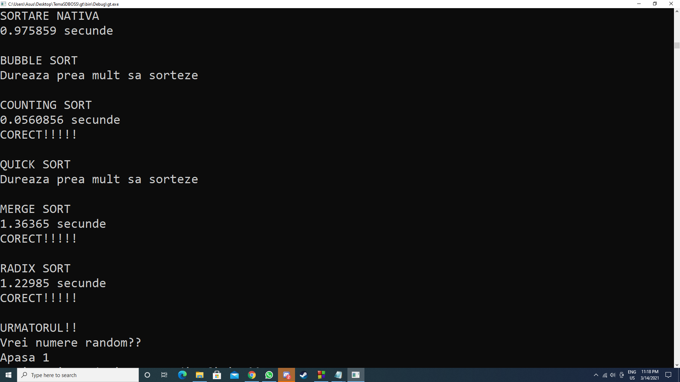
N=10^7, max=10^6, Vector crescator

Slide 20

N=10^7, max=10^6, Vector descrescator

Slide 21

N=10^7, max=10^6, Vector aproape crescator

