Slide 1
Object Detection within a particular distance using Sonar Sensor with Arduino Uno

Slide 2
Group Members
Chowdhury Md Rabby Mahmud ID - 15 - 30760 – 3
Chowdhury Md Muyeen Hossain ID – 15 – 30759 – 3
Md Kaykous Ahmad ID – 15 – 30405 – 3

Slide 3
Working Principle of Ultra Sonic Sensor
Ultrasonic sensors are devices that use electrical-mechanical energy transformation to measure distance from the sensor to the target object.
Ultrasonic waves are longitudinal mechanical waves which travel as a sequence of compressions and rarefactions along the direction of wave propagation through the medium.
Apart from distance measurement, they are also used in ultrasonic material testing, Object detection, position detection, ultrasonic mouse, etc.
These sensors are categorized in two types according to their working phenomenon piezoelectric sensors and electrostatic sensors. Here we discussing the ultrasonic sensor using the piezoelectric principle. Piezoelectric ultrasonic sensors use a piezoelectric material to generate the ultrasonic waves.

Slide 4
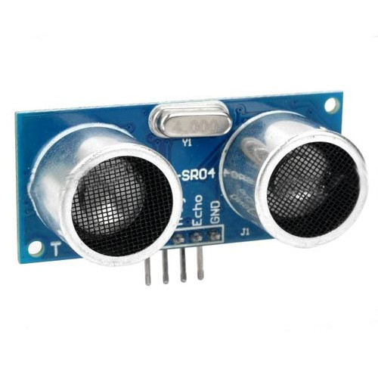
HC-SR04 Sensor

Slide 5
About the HC-SR04 Sensor
The HC-SR04 ultrasonic sensor uses sonar to determine distance to an object like bats do.
It offers excellent non- contact range detection with high accuracy and stable readings from 2cm to 400cm or 1” to 13 feet.
Its operation is not affected by sunlight or black material like Sharp rangefinders do.
Although acoustically soft materials like cloth can be difficult to detect.
It comes complete with ultrasonic transmitter and receiver module.

Slide 6
Features of HC-SR04 Sensor
Power Supply : +5V DC
Quiescent Current: <2mA
Working Current : 15mA
Effectual Angle : <15 degree
Ranging Distance : 2cm – 400 cm/1” – 13 ft
Resolution : 0.3 cm
Measuring Angle : 30 degree
Trigger Input Pulse width : 10uS
Dimension : 45mm x 20 mm x 15mm
PARAMETER | MIN | TYPE | MAX | UNIT
Operating Voltage | 4.5 | 5 | 5.5 | V
Quiescent Current | 1.5 | 2 | 2.5 | mA
Working Current | 10 | 15 | 20 | mA
Ultrasonic Frequency | - | 40 | - | kHz

Slide 7
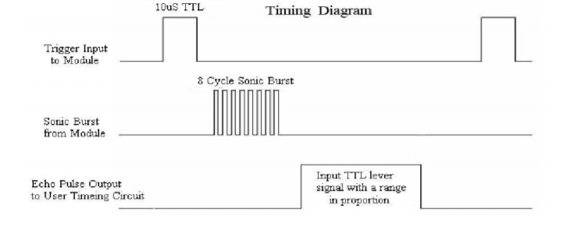
Operation Of The Sensor
The timing diagram of HC-SR04 is shown. To start measurement, Trig of SR04 must receive a pulse of high(5V) and delay for a at least 10us, this will initiate the sensor will transmit out 8 cycle of ultrasonic burst at 40kHz and wait for the reflected ultrasonic burst.
When the sensor detects ultrasonic signals from receiver, it will set the Echo pin to high(5V) and delay for a period which proportion to distance. To obtain the distance, measure the width(Ton) of Echo pin.

Slide 8
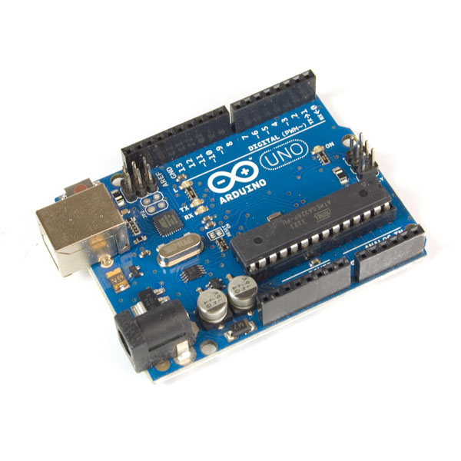
Arduino Uno

Slide 9
About Arduino Uno
Arduino Uno is a microcontroller board based on the ATmega328P.
It has 14 digital input/output pins, 6 analog inputs, a 16 MHz quartz crystal, a USB connection, a power jack, an ICSP header and a reset button.
We can connect it to a computer with a USB cable or power a AC-to-DC adapter or battery to get started.

Slide 10
Arduino IDE Program
Source Code:
constintechoPin = 2; // Echo Pin of Ultrasonic Sensor
constinttrigPin = 3; // Trigger Pin of Ultrasonic Sensor
constint LED = 13; // LED at Pin 13
void setup()
{
Serial.begin(9600); // Starting Serial Communication
pinMode(trigPin, OUTPUT); //
initialising pin 3 as output
pinMode(echoPin, INPUT); //
initialising pin 2 as input
}

Slide 11
void loop()
{
long duration, inches, cm;
digitalWrite(trigPin, LOW);
delayMicroseconds(2);
digitalWrite(trigPin, HIGH);
delayMicroseconds(10);
digitalWrite(trigPin, LOW);
duration = pulseIn(echoPin, HIGH); //
usingpulsin function to determine total time
inches = microsecondsToInches(duration); // calling method
cm = microsecondsToCentimeters(duration); // calling method
if(cm<10)
{
Serial.print(inches);
Serial.print("in, ");
Serial.print(cm);
Serial.print("cm");
Serial.println();
digitalWrite(LED, HIGH);
}
else
{
digitalWrite(LED, LOW);
}
delay(100);
}

Slide 12
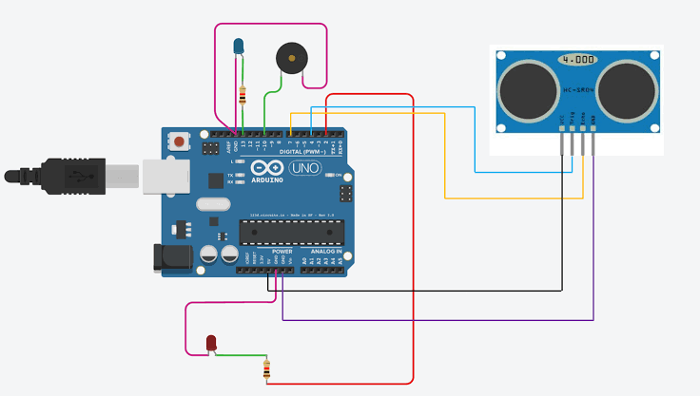
Block Diagram

Slide 13
Applications
Ultrasonic sensors can detect movement of targets and measure the distance to them in many automated factories and process plants. Sensors can have an on or off digital output for detecting the movement of objects, or an analog output proportional to distance. They can sense the edge of material as part of a web guiding system.
They are being used for a number of other automotive use including ultrasonic people detection and assisting in autonomous UAV navigation.
Passive ultrasonic sensors may be used to detect high-pressure gas or liquid leaks, or other hazardous conditions that generate ultrasonic sound. In these devices, audio from the microphone is converted down to human hearing range.

Slide 14
Ultrasonic sensors use sound rather than light for detection, they work in applications where photoelectric sensors may not.
Ultrasonic are a great solution for clear object detection, clear label detection and for liquid level measurement, applications that photoelectric struggle with. As well, target color and/or reflectivity do not affect ultrasonic sensors, which can operate reliably in high-glare environments.
High-power ultrasonic emitters are used in commercially available ultrasonic cleaning devices. An ultrasonic microphone is affixed to stainless steel pan which is filled with a solvent. An electrical square wave feeds the microphone, creating sound in the solvent strong enough to cause cavitation.

Slide 15
Thank You

