Slide 1

WHAT WE DON’T KNOW ABOUT PEOPLE IN COSMOS
1/7
By team «Betelgeuse»

Slide 2
WHAT ABOUT PROBLEM.
2/7
People have a low level of education in the issues of the human body in space.

Slide 3
IDEA & TOPICALITY
3/7
Create a platform that will close the gaps in people's knowledge and demonstrate an example of a creature that will survive in space.
The relevance lies in the popularization of scientific research in the field of genetic adaptations of the human body for being in outer space.

Slide 4
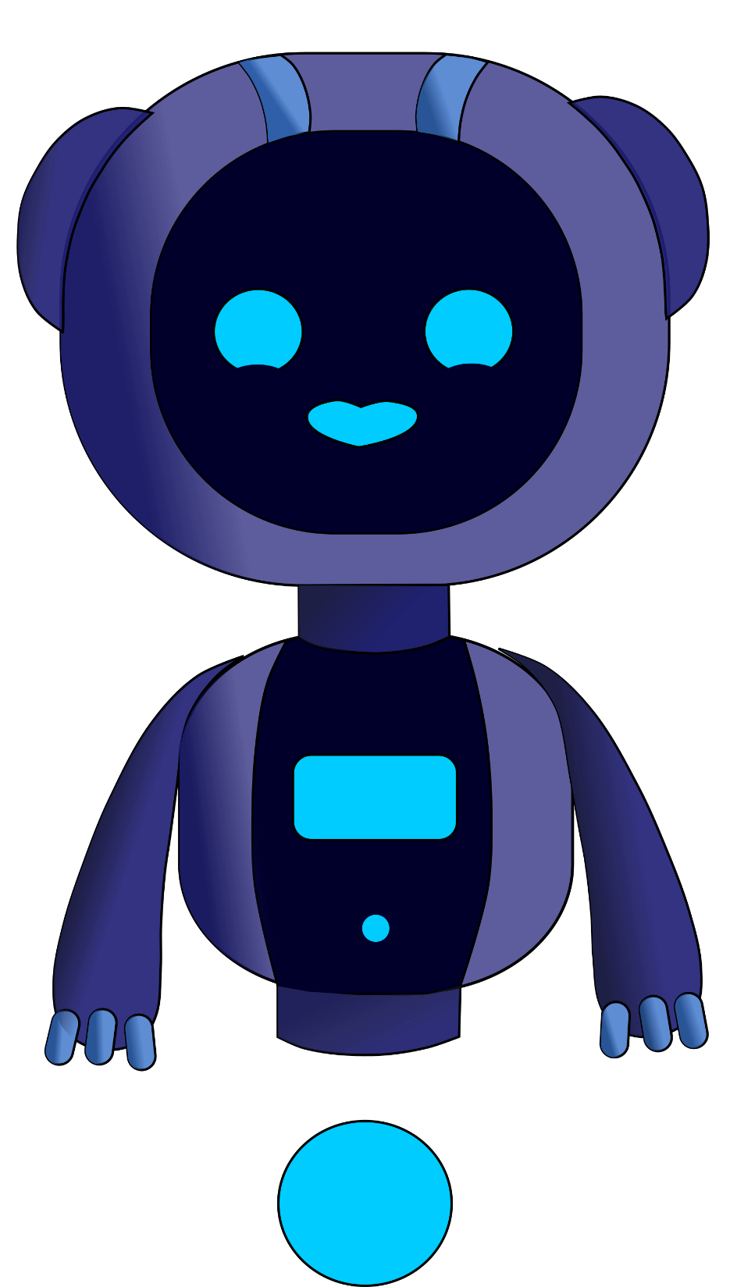
4/7
Uniqueness of the project:
Comfortable
Easy to use
Informative
Creative
Promotion of science in game form

Slide 5
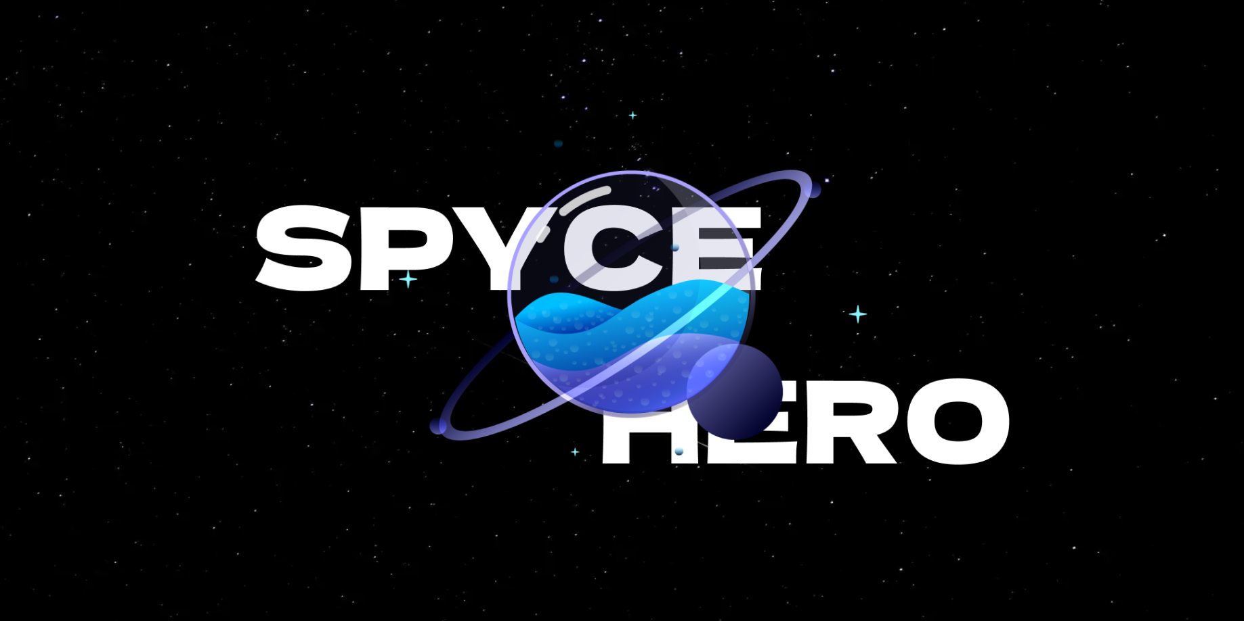
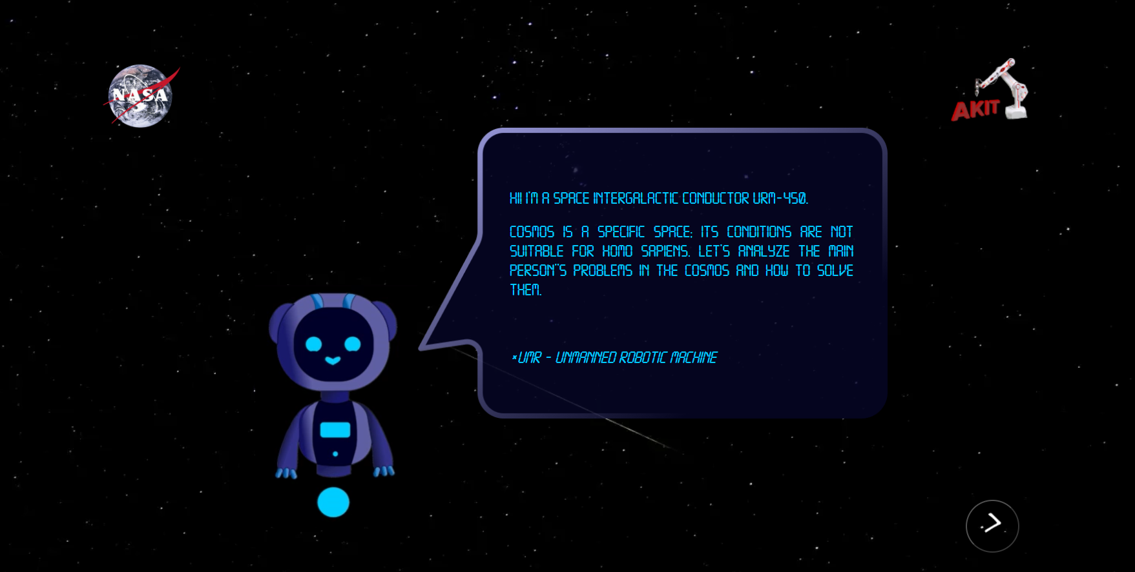
EXAMPLE

Slide 6
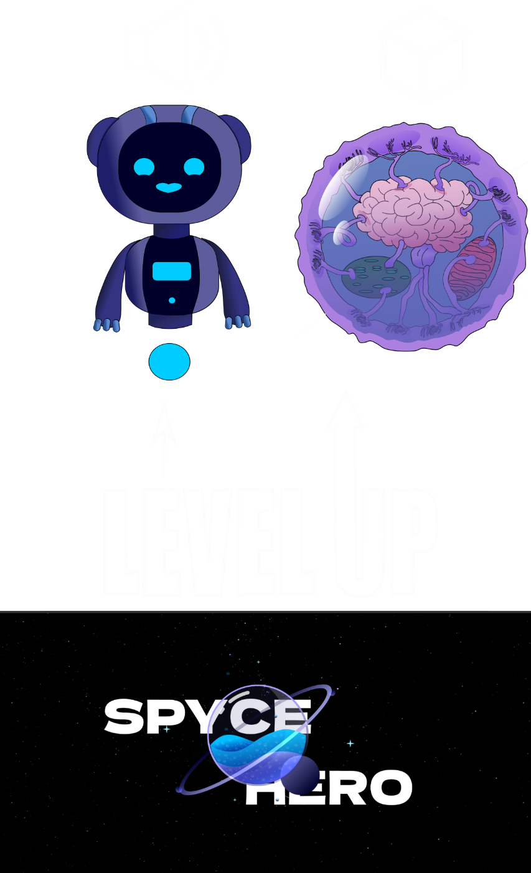
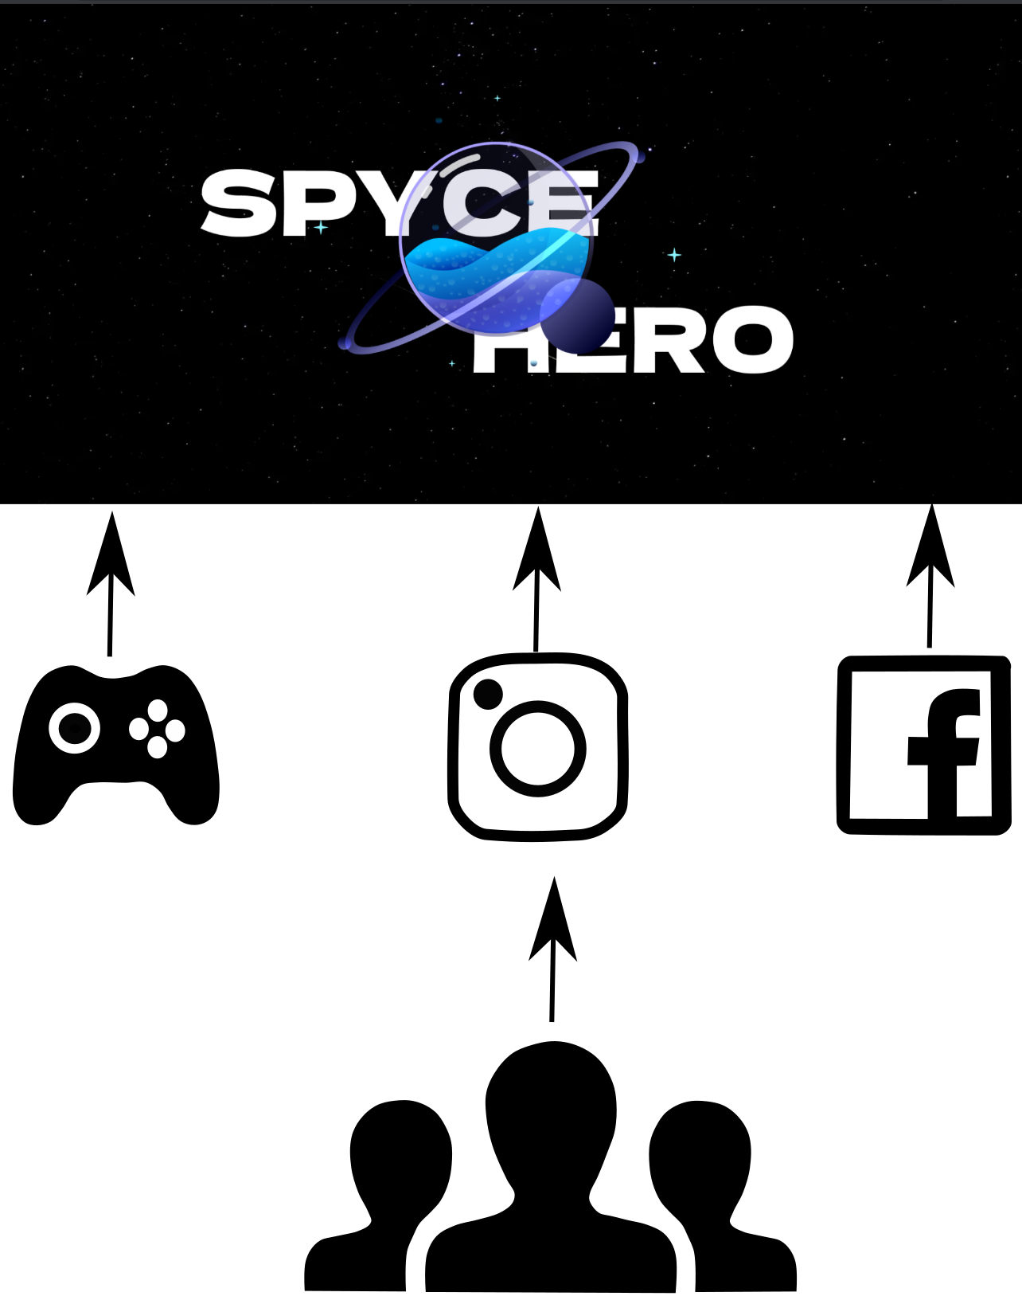
BUSINESS MODEL
DEVELOPMENT PERSPECTIVE

Slide 7
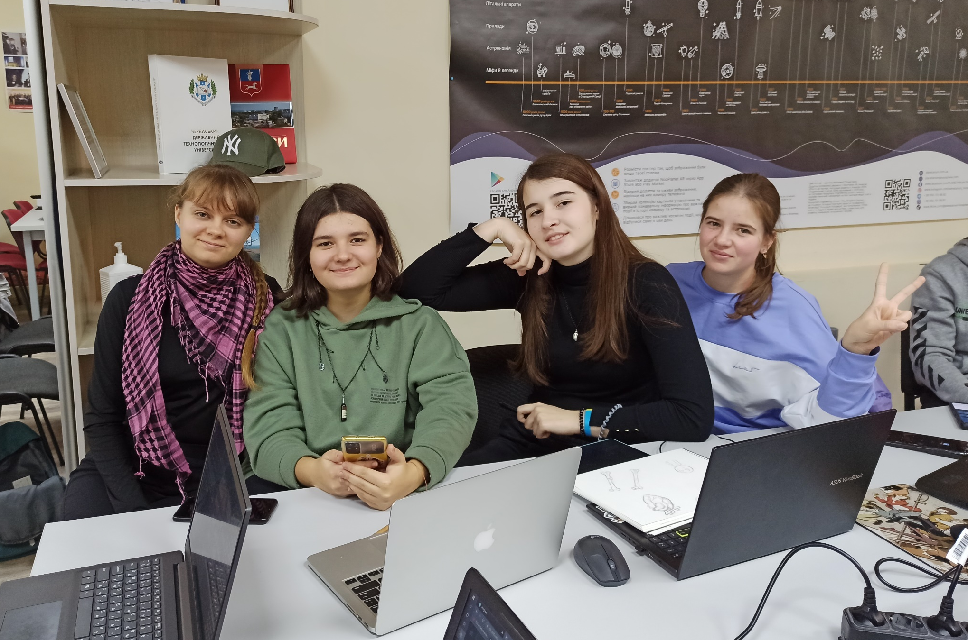
OUR TEAM

