Slide 1

SEASONAL AGRICULTURE PERFORMANCE ANALYSIS
SOFIA TM
PSGR KRISHNAMMAL COLLEGE, COIMBATORE
AICTE STU ID : STU68654ca9d120f1751469225

Slide 2

PROBLEM STATEMENT
Agricultural activities are influenced by seasonal variations in environmental conditions, farming practices, resource availability and market conditions. As a result, agricultural performance may differ from one season to another. However, raw agricultural data does not clearly explain how agricultural performance changes across seasons or what patterns can be observed in different seasonal conditions. The problem is to analyze the given agricultural dataset and investigate seasonal differences in agricultural performance by identifying meaningful patterns, trends, relationships and variations within the available data.

Slide 3
Project Description
Data Analytics study of seasonal farm performance
● Analyzed 4,000 farm-level records across 3 seasons (Kharif, Rabi, Zaid), 8 states and 8 crops, covering environmental, operational, production and economic variables.
● Performed full data cleaning: handled missing values (median imputation), checked for duplicates, and profiled outliers using the IQR method.
● Carried out univariate, bivariate and multivariate analysis, a full correlation study, and a dedicated season-wise comparison of yield, profit and resource use.
● Designed and ran 3 original analyses beyond the base template: regional profit-by-season patterns, the share of loss-making farms per season, and whether fertilizer use actually predicts yield.
● Documented 8 evidence-based insights, 5 recommendations and clearly stated limitations, all traceable to specific computed results in the notebook.

Slide 4

WHO ARE THE END USERS?
Farmers & farm managers — to understand which seasons and practices carry the most financial risk
State agriculture departments — to target seasonal support and advisories by region rather than nationally
Agricultural policy planners — to base seasonal planning and subsidy decisions on evidence, not assumption
Agri-lenders & crop insurers — to price risk with a realistic view of how common losses are, even in good seasons
Researchers & students — as a worked example of season-wise agricultural data analysis

Slide 5

Technology Used
Pandas & NumPy — data loading, cleaning, transformation
Python — core language for the analysis
Matplotlib & Seaborn — all charts and the correlation heatmap
Jupyter Notebook — the analysis environment & deliverable
Statistical methods — IQR outliers, groupby, Pearson correlation

Slide 6
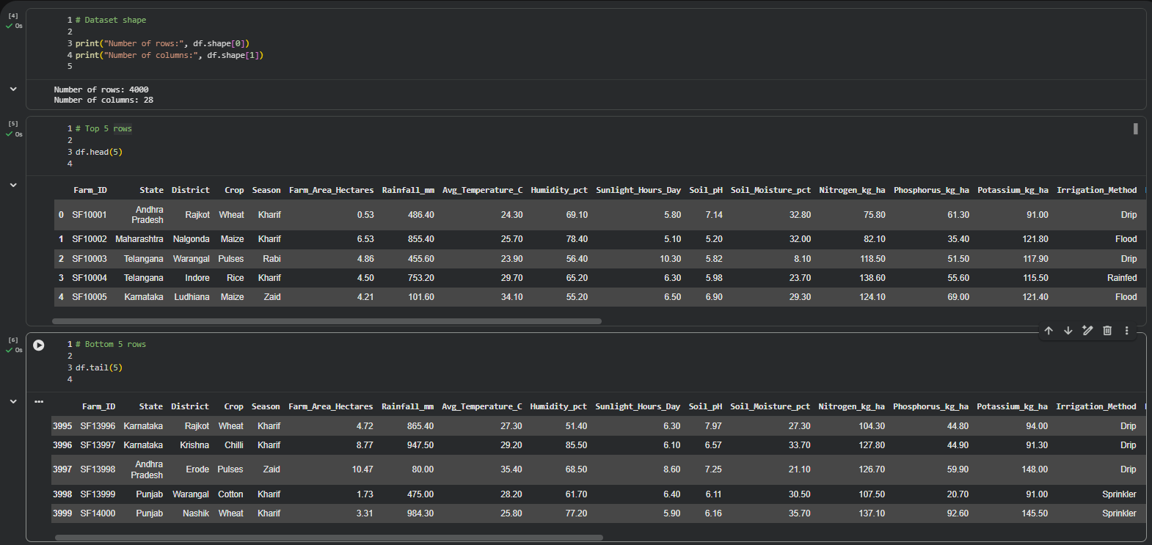
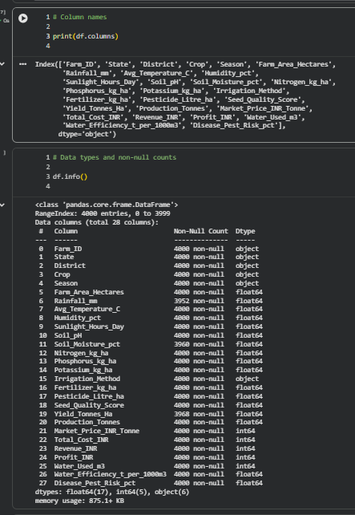
RESULTS
Dataset structure: shape, columns and data types

Slide 7
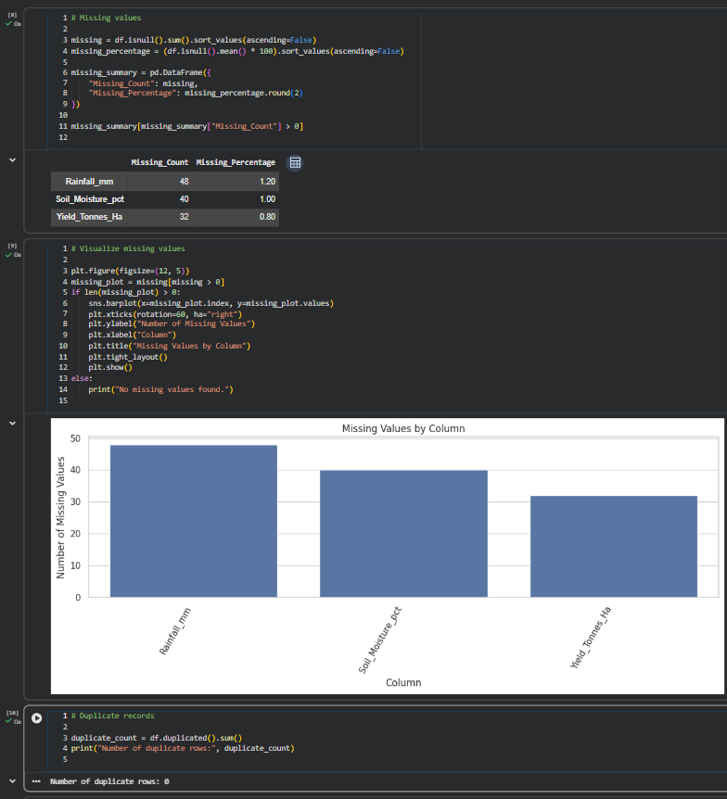
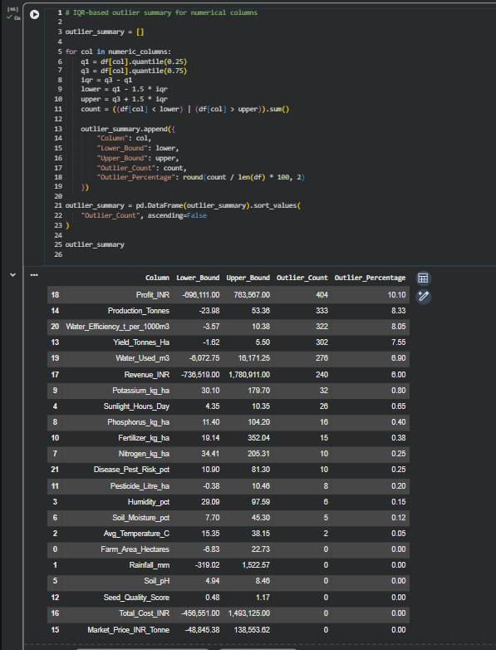
RESULTS
Data quality: missing values and IQR-based outliers

Slide 8
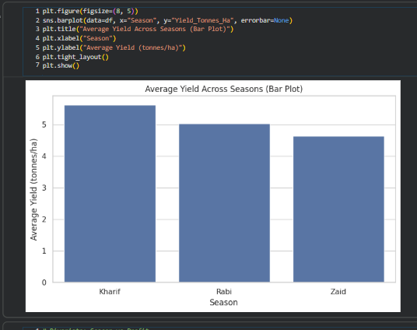
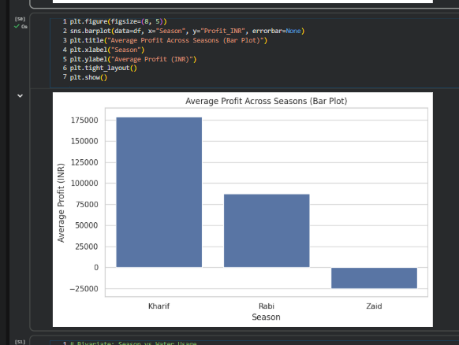
RESULTS
Seasonal comparison: average yield and profit

Slide 9
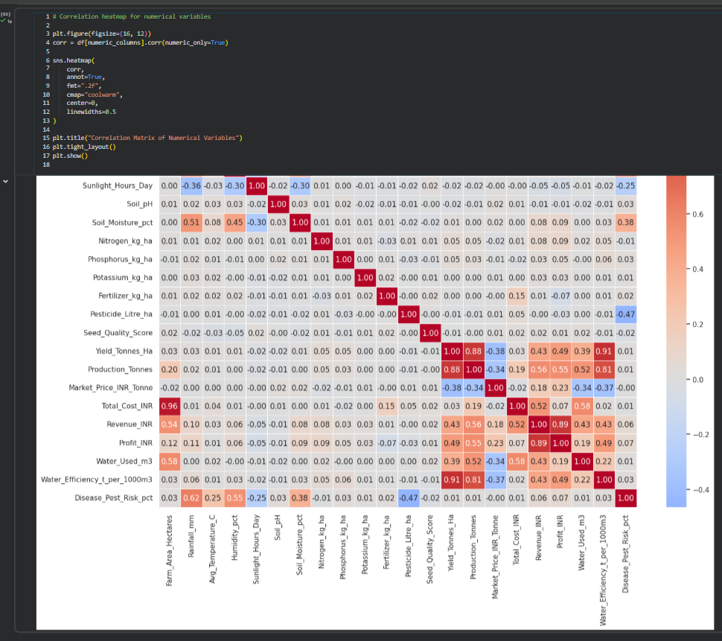
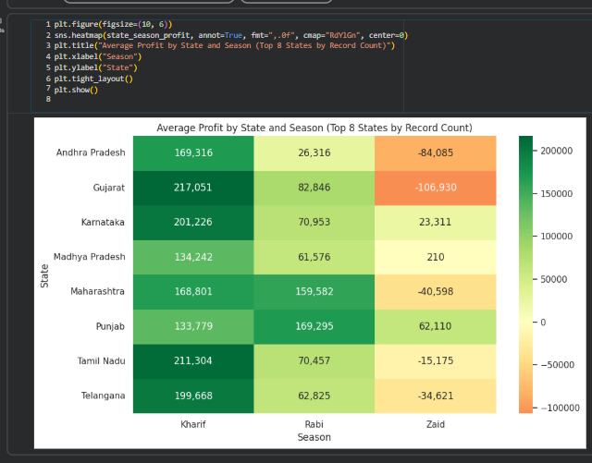
RESULTS
Correlation matrix and regional (state x season) profit

Slide 10
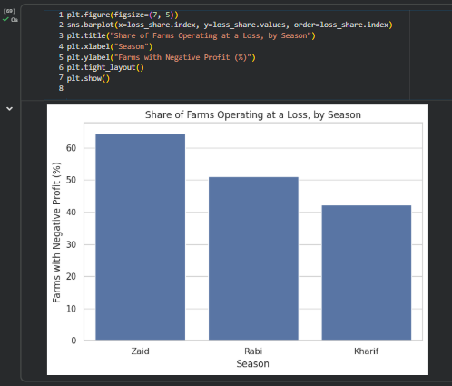
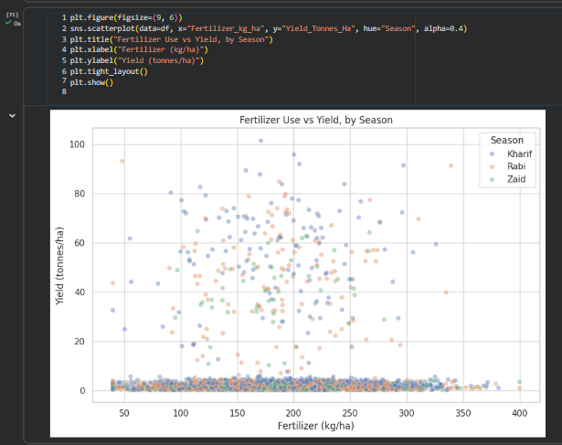
RESULTS
Loss share and fertilizer vs yield

Slide 11
Future scope
● Bring in multi-year data to separate genuine season effects from year-to-year weather variation.
● Break down the cost components behind profit (input cost, labour, transport, price realization) to explain why profit is far more volatile than yield.
● Apply non-linear or interaction-based methods to re-test fertilizer, rainfall and seed-quality effects on yield, since only linear correlation was checked here.
● Extend the regional analysis to all states, not just the 8 with the most records.
● Build a simple predictive model for season-level profit risk to support the recommendations already made.

Slide 12
GitHub Link
https://github.com/Sofia6002/Seasonal_Agriculture_Performance_Analysis

Slide 13
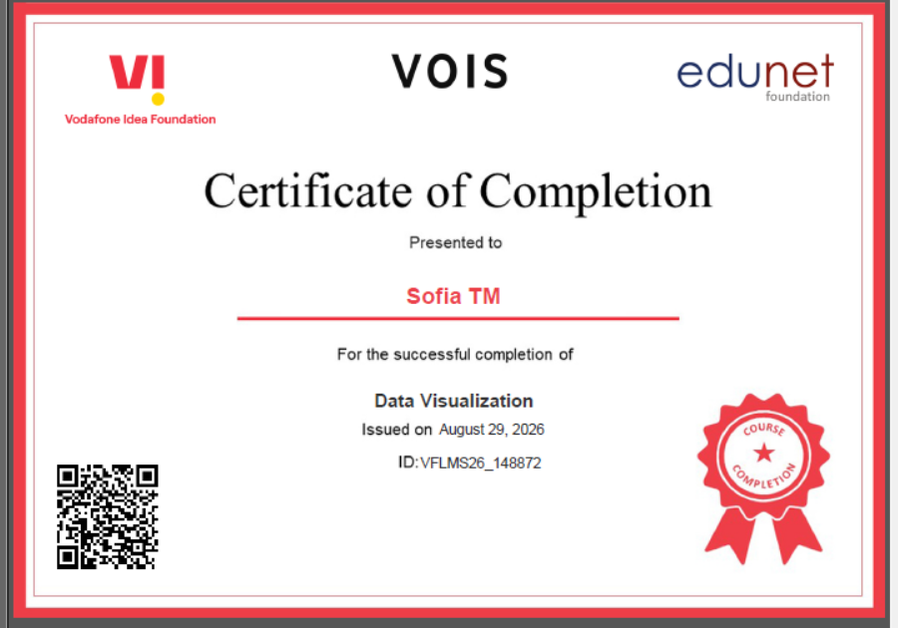
VOIS Course completion certificate -
Course name- Data Visualization

Slide 14
Thank you
.
.

