Slide 1
Data-driven Prediction of Alzheimer's disease
2023 SUMMER SCHOOL: COMPUTATIONAL BIOLOGY
Joana Ribeiro and Sofia Guerreiro
Supervised by
Anuschka Silva-Spínola (LARN, CISUC )
Prof. Joel P. Arrais (LARN, CISUC )

Slide 2
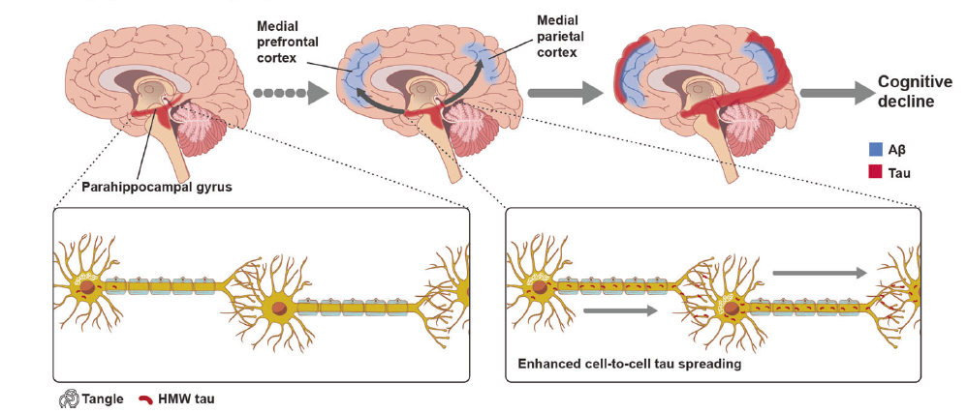
Alzheimer’s disease
Neurodegenerative disorder
Most common cause of dementia
Characterized by progressive cognitive decline and memory loss

Slide 3
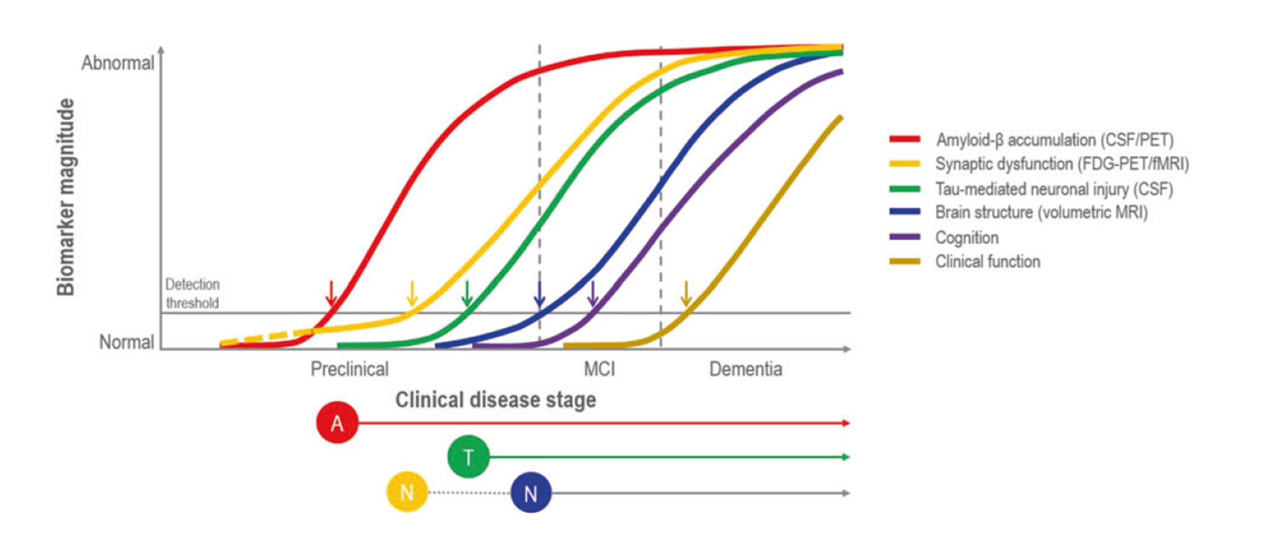
Model of dynamic biomarkers of the AD

Slide 4
Research questions
1) Who will progress to Alzheimer’s disease (AD)?
2) When will these mild cognitive impairment (MCI) patients progress?

Slide 5
Pipeline
Data Collection
Data Preprocessing
Feature Selection
Data Splitting
Model Training
Model Evaluation

Slide 6
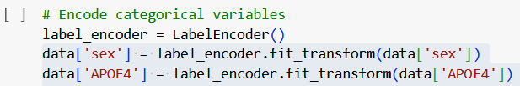
Data processing

Slide 7
Feature Selection
correlation between features and the target variable
prevent circularity redundancy in the model
Data splitting
We implemented a randomized, diagnosis stratified 80–20 split of the data into train-test sets.
repeated this 80–20 split 42 times

Slide 8
Goal
Development of an accurate predictive model to identify individuals at risk of progressing to dementia allowing early intervention and personalised medicine.
aim to evaluate the structure and function of the brain across different disease states and use clinical measures and biomarkers to monitor disease progression.

