Slide 1

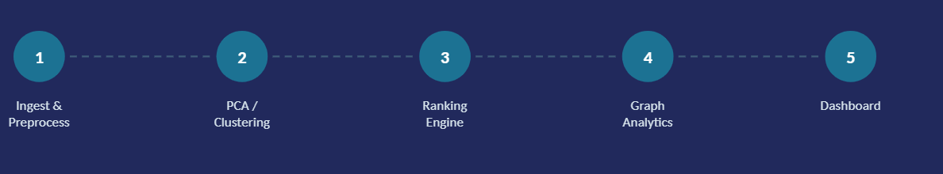
CLINICAL DATA INTELLIGENCE PIPELINE
Clustering patient profiles and treatment pathways in a 55,500-admission synthetic healthcare dataset
Big Data — Final Project | Universidad Peruana de Ciencias Aplicadas | Section 18519
Gómez Rubina, L. · Miranda Cárdenas, S. · Olivera Álvarez, L.
Notes:
1

Slide 2
DATA & PREPROCESSING
From a raw Kaggle export to a clean, ethics-documented relational model
55,500
54,966
33
0
raw admission
records (Kaggle,
synthetic)
records after
duplicate
removal
engineered
features in the
patient matrix
missing values
in the final
dataset
1
Normalized relational model — patients, hospitals, doctors, medical_conditions, medications, medical_records, joined on documented primary/foreign keys.
2
Ethics & Access Note — the source dataset is synthetic (Kaggle) and contains no real patient records; all findings describe patterns within this synthetic population, not clinical claims.
3
Feature engineering — Cost_Per_Day and decoded categorical labels were derived at this stage, feeding directly into the 33-feature patient matrix used for PCA.
Notes:
2

Slide 3
DIMENSIONALITY REDUCTION & CLUSTERING
PCA compresses the feature space; K-Means and DBSCAN are compared head-to-head for production
PCA + t-SNE
K-Means vs. DBSCAN
14–15
K-Means
DBSCAN
Segments found
4 operational
patient groups
100% noise for
eps ≤ 1.5
components retain
~95–100% of variance
(from 33 features)
Best config result
Clean, validated
clusters
eps = 2.5 →
only 2 clusters,
14.55% noise
t-SNE confirms a dominant patient population plus a smaller, persistent subgroup — motivating clustering rather than assuming one homogeneous population.
Role in project
Primary production
segmentation
Outlier / forensic
detection only
Validated with: silhouette score and the Calinski-Harabasz index.
Decision: K-Means selected for production — validated by both metrics and interpreted through a documented boundary/noise failure analysis.
Notes:
3

Slide 4
RANKING ENGINE
Predicting priority for an Abnormal test result at admission time — ensemble vs. three baselines
Precision@10
3x
Random ranking
0.200
the random-ranking baseline's Precision@10 — every evaluated K outperforms all three baselines
Clinical-rule ranking
0.300
F1 Macro = 0.380
Most-frequent-class
0.350
Error analysis shows a symmetric confusion matrix — evidence the admission-time feature set (no acute biological signal) sets a ceiling, not the model choice.
Ensemble (RF + CatBoost)
0.600
Temporal split: trained on 2023 admissions, tested on 2024 (1,108 train / 88 test) to expose population drift before deployment.
Notes:
4

Slide 5
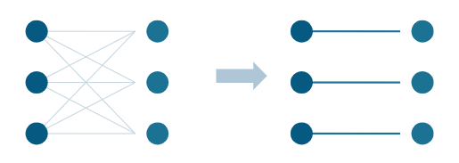
GRAPH ANALYTICS
Filtering the condition ↔ medication graph by statistical significance, not raw co-occurrence
Before → After lift ≥ 1.05 filter
ρ = 0.38
Spearman correlation between PageRank and raw popularity — down from ρ = 0.97 on the unfiltered graph.
dense / unfiltered
(sparsity = 0.000)
lift-filtered
(sparsity = 0.633)
!
Interpretation note: PageRank and centrality here are structural measures, not clinical ones. A high-PageRank medication is not a flagged clinical risk — this graph informs periodic dashboard review, not per-patient triage decisions.
11 nodes · 11 edges
small, threshold-dependent — findings describe this dataset, not a stable generalizable signal
Notes:
5

Slide 6
MONITORING, LIMITATIONS & PATH FORWARD
What keeps this pipeline honest once it leaves the notebook
1
In Production
2
Known Limitations
3
Next Steps
Retrain if F1 Macro / Precision@10 drops below 0.380 / 0.600
Cluster_Biz fit before the train/test split — a documented leakage caveat
Add early clinical signals (vitals, labs, triage score) to break the feature ceiling
Track boundary-case (negative-silhouette) rate for cluster drift
Ranking + graph layers cover only 1,196 of 54,966 records (cluster-join subset)
Persist the K-Means model on train-only data to close the leakage caveat
Rebuild the graph on a fixed cadence; a changed edge set is itself a signal
data/interim/healtcare_processedv2.csv has no traceable generating step yet
Ship build_graph.py as a standalone CLI script, independent of notebook state
github.com/SofiaGMiranda/BIG-DATA-FINAL-PROYECT-2025-01 · Live dashboard linked in repo README
Notes:
6

