Slide 1
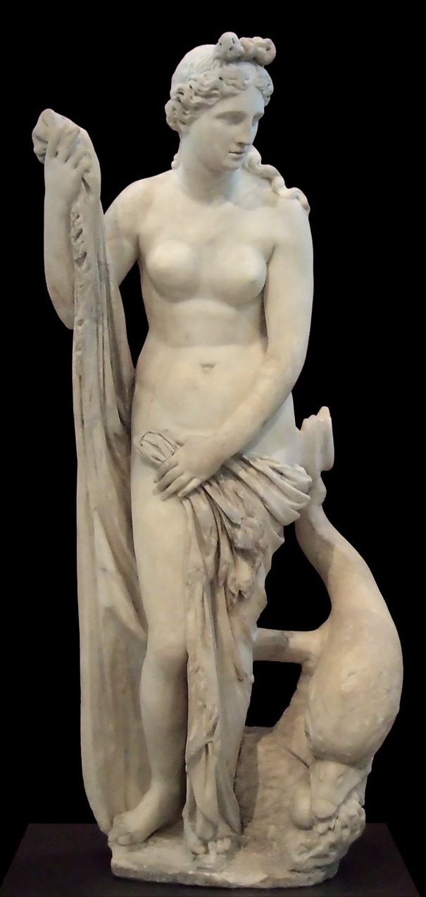
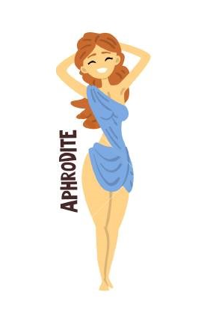
APHRODITE
GODDESS
OF
LOVE, PASSION, PLEASURE AND BEAUTY
PARENTS : Some myths say she was the daugther of Zeus and Dione (ancient Titanesse),
others say she was born from the waves when the genitals of Uranus fell into the sea.
CONSORT : Wife of Hephaestus, but had many lovers, most notably Ares
CHILDREN :
Though Aphrodite did not give any child to her husband, but she was nevertheless the happy mother of many, some of them …
Eros and the Eratos (God of Love and Attraction & smaller gods of different types of love), Harmonia (Harmony),
Phobos (Fear), Deimos (Terror), Adrestia (Revolt), all fathered by Ares.
Peitho (Seduction), Hymen (Marriage), Priapus (Male fertility), The Graces (3 goddesses of beauty), fathered by Dionysus
Hermaphroditus (who merged himself with his love, so was a man and a woman in one), fathered by Hermes.
Aeneas (Greek hero, main character of Virgil's Aeneid) fathered by human prince Anchises
SYMBOLS : Rose, Scallop Shell, Myrtle, Girdle, Mirror, Pearl
SACRED ANIMALS : Dolphin, Dove, Sparrow, Swan
ROMAN COUNTERPART : Venus
NOWADAYS : Friday → „Dies Veneris = „Day of Venus” + the planet Venus wears the Roman form of her name
LITTLE INTRODUCTION :
Aphrodite knew no mercy when it came to love and beauty : she started the Troyan war for being judged as the most beautiful, she helped Hippomenes cheating in competition with princess Atalanta to win her hand and she loved to make other gods fall for humans. Zeus often had to intervene around her - it is told he gave her hand to the ugly Hephaestus to stop other gods competing for it! Altough Aphordite was not totally satisfied, but Hephaestus, the god of metal and fire covered her with breathtaking jewelleries and she was still free to cause romantic troubles, so it turned out finally quite well.

Slide 2
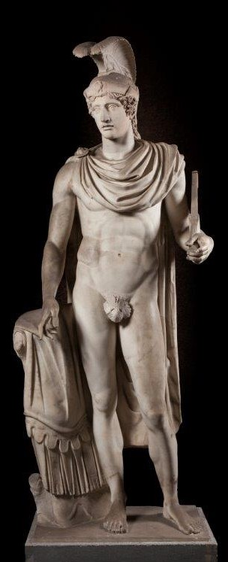
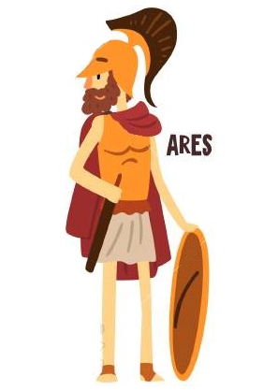
ARES
GOD
OF
DESTRUCTIVE WAR, BLODSHED AND VIOLENCE
PARENTS : Son of Zeus and Hera
CONSORT : Lover of Aphrodite (and many other from time to time)
CHILDREN :
Eros (Love and Attraction) , Anteros (Returned Love), Harmonia (Harmony), Phobos (Fear),
Deimos (Terror), Adrestia (Revolt), fathered to Aphrodite.
Phlegyas (King of Lapiths), Oenomaus (King of Pisa), fathered to mortal women
The Amazons, fathered to Harmonia
SYMBOLS : Sword, Spear, Shield, Helmet, Chariot, Flaming torch
SACRED ANIMALS : Dog, Boar, Vulture
ROMAN COUNTERPART : Mars
NOWADAYS : Tuesday → „Dies Martis” = „Day of Mars” + the planet Mars wears the Roman form of his name
LITTLE INTRODUCTION :
Ares was the least liked god both on earth and on the Olympus, even if he was a really handsome guy, but he missed the humour – no wonder since mostly he was wondering on battlefields with his charming sons Deimos (Terror) and Phobos (Fear). His only weak point was Aphrodite, his borther’s wife, with who he had a long-term relationship, which caused the most embarrasing incident of the Olympus : Once Helios, the God of Sun discovered him having some moments with Aphrodite, and ran to tell Hephaestus. He, being the God of Metal, created an armour making him invisible, then locked the pair in the room, called the other gods (only the men went) and did some old-fashioned public humiliation

Slide 3
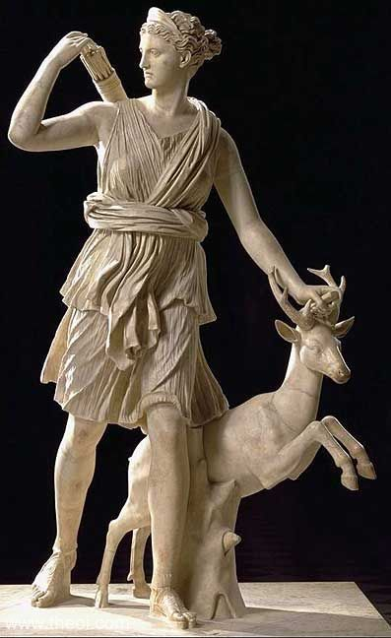
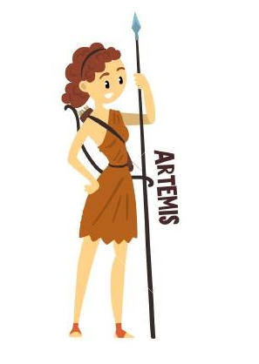
ARTEMIS
GODDESS
OF
HUNT, WILDERNESS, WILD ANIMALS,
YOUNG GIRLS, CHASTITY AND MOON
PARENTS : Daugther of Zeus and Leto, twin sister of Apollo
CONSORT : Virgin Goddess
CHILDREN :
Though Artemis never had children, she was the the patron and protector of young girls - her company included 60 young girls as her choir, and 20 nymphs to be her handmaidens who she guarded closely. She was also worshipped as one of the primary goddesses of childbirth and midwifery along with Eileithyia.
SYMBOLS : Bow, Arrows, Moon
SACRED ANIMALS : Stags, Hunting dog
ROMAN COUNTERPART : Diana
NOWADAYS : Monday → „Dies Lunae” = „Day of Moon”
(Though this day actually belongs to Selene, or more to her Roman counterpart Luna, the main goddess and actual personification of the Moon, but since Artemis is also one of the lunar goddesses, let’s give her the honor!)
LITTLE INTRODUCTION :
Artmesis was a very determined young lady – right after she was born, she presented a wish list of 10 points to her father Zeus, including her wish to never marry and to be differenciated strongly from her twin brother Apollo (oh, and to be called Light Brighter, have all the mountains and any cities). Later she became a badass goddess and punised every man who wanted to force himself on her – once she turned them into deers to be killed by their own hounds, another time she turned them into girls, but once she just simply stroke a man who only thought of approaching her.

Slide 4
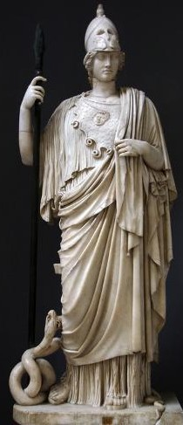
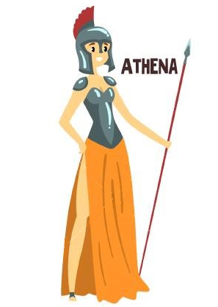
(PALLAS) ATHENA
GODDESS
OF
REASON, WISDOM, INTELLIGENCE,
SKILL, HANDICRAFTS AND WAR STRATEGY
PARENTS : It was told that she was born from Zeus's forehead, fully formed and armored.
CONSORT : Virgin Goddess
CHILDREN :
Tough Athena did not have children, but she was a real mother-type, being the patron of many heroes (ex. Perseus, Heracles, Bellerophon, Odysseus) and cities (Athen of course, but also Argos, Sparta, Gortyn, Lindos, Larisa).
SYMBOLS : Sword, Spear, Shield, Helmet, Chariot, Flaming torch
SACRED ANIMALS : Dog, Boar, Vulture
ROMAN COUNTERPART : Minerva
NOWADAYS : The city of Athen wears her name even now – she won it against Poseidon by creating the olive tree.
LITTLE INTRODUCTION :
Athena was the wisest of all the gods and one of Zeus’s personal favourite. Ares often complained to Zeus that he prefers his sister among him, which was undeniable, since Athena represented the warfare strategy and war heroism, contrary to Are who presented the aimless and violent bloodshed. Also, Athena was literally „daddy’s girl”, given the circonstances of her birth! Athena liked humans and helped them where she could : she taugth them arts and crafts, how to live well and also how to think clearly, so basically she started philosophy. But she was also a proud goddess and did not like to be outsmarted – a greek princess and Athena’s student, Arachne once started to spread that her skills are greater than Athena’s. She engaged in a weaving contest with the goddess, but she chose to present Zeus’s affairs with mortals, what outraged Athena (also the fact that it was indeed better work than her’s) and turned her rival into a spider.

Slide 5
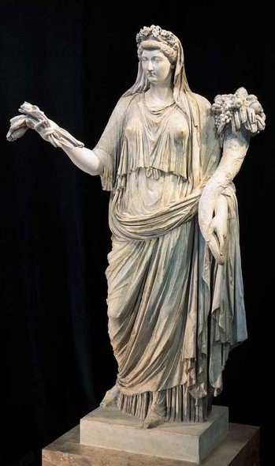
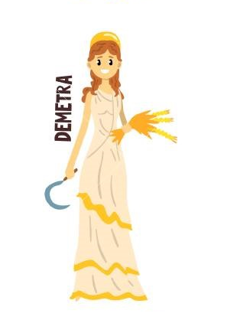
DEMETER
GODDESS
OF
GRAIN, AGRICULTURE, HARVEST, GROWTH, AND NOURISHMENT
PARENTS : Cronus and Rhea, God of Time and his sister,
who are the parents of first-generation Olympian gods
CONSORT : No
CHILDREN :
Persephone, the Goddess of Spring and Nature, then Queen of Underworld, fathered by Zeus
SYMBOLS : Cornucopia, Wheat, Torch, Bread
SACRED ANIMALS : She was rather a vegetable person.
ROMAN COUNTERPART : Ceres
NOWADAYS : We use her name on daily basis, since the world „cereal” is coming from the Roman version of her name, Ceres.
LITTLE INTRODUCTION :
Demeter was a highly respected goddess, since she was responsible for the change of seasons and the growing of all things on earth, what she did happily. However, when Hades abducted her daugther Persephone, Demeter went out-of-office and started a desperate search for her daugther. While she was away, all things stared to die, forcing Zeus to tell Demeter where her daugther is and to order Hades to give back Persephone. However, while she was underground, Persephone ate a pomegranate seed and that meant she can never leave. Demeter threatened Zeus to destroy life on Earth if she doesn’t get back her daugther, and so Zeus made a compromise : Persephone spent one half of the year on Earth with her mother, and the other half with her husband in the Underworld – that’s why half of the year is brigth and warm, and the other half is cold and dead.

Slide 6
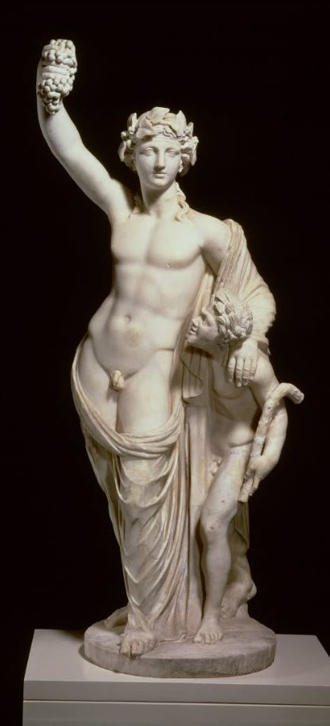
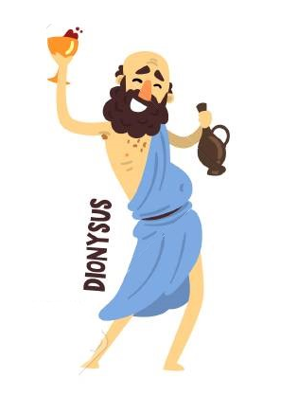
DIONYSUS
GOD
OF
WINE, FRUITFULNESS, FESTIVALS, MADNESS, ECSTASY, AND THE THEATER
PARENTS : Zeus and Semele (Daugther of Harmonia), altough it was rather just Zeus,
since he had to snatch Dionysus from his mother's womb, stitched him into his own thigh
and carried him until he was ready to be born
CONSORT : Ariadne, greek princess who Dionysus found and saved from death
after her formal lover Theseus left her, despite helping him in the labiryth with the Minotaurus
CHILDREN : Dionysus had many offsprings, the most famous were…
Peitho (Seduction), Hymen (Marriage), Priapus (Male fertility), The Graces (3 goddesses of beauty), fathered to Aphrodite
Comus (Festivity), Phthonus (Romantic jelousy), fathered to smaller deities
SYMBOLS : Thyrsus, Grapevine, Ivy, Masks, Chalice
SACRED ANIMALS : Bull, Panther, Goat
ROMAN COUNTERPART : Bacchus
NOWADAYS : His Roman name Bacchus is used in form of „bacchanalia”, which refers to really crazy parties.
LITTLE INTRODUCTION :
Dionysus was a great favourite of ancient Greeks, which is no wonder since he taught humans how to make vine and how to party. He even had a secret culture in the Ancient Rome, the Bacchic cult. He was also liked among gods, with the exception of Hera, who feared that Zeus chose Semele, Dionysus’s monther over her and chased her son during a long time of their immortal life – she threw Semele in the Underworld, but good-guy Dionysus saved her, as well as he saved his future wife Ariadne from death. However, Hera found a way to poison Dionysus’s invention – she sent madness to those who consume vine and it can be stopped only with moderated vine culture, what her grand-mother Rhea taught to Dionysus..some things never change, grandmas always know best!

Slide 7
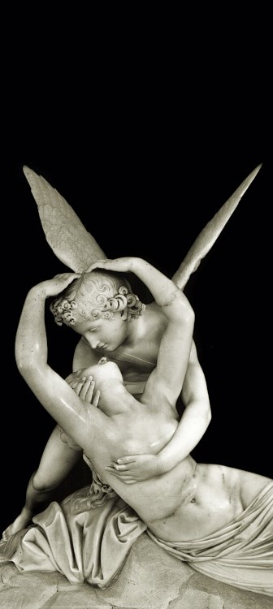
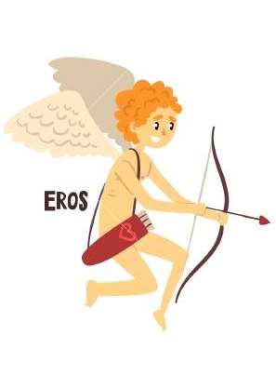
EROS
GOD
OF
LOVE, ATTRACTION AND DESIRE
PARENTS : Aphrodite and Ares
CONSORT : Psyche (Greek Princess, then Goddess of Human Soul)
CHILDREN :
Hedone (Bliss)
SYMBOLS : Pomegranate, Seeds of Grain, Torch, Flowers
SACRED ANIMALS : Deer
ROMAN COUNTERPART : Amor, Cupid
NOWADAYS : He does not have any day, but for falling in love, we still use the term of „hit by Amor’s arrow”
LITTLE INTRODUCTION :
Eros’s task was to plant love in the hearth of humans (and sometimes gods, like his mother). Once Aphrodite got jealous of the beauty of mortal princess Psyche, as men were leaving her altars barren to worship a mere human woman instead, and so she commanded her son Eros, the god of love, to cause Psyche to fall in love with the ugliest creature on earth. But instead, Eros fell in love with Psyche himself and spirited her away to his home. Their fragile peace was ruined by a visit from Psyche's jealous sisters, who caused Psyche to betray the trust of her husband. Wounded, Eros left his wife, and Psyche wandered the Earth, looking for her lost love. Eventually, she approached Aphrodite and asked for her help. Aphrodite imposed a series of difficult tasks on Psyche, which she was able to achieve by means of supernatural assistance. After successfully completing these tasks, Aphrodite relented and Psyche became immortal to live alongside her husband Eros – basically, the story of Eros and Psyche was the first Cinderella story, even fairies are there, since Psyche was often portrayed with butterfly wings after she became a goddess!

Slide 8
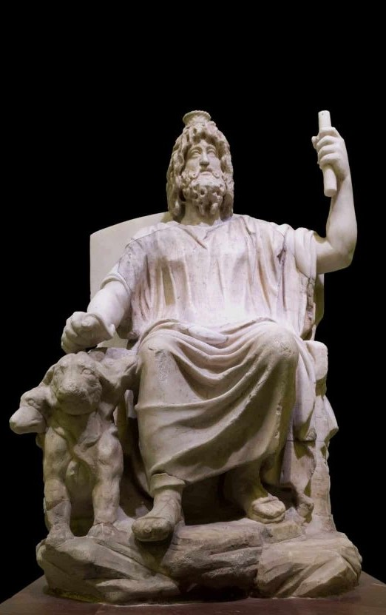
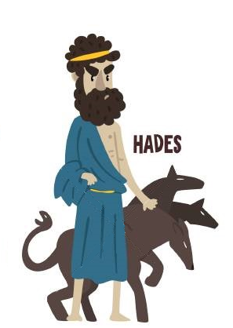
HADES
GOD
OF
UNDERWORLD, DEAD AND WEALTH
PARENTS : Cronus and Rhea, God of Time and his sister,
who are the parents of first-generation Olympian gods
CONSORT : Persephone (Goddess of Spring and Nature, Queen of Underworld)
CHILDREN :
Plutus (Wealth), Macaria (Blessed Death), Melinoe (Bringer of nightmares)
SYMBOLS : Cornucopia, Cypress, Narcissus, Keys, Mint plant, White poplar, Chariot
SACRED ANIMALS : Serpent, Dog, Sheep, Screech Owl, Horse
ROMAN COUNTERPART : Pluto
NOWADAYS : He does not have a day, but the famous Pluto start/planet belongs to him.
LITTLE INTRODUCTION :
There are realitvely little data of Hades compared to other gods, especially since he was one of the 3 main gods, alog with Zeus and Poseidon. That is mainly because people did not want to talk about him for not attiring his attention. He did not even had a proper name – Hades rather refers to the underground itself, it’s ruler was referred as Plouton ("the Rich one„) as at the end he will have everything and everyone (that sounded more positive, also it was useful since many was afraid to tell even the word Hades). Hades was portrayed as a cold god, not caring much about the Olympus, but he was not portrayed evil either, rather neutral. However, there are stories which told that he was seen as a cunning god – he tricked his wife into staying with him, and when he learned that a greek prince wants kidnap his wife, he pretended to offer him hospitality and set a feast, but as the prince sat down, snakes coiled around his feet and held him there forever. Hades also had a cloak which made him invisible – maybe that inspired the cloak of Death in Harry Potter?

Slide 9
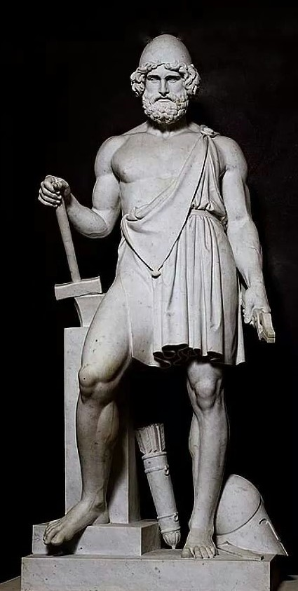
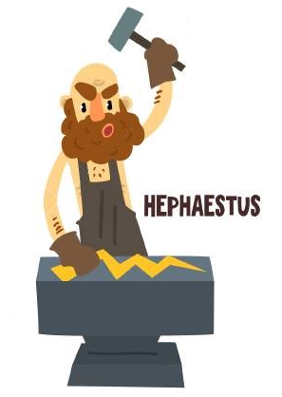
HEPHAESTUS
GOD
OF
FIRE, METALWORKING, AND CRAFTS
PARENTS : It was told that Athena was born from Zeus's forehead, fully formed and armored,
Hera was so jelous, that she tried herself the same thing, and that’s how she gave birth
to Hephaestus who she immediately threw from the Olympus once she saw his ugliness
CONSORT : Aphrodite
CHILDREN :
Younger Charities : Eucleia (Glory), Euthenia (Prosperity), Eupheme (Praise), Philophrosyne (Kindness) by Aglaea
Thalia (Nymph of Plant Green and Joy)
SYMBOLS : Hammer, Anvil, Tongs, Volcan
SACRED ANIMALS : Donkey, Guard dog, Crane
ROMAN COUNTERPART : Vulcan
NOWADAYS : His Roman name stayed alive in form of every volan on the Earth.
LITTLE INTRODUCTION :
After Hera ejected Hephaestus from the heavens, he fell into the ocean and was found and raised by Thetis (mother of Achilles and Goddess of Water). After growing up and becoming the master of metal and crafts, Hephaestus gained revenge against Hera for rejecting him by making her a magical golden throne, which, when she sat on it, did not allow her to stand up. The other gods begged Hephaestus to return to Olympus to let her go, but he refused, saying "I have no mother”. At last, Dionysus fetched him, intoxicated him with wine, and took the subdued smith back to Olympus where he became the smith of gods. Not a bad evening out – he woke up living again on Olympus, and the bonus was the hand of the goddess of beauty and love! Well played, Hephaestus!

Slide 10
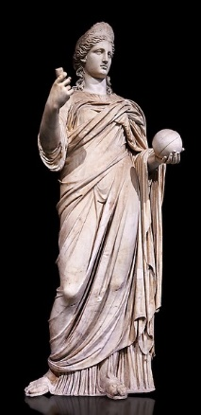
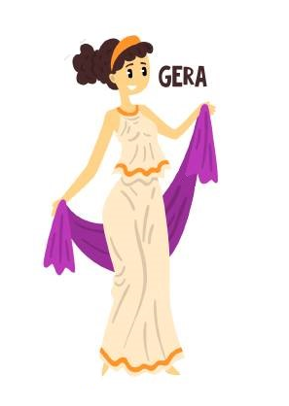
HERA
QUEEN OF GODS
GODDESS
OF
MARRIAGE, WOMEN, CHILDBIRTH, RULERS, AND EMPIRES
PARENTS : Cronus and Rhea, God of Time and his sister,
who are the parents of first-generation Olympian gods
CONSORT : Zeus
CHILDREN :
Ares (God of War), Enyo (Goddess of War), Eris (Goddess of discord), Eileithyia (Goddess of Childbirth), Hebe (Goddess of Youth), all fathered by Zeus
Hephaestus (God of Fire and Metalwork) was born from Hera's forehead, fully formed but also deformed, out of jelousy over the birth of Athena. Once she saw his ugliness, she immediately threw from the Olympus.
SYMBOLS : Pomegranate, Peacock feather, Diadem, lily, lotus, scepter, throne
SACRED ANIMALS : Peacock, Cow, Cuckoo, Panther, Lion,
ROMAN COUNTERPART : Juno
NOWADAYS : The popular month and female name „June” wears the Roman form of her name
LITTLE INTRODUCTION :
Hera was the sister and wife of Zeus, the queen of gods and the first of goddesses, but it did not make her too happy. Mostly she raged in jelousy over Zeus’s many affairs and spent a good portion of her time chasing his mistresses and children : she commanded all earths to refuse to give place to the mother of Appollon and Artemis when she was pregnant, she drove Hercules mad and made him murder his family, and she throw the mother of Dionysus into the Underworld. Zeus tried to explain her that he loves her, but he also loves Greece and he wishes to father as many Greek heros as possible, but somehow Hera was not too comprehensive. But that is not too suprising if we consider that she was the protectress of women, marriage and childbirth, frequently punishing offending husbands.

Slide 11
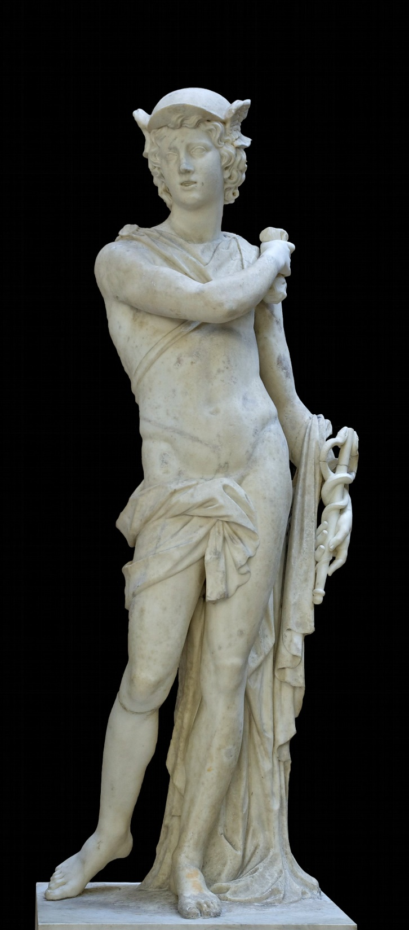
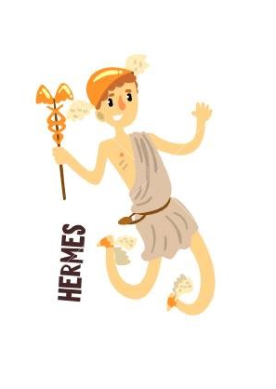
HERMES
GOD
OF
TRAVEL, COMMUNICATION, TRADE, THIEVES,
LANGUAGE AND WRITING
PARENTS : Zeus and Maia
CONSORT : Peitho (Goddess of Seduction and Persuasion)
CHILDREN : Hermes had many offsprings, the most famous were…
Pan (God of wilderness), Hermaphroditus ((who merged himself with his love, so was a man and a woman in one)
Autolycus (successful robber who had the power of metamorphosing both the stolen goods and himself), whose grand-son was Odysseus, greek hero known for his cunning and rethorical skills
Angelia (Messenger of Gods),
SYMBOLS : Caduceus, Lyre, Petasos (Winged helmet), Talaria (Winged sandals)
SACRED ANIMALS : Tortoise, Rooster
ROMAN COUNTERPART : Mercur
NOWADAYS : Wednesday → „Dies Mercurii” = „Day of Mercury” + the name of planet Mercur wears the Roman form of his name
LITTLE INTRODUCTION :
Hermes was the trickster of gods, cunning without being evil – he liked to make fun of others, but being the god of communication and the deputy of gods, he could easily get along with other gods and humans. It meant also that he was a bit hyperactive, never rested (no wonder he was also the patron of athletes!) : right after his birth he made a lyre of the tortoise-shell, and when he got bored with it and hungry, he stole the sacred cows of his brother Appollon, covered his act cleverly and ate two of them to finish his first day. However Appollon found out what happened, but simply couldn’t get mad at his small bro, especially when Hermes apologized with big eyes and give him the lyre he made, and what Appollon adored and made his symbol. Since that day Hermes is the god of thieves and those who wander, but also of smart wit – while his sister Athena was the goddess of intelligence, but it was the task of Hermes to assing the intelligence level to each person.

Slide 12
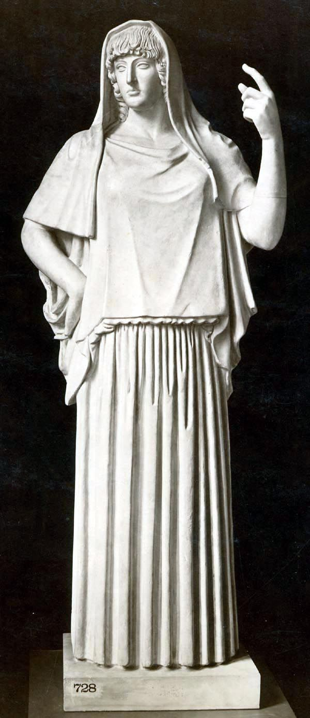
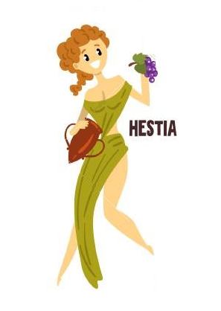
HESTIA
GODDESS
OF
HEARTH, HOME, HOUSE, FAMILY AND CHASTITY
PARENTS : Cronus and Rhea, God of Time and his sister,
who are the parents of first-generation Olympian gods
CONSORT : Virgin Goddess
CHILDREN :
The goddess of the home and family never had a family of her own. At one time, Poseidon and the younger god Apollo pursued her, and the competition for her favor threatened to get ugly. But her dedication to peace never allowed Hestia to take part in wars, rivalries, or other disputes. So in order to maintain peace on Olympus, Hestia turned down both rivals and swore to maintain her chastity forever. Zeus rewarded her for this sacrifice by guaranteeing her the honor of receiving the first portion of every public sacrifice.
SYMBOLS : Hearth, Fire, Fireplace
SACRED ANIMALS : Donkey
ROMAN COUNTERPART : Vesta
NOWADAYS : The second largest and the brightest asteroid of the asteroid belt is named Vesta
LITTLE INTRODUCTION :
The first-born of the six children of Rhea and Cronus, Hestia was the kindest, most virtuous, and most charitable of all the Olympians. It is told that when Dionysus arrived, Hestia sacrificed her Olympian status to allow the young god join the main Olympian tewlves. As goddess of the hearth and fire, the symbolic center of home, Hestia watched over the private and public home of humans - some storytellers assert that Hestia invented the art of building houses, and like this she protected the civic affairs of the communal family. Since basically every home and the public hearth of every city was hers, Hestia had few shrines built to honor her in the ancient Greek, but in the ancient Rome, the cult of Vesta was a reputed group of virgins living together in a small community quietly and guarding the flame of Vesta.

Slide 13
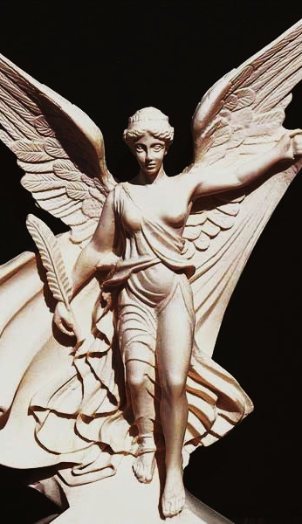

NIKE
GODDESS
OF
STRENGTH, SPEED, AND VICTORY
PARENTS : Pallas and Styx
CONSORT : Virgin Goddess
CHILDREN :
She does not have any children since she was too busy flying around the battlefields with the raging greeks.
SYMBOLS : Golden sandals, Wings, Wreaths
SACRED ANIMALS : Eagle
ROMAN COUNTERPART : Victoria
NOWADAYS : Both the Roman and Greek name of the goddesse still lingers around us, as one of the most famous girl name and one of the most famous sport brand.
LITTLE INTRODUCTION :
Nike and her siblings were close companions of Zeus, the dominant deity of the Greek pantheon. According to classical (later) myth, Styx brought them to Zeus when the god was assembling allies for the Titanomachy against the older deities. Nike flew around battlefields rewarding the victors with glory and fame, symbolized by a wreath of laurel leaves (bay leaves). Nike was also a very close acquaintance of Athena, as this latest was the goddess of war strategy, representing that mastery and strategy wins over the chaos and bloodshed of Ares.

Slide 14
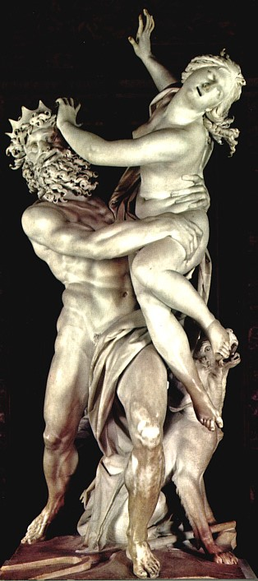

PERSEPHONE
GODDESS
OF
SPRING
AND QUEEN OF THE UNDERWORLD
PARENTS : Zeus and Demeter
CONSORT : Hades
CHILDREN :
Melinoe (Bringer of nightmares)
SYMBOLS : Pomegranate, Seeds of Grain, Torch, Flowers
SACRED ANIMALS : Deer
ROMAN COUNTERPART : Proserpina
NOWADAYS : Persephone today represents the mysterious woman, and the name is still used – just think of Matrix!
LITTLE INTRODUCTION :
Persephone was often called „The Maiden” when she was still the Goddess of Spring, representing the age of youth in a woman’s life. But Hades, the God of Underworld fell in love with her, abduct her and tricked her to be his wife by offering her a seed of pomegranate to eat. Her mother Demeter went on quest to find her daughter and finally made a deal with Hades and Zeus to allow Persephone spending half of the year in the underworld, in exchange to spend the other half of it with her mother on the earth. Tough Persephone was abducted, but she eventually learned to accept her husband (some myths suggest that she ate the seed willingly) – it shows that when she found out that the nymph Minthe, associated with the river Cocytus, loved by Hades, the jealous Persephone turned her into the mint plant (though Hades kept on wearing mint leaf to annoy his wife). In fact, the story of Hades and Persephone is the first form of the story of the Beauty and the Beast. Even as the Queen of Underworld, she remained a gentle character – she was the one who let back Eurydice back to life when her husband Orpheus came down to the Underowlrd to beg for her life with his sweet music.

Slide 15
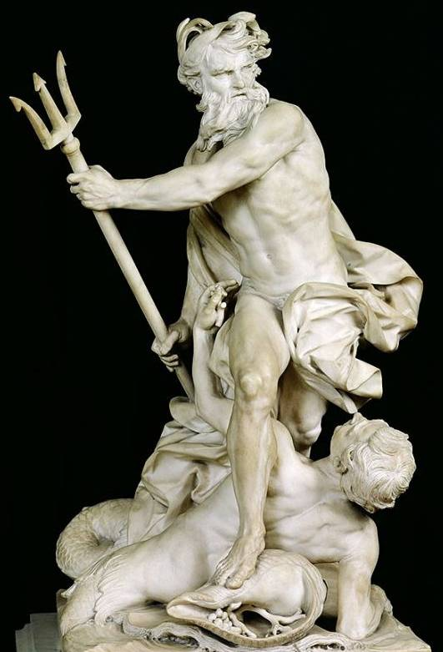
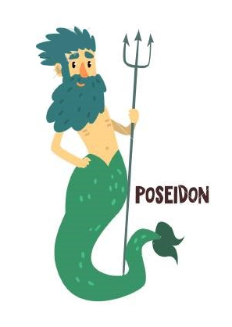
POSEIDON
GOD
OF
SEA, RIVERS, FLOODS, DROUGHTS, AND EARTHQUAKES
PARENTS : Cronus and Rhea, God of Time and his sister,
who are the parents of first-generation Olympian gods
CONSORT : Amphitrite (Goddess of Sea)
CHILDREN : Poseidon had countless affairs and offpring, the most famous are…
Theseus (Greek hero), Triton (God of Sea), Polyphemus (Cyclops), Orion (Giant hunter),
Atlas (the first king of Atlantis), Pegasus (Horse with wings)
SYMBOLS : Trident
SACRED ANIMALS : Horse, Bull, Dolphin, Fish
ROMAN COUNTERPART : Neptune
NOWADAYS : He does not have day, but the planet Neptunus was named after him (and he has a lot to do
with Little Mermaid and Aquaman too!)
LITTLE INTRODUCTION :
Poseidon was one of the main 3 gods along with his borthers Zeus and Hades, the most dominant after Zeus and very sensitive about his second position. He was told to be a quickly angered and sassy god – no wonder that Zeus prefered him having under-water, where he could amuse himself with sending earthquakes and storms on those who did not respect him. He constantly tried to expand his power over the cities on the land : he contested for Argos with Hera, for Corinth with Helius and for Athen with Athena, but he lost all 3 disputes, so remaind the patronage of various islands and seaports. However, his greedy nature had the good side of being very protective also with all of his children – for example he chased Odysseus for 10 years after the hero blinded his Cyclops son.

Slide 16
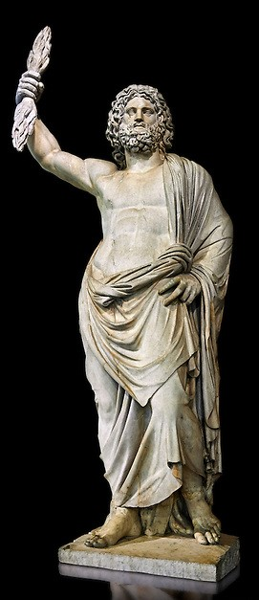
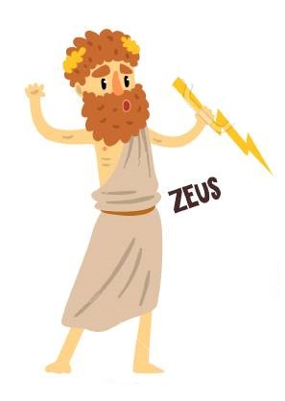
ZEUS
KING OF THE GODS, RULER OF MOUNT OLYMPUS
GOD
OF
SKY, WEATHER, THUNDER, LIGHTNING, LAW AND JUSTICE
PARENTS : Cronus and Rhea, God of Time and his sister,
who are the parents of first-generation Olympian gods
CONSORT : Hera
CHILDREN : Zeus fell in love easily and he tried to father as many children as possible, since his love for Greece made him want to populate it with many great heros and gods, and he was quite successful. His most famous children are…
Gods : Aphrodite (Love), Apollo (Arts and Music), Ares (War), Artemis (Hunt), Athena (Wisdom), Dionysus (Wine), Eileithyia (Childbirth), Enyo (War), Eris (Discord), Hebe (Youth), Helen of Troy, Heracles, Hermes (Language), Persephone (Spring), the Muses and the Moirai (3 goddesses of Faith)
Mortals : King Minos, Hero Perseus, Hero Heracles, Helen of Troy
SYMBOLS : Thunderbolt, Oak
SACRED ANIMALS : Eagle, Bull
ROMAN COUNTERPART : Jupiter
NOWADAYS :Thursday → „Dies Iovis” = „Day of Jupiter” + also the planet Jupiter, the biggest planet, belongs to Zeus
LITTLE INTRODUCTION :
Zeus was the first of the Olympian gods and became their king after killing Cronus, his and Olympian twelve’s father who ate his children, and released all his sisters and brothers. Together they beath the ancient gods, the Titans and moved to the Mount Olympus to watch over the humans. Zeus ruled over them with justice, but he was an incorrigible Don Juan, seducing women however he could (Leda as a swann, Hera as a cuckoo, Europe as a bull) what was a constant source of conflict with his wife Hera, whose rage was the only thing Zeus feared. But beside the endless troubles, Zeus’s children shaped the Greek mythology and therefore at least it ws not a ‚much ado about nothing’!

