Slide 1

VOLATUM
For “Don’t Crash My Drone”
2016 NASA Space Apps Challenge
It is our challenge to promote unique solutions while continuing to utilize high standards in our methods to develop an application to aid drone pilot

Slide 2
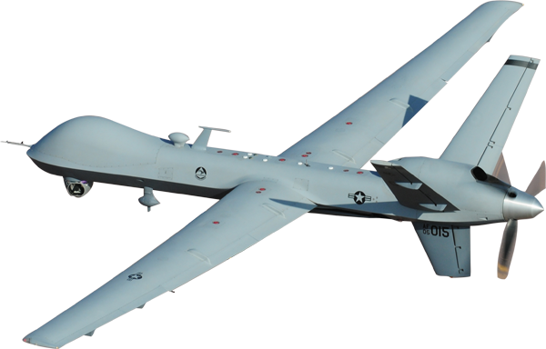
OVERVIEW
Enables drone operators to know about
Weather conditions
Local terrain
No fly zones
Within a 5 mile radius of the drone’s location

Slide 3

Weather conditions
Data for
Wind speed
Cloudiness
Pressure
Humidity
Temperature
is extracted from OpenWeatherMap

Slide 4
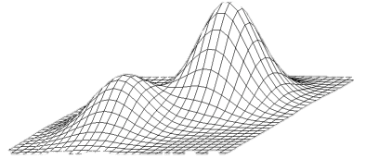
Local Terrain
Google Maps API is used to get information for
Elevation of the surface of earth within 5 miles of the drone
location

Slide 5
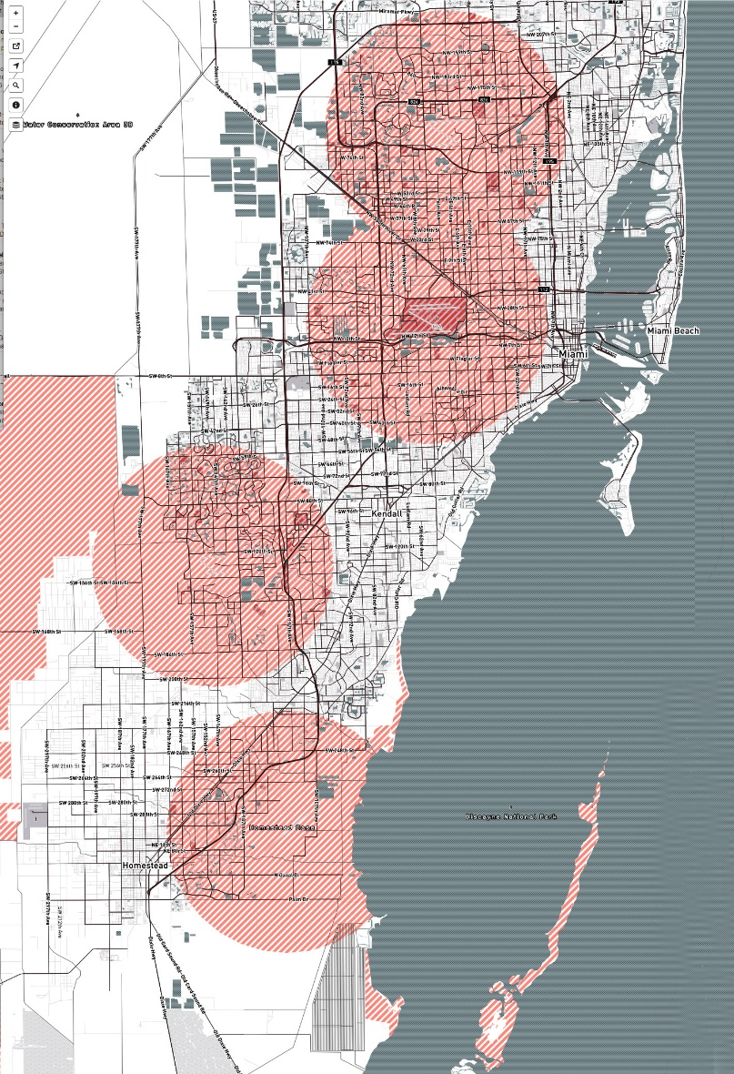
No Fly Zones
The data for no fly zones is take from
openfly.org

