Slide 1
METABOLITES

Slide 2
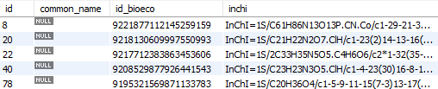
A
B

Slide 3
A
B

Slide 4
PROVIDERS

Slide 5

A
B

Slide 6
PRICES

Slide 7

A
B

Slide 8
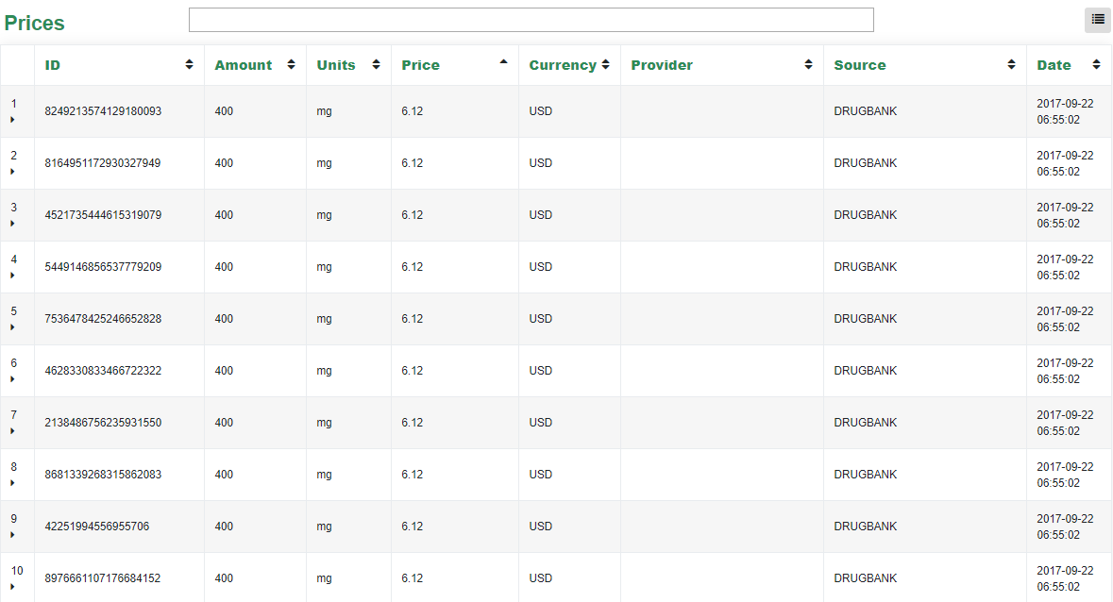

Slide 9
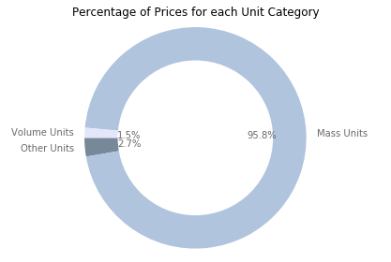
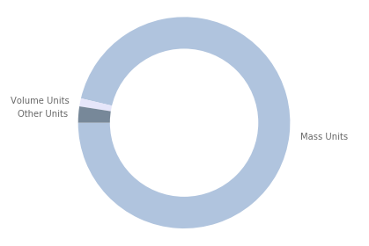
With Only Distinct Prices
With All Prices
1.2%
2.5%
96.3%

Slide 10
Metabolite | Configuration | Provider
M | 20g | P1
M | 20g | P2
M | 40g | P1
M’ | 20g | P1
M’ | 40g | P1
M’ | 40g | P2
- Price
P1
P2
+ Price

Slide 11
CASE STUDIES

Slide 12
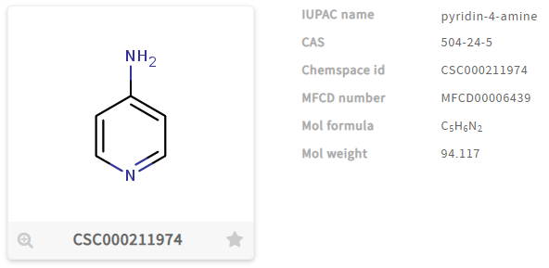
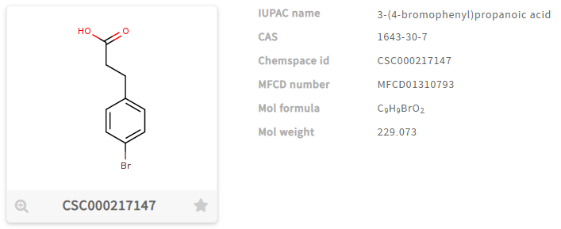
A
B

Slide 13
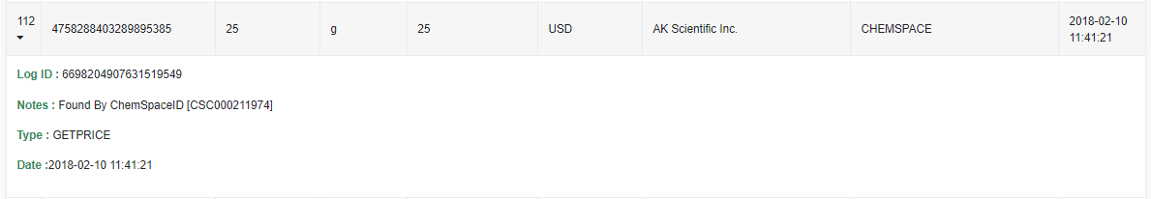
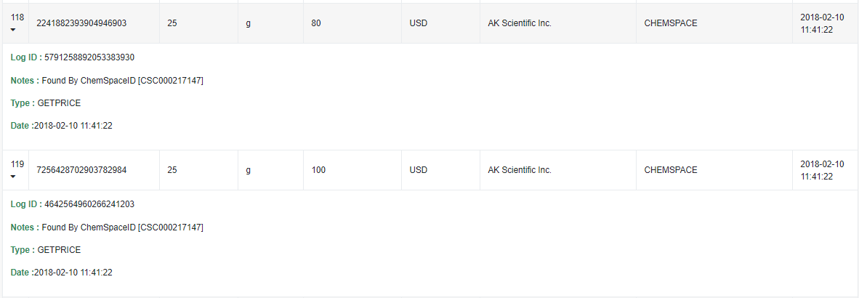
A
B

Slide 14
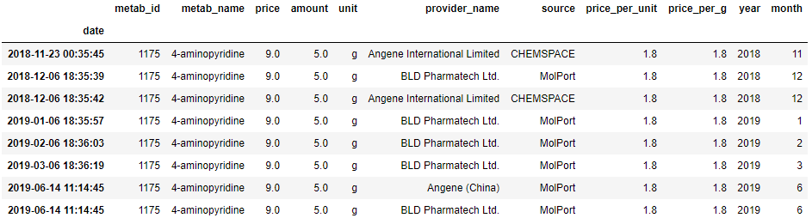
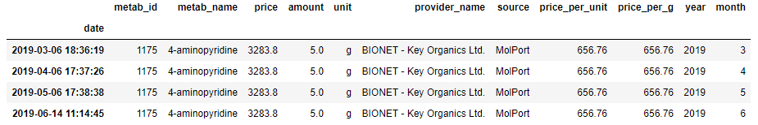
A
B

Slide 15
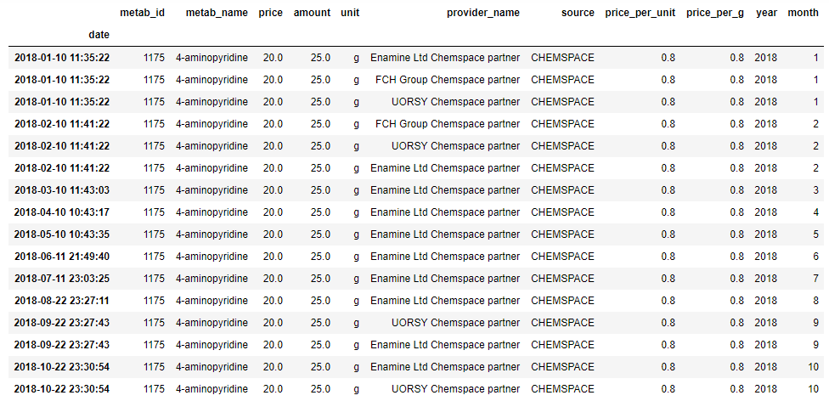
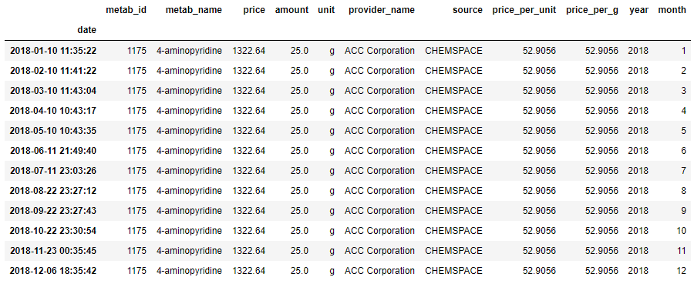
A
B

