Slide 1
METABOLITES

Slide 2
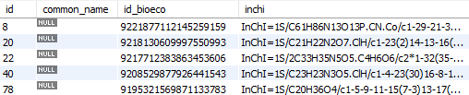
A
B

Slide 3
A
B

Slide 4
PROVIDERS

Slide 5

A
B

Slide 6
PRICES

Slide 7

A
B

Slide 8
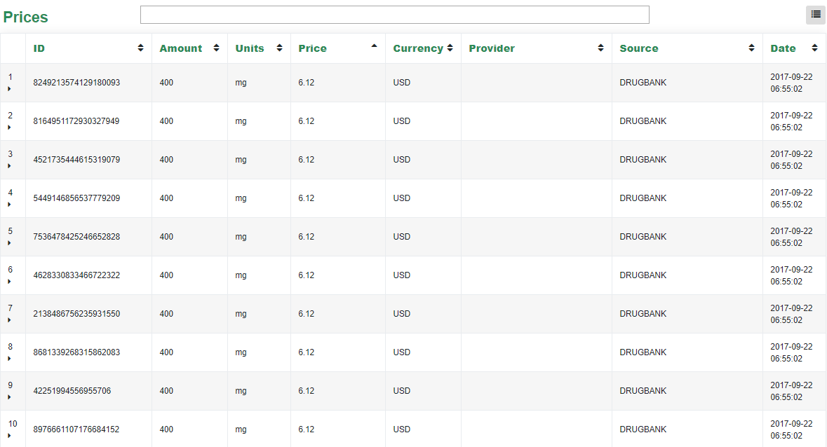

Slide 9
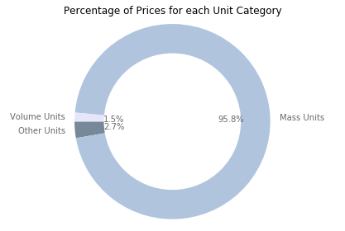
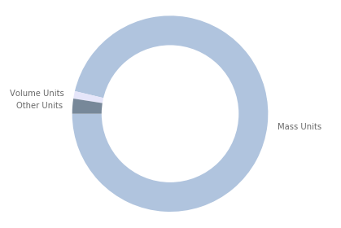
With Only Distinct Prices
With All Prices
1.2%
2.5%
96.3%

