Slide 1

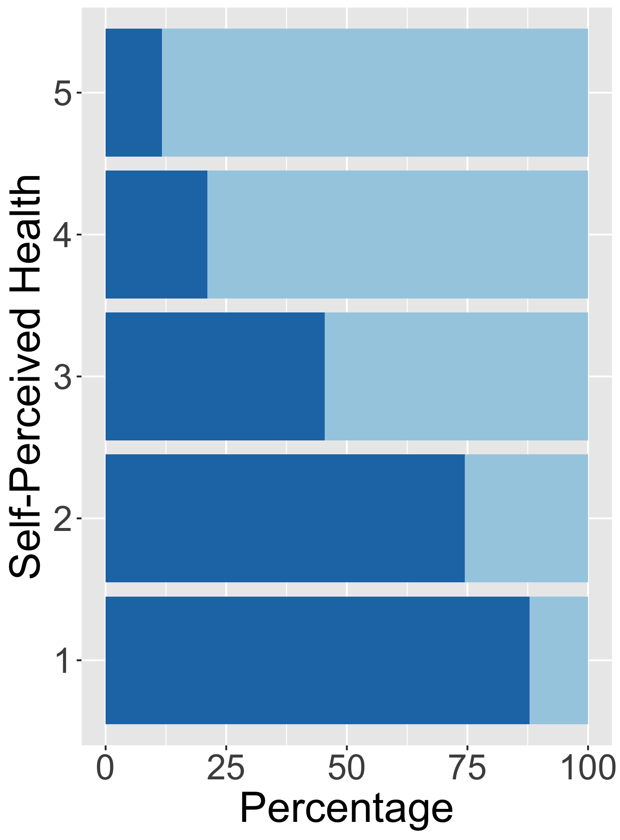
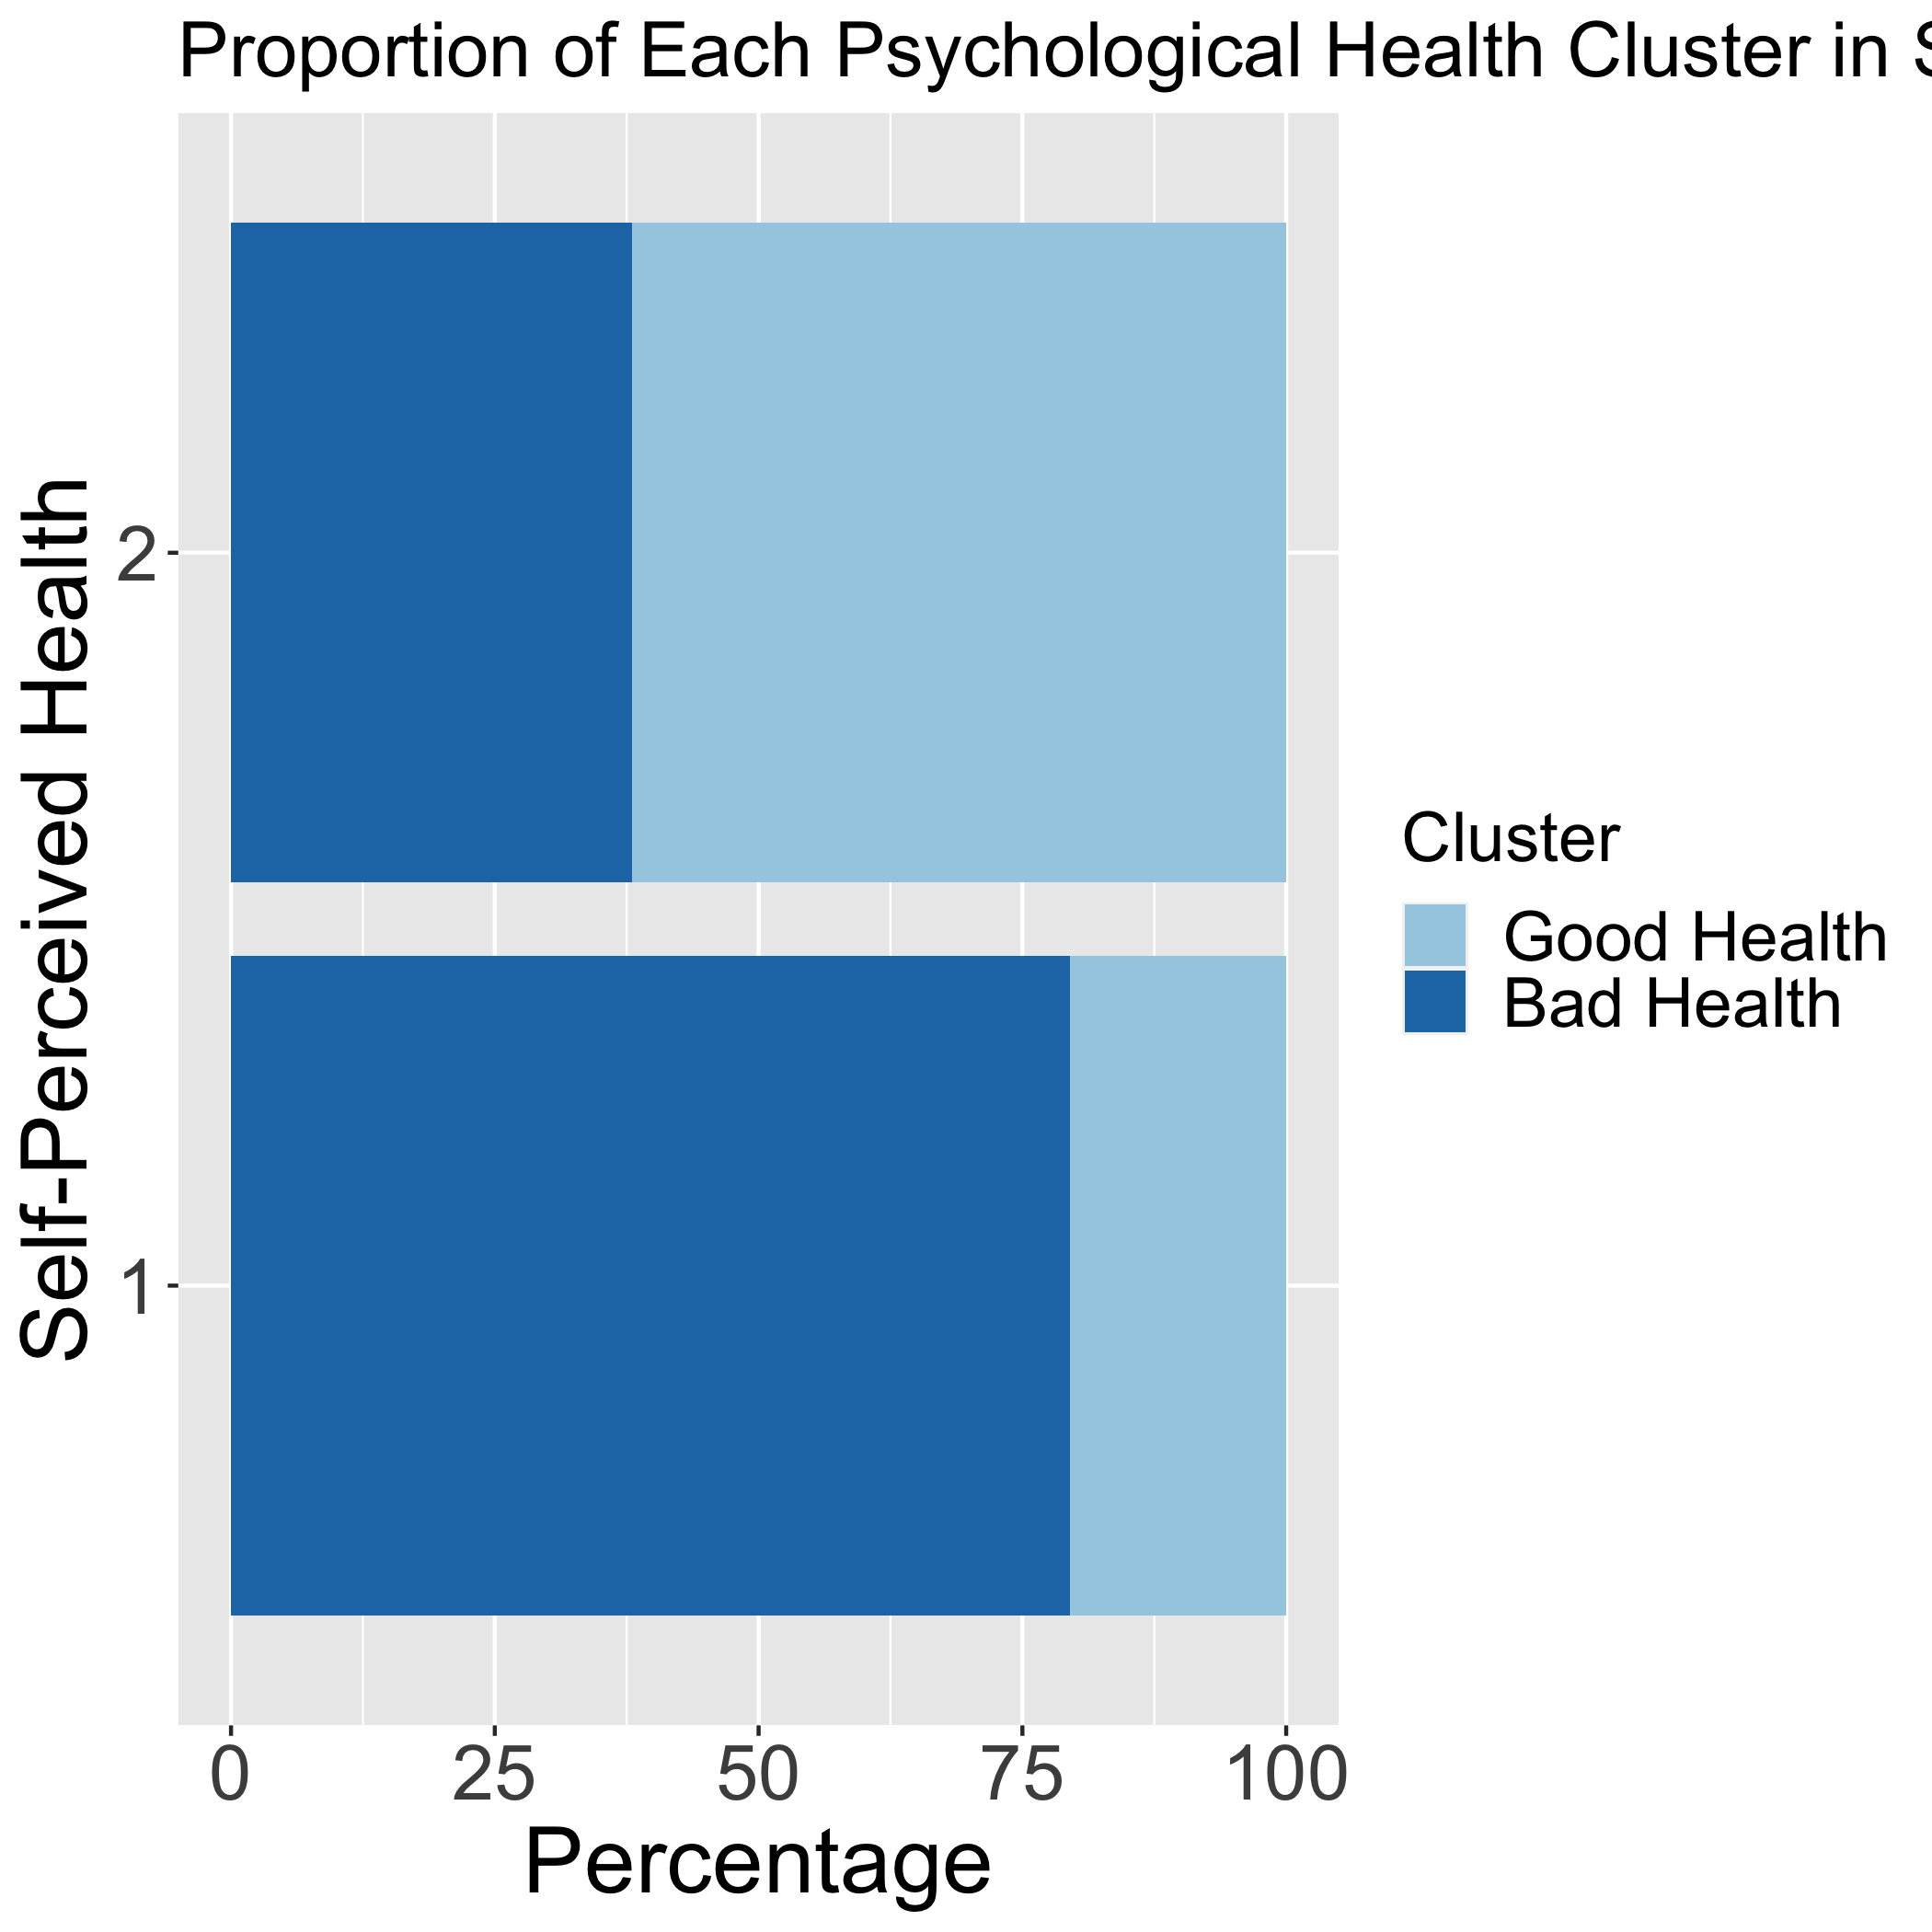
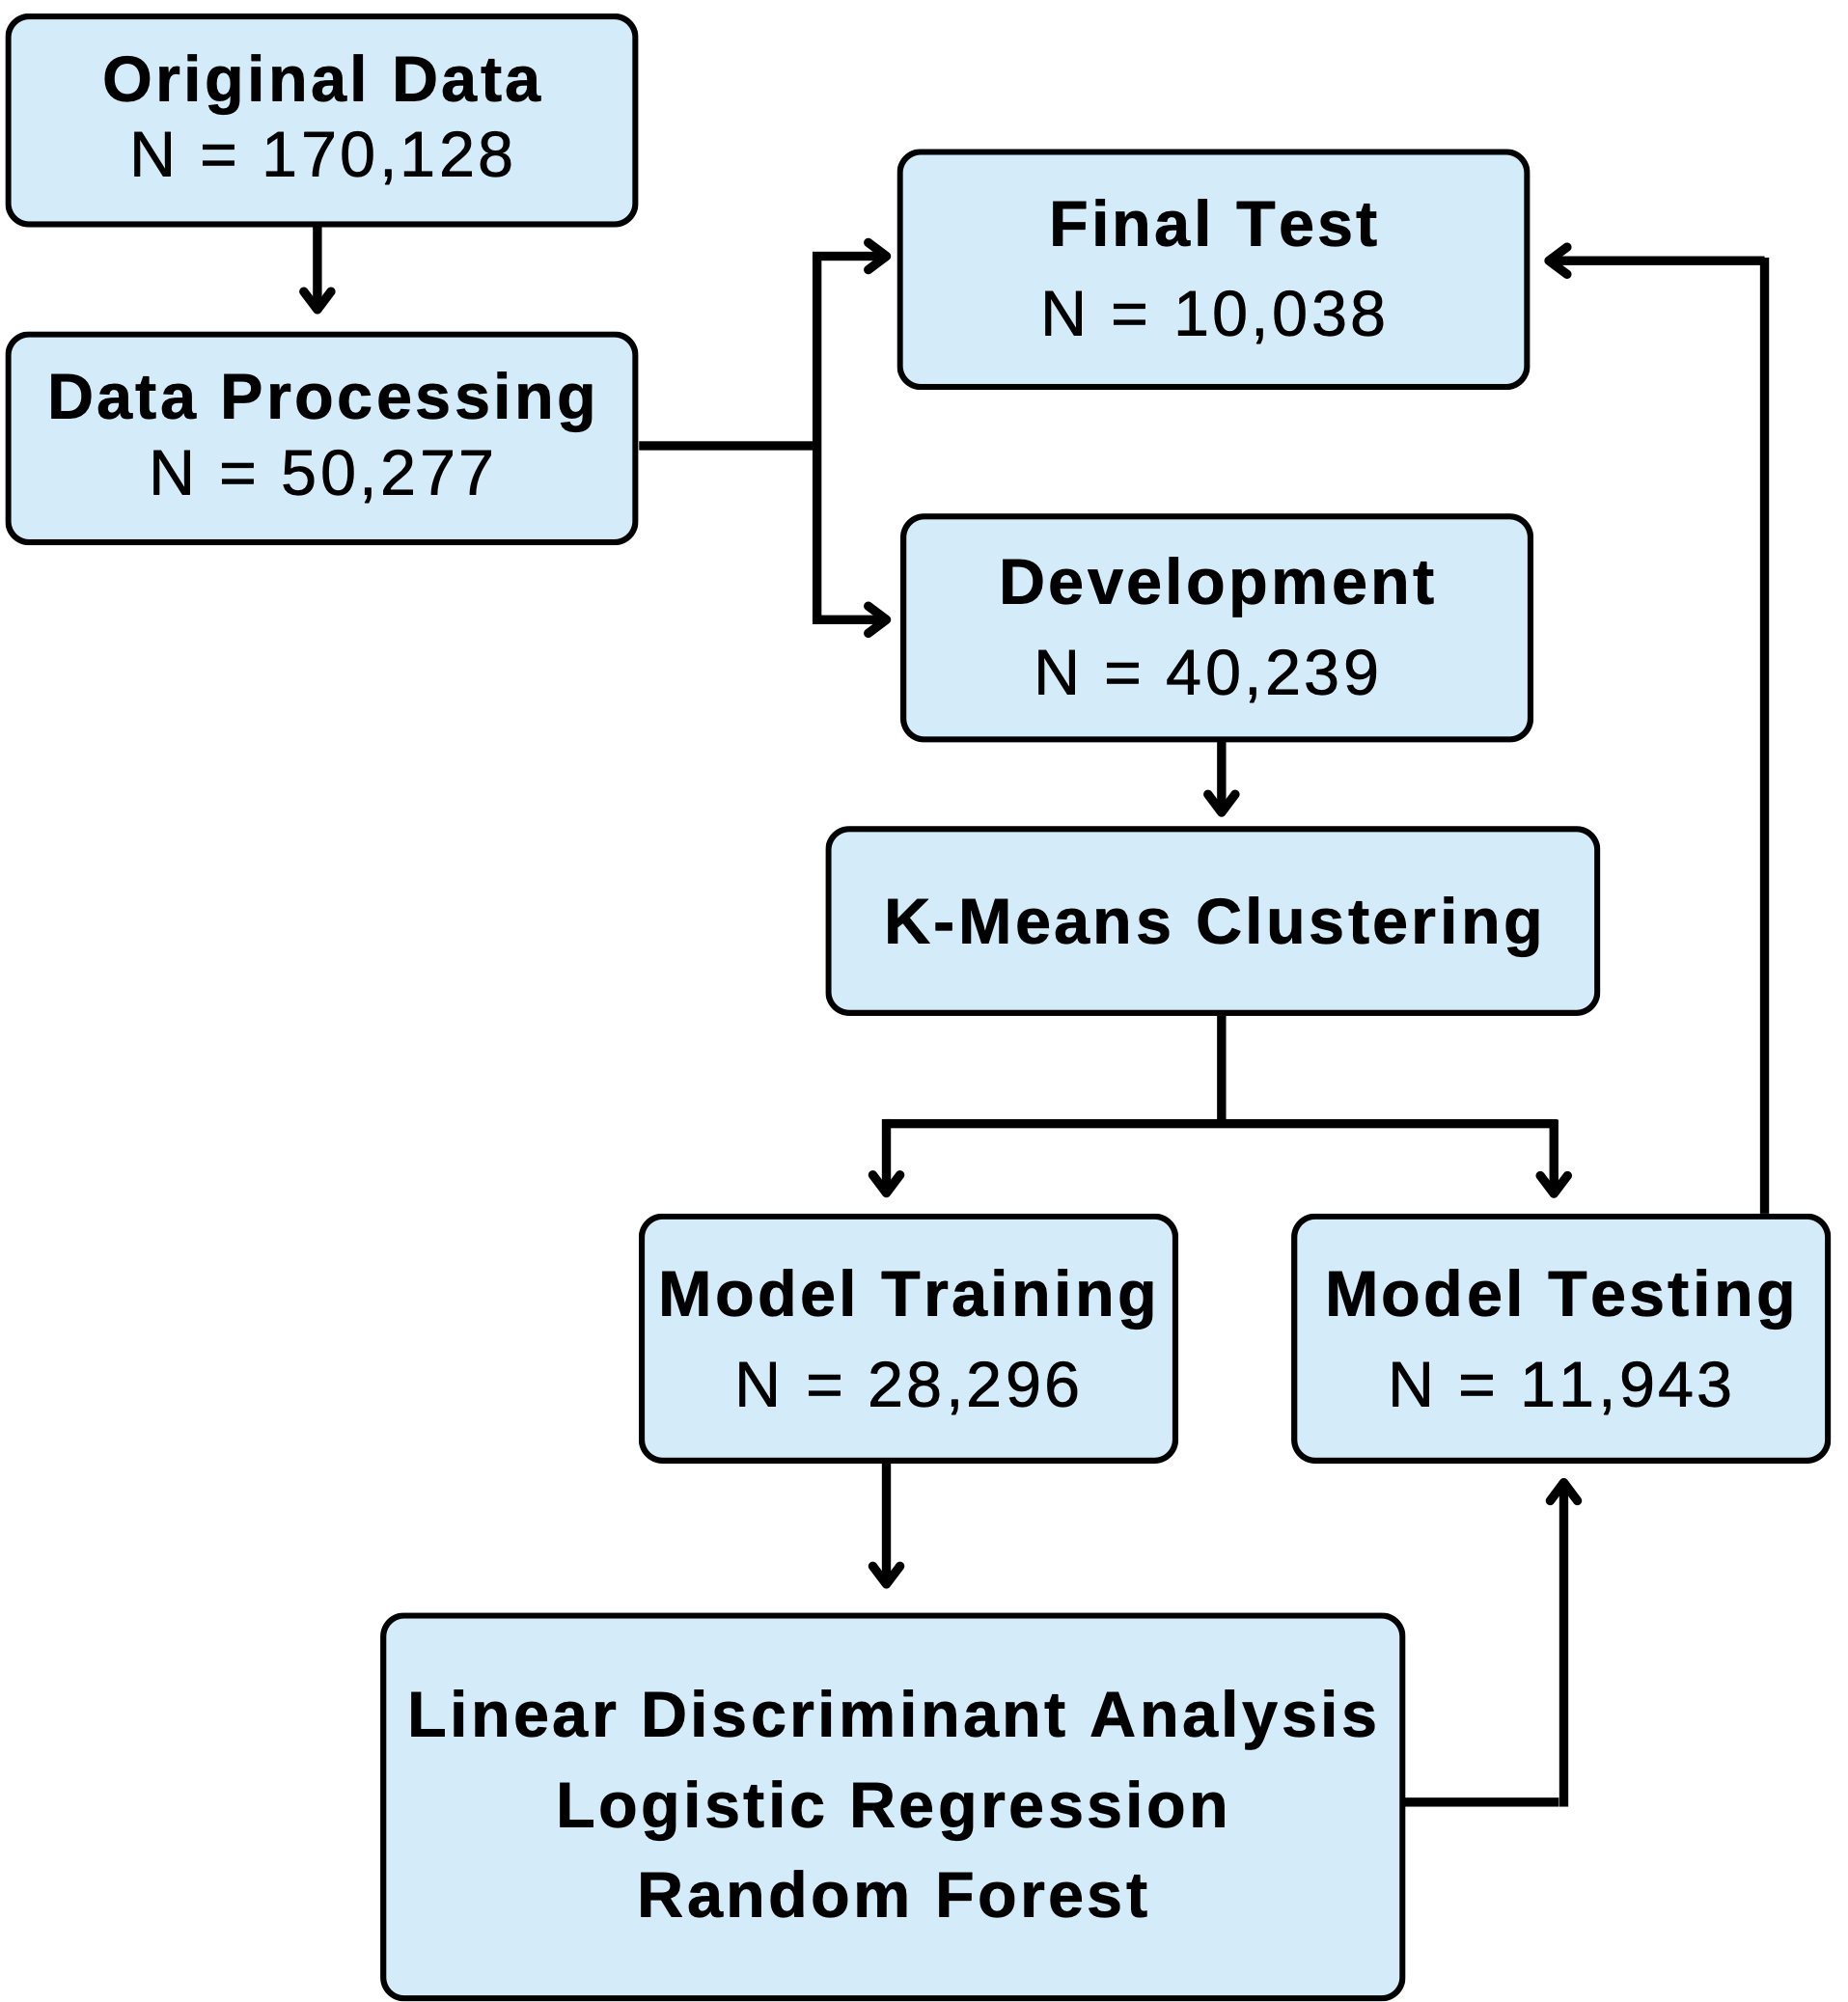
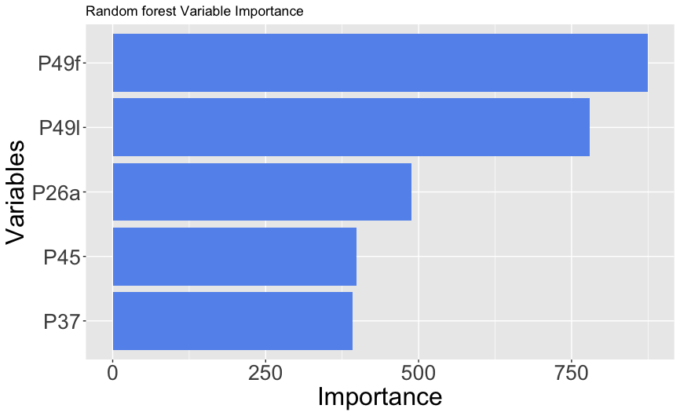
Insights into Adolescent Self Perceived Health: A Machine Learning Approach
Mairead Dillon¹, Shannon Murphy¹, Sofia Pozsonyiova¹, and Jessilyn Dunn, PhD¹
1. Department of Biostatistics and Bioinformatics, Duke University Medical Center
Project Background
Results
Top 5 Predictors:
P49f: I feel confident about the future.
P49l: I feel valued and appreciated by others.
P26a: Community or school offers sports teams
P45: Hours of Sleep
P37: Total minutes of physically activity
Logistic Regression: LR were built using all 126 predictors, 20 of the most important predictors, 5 of the most important predictor variables, and 1 important predictor that were identified in the Random Forest.
LDA: LDA identified 40 predictors that would best classify students into good or fair SPH. Utilizing the algorithms most accurate cutoff LDA produced a ROC curve of 72.2% and an accuracy rate of 75.6%.
1. Introduction
Self-perceived health has been found to be a strong predictor of overall mortality [2]. To date, most self-perceived studies have been conducted in adults. Several studies have been done to predict self-perceived health in young people [1] revealing a high percentage of students reporting having good or excellent health, but none have been conducted in the United States.
These studies have shown that for young people their self-perceived health scores tend to be more based on their behaviors such as exercise and maintaining a healthy diet than the presence of actual illnesses [3].
2. Hypothesis
We hypothesize psychological health and social support will be the most important predictors of self-perceived health (SPH).
1. Unsupervised Learning Approach
K-means Clustering: Fuzzy k-means clustering was used on the full data set for dimensionality reduction. Clustering was then performed separately for each of the five variable groups. The cluster membership probabilities for the three most accurate cluster groups were used as covariates in the predictive models.
Classification Accuracy
Psychological Health – 73% Social Support – 71%
Physical Health – 68% School-Related – 65%
Demographics – 57%
2. Supervised Model Development
Random Forest: RF was run containing all predictors. After averaging the impurity metric, there were 20 predictors that decreased the model impurity the most (most important), with these 5 having the greatest contribution. A RF with 5 predictors: 72.8% accuracy rate,15.1% misclassification rate for SPH = good, and 47.2% misclassification for SPH = Poor.
 | Accuracy | Sensitivity | Specificity
126 Predictors | 76.1% | 59.9% | 85.3%
20 Predictors | 75.0% | 57.9% | 84.8%
5 Predictors | 70.2% | 55.2% | 78.9%
2 Predictors | 71.8% | 46.6% | 86.3%
1 Predictor | 70.2% | 55.2% | 78.9%
Prop. Psychological Health Cluster in Self-Perceived Health Groups
Data
Table 1. Breakdown of LR model results.
The Minnesota Student Survey is one of the longest-running youth surveys in the U.S. and it is administered every three years to middle and high school students (81% participation rate) [4].
Utilizing the 2019 survey
Focusing on 128 variables that were categorized into 5 major categories: physical health, psychological health, school-related variables, social contacts, and socio-demographic
Outcome: How would you describe your health in general?
Accomplishments/Next Steps
Key Accomplishments
Feeling good about the future has a statistically significant impact on SPH.
Creating clusters that are ~80% accurate for extreme values of SPH.
Random forest, LDA, and Logistic regression models were able to classify at a 73% - 80% classification rate with only 20 predictor variables
Next Steps
Test models on new 2022 survey data
Repeat analyses with a balanced data set
Separate analysis into middle and high school students
Methods
Figure 1: Psychological health clustering results by SPH dichotomized (left) and on the five-point scale (right). The plot on the right shows the clustering groups are more accurate for more extreme values of self-perceived health.
Random Forest Variable Importance
References
Fernandes, G., & Lemos, S. (2022). Quality of life and self-perceived health of adolescents in Middle School. CoDAS, 34(6), e20210046. https://doi.org/10.1590/2317-1782/20212021046
Heistaro, S., Jousilahti, P., Lahelma, E., Vartiainen, E., & Puska, P. (2001). Self rated health and mortality: a long term prospective study in eastern Finland. Journal of epidemiology and community health, 55(4), 227–232. https://doi.org/10.1136/jech.55.4.227
Krause, N. M., & Jay, G. M. (1994). What Do Global Self-Rated Health Items Measure? Medical Care, 32 (9), 930-942.
Minnesota Student Survey. https://education.mn.gov/MDE/dse/health/mss/mde059027.
Figure 2: Variable importance according to mean decrease in Gini Index.
Notes:
2020 Posters and Presentations: Data+ (2020) | Duke Bass Connections
Poster Design Guidance
Keep the design simple, with plenty of blank space for breathing room
Use graphics and photos whenever possible to illustrate your points, and keep text to a minimum
Use headings to break up the sections of your poster (recommended font size for headings is 48, bold)
Aim for a font size of 36 to 40 for main text
Use graphics that are at least 300 dpi or vector-based so that they do not become distorted when enlarged
Try to avoid too much information, small fonts, confusing graphics that are unlabeled or have hard-to-read labels, too many different colors or fonts, big blocks of text
Many posters typically include sections on Introduction, Methods and Data, Results, Conclusion, Next Steps, but these are not required; your poster should reflect your unique project team (for example, an infographic may be more appropriate)
Check at 400% before finalizing; everything should look crisp and clear
Print it out on a regular 8.5x11 sheet of paper and hold it at arm’s length to make sure it’s readable at that distance
Save your poster as a PDF

Slide 2


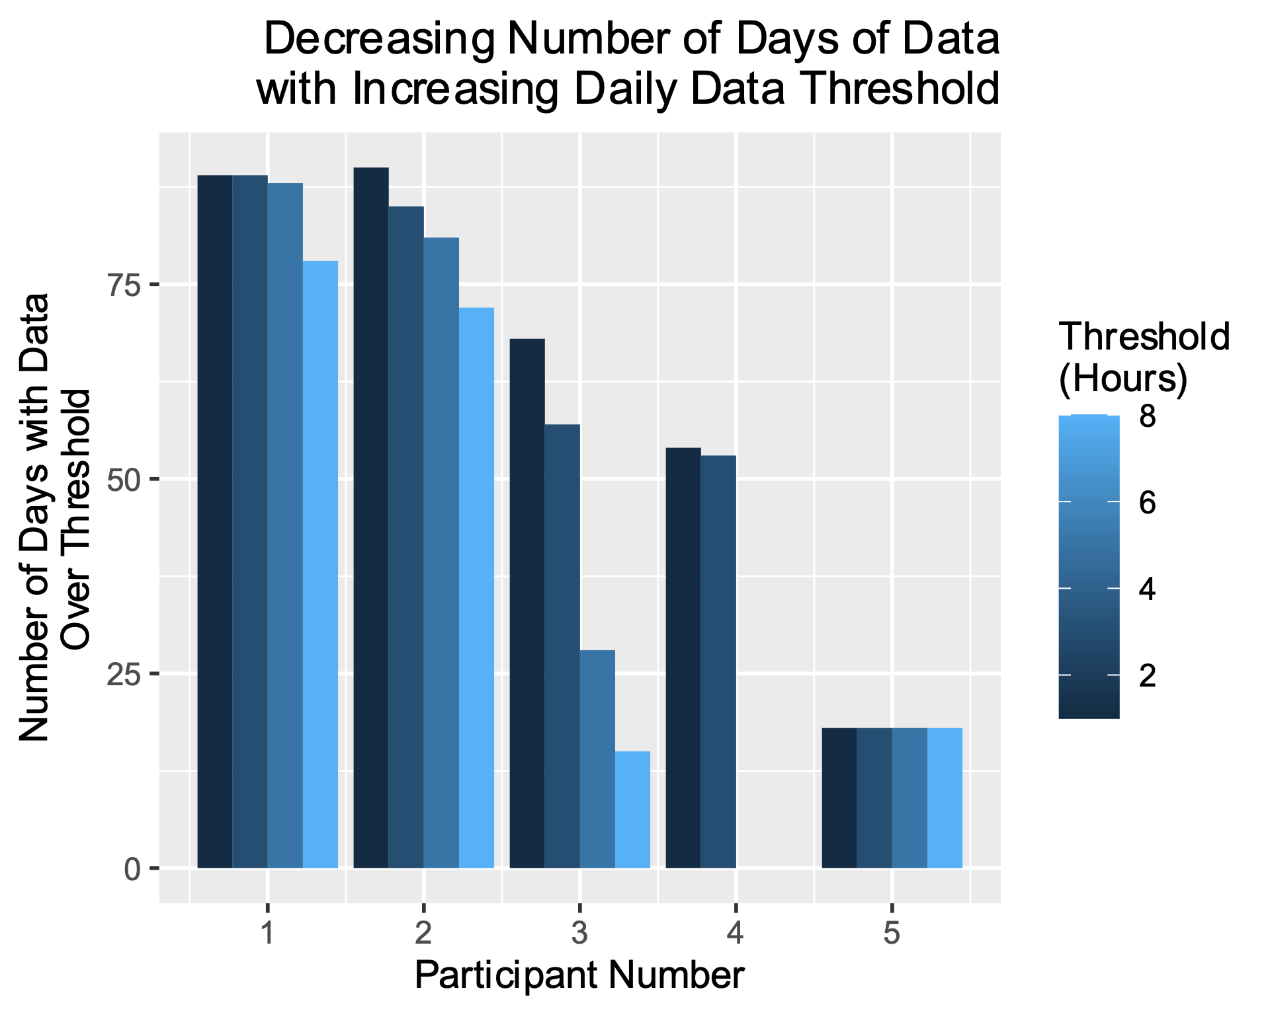


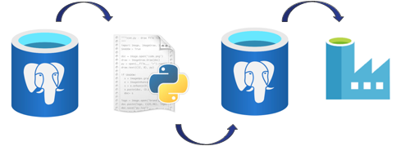
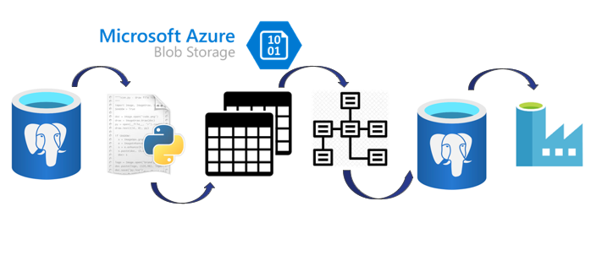
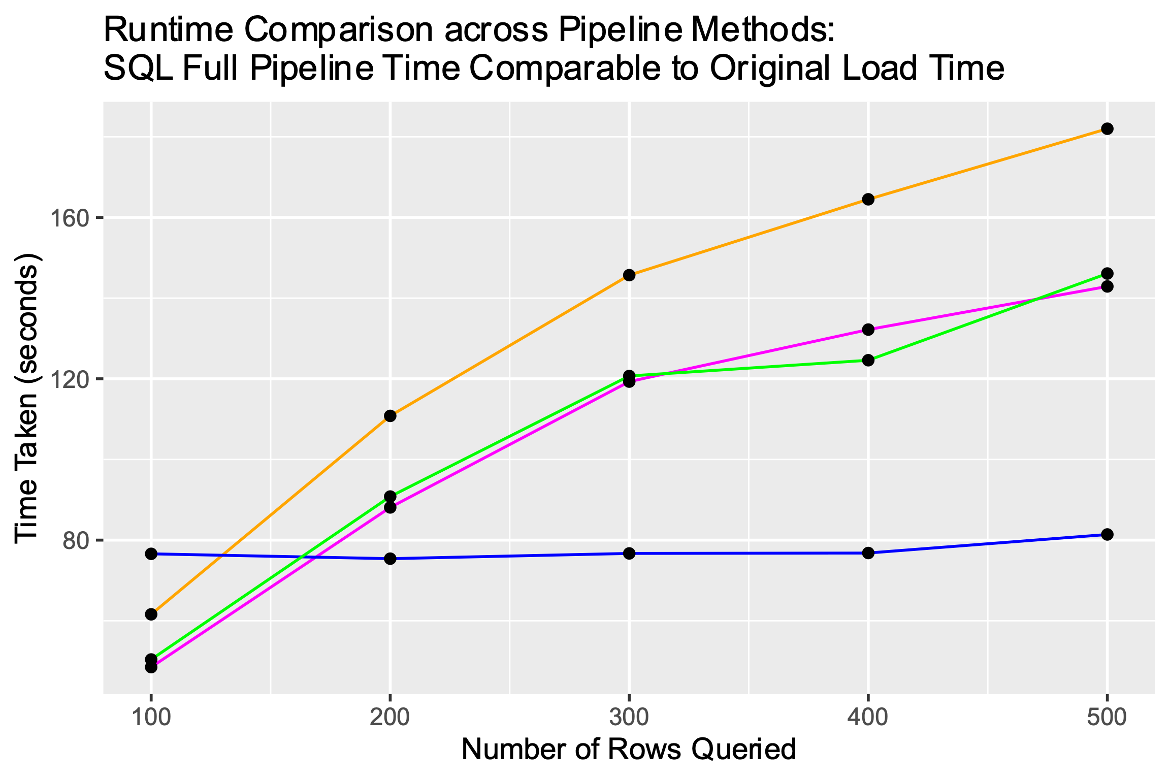
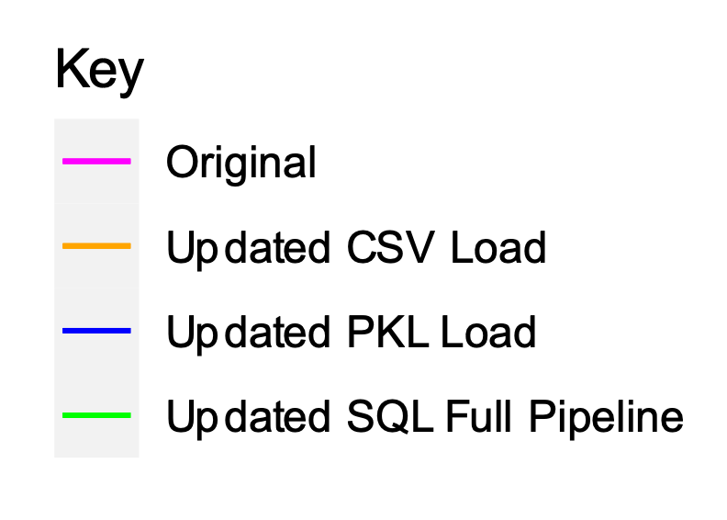


Project 10: CovIdentify Sean Fiscus, Alyssa Shi, Yamil Lopez-Ruiz, Emmanuel Mokel Duke University BIG IDEAS LAB
Project Background
Results
4. User Adherence Analysis
Problem: CovIdentify's smartwatch data currently unassessed in terms of users’ daily and inter-day adherence to recording data and is thus incomparable to other studies.
Solution: Created SQL scripts to subset data by users’ adherence to devices. Can now set and monitor thresholds for minimum recording adherence for daily and inter-day timespans. ​
CovIdentify is an ongoing study at Duke University focusing on using data from wearables to predict and diagnose COVID-19 and the Flu. Studies have shown that biomarkers like heart rate and steps coming from wearable devices such as Fitbit, Garmin, and Apple watches can indicate signs of COVID-19 several days earlier than symptoms arise.^{1,2} This project builds on work previously done by the students in the Masters in Interdisciplinary Data Science (MIDS) program, and the BIG IDEAS LAB led by Dr. Jessilyn Dunn.
1. Memory Efficiency Improvements
Problem: After data was read into python from the initial SQL database, it was appended to a quickly-growing Pandas dataframe at two different locations in the pipeline. Using Azure Cloud Services, the team needed to find a way to avoid this large RAM storage.
Solution: Implemented batch-pulling method to pull from the database; added a row-by-row normalization and exportation to csv process.
2. Pipeline Speed and Simplification
Problem: Multi-step pipeline with redundant data transfers and stores; data upload speeds now slower with new implementation for improving memory efficiency
Solution: Tested use of pickle files as potentially faster data storage method; created Python scripts to write directly to new SQL database after normalization, cutting out need for csv/pickle.
3. Data Type Expansion
Problem: Data types from users absent from final database
Solution: Added pipeline capability to normalize minute-by-minute Fitbit resting heart rate, steps, and sleep data recorded after user sign-up
Objectives
1. Improving memory usage of existing pipeline
2. Adapting pipeline to incorporate efficient methods for data storage, remove redundant steps.
3. Implementing all data sources for preprocessing
4. Assessing smart watch user adherence to data collection in data
For four thresholds (2, 4, 6, and 8 hours), the number of days with data collected for longer than threshold is calculated for five selected participants.
Simplified pipeline: initial database to python script to final database (removes intermediate Blob Storage step)
Accomplishments/Next Steps
Key Accomplishments
Reduced memory usage of the ETL pipeline
Expanded type and resolution of data in storage
Created a foundation for future wearable data processing
Next Steps
Integrating iOS data
Continue analyzing and applying machine learning algorithms to data
Methods/Applications
Azure Machine Learning
A cloud-based service with virtual computers
Where data was extracted, transformed, then loaded (ETL) to storage
Azure Data Studio
Houses SQL databases where data is stored both before and after processing
References
Comparison of time taken for query, normalization, and writing to data storage type in original pipeline, modified csv upload and pickle upload with time taken for query, normalization, and writing to database in simplified pipeline.
Mishra, Tejaswini, Meng Wang, Ahmed A. Metwally, Gireesh K. Bogu, Andrew W. Brooks, Amir Bahmani, Arash Alavi, et al. “Early Detection Of COVID-19 Using A Smartwatch.” MedRxiv, July 7, 2020, 2020.07.06.20147512. https://doi.org/10.1101/2020.07.06.20147512.
Natarajan, Aravind, Hao-Wei Su, and Conor Heneghan. “Assessment of Physiological Signs Associated with COVID-19 Measured Using Wearable Devices.” Npj Digital Medicine 3, no. 1 (November 30, 2020): 1–8. https://doi.org/10.1038/s41746-020-00363-7.
Notes:
2020 Posters and Presentations: Data+ (2020) | Duke Bass Connections
Poster Design Guidance
Keep the design simple, with plenty of blank space for breathing room
Use graphics and photos whenever possible to illustrate your points, and keep text to a minimum
Use headings to break up the sections of your poster (recommended font size for headings is 48, bold)
Aim for a font size of 36 to 40 for main text
Use graphics that are at least 300 dpi or vector-based so that they do not become distorted when enlarged
Try to avoid too much information, small fonts, confusing graphics that are unlabeled or have hard-to-read labels, too many different colors or fonts, big blocks of text
Many posters typically include sections on Introduction, Methods and Data, Results, Conclusion, Next Steps, but these are not required; your poster should reflect your unique project team (for example, an infographic may be more appropriate)
Check at 400% before finalizing; everything should look crisp and clear
Print it out on a regular 8.5x11 sheet of paper and hold it at arm’s length to make sure it’s readable at that distance
Save your poster as a PDF

