Slide 1

MAJOR PROJECT SEMINAR
ON
WEB APPLICATION FOR RAMMOHAN CHILDREN'S HOSPITAL
BATCH-7(B)
By
Sofia Tarannum 19281A0590
U. Madhumitha 19281A0598
S. Satwika 19281A0578
Sardar Hansraj Singh 19281A05B5
Under the guidance of
Neelakant Deshpande
Assistant Professor, cse

Slide 2
Index
Abstract
Introduction
Existing System
Proposed System
Software and Hardware Requirements
Design
Tables in Database
Implementation
Testing
Results
Conclusion and Future Scope

Slide 3
Abstract
The main aim of this project is to create an online portal for a hospital that offers its services exclusively to infants, children, adolescents and young adults.
The website helps the user to book an appointment for check-up, vaccine, go for reappointment, revaccination, donate blood and apply for a job.
On the other hand the admin will provide all the information related to vaccines available, required job applicants and can fetch the data like in-patient, out-patient details etc.
In this website, in order to provide security the admin is given login credentials.

Slide 4
Introduction
The online portal for the hospital helps the user to book an appointment for check-up, vaccine, go for reappointment, revaccination, donate blood and apply for job.
The admin provides the information about available vaccines and required jobs.
The admin will be able to generate the online reports, bills and send them to the respective users. The user will receive the online generated reports and bills through email.
The admin will be able to fetch the data like number of appointments fixed, total number of in-patients and out-patients, hospital earnings, patient details etc.

Slide 5
Existing System
In the present system there is no online portal which provides appointment for check-up and vaccine, blood donation form and information about vaccines at the same place.
The fetching of data like in-patient and out-patient details, number of patients admitted was not that easy.
The generation of online reports, bills and sending them to patients was also missing.
The existing system did not contain the job opportunities available for the hospital.

Slide 6
Proposed system
To overcome all these problems, the proposed system provides services such as
Online booking for an appointment
Booking a vaccine
Booking to donate blood
Apply for job
The user will also get the online generated reports, bills through email.
The admin will provide the information about the vaccines, required jobs and fetch the details of in-patients, outpatients easily.

Slide 7
Software and Hardware Requirements
Software requirements:
Operating system – Intel Dual Core
Technology – HTML, CSS, JavaScript, Bootstrap, Python, Django framework
Database – MySQL
Web Server- XAMPP server
Hardware Requirements:
Processor needed – i5 or above
Hard Disk – 320GB or High
RAM – 4GB or High

Slide 8
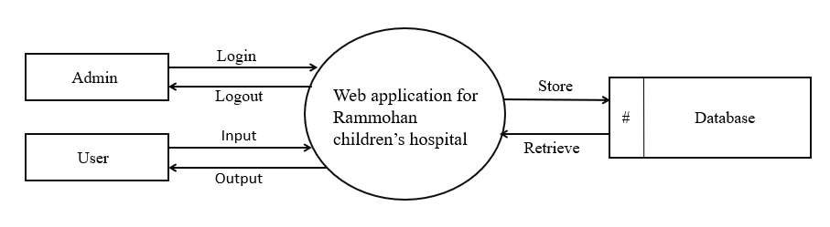
Design
Data Flow diagram

Slide 9
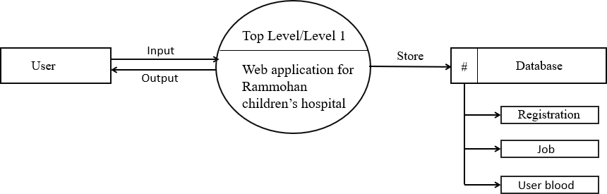
First level Data Flow Diagram for User

Slide 10
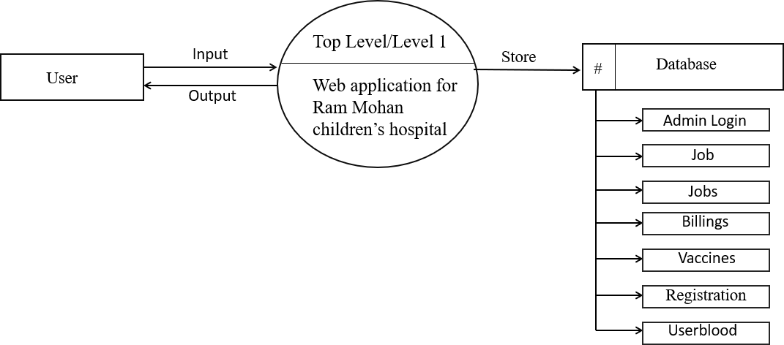
First level Data Flow Diagram for Admin

Slide 11
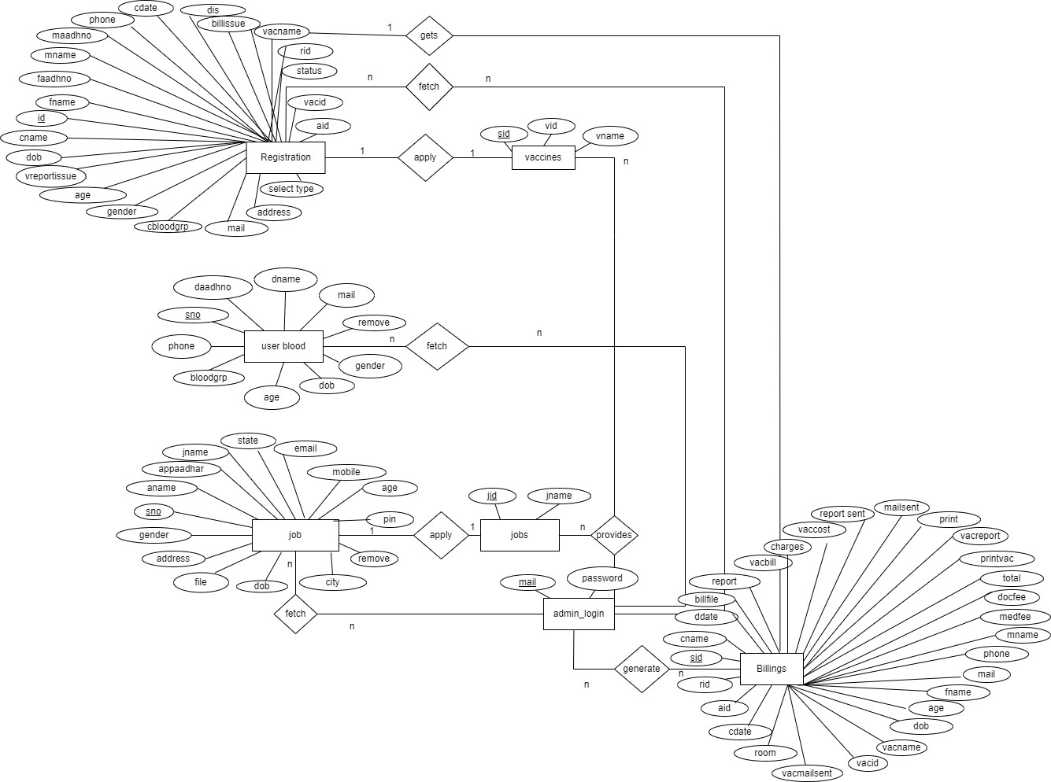
ER Diagram

Slide 12
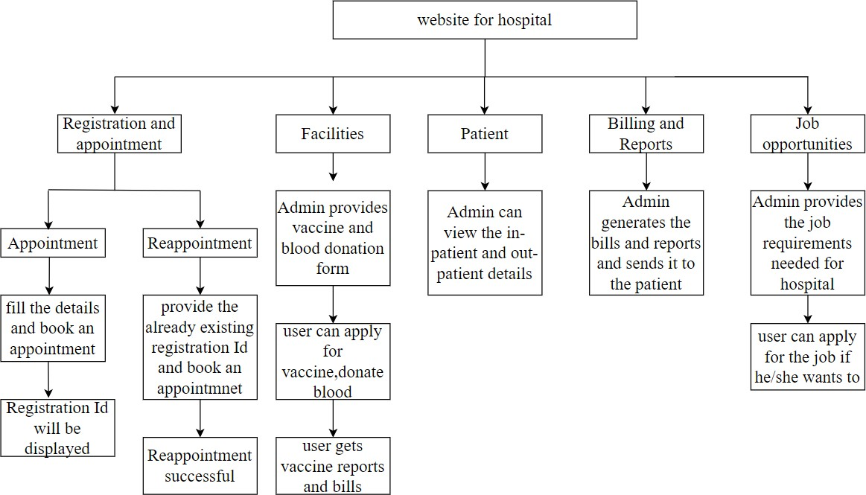
Block Diagram

Slide 13
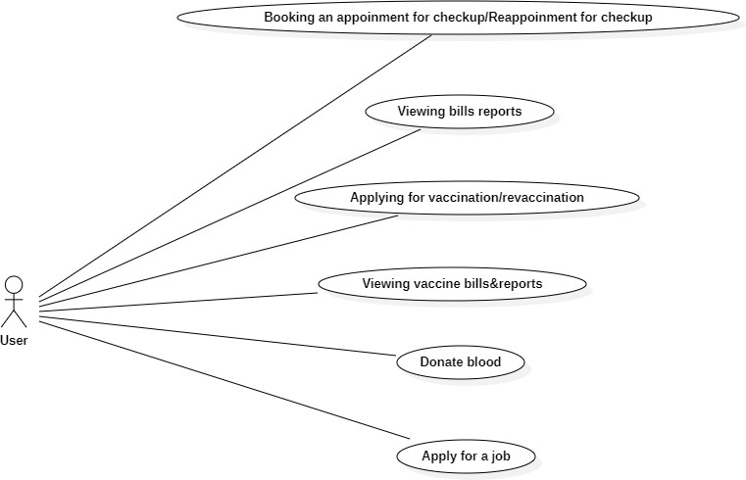
UML Diagrams
Use Case Diagram for User

Slide 14
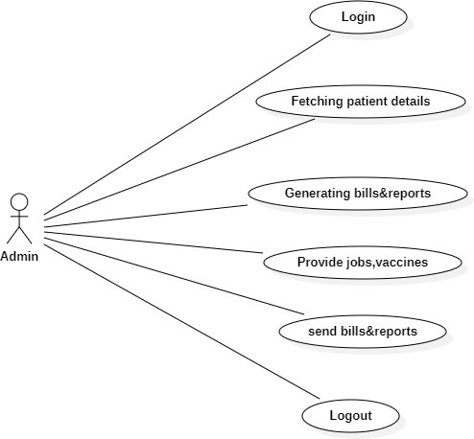
Use Case Diagram for Admin

Slide 15
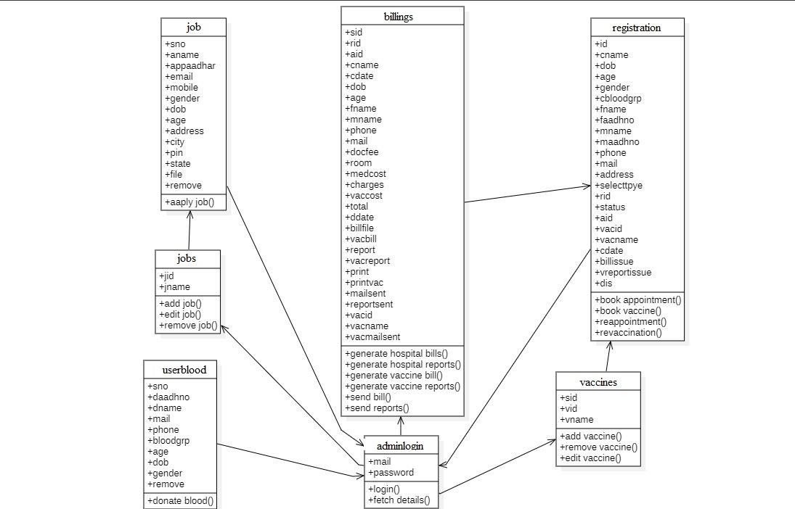
Class Diagram

Slide 16
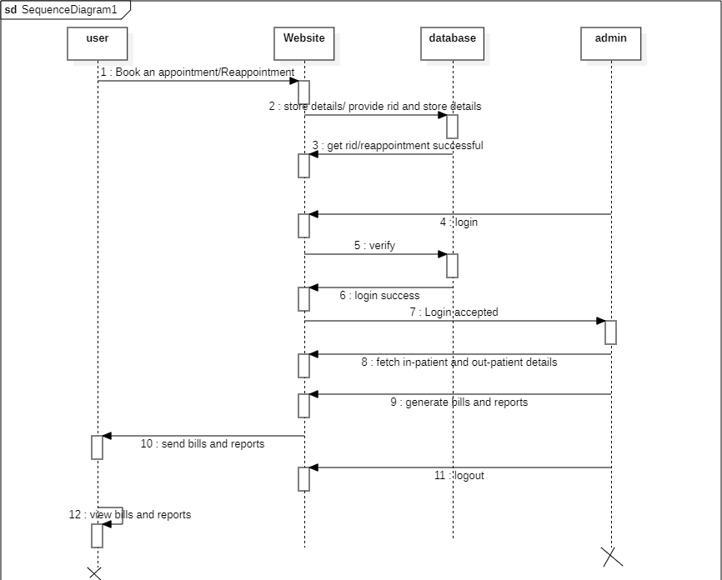
Sequence Diagram for Appointment

Slide 17
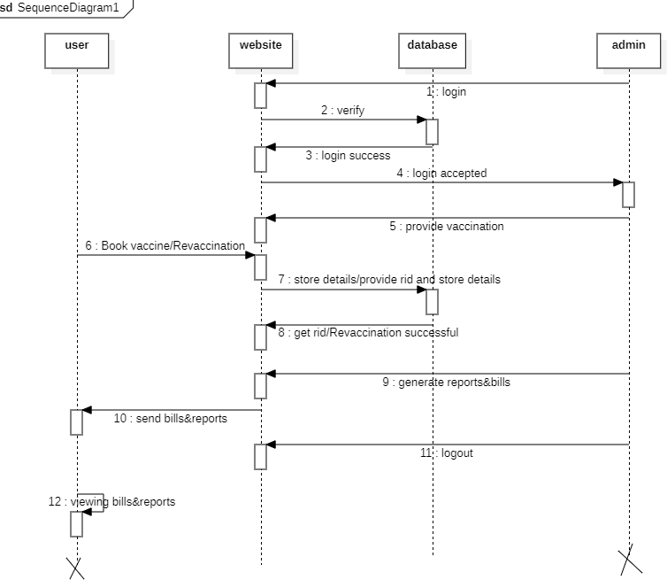
Sequence Diagram for Vaccine

Slide 18
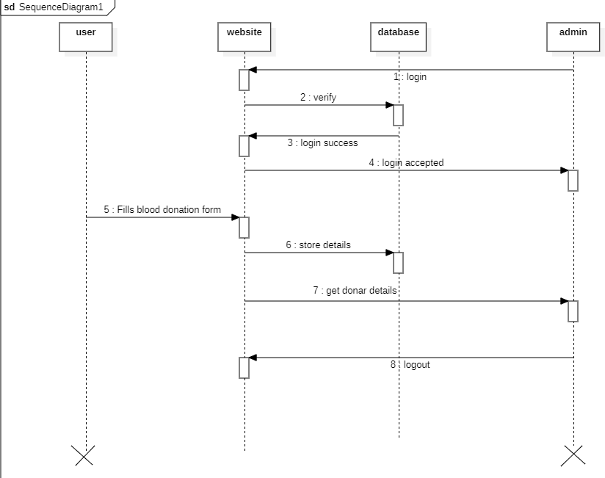
Sequence Diagram for Blood Donation

Slide 19
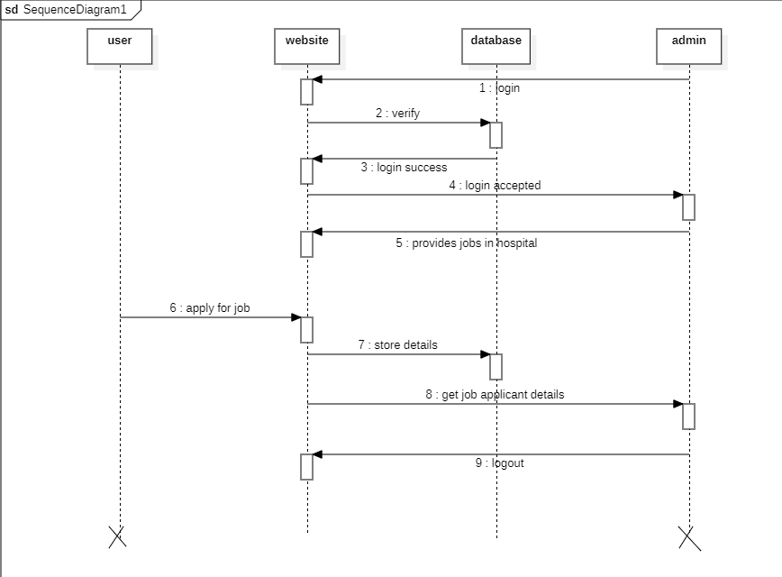
Sequence Diagram for job

Slide 20
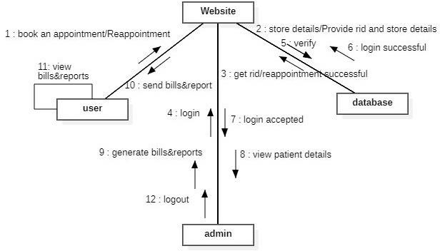
Collaboration Diagram for Appointment

Slide 21
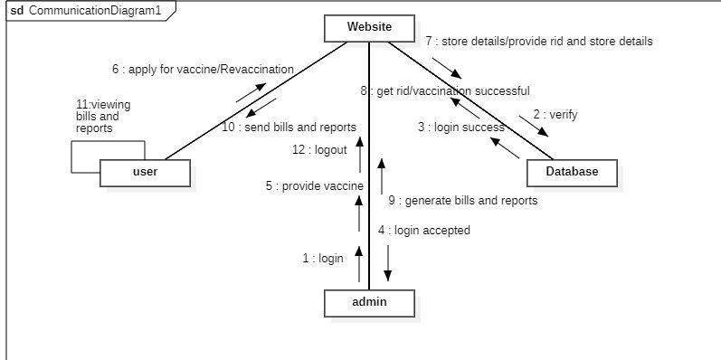
Collaboration Diagram for Vaccine

Slide 22
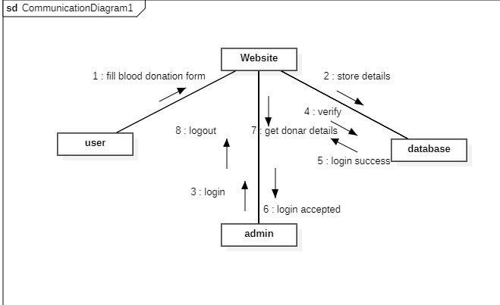
Collaboration Diagram for Blood Donation

Slide 23
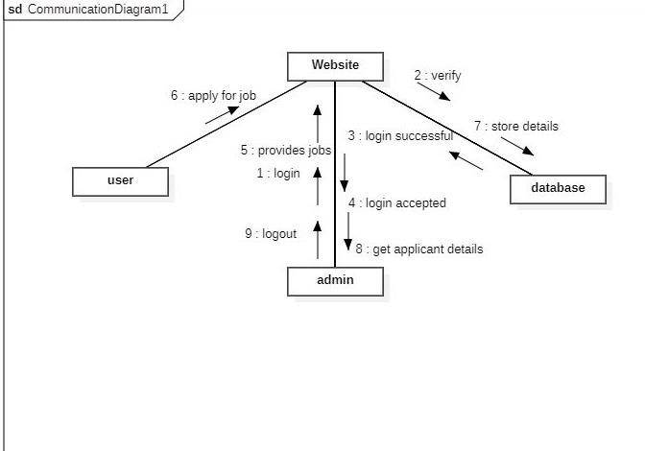
Collaboration Diagram for job

Slide 24
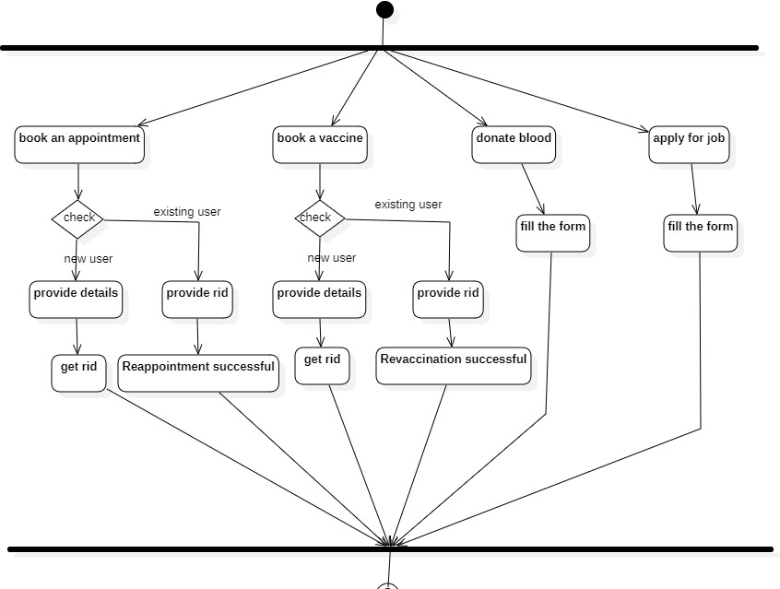
Activity Diagram for User

Slide 25
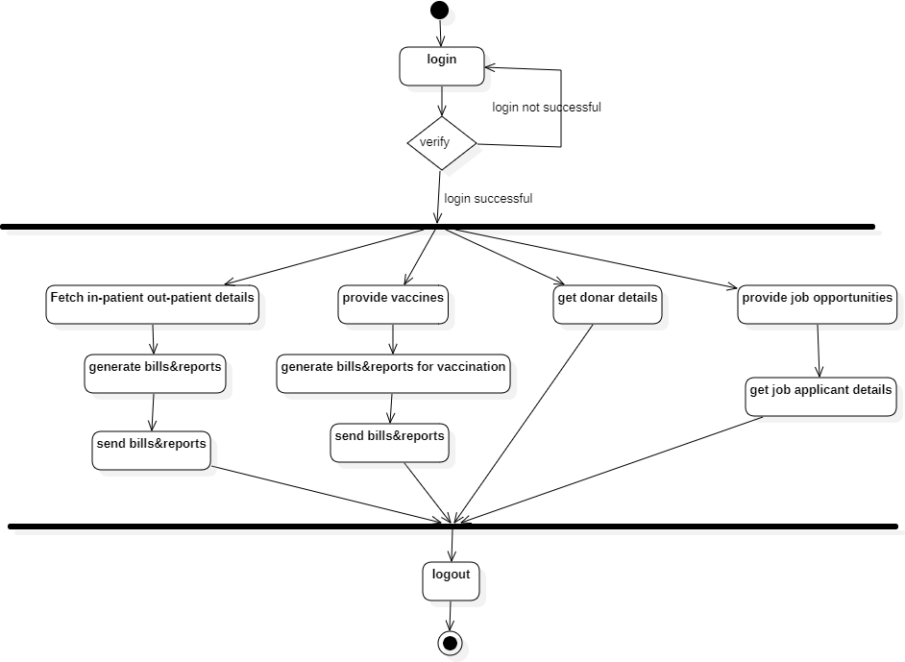
Activity Diagram for Admin

Slide 26
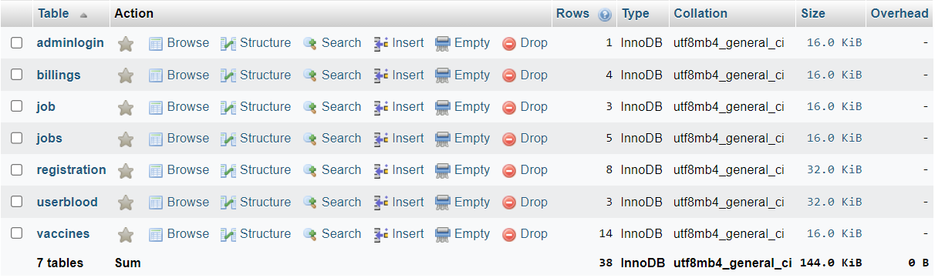
Tables in Database
hospital database

Slide 27
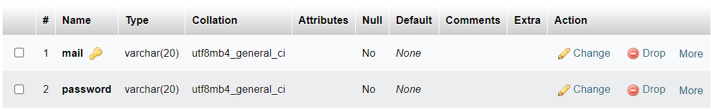
adminlogin table

Slide 28
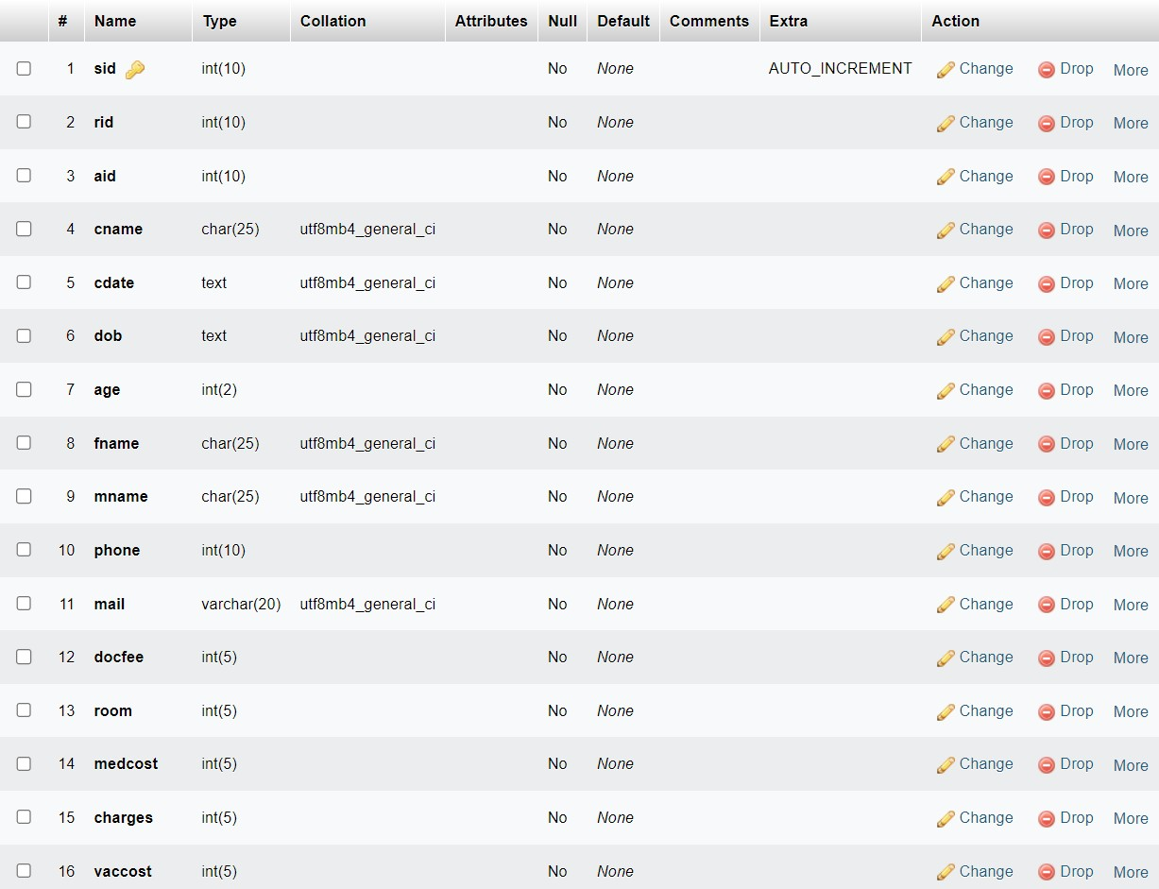
billings table

Slide 29
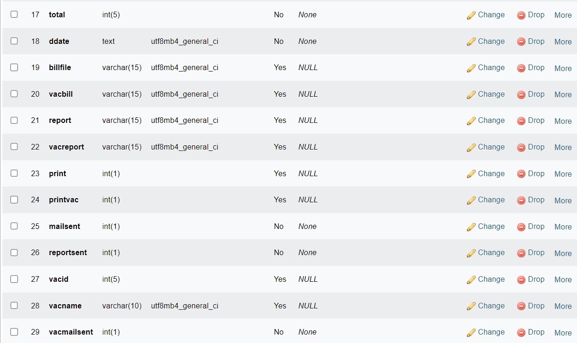

Slide 30
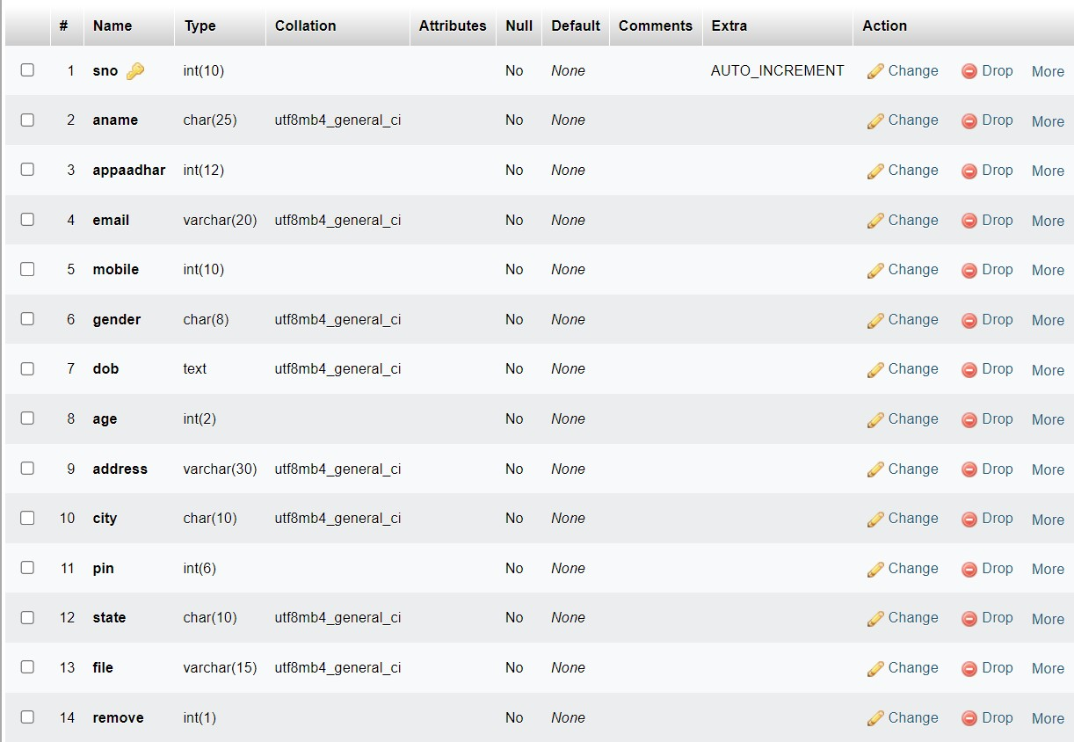
job table

Slide 31
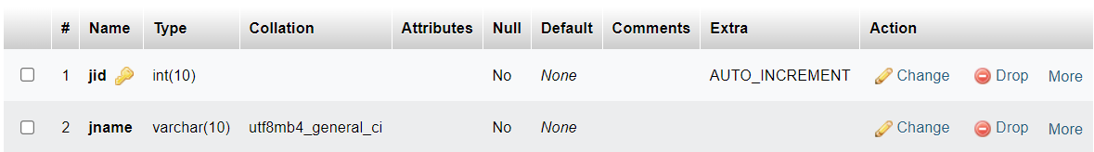
jobs table

Slide 32
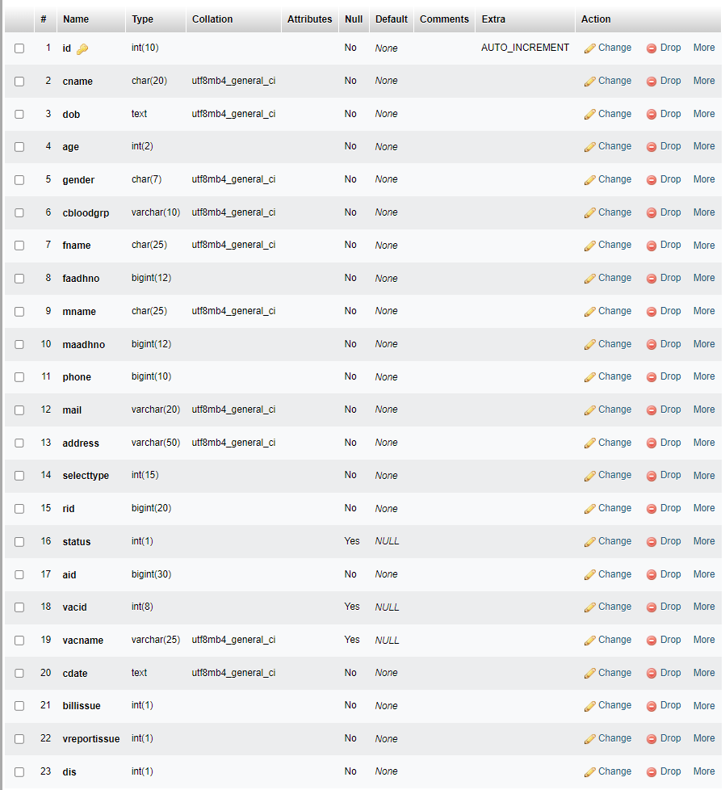
registration table

Slide 33
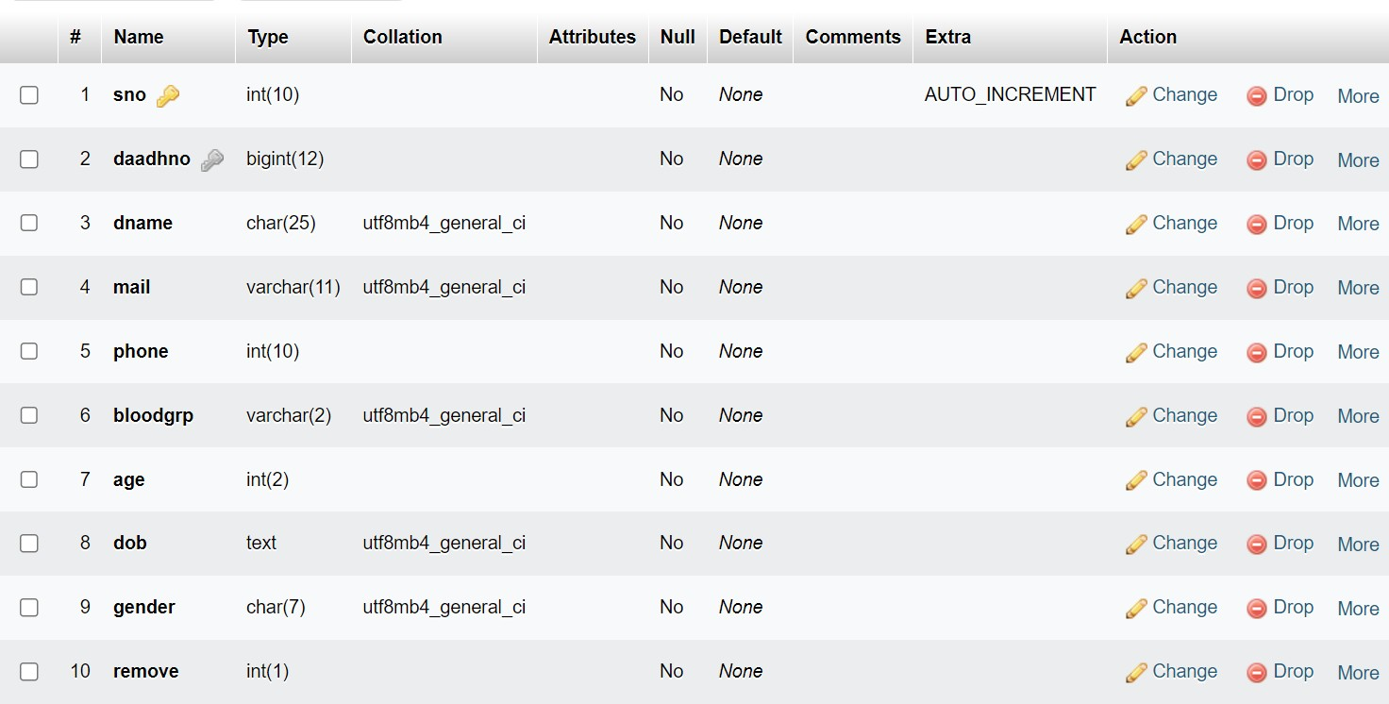
userblood table

Slide 34
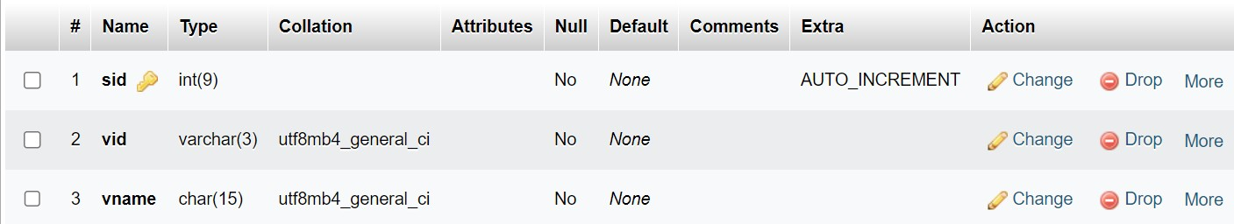
vaccines table

Slide 35
Implementation
Technologies Used :
Python
Django Framework
HTML
CSS
JAVASCRIPT
MYSQL
BOOTSTRAP

Slide 36
Testing
Black Box Testing :
Black Box Testing is testing technique having no knowledge of the internal functionality of the system.
All field entries and it checks the pages that must be activated from the identified link.
It looks after that no duplicate entries should be allowed.
White Box Testing:
White Box Testing is an approach that allows testers to inspect and verify the inner working loops.
In this testing, all loops at their boundaries and within their operational bounds are executed.

Slide 37

Results
Home Page - This is our home page. It includes Make an Appointment, Donate blood, Apply for a job.

Slide 38
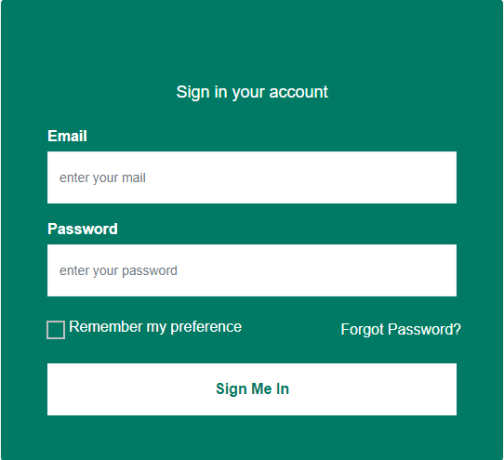
Screenshot of Admin’s login page

Slide 39
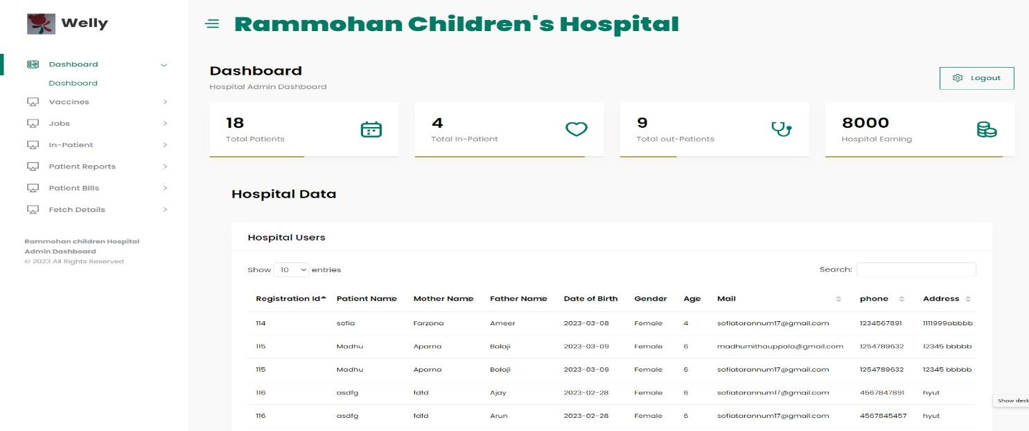
Screenshot of Admin Dashboard

Slide 40
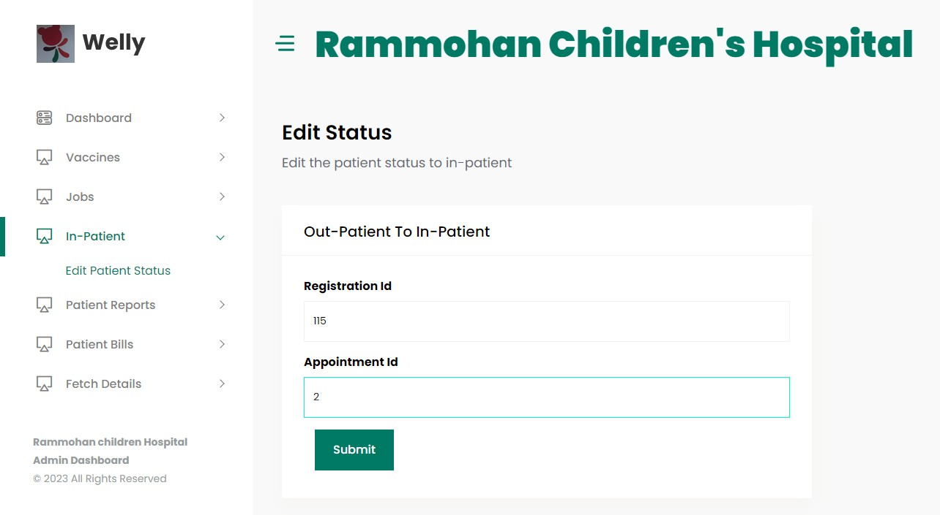
Edit Status - The below figure shows how to edit the status from out-patient to in-patients.

Slide 41
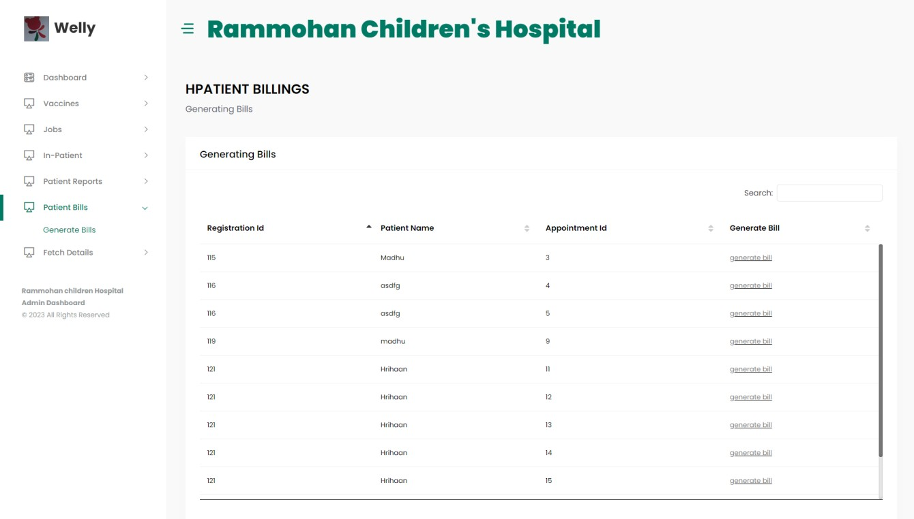
Screenshot of generating bills

Slide 42
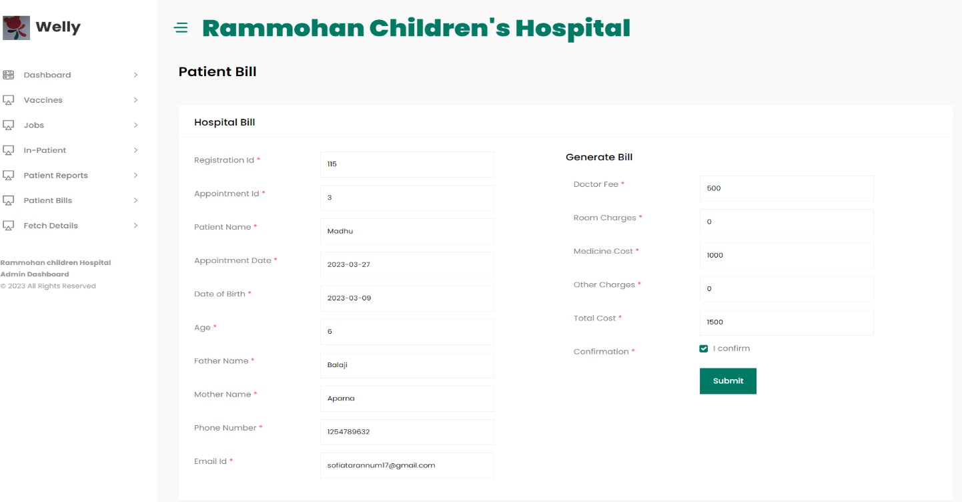
Screenshot of Hospital bill form

Slide 43
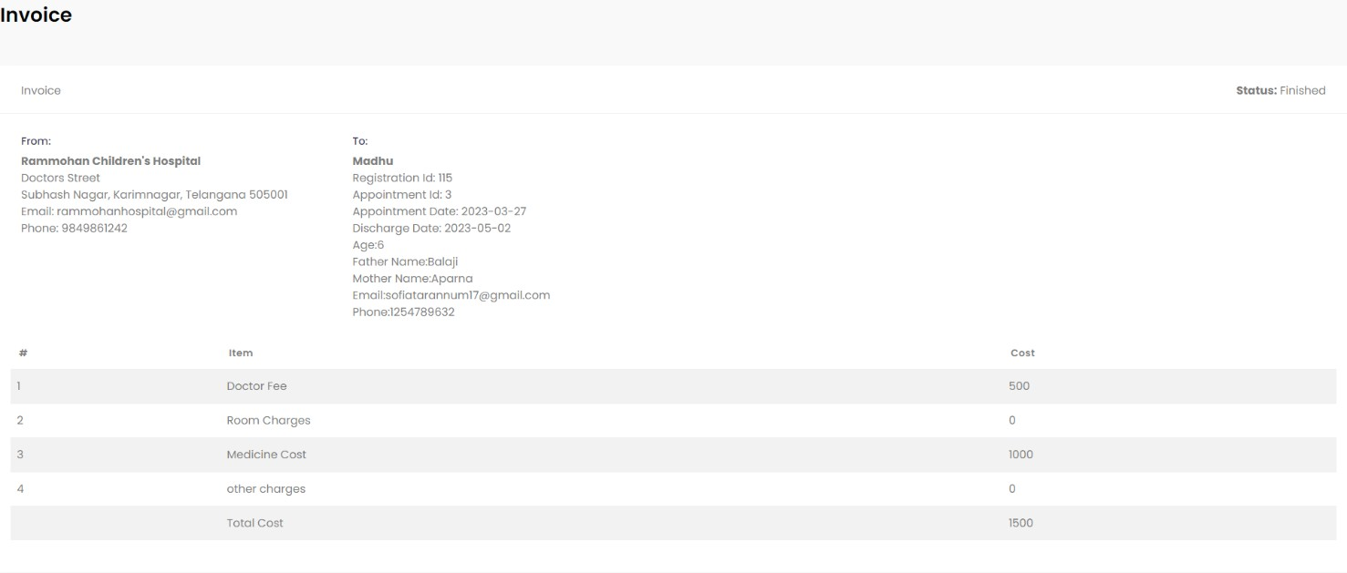
Online generated Hospital bill

Slide 44
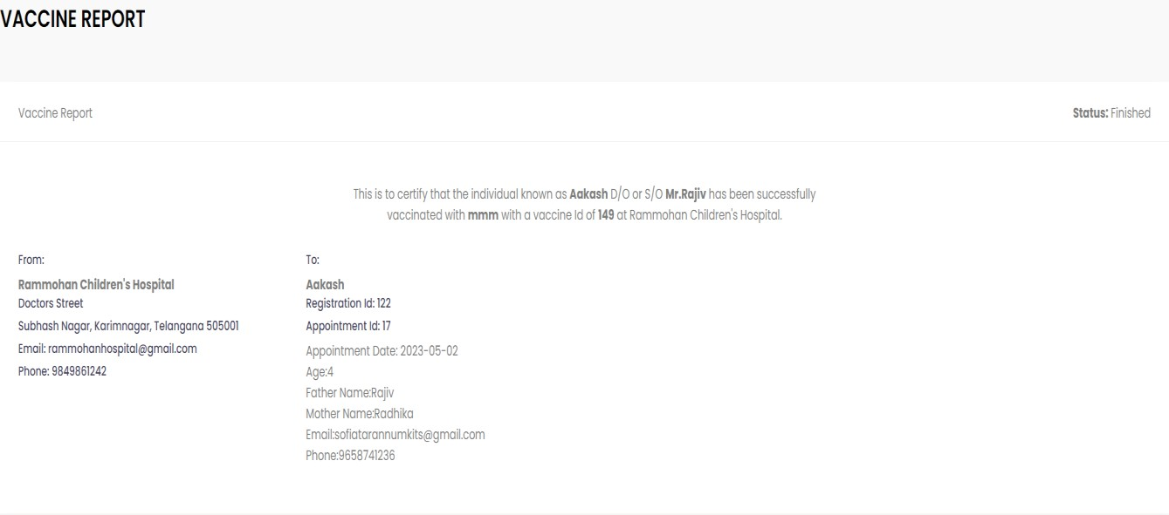
Screenshot of sample vaccine report

Slide 45
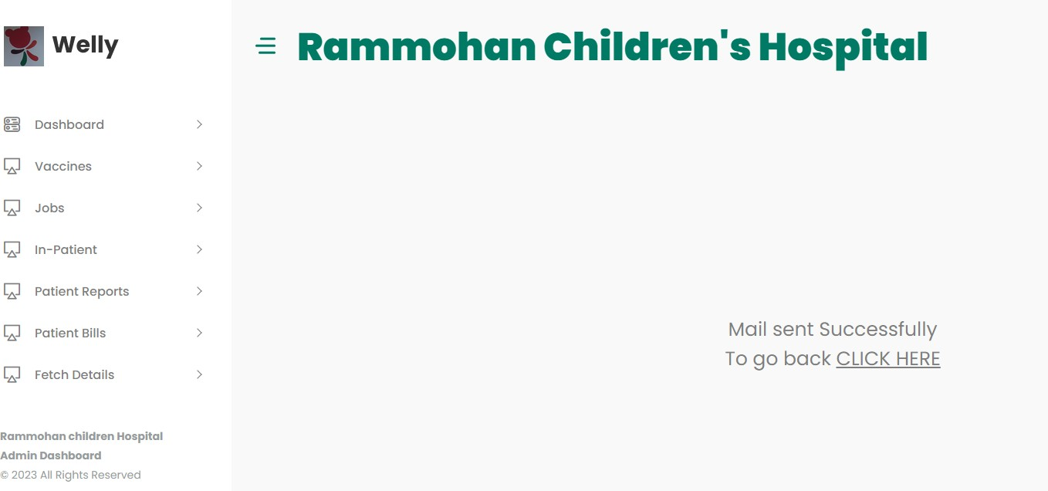
Screenshot of mail sent successfully

Slide 46
Conclusion
The project we developed is “WEB APPLICATION FOR RAMMOHAN CHILDREN’S HOSPITAL”, which has become a powerful tool to help the healthcare organization to improve their processes and streamline their operations. It provides an integrated, comprehensive solution to managing patient records and billings. Throughout the project, we have identified and addressed various challenges, including designing a user-friendly interface, implementing efficient data management and ensuring platform security. Our project helps the admin to easily fetch the in-patient and out-patient data and also helps the users to get bills, reports through emails which saves a lot of time and effort standing in queue. Overall, the children’s hospital project is vast and there are numerous opportunities for growth and development. The key is to stay current with the latest trends in technology and be responsive to the needs of patients and their families.

Slide 47
Future Scope
Use of Artificial Intelligence and Machine Learning
Implementation of Telemedicine
Online Payment
Donations and Funds
Hospital staff management

Slide 48
References
1.HTML Black Book by Steven Holzner.
2. The Unified Modeling Language User Guide, by Grady Booch, James Rumbaugh;2nd Edition;
Addison-Wesley Professional; ISBN-10: 0321267974, ISBN-13: 978 0321267979
3. Fundamentals of Python Programming by D. Prashanth Kumar ,Dr.K.Praveen Kumar Rao; ISBN-
13: 978-8195376551, ISBN-10: 819537655X
4. Software Testing concepts and Tools, by NageshwarRao Pusuluri; 2nd Edition; Dream tech press;
ISBN-10: 8177227122, ISBN-13:978-8177227123.
5. Database Modeling and Design, by Toby J.Teorey.Sam S.Lightstone, Tom Nadeau;5th Edition;
Morgan Kaufmann;ISBN-10:0123820200,ISBN-13:978-0123820204.
6. Database Design using Entity-Relationship Diagrams by Richard Earp 2nd Edition, April
16, 2007;Auerbach Publications; ISBN-10:1439861765, ISBN-13:978-1439861769.

Slide 49
THANK YOU

