Slide 1
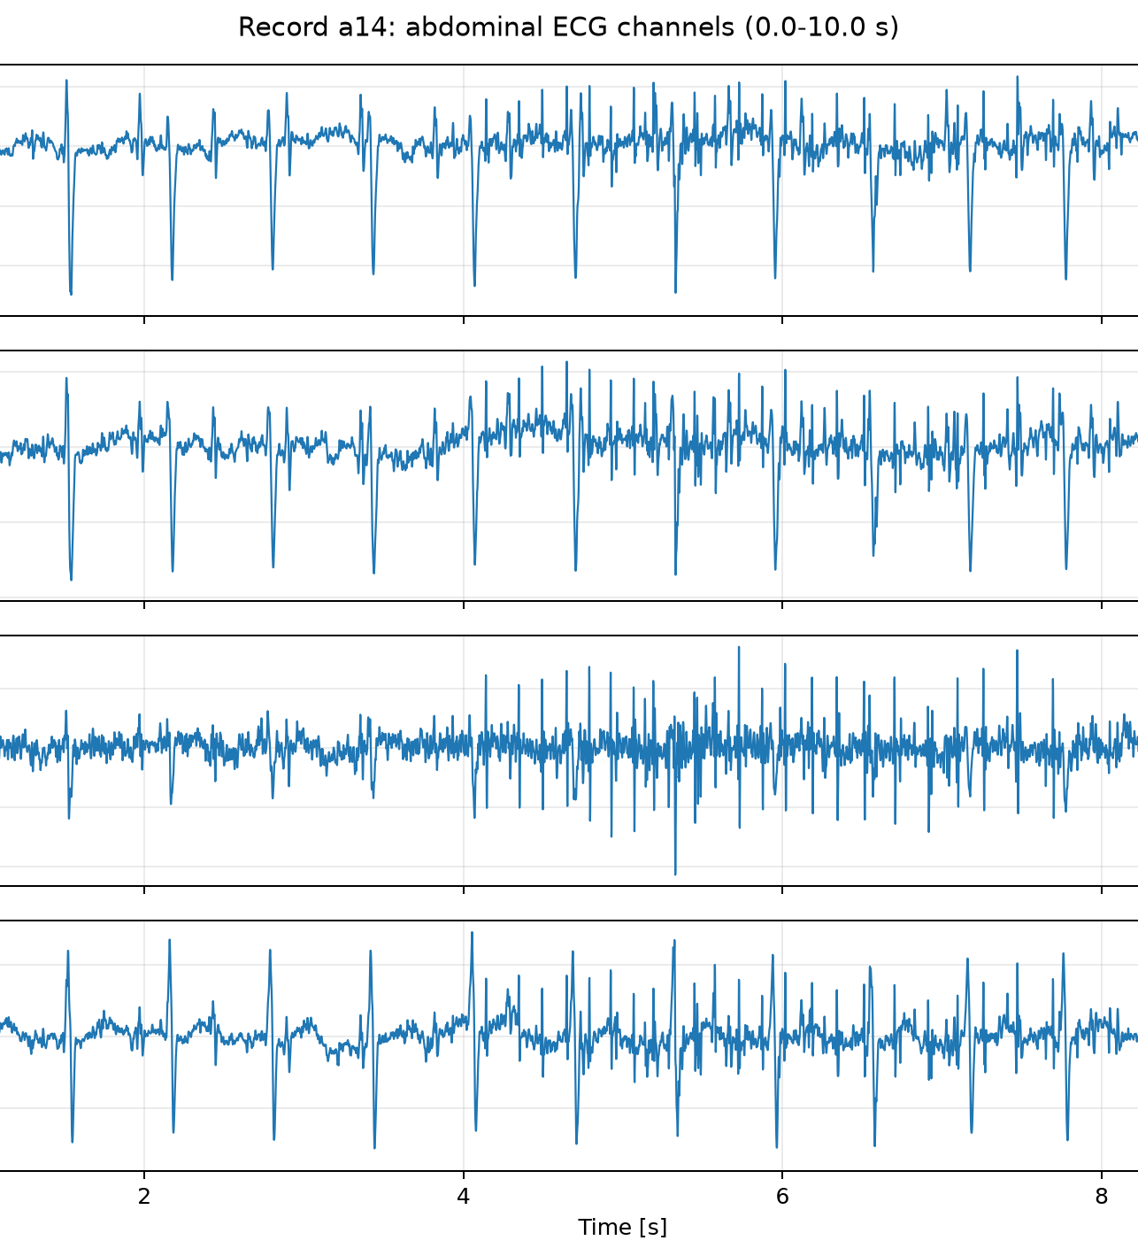
Biomedical Signal Processing | University of Milan
Robust Fetal ECG Detection from Abdominal Recordings
Implementation of Martens et al. (2007) and evaluation on PhysioNet Challenge 2013 Set-A
Sofia Maggioni
Matricola 75788A
Example raw abdominal ECG signal: record a14
Notes:
Start by introducing the goal: detecting fetal heartbeats from abdominal ECG recordings.
Say that the project follows the algorithm proposed by Martens et al. and tests it on real PhysioNet data.
Keep this slide short: name, objective, paper, dataset.
[Sources]
Paper: S. M. M. Martens, C. Rabotti, M. Mischi, R. J. Sluijter, A robust fetal ECG detection method for abdominal recordings, Physiological Measurement, 2007.
Dataset: PhysioNet Computing in Cardiology Challenge 2013, Set-A.
Visual asset: figures/notebook01/a14_s1_overview_0_10s.png generated by notebook 01 in this project.

Slide 2
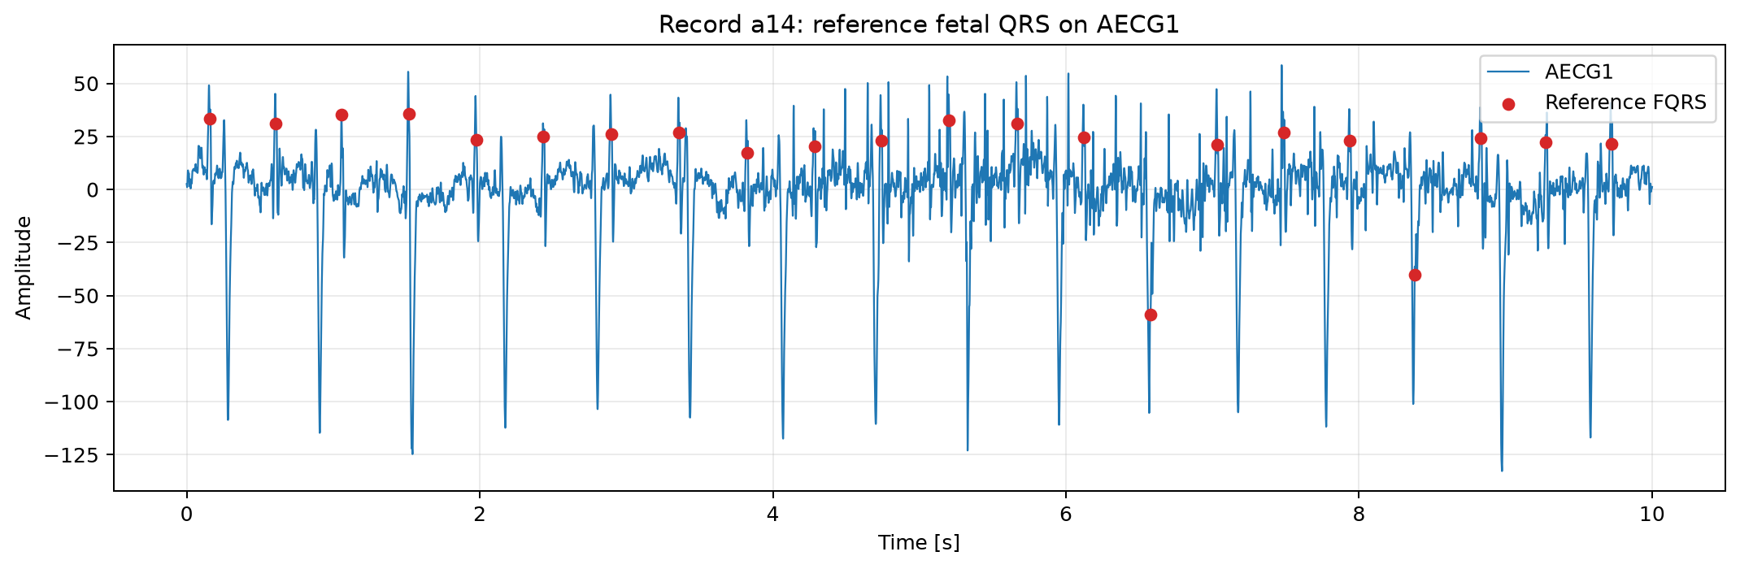
02
Paper and dataset define the detection task
The method is implemented from the assigned paper and tested on real abdominal ECG recordings.
Reference paper
Martens et al., 2007
A robust fetal ECG detection method for abdominal recordings
Core idea: progressively clean the abdominal ECG, remove the maternal ECG, then detect fetal QRS complexes.
Dataset used
PhysioNet Challenge 2013, Set-A
Main record: a14
Batch evaluation: a10, a12, a13, a14, a15
.dat = signal | .hea = header | .fqrs = fetal reference beats
Red markers show the reference fetal beats. They are not used as input to detect the beats, but are used later to measure performance.
Input data: abdominal ECG signals with fetal QRS annotations for evaluation
Notes:
Explain that this slide answers two questions: which method was implemented and which data were used to test it.
The assigned paper is Martens et al. 2007. The algorithm is organized as a sequence of processing blocks: preprocessing, maternal ECG detection/removal, and fetal QRS detection.
The data come from PhysioNet Challenge 2013 Set-A. Record a14 is used for the detailed explanation, while five records are used for the final batch evaluation.
The .dat file contains the signal, the .hea file contains recording information, and the .fqrs file contains the fetal reference beats used only for evaluation.
[Sources]
Paper: S. M. M. Martens, C. Rabotti, M. Mischi, R. J. Sluijter, A robust fetal ECG detection method for abdominal recordings, Physiological Measurement, 2007.
Dataset: PhysioNet Computing in Cardiology Challenge 2013, Set-A.
Visual asset: figures/notebook01/a14_reference_fqrs_ch1_0_10s.png generated by notebook 01 in this project.

Slide 3
03
The method follows a six-stage pipeline
Each block produces a cleaner or more useful signal for the next processing step.
Signal flow
S1
S2
S3
S4
S5
S6
Raw abdominal ECG
->
Baseline removed
->
Power-line removed
->
Upsampled signal
->
Maternal ECG removed
->
Fetal beats and average FECG
Preprocessing
Maternal ECG cancellation
Fetal detection
Remove slow movement artifacts, reduce 50 Hz electrical noise, and adapt the sampling frequency.
Detect maternal QRS complexes, build an estimate of the maternal ECG, and subtract it from the signal.
Detect fetal QRS complexes and compare them with the reference annotations to quantify performance.
The reference annotations are used only at the end, to evaluate the detected fetal beats.
Notes:
Use this slide as the roadmap for the rest of the presentation.
S1 is the original abdominal ECG. S2 removes baseline wander. S3 removes power-line interference. S4 adapts the sampling frequency. S5 is obtained after maternal ECG cancellation. S6 represents the fetal detections and the averaged fetal ECG information used for interpretation.
Explain that the maternal QRS detection is necessary because the maternal ECG is usually the strongest component in abdominal recordings.
The fetal reference annotations from PhysioNet are not used as input to the algorithm. They are used only at the end to evaluate the detections.
[Sources]
Pipeline based on: S. M. M. Martens, C. Rabotti, M. Mischi, R. J. Sluijter, A robust fetal ECG detection method for abdominal recordings, Physiological Measurement, 2007.
Implementation artifacts: notebooks 01-09 and project source code in this repository.

Slide 4
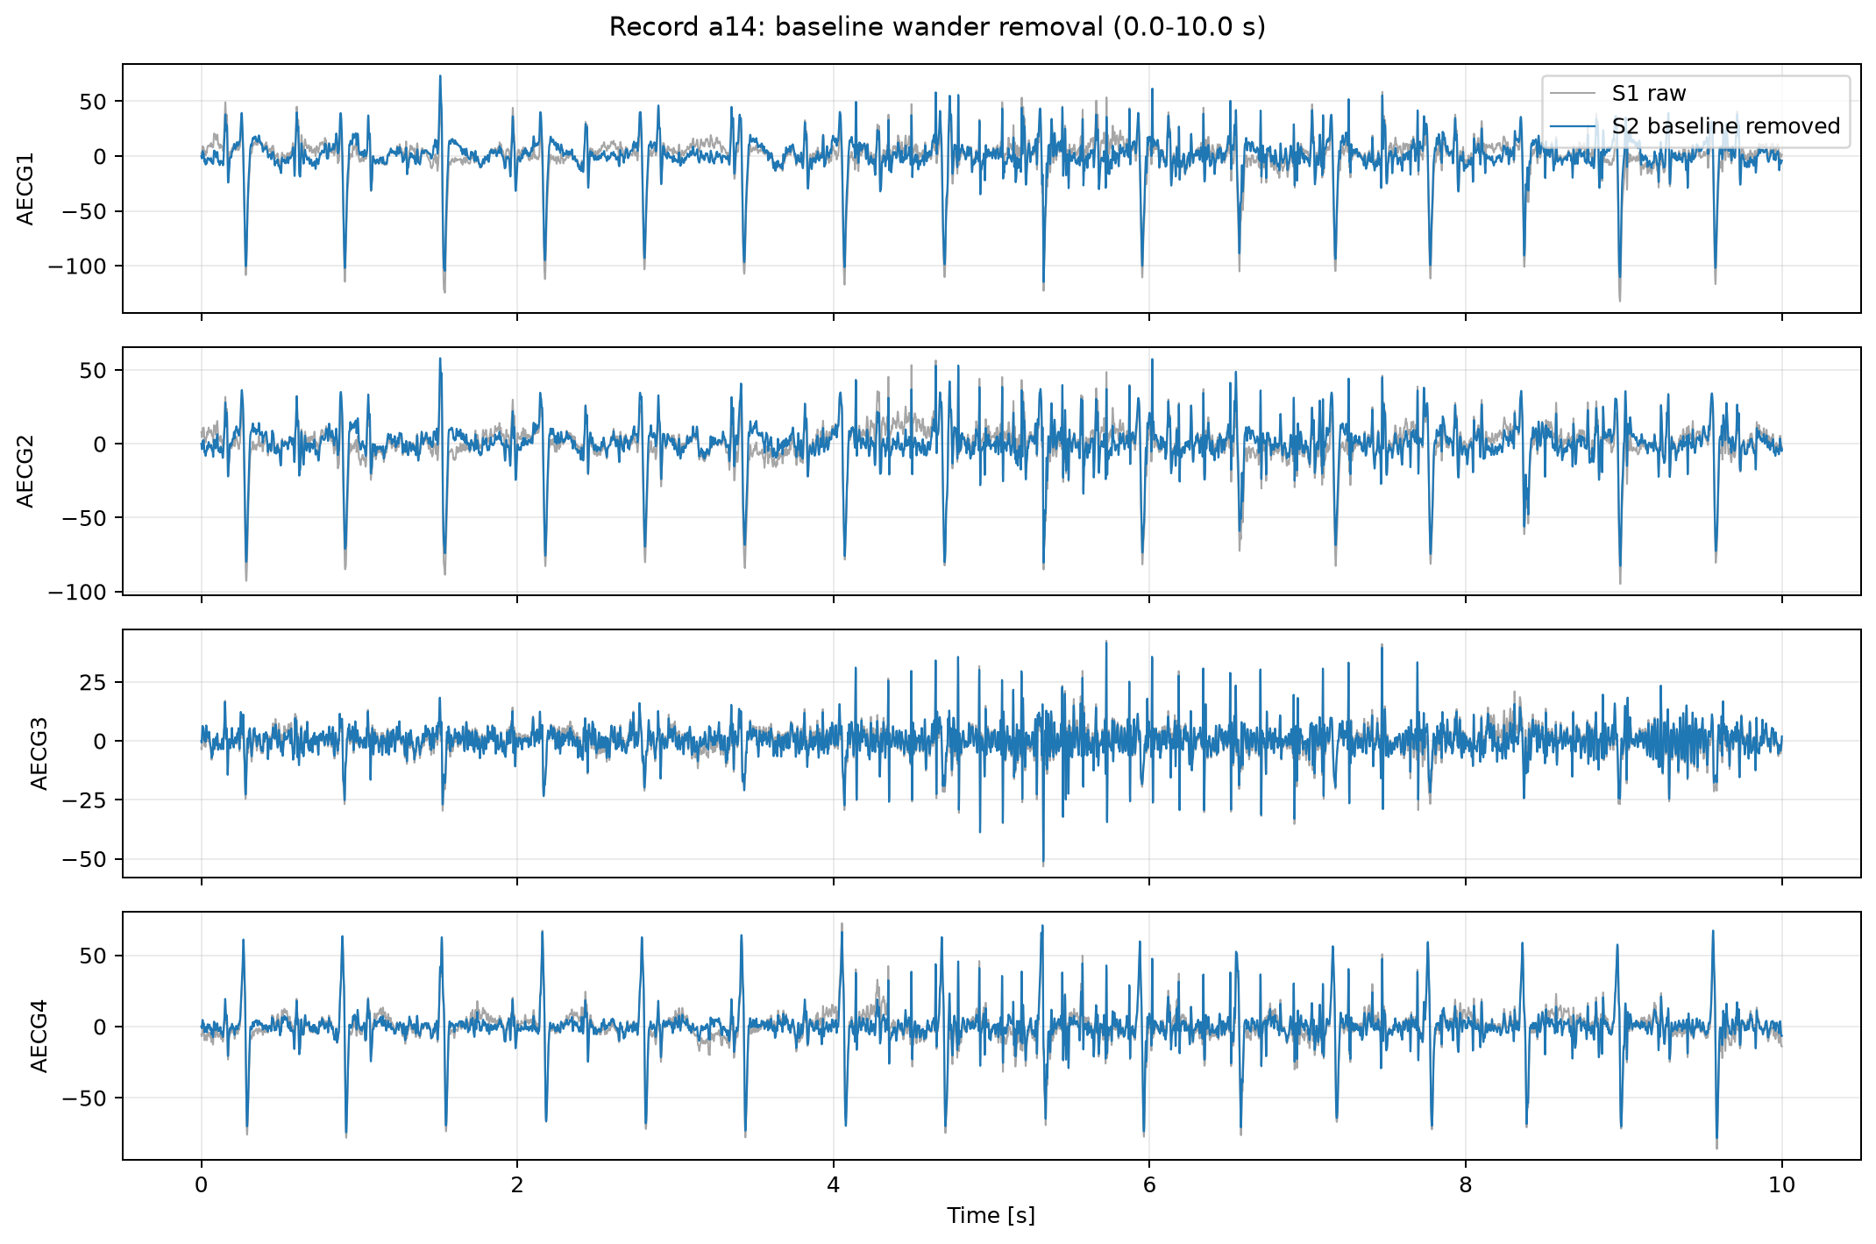
04
Baseline removal centers the ECG
Slow drift from movement and respiration is removed before detection.
S1 -> S2
Problem
The signal slowly moves up and down because of maternal respiration and body movement.
Method
A high-pass FIR filter removes very slow components while preserving the QRS peaks.
Cutoff
3 Hz: frequencies below this value are strongly attenuated.
Gray: original S1 signal. Blue: S2 after baseline removal. The useful fast ECG peaks remain visible.
Notes:
Explain this as the first preprocessing step: the abdominal ECG can drift slowly because of respiration and movement.
The goal is not to remove the ECG peaks. The goal is to remove the slow baseline movement so that the signal is centered more stably around zero.
The implementation uses a high-pass FIR filter with cutoff frequency equal to 3 Hz. In simple words, slow components below 3 Hz are attenuated, while the faster QRS information is preserved.
In the figure, gray is S1 before filtering and blue is S2 after filtering. The difference can be subtle in some intervals, but the blue signal is less affected by slow drift.
[Sources]
Algorithm step based on: S. M. M. Martens, C. Rabotti, M. Mischi, R. J. Sluijter, A robust fetal ECG detection method for abdominal recordings, Physiological Measurement, 2007.
Visual asset: figures/notebook02/a14_s1_s2_baseline_comparison_0_10s.png generated by notebook 02 in this project.

Slide 5
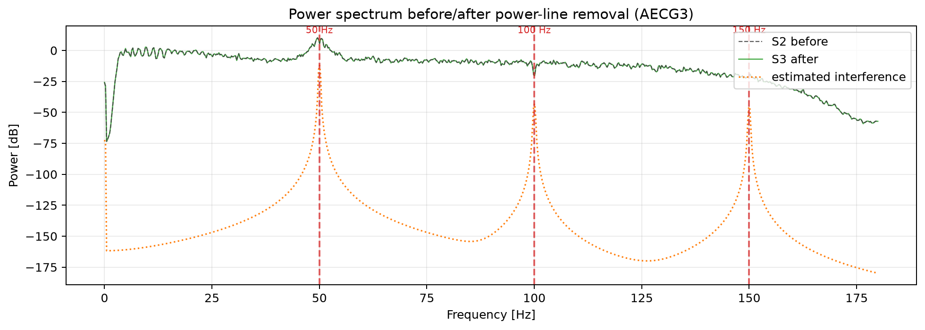
05
Power-line cancellation targets 50 Hz noise
Electrical interference is estimated at 50 Hz and harmonic frequencies, then subtracted from the signal.
S2 -> S3
Problem
The recording can contain a sinusoidal disturbance from the electrical power line.
Method
Estimate sinusoidal components at 50, 100 and 150 Hz and subtract them from S2.
Interpretation
In the time signal S2 and S3 may look very similar because this noise is small compared with ECG peaks.
The spectrum highlights the targeted frequencies: 50 Hz and its harmonics at 100 and 150 Hz.
Notes:
Explain this as the second preprocessing step: after baseline removal, the algorithm removes electrical interference.
In Europe the fundamental power-line frequency is 50 Hz. Harmonics appear at multiples such as 100 Hz and 150 Hz.
The implemented method estimates sinusoidal interference components and subtracts them from S2 to obtain S3.
A key point for the presentation: S2 and S3 can look almost identical in the time-domain graph because the removed interference is small compared with the ECG peaks. The spectrum is more informative because it shows the targeted frequencies directly.
[Sources]
Algorithm step based on: S. M. M. Martens, C. Rabotti, M. Mischi, R. J. Sluijter, A robust fetal ECG detection method for abdominal recordings, Physiological Measurement, 2007.
Visual asset: figures/notebook03/a14_powerline_spectrum_strongest_channel.png generated by notebook 03 in this project.

Slide 6
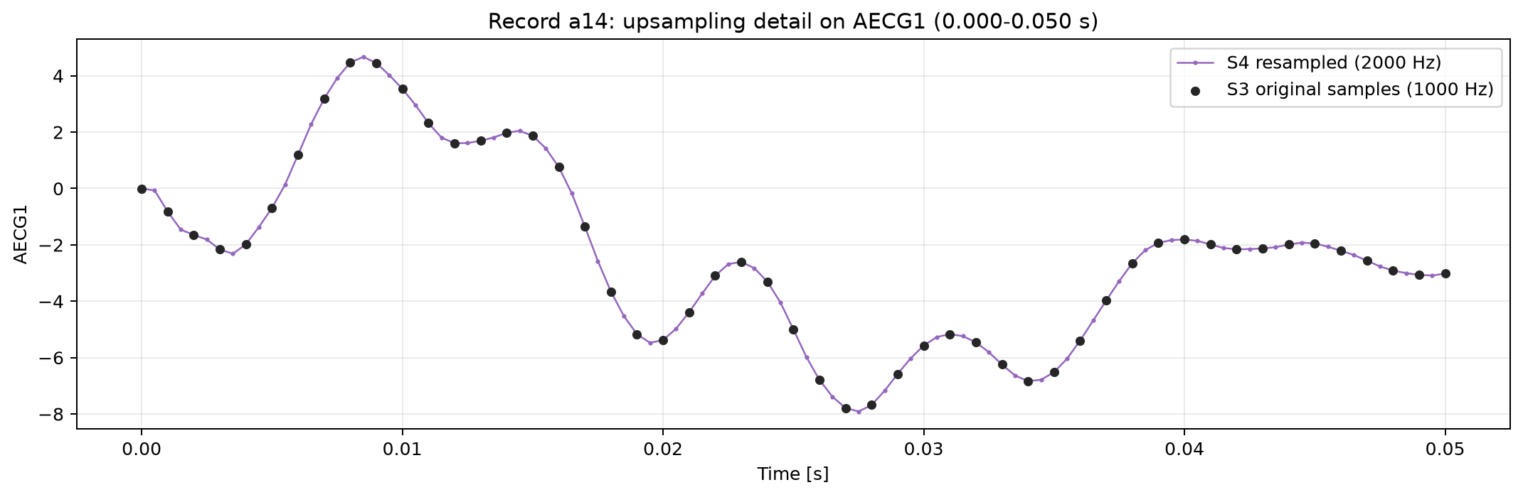
06
Upsampling increases temporal resolution
The same 60-second signal is represented with more samples before QRS detection.
S3 -> S4
1000 Hz -> 2000 Hz
What changes
Sampling frequency is increased from 1000 Hz to 2000 Hz.
60000 samples -> 120000 samples
Duration unchanged: 60 s
What stays the same
The recording duration remains 60 seconds; the signal is not duplicated.
Why it helps
More time points help localize QRS peaks more precisely in later steps.
Black dots are the original S3 samples. The purple curve shows the resampled S4 signal at 2000 Hz.
Notes:
Explain that upsampling does not create a longer recording. The duration remains the same: 60 seconds.
The sampling frequency is increased from 1000 Hz to 2000 Hz. Therefore the number of samples doubles from 60000 to 120000.
This is useful because later QRS detection and refinement work on sample positions. With more samples, the temporal grid is finer.
In the figure, the black dots are original S3 samples and the purple line is the resampled S4 signal.
[Sources]
Algorithm step based on: S. M. M. Martens, C. Rabotti, M. Mischi, R. J. Sluijter, A robust fetal ECG detection method for abdominal recordings, Physiological Measurement, 2007.
Implementation: notebook 04 uses scipy.signal.resample to obtain S4 from S3.
Visual asset: figures/notebook04/a14_upsampling_zoom_ch1_0_0p05s.png generated by notebook 04 in this project.

Slide 7
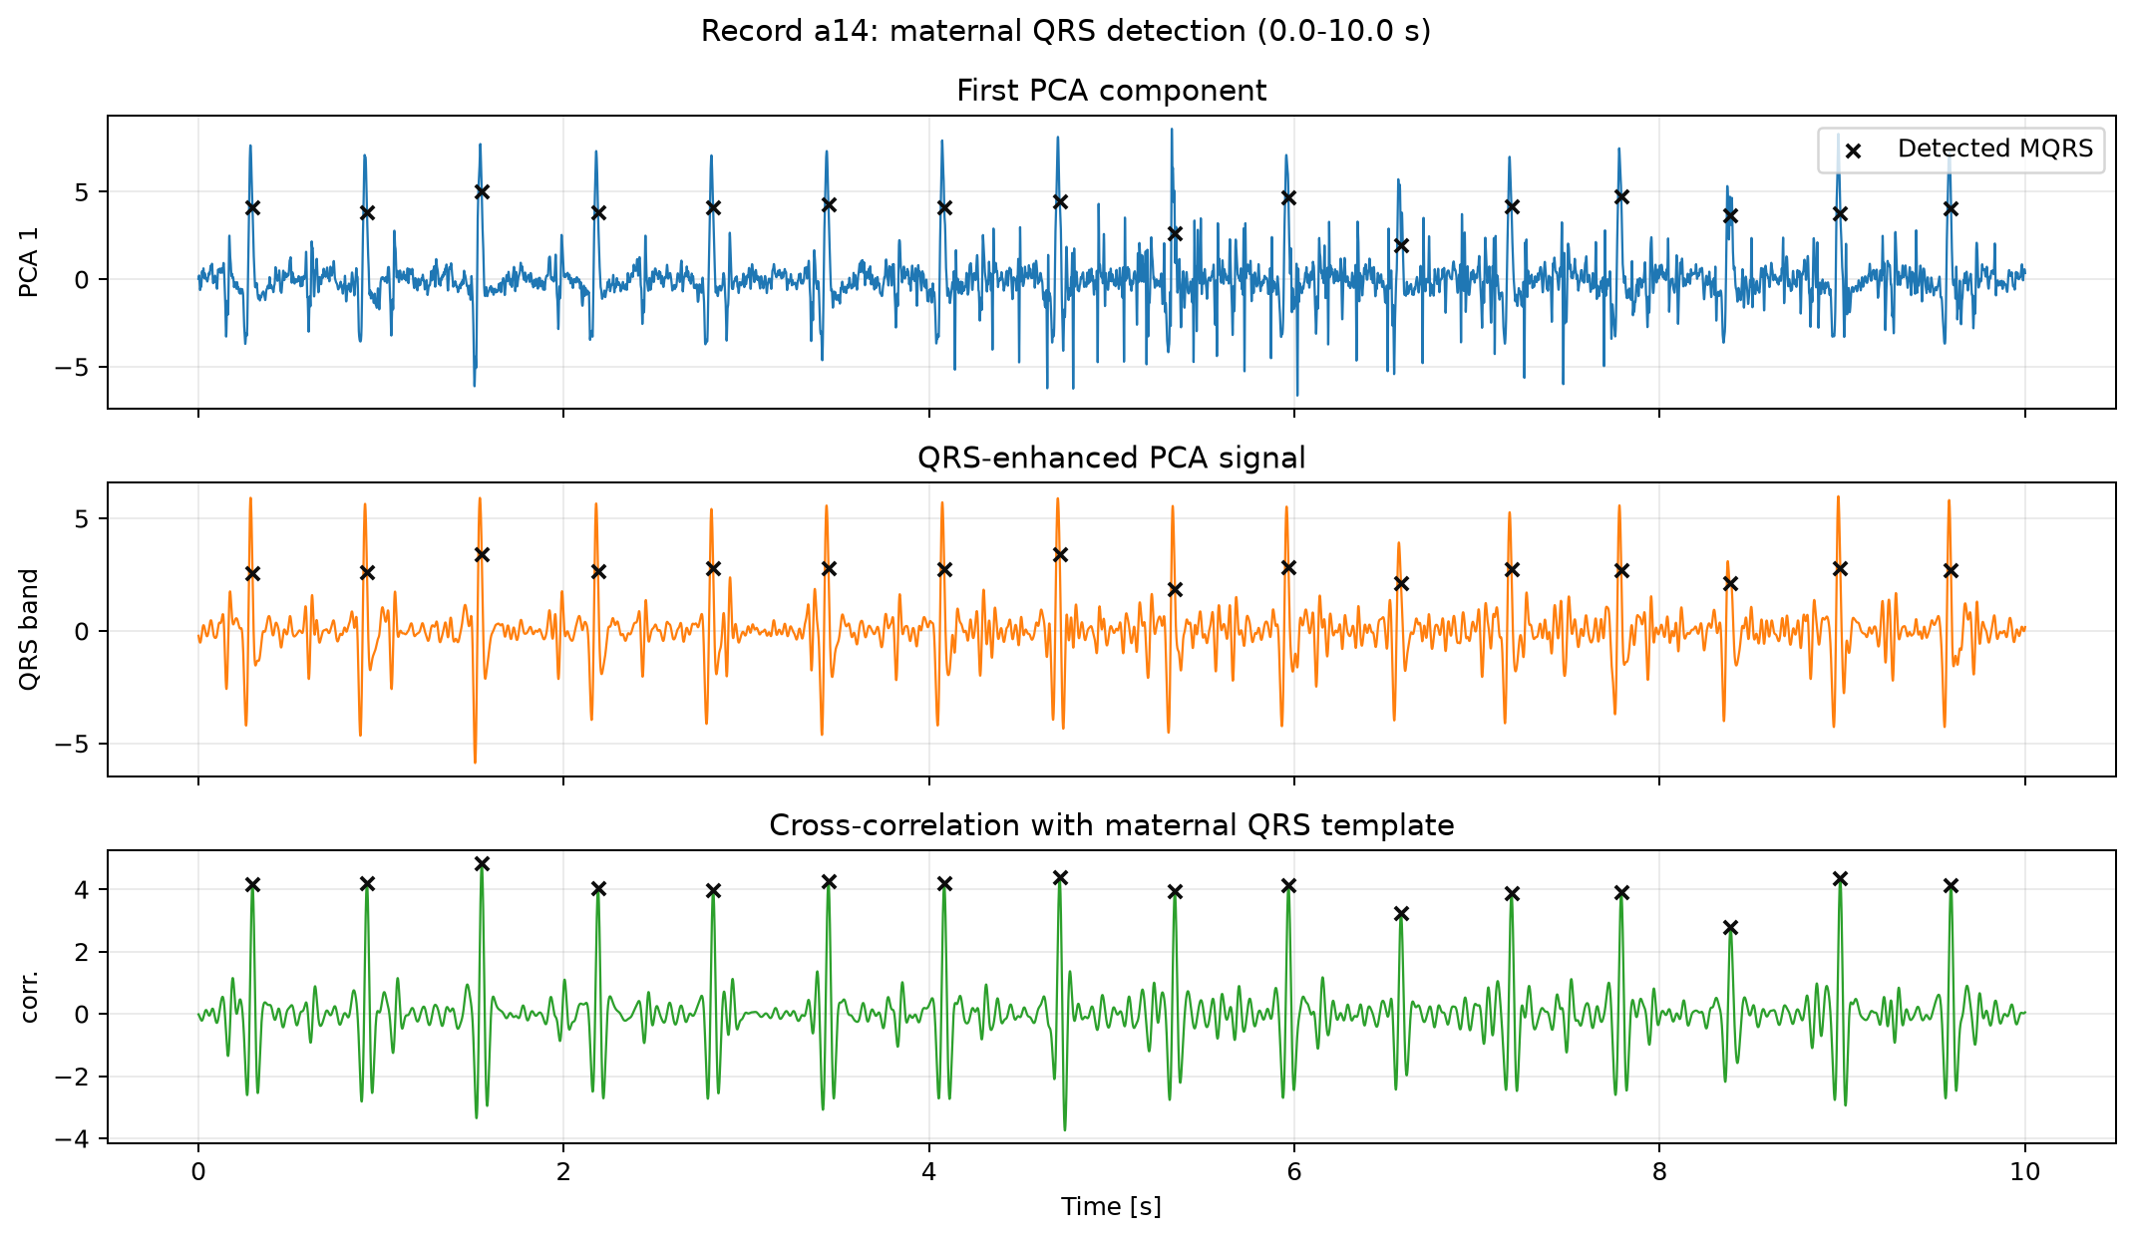
07
MQRS detection finds maternal beats
Maternal QRS positions are needed to estimate and remove the maternal ECG.
S4 -> MQRS
1. Combine channels
PCA extracts a component where maternal beats are clearer.
2. Build a template
A typical maternal QRS shape is used as a reference pattern.
3. Detect matches
Cross-correlation peaks identify the maternal beat positions.
102 detected MQRS
Black crosses mark the detected maternal QRS positions in the first 10 seconds of record a14.
Notes:
Explain that MQRS means maternal QRS. These are the mother's heartbeats.
This step is necessary because the maternal ECG is usually stronger than the fetal ECG in abdominal recordings.
The method first combines the abdominal channels with PCA, then builds a maternal QRS template, and finally uses cross-correlation to find repeated occurrences of that template.
In the figure, black crosses mark the detected maternal QRS positions. For record a14, the notebook saved 102 detected maternal beats.
These positions will be used in the next step to build and subtract the maternal ECG estimate.
[Sources]
Algorithm step based on: S. M. M. Martens, C. Rabotti, M. Mischi, R. J. Sluijter, A robust fetal ECG detection method for abdominal recordings, Physiological Measurement, 2007.
Visual asset: figures/notebook05/a14_mqrs_detection_0_10s.png generated by notebook 05 in this project.
Result source: results/notebook05/a14_mqrs_detected.csv generated by notebook 05 in this project.

Slide 8
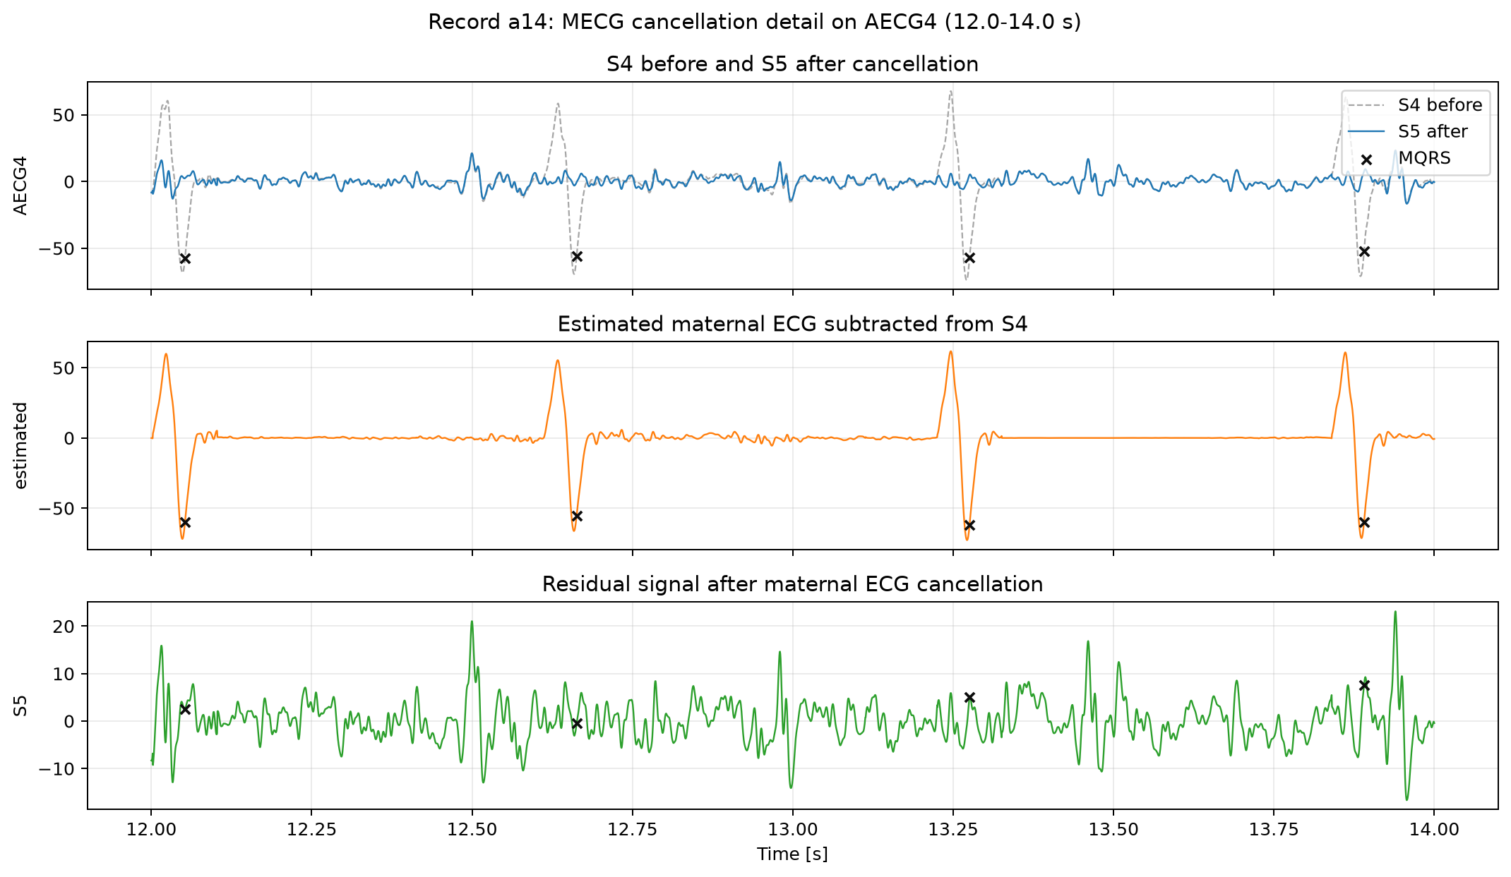
08
Maternal cancellation reduces dominant ECG
The maternal beat estimate is subtracted from S4 to obtain the cleaner signal S5.
S4 + MQRS -> S5
1. Estimate the mother
For each maternal beat, the previous 10 beats are aligned and averaged.
2. Adapt the shape
P, QRS and T parts are scaled separately to match the current beat.
3. Subtract it
The estimated maternal ECG is removed from the abdominal signal.
AECG4 RMS: 33.9 -> 6.2 uV
81.7% reduction around MQRS
The middle plot is the estimated maternal ECG; subtracting it leaves the S5 residual shown at the bottom.
Notes:
Explain that MECG means maternal ECG. This is the ECG of the mother, which is usually the strongest component in abdominal recordings.
The previous slide found the maternal QRS positions. Here those positions are used as anchors to build a local estimate of the maternal ECG.
For each current maternal beat, the algorithm averages the previous 10 maternal beats. Then it scales the P, QRS and T parts separately, because the maternal waveform can change slightly.
The estimated maternal ECG is subtracted from S4, producing S5. In the figure, the top plot compares S4 before and S5 after, the middle plot shows the estimated maternal ECG, and the bottom plot shows the residual S5.
For AECG4 in record a14, the RMS around maternal QRS positions decreases from 33.9 to 6.2 uV, which is an 81.7% reduction.
The next step uses S5 to detect the weaker fetal QRS complexes.
[Sources]
Algorithm step based on: S. M. M. Martens, C. Rabotti, M. Mischi, R. J. Sluijter, A robust fetal ECG detection method for abdominal recordings, Physiological Measurement, 2007.
Visual asset: figures/notebook06/a14_mecg_cancellation_detail_strongest_channel_12_14s.png generated by notebook 06 in this project.
Result source: results/notebook06/a14_mecg_cancellation_summary.csv generated by notebook 06 in this project.

Slide 9
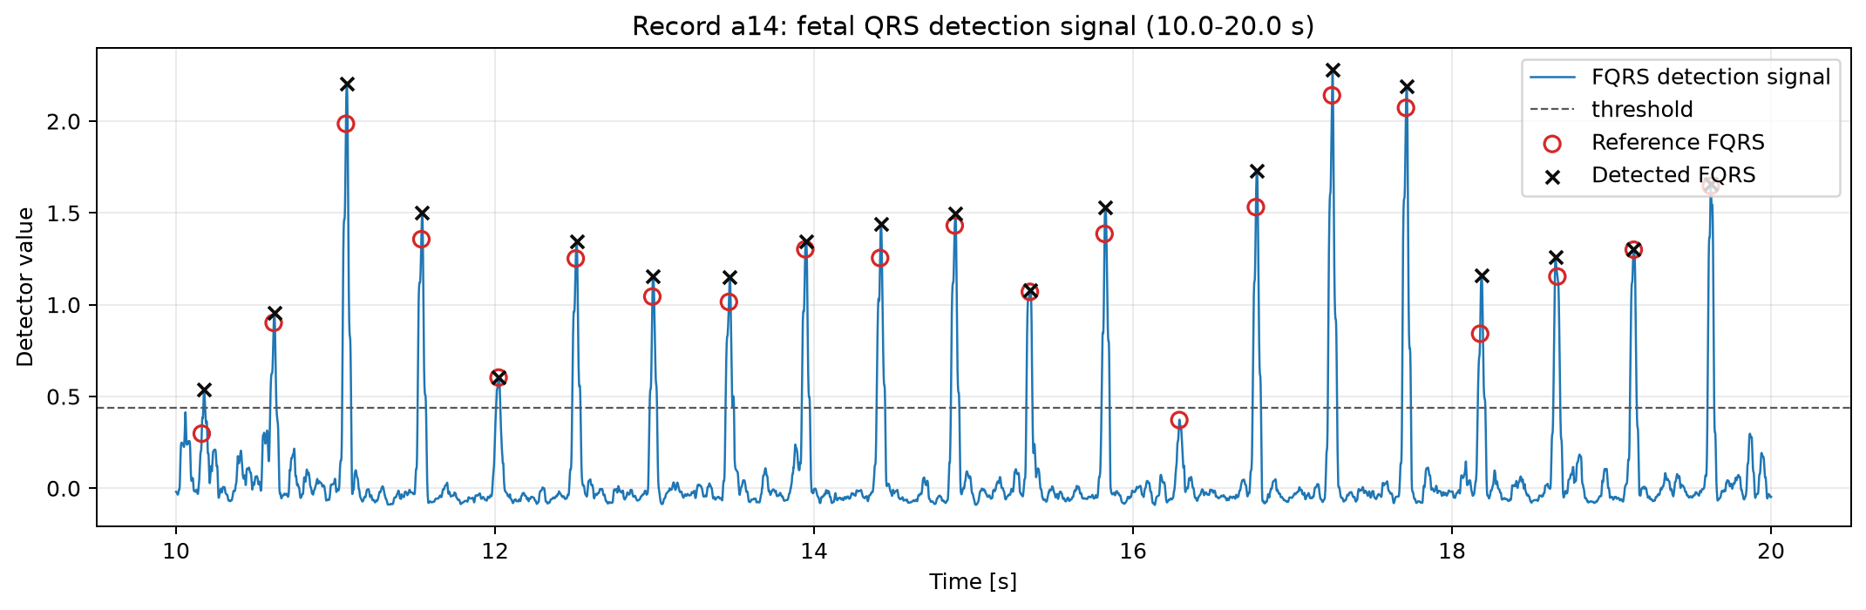
09
Fetal QRS detection matches reference beats
Peaks in the S5 detection signal are compared with PhysioNet fetal annotations.
S5 -> FQRS
1. Emphasize fetal peaks
The cleaned signal S5 is filtered to make small fetal QRS peaks easier to detect.
2. Build a detector signal
The four channels are combined into one curve where fetal beats appear as peaks.
3. Compare with reference
Detected peaks are matched against the .fqrs fetal reference within 50 ms.
124 detected vs 123 reference
Black crosses are detected fetal beats; red circles are the PhysioNet reference annotations.
Sensitivity 90.2% | PPV 89.5% | F1 89.9%
Mean absolute timing error for matched beats: 6.4 ms.
Notes:
Explain that FQRS means fetal QRS: these are the fetal heartbeat positions.
After MECG cancellation, the fetal peaks are still small, but they are easier to search for because the dominant maternal ECG has been reduced.
The notebook builds a fetal detection signal from S5. Peaks above the threshold become candidate fetal QRS positions.
The black crosses in the figure are the detected FQRS. The red circles are the PhysioNet fetal reference annotations. When they overlap, the detection is correct.
For record a14, the algorithm detected 124 FQRS while the reference contains 123. The matching tolerance is 50 ms. The result is sensitivity 90.2%, PPV 89.5%, F1-score 89.9%, and mean absolute timing error 6.4 ms.
This slide is the main single-record detection result; the later performance slide will show how the same pipeline behaves on five records.
[Sources]
Algorithm step based on: S. M. M. Martens, C. Rabotti, M. Mischi, R. J. Sluijter, A robust fetal ECG detection method for abdominal recordings, Physiological Measurement, 2007.
Reference annotations: PhysioNet Challenge 2013 Set-A .fqrs file for record a14.
Visual asset: figures/notebook07/a14_fqrs_detection_signal_10_20s.png generated by notebook 07 in this project.
Result sources: results/notebook07/a14_fqrs_performance.csv and results/notebook07/a14_fqrs_detected.csv generated by notebook 07 in this project.

Slide 10
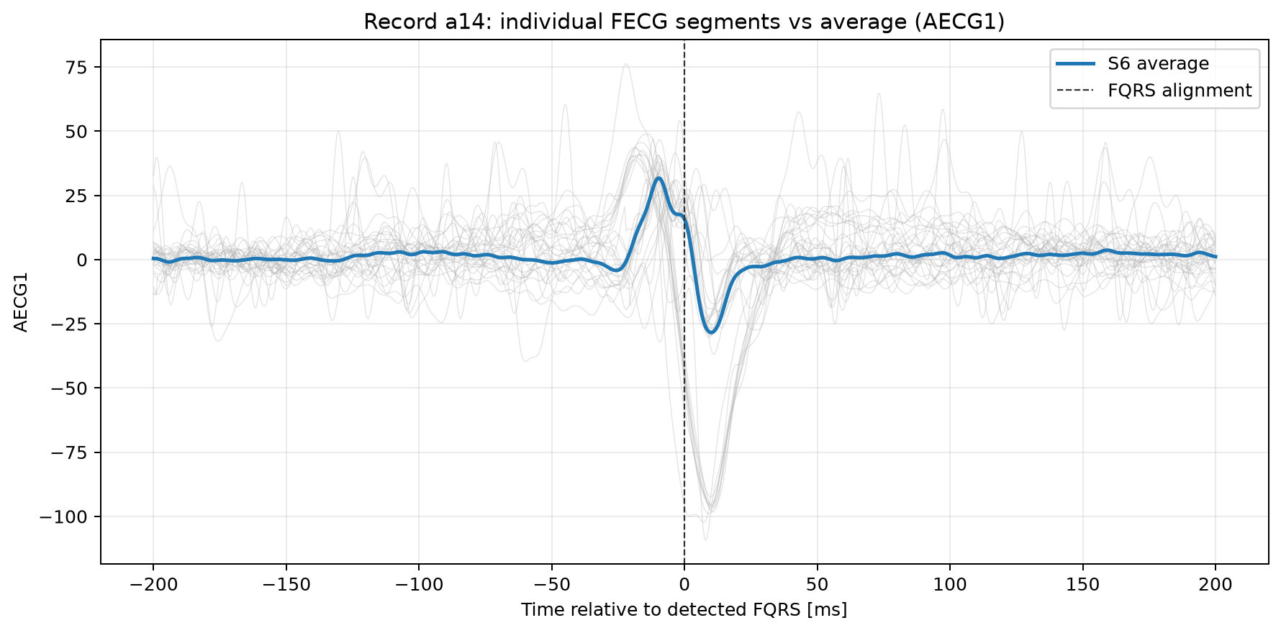
10
Averaging reveals the fetal ECG waveform
Detected FQRS positions are used to align and average short S5 windows.
S5 + FQRS -> S6
1. Cut fetal windows
Around each detected FQRS, a short S5 segment is extracted.
2. Align on FQRS
Every segment is centered on the fetal QRS position, marked at 0 ms.
3. Average beats
Random noise is reduced while the repeated fetal waveform remains.
123 FQRS used in S6 average
Window: 200 ms before and after | SNR gain ~11.1
Gray curves are individual fetal windows; the blue curve is the final average waveform S6.
Notes:
Explain that S6 is not another long ECG recording. S6 is the average fetal ECG beat shape.
A single fetal beat in S5 is small and noisy. Since the previous slide found the FQRS positions, we can use them as alignment points.
The notebook extracts a 400 ms window around each detected fetal beat: 200 ms before the FQRS and 200 ms after it.
Each gray curve in the figure is one extracted fetal segment. The vertical dashed line is the detected FQRS alignment point at 0 ms.
Averaging 123 valid segments reduces random noise and leaves the repeated fetal ECG shape. The blue curve is the final S6 average.
The expected SNR gain is about the square root of the number of averaged beats, here approximately 11.1.
[Sources]
Algorithm step based on: S. M. M. Martens, C. Rabotti, M. Mischi, R. J. Sluijter, A robust fetal ECG detection method for abdominal recordings, Physiological Measurement, 2007.
Visual asset: figures/notebook08/a14_fecg_segments_vs_average_strongest_channel.png generated by notebook 08 in this project.
Result sources: results/notebook08/a14_average_fecg_summary.csv and results/notebook08/a14_average_fecg_s6.csv generated by notebook 08 in this project.

Slide 11
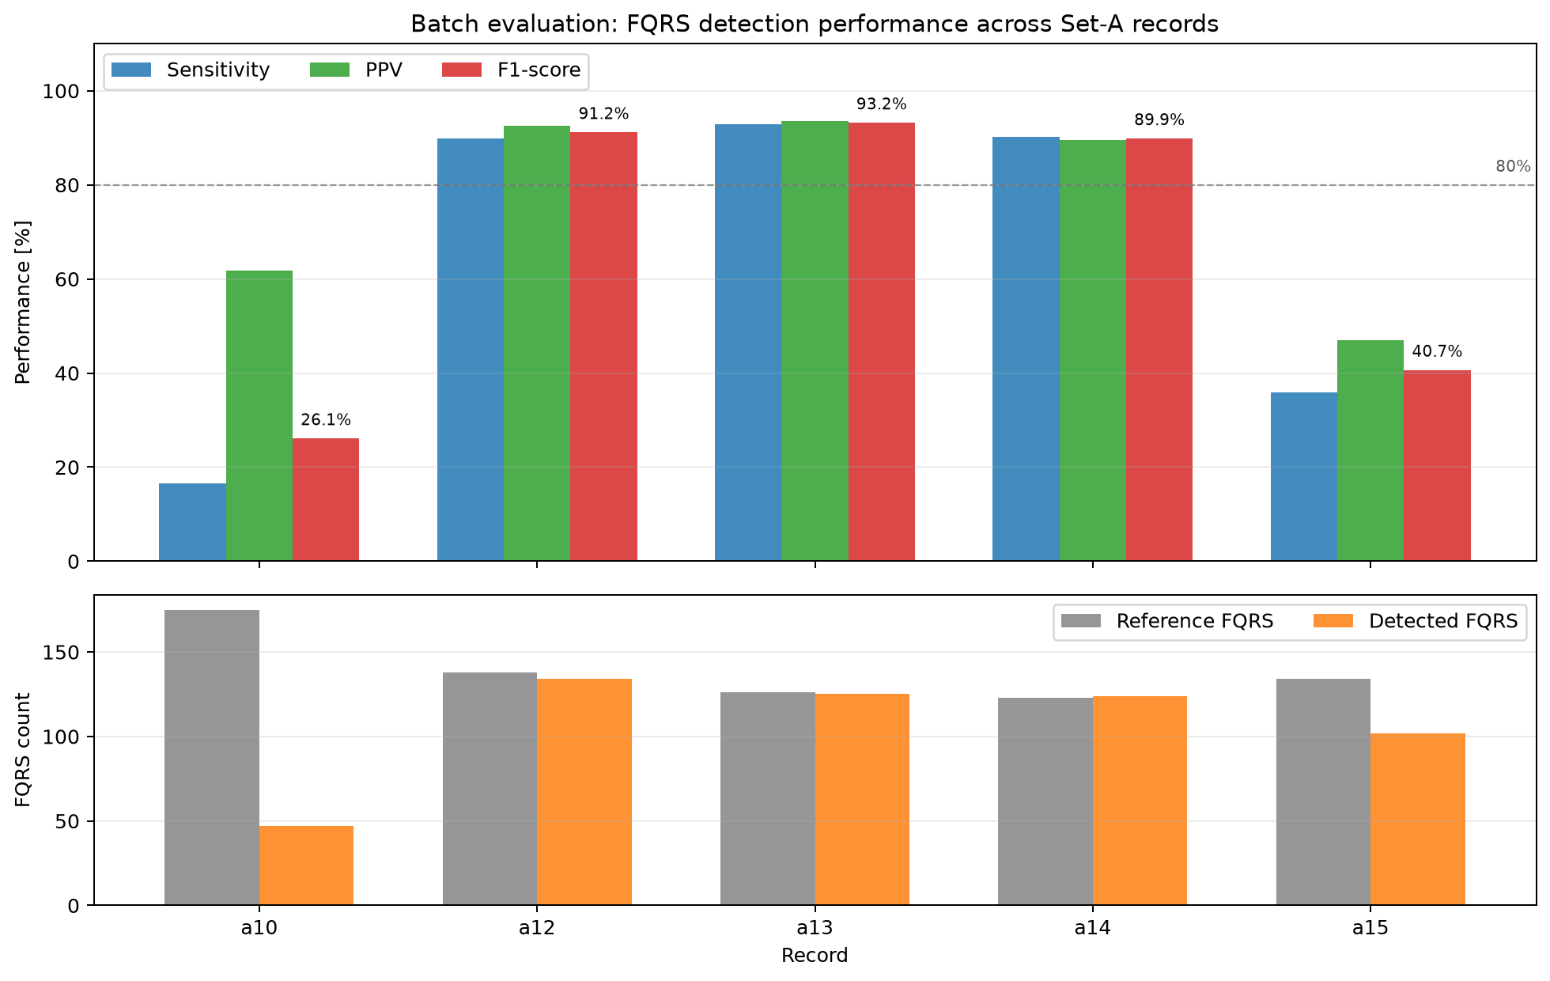
11
Performance is strong on three Set-A records
The full pipeline was evaluated on five PhysioNet Set-A recordings.
FQRS vs reference
Metrics used
Sensitivity measures found reference beats. PPV measures correct detections. F1 balances both.
Records tested
Batch evaluation used a10, a12, a13, a14 and a15 from Set-A.
Interpretation
a12, a13 and a14 are close to the reference; a10 and a15 lower the average.
Mean F1-score: 68.2%
Top: detection metrics. Bottom: reference vs detected FQRS counts for each record.
Notes:
Explain that this slide evaluates the full pipeline beyond the single detailed record a14.
The five records used are a10, a12, a13, a14 and a15 from PhysioNet Challenge 2013 Set-A.
Sensitivity answers: of the true fetal beats in the reference, how many did we find? PPV answers: of the beats found by the algorithm, how many are correct? F1-score summarizes both.
The strongest results are on a12, a13 and a14, with F1-scores 91.2%, 93.2% and 89.9%. These records also show reference and detected FQRS counts that are very close.
a10 and a15 are lower-performance cases, likely due to weaker fetal signal, more noise or remaining maternal ECG after cancellation. This explains why the mean over five records is lower: mean F1-score 68.2%, mean sensitivity 65.1% and mean PPV 76.9%.
No record failed during batch execution; all five produced output files.
[Sources]
Dataset: PhysioNet Challenge 2013 Set-A records a10, a12, a13, a14 and a15.
Visual asset: figures/notebook09/set_a_5_records_batch_performance.png generated by notebook 09 in this project.
Result sources: results/notebook09/set_a_5_records_performance.csv, set_a_5_records_summary.csv and set_a_5_records_failures.csv generated by notebook 09 in this project.

Slide 12
12
The pipeline works with record-dependent limits
The implementation follows the paper workflow and evaluates it on real abdominal ECG recordings.
Implemented signal path
S1
S2
S3
S4
S5
FQRS
S6
raw ECG
->
no drift
->
no 50 Hz
->
2000 Hz
->
MECG removed
->
fetal beats
->
average FECG
Overall takeaway: fetal beat detection is feasible, but performance depends strongly on signal quality.
What was completed
What the results show
Main limitation
Complete Python pipeline from preprocessing to S6. The project produces notebooks, figures and CSV tables.
Record a14 performs well: F1-score 89.9% and mean timing error 6.4 ms. On 5 records, mean F1-score is 68.2%.
Some records are much noisier. A useful future improvement is tuning the detector per record and improving MECG cancellation.
Notes:
This is the final summary slide.
First, summarize what was done: the full processing chain was implemented from the raw abdominal ECG to the average fetal ECG waveform.
The main blocks are baseline removal, power-line removal, upsampling, maternal QRS detection, maternal ECG cancellation, fetal QRS detection and average FECG extraction.
Then summarize the evidence: for record a14, the fetal beat detector gives a strong result, with about 89.9% F1-score and an average timing error of about 6.4 ms.
In the batch test on five Set-A records, the mean F1-score is lower, about 68.2%, because some recordings are more difficult.
The most important conclusion is that the method can recover fetal beat positions and an average fetal ECG waveform, but the result is record-dependent.
A possible future improvement is to tune the parameters per recording, improve maternal ECG cancellation and test on more records.
[Sources]
Algorithm reference: S. M. M. Martens, C. Rabotti, M. Mischi, R. J. Sluijter, A robust fetal ECG detection method for abdominal recordings, Physiological Measurement, 2007.
Dataset: PhysioNet/CinC Challenge 2013 Set-A.
Result sources: outputs generated by notebooks 07, 08 and 09 in this project.

