Slide 1
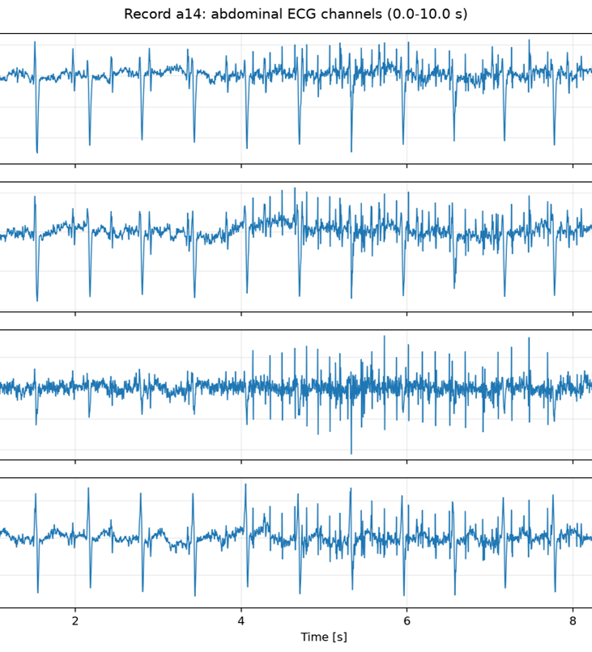
Robust fetal ecg detection from abdominal recordings
Biomedical Signal Processing | Università degli studi di Milano
Implementation of Martens et al. (2007) and evaluation on PhysioNet Challenge 2013 Set-A
Sofia Maggioni | matr. 75788A

Slide 2
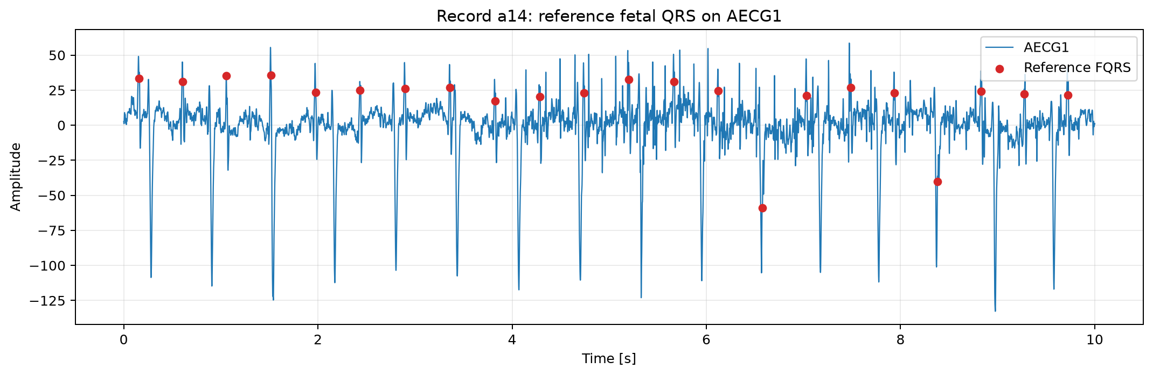
Context and clinical challenge
Core idea: progressively clean the abdominal ECG, remove the maternal ECG, then detect fetal QRS complexes.
Dataset used: PhysioNet Challenge 2013, Set-A
Main record: a14.
Batch evaluation: a10, a12, a13, a14, a15
.dat = signal | .hea = header | .fqrs = fetal reference beats
«To non-invasively detect and extract the weak fetal electrocardiogram (fECG), which is completely masked in abdominal recordings by the dominant maternal ECG (mECG) and severe biological and instrumental noise.»

Slide 3
Roadmap – pipeline overview
A multi-stage, modular workflow for maternal ECG suppression, fetal detection, and morphological reconstruction
S1
S2
S3
Data ingestion
Baseline removed
Power-line removed
S4
S5
S6
Post processing & validation
upsampling
Mathernal ECG removed
Fetal ECG reveal
Preprocessing: remove baseline wander and attenuates to 50 Hz the power-line interference.
Phase S2 & S3
Upsampling: increases the sampling rate from 100Hz to 200Hz, halving the sampling interval to 0.5 ms.
Phase S4

Slide 4
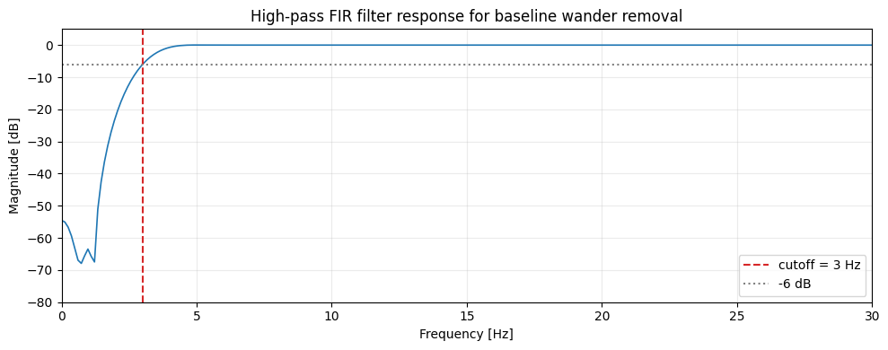
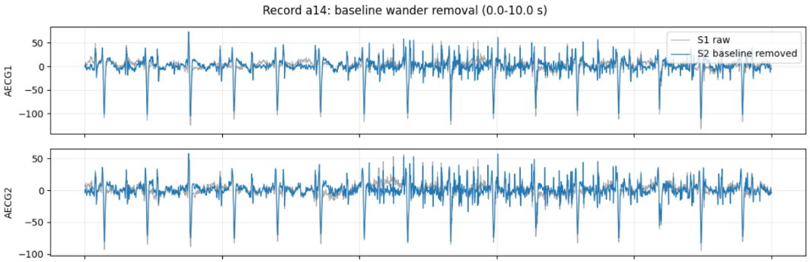
Baseline wander removed
From S1 to S2
Baseline wander: is a low-frequency disturbance (<1Hz) superimposed on the ECG signal. This prevents the waveform from returning to the isoelectric line (zero) between successive beats, causing the R-peaks to start from shifting baselines and introducing detection errors.
A high-pass FIR filter removes very slow components while preserving the QRS peaks.
For this filter I decide to apply a cutoff of 3Hz

Slide 5
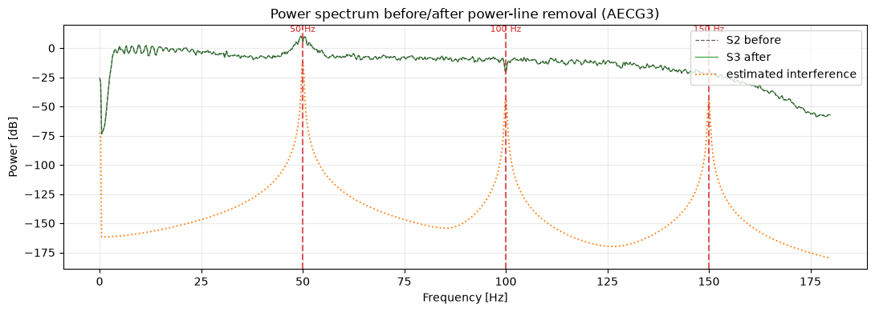
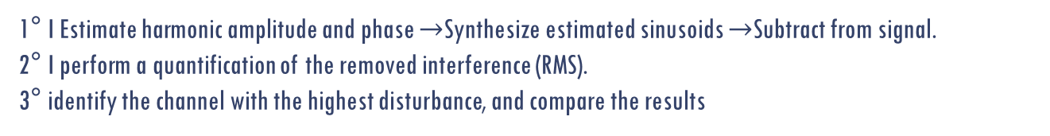
Power-line interference
From S2 to S3
Power-line interference: is a narrow-band noise occurring at 50 Hz and its higher harmonics (100 Hz and 150 Hz).
I use a time-adaptive estimation and subtraction method
1° I Estimate harmonic amplitude and phase $→$Synthesize estimated sinusoids $→$Subtract from signal.
2° I perform a quantification of the removed interference (RMS).
3° identify the channel with the highest disturbance, and compare the results

Slide 6
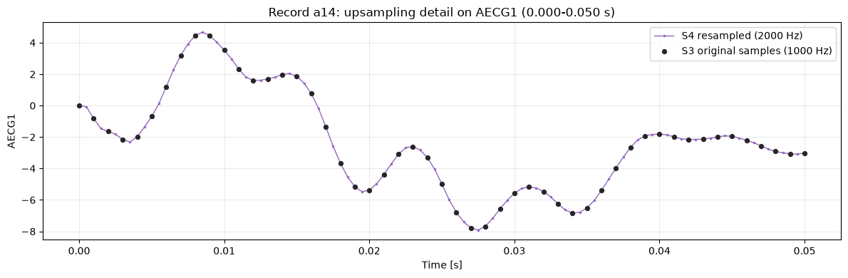
upsampling
From S3 to S4
Upsampling: Increases the sampling frequency from 1000 Hz to 2000 Hz to enable fine alignment of the average template with each R-peak.
The sampling interval is reduced from 1 ms to 0.5 ms,
doubling the number of samples per channel from 60,000 to 120,000.

Slide 7
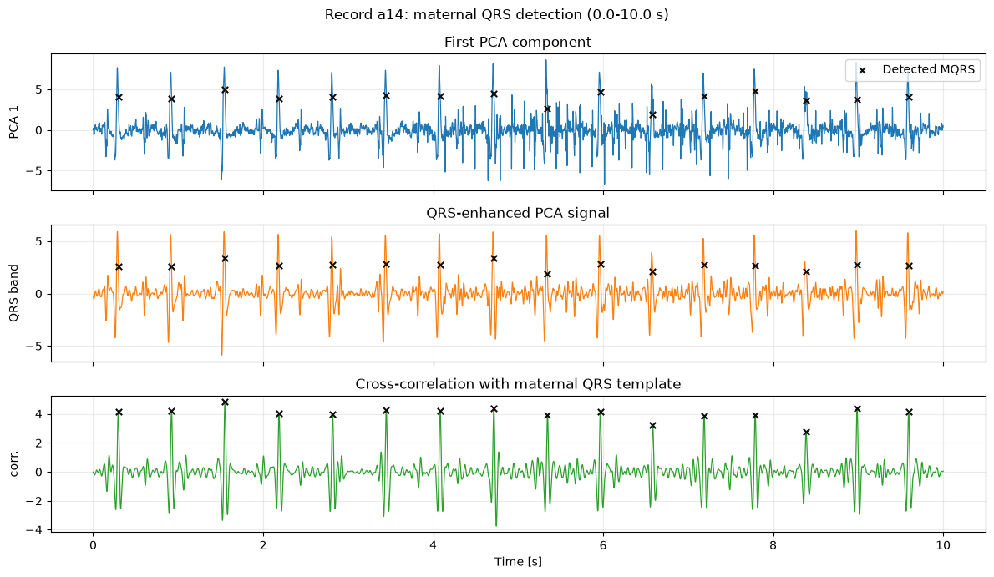
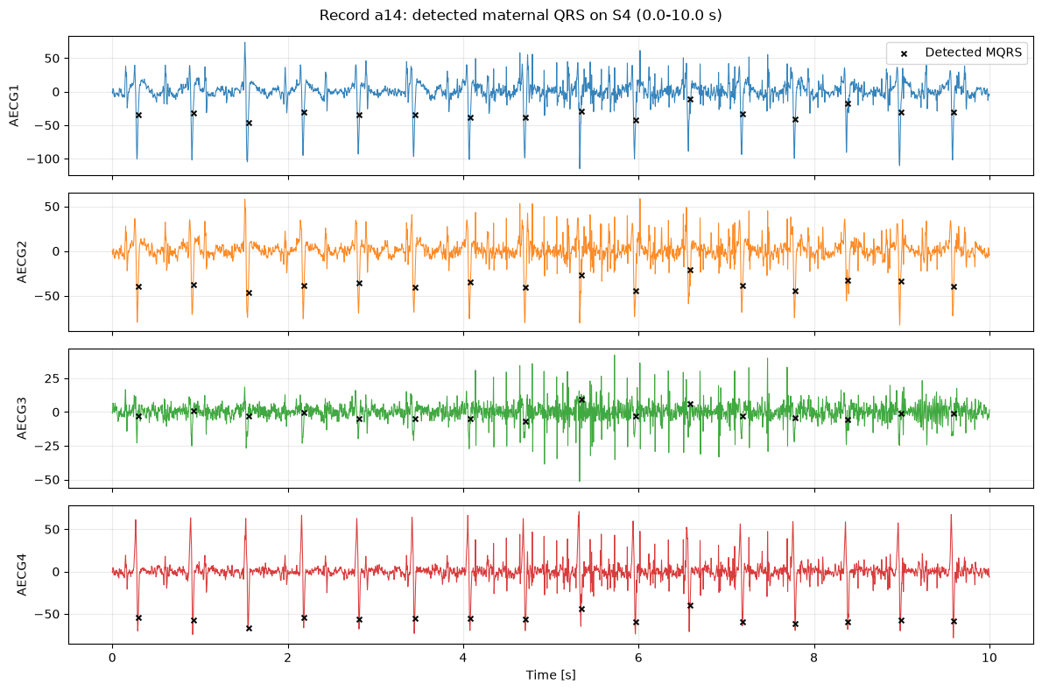

Mqrs detection
S4
To detect mathernal QRS I use three different steps:
1° PCA (principal component analysis)
2° I reconstruct the ideal maternal QRS complex
3° I find the actual beats $→$ thanks to an index table that I am going to use on the next step.

Slide 8
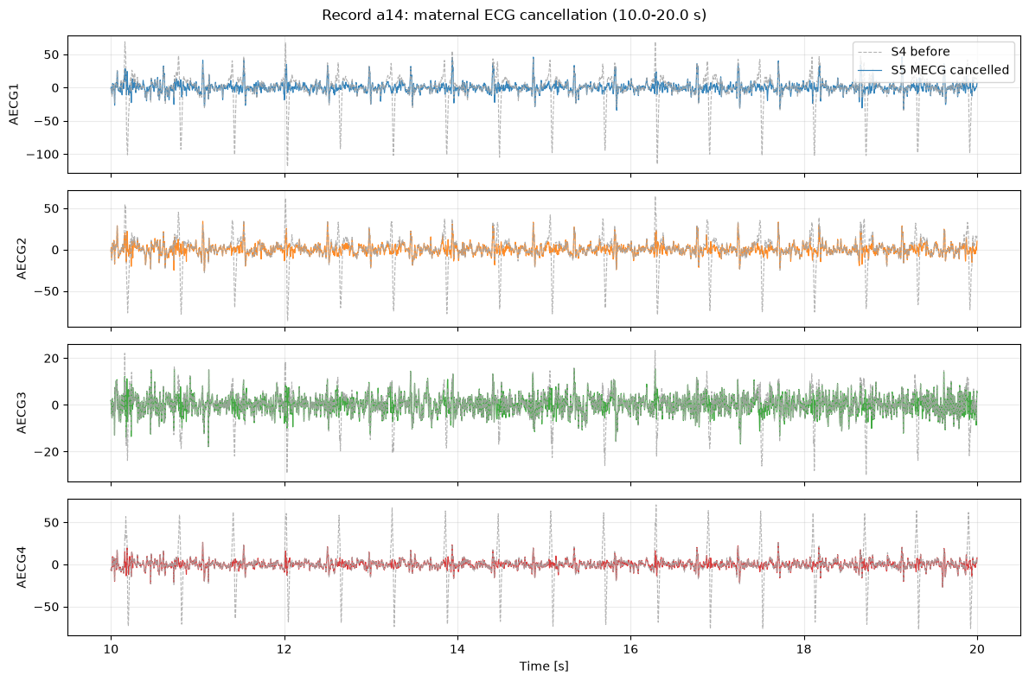
Mqrs removed
From S4 to S5
For each maternal beat, the algorithm uses the 10 preceding maternal beats to build a local maternal ECG estimate. The estimate is split into P-wave, QRS-complex, and T-wave zones. Each zone is scaled separately, then the full estimated maternal ECG is subtracted.
After that As a simple check, I compare the RMS amplitude around the maternal QRS positions before and after cancellation. A lower RMS after cancellation means that the large maternal QRS peaks were reduced.

Slide 9
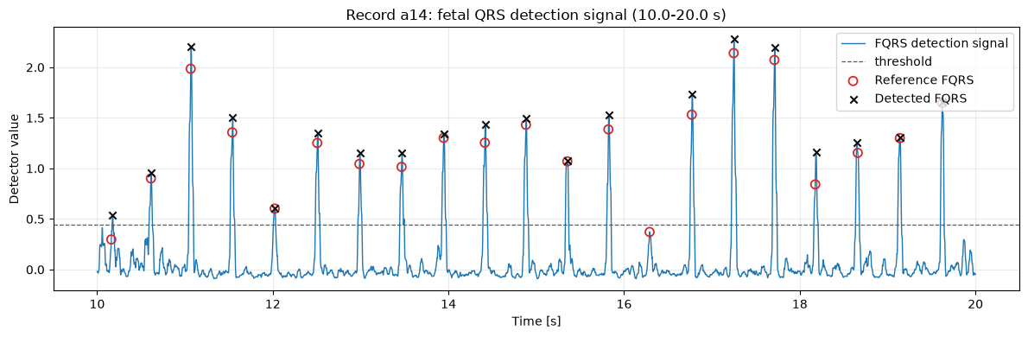
fqrs removed
From S5 to S6
I detects fetal QRS positions and evaluates them against the reference annotations supplied by PhysioNet.
I use .fqrs file, converting it into 2000 Hz.
A detected fetal beat is counted as correct if it falls within 50 ms of a reference fetal beat. This gives true positives, false positives, false negatives, sensitivity, positive predictive value, and F1-score. I also calculate the mean fetal R-R interval and the estimated fetal heart rate from the detected fetal beats.

Slide 10
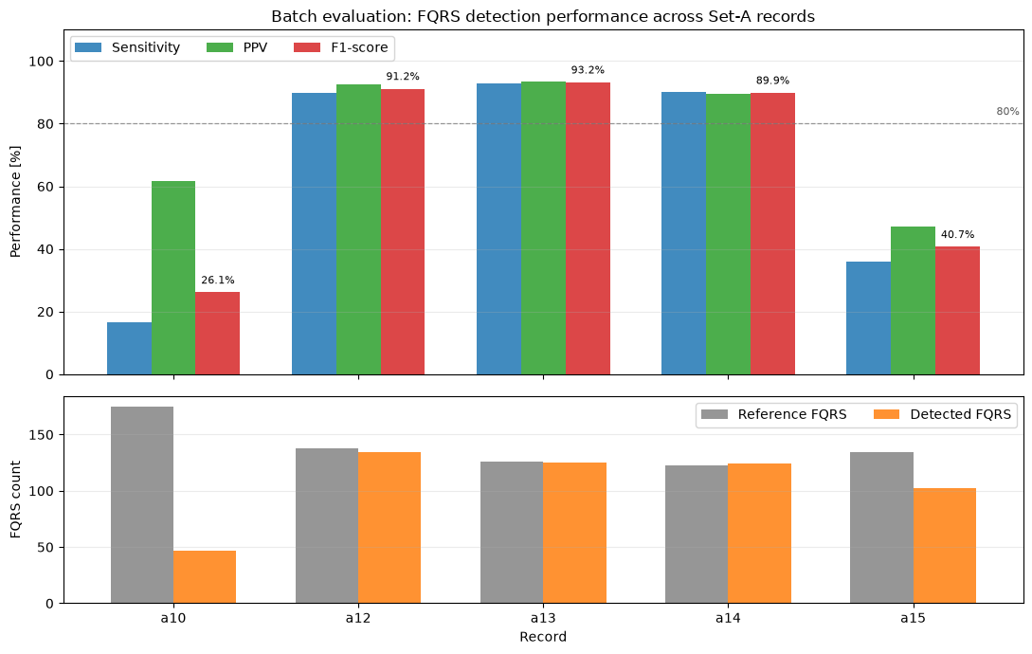
Batch evolution on other records
For the project, it is useful to show that the implementation can also be tested on multiple recordings
We use five Set-A records: a10, a12, a13, a14, a15
These four records check whether the same code also runs on different signals. `a11` was not used in this small final batch because the PCA step did not converge on that record with the fixed parameters

