Slide 1


Data Science Intern Application
Sofian Othmane
MSc Data Science and Economics (UCL)

Slide 2
Introduction
The Challenge: Predicting Credit Default
Credit scoring is a fundamental risk management tool in the financial services industry, serving as the cornerstone of lending decisions. It aims to balance two competing objectives: expanding the lending portfolio while minimizing exposure to default risk
The Dataset:
The dataset contains 30,000 records of Taiwanese credit card clients, covering the period from April to September 2005. It includes 23 variables grouped into three main categories:
Demographics: Gender, education, marital status, and age.
Financial Behaviour: Six months of payment history, bill statement amounts, and previous payments.
Target Variable: Binary indicator of default status (1 = default, 0 = non-default).
This dataset provides a comprehensive view of credit card usage and repayment behaviour, forming the foundation for the predictive credit scoring model.

Slide 3
Introduction
Understanding Credit Scoring
Credit scoring represents a systematic approach to evaluating the creditworthiness of potential borrowers by predicting their likelihood of default.
At its core, credit scoring translates complex borrower characteristics into a single numerical value that represents credit risk. This transformation allows lenders to make consistent, data-driven decisions about loan approvals, interest rates, and credit limits.

Slide 4
Methodology
I develop a credit scoring model to predict default risk using the Taiwan credit card dataset. The analysis prioritises recall and cost-sensitive evaluation to minimize undetected defaults while ensuring interpretability and fairness. (This is assuming the position of a firm that wishes to minimise their capital at risk, which is common in industry)
The process includes:
Data Preparation – Cleaning, preprocessing, and handling missing values.
Exploratory Analysis – Identifying key trends in payment behaviour and financial indicators.
Model Training & Evaluation – Comparing multiple models, optimising for recall, and ensuring robustness.
Feature Importance – Highlighting the most influential predictors for transparency and decision-making.
The final model balances predictive accuracy, fairness, and regulatory compliance, offering actionable insights for financial institutions to enhance lending strategies and risk management.

Slide 5
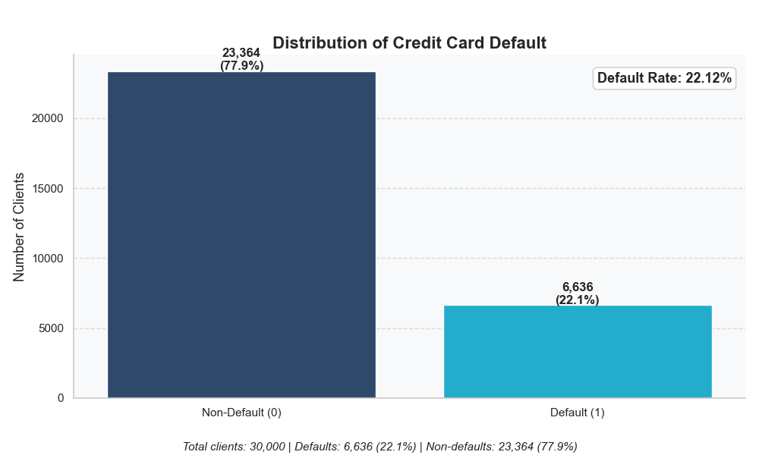
Target Variable Analysis
Our target variable is a binary label: ‘Default’ vs. ‘Non-Default’ .Thus fitting a classification framework.
Approximately 22% of borrowers are defaulters, while 78% are not.
Such an imbalance can distort naïve accuracy metrics, leading us to emphasize metrics that focus on catching defaulters.
Financial Theory: Reducing Probability of Default (PD) misestimation is critical for provisioning and regulatory capital requirements.

Slide 6
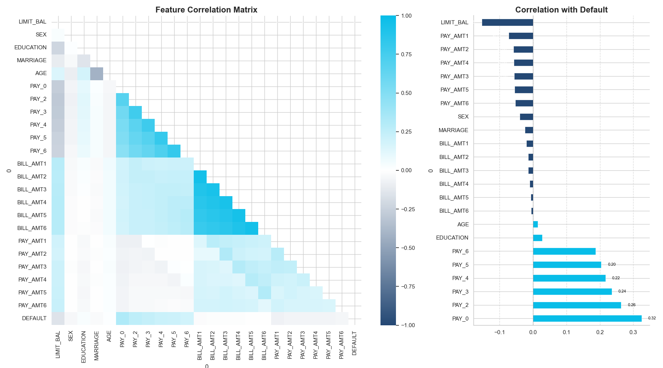
Correlation Matrix

Slide 7
Correlation Matrix
From the correlation matrix we can see the following:
The top predictors were all recent missed payments – suggesting that the most likely people to default had missed recent payments. This is key for early default detection.
From the plot we can see that the most impactful negative covariate with default is the limit balance – this is trivial as higher payment ratios are associated with lower default risk.
We can therefore say payment timeliness is a major determinant of creditworthiness; this is confirmed by real world practices within the credit markets globally.

Slide 8
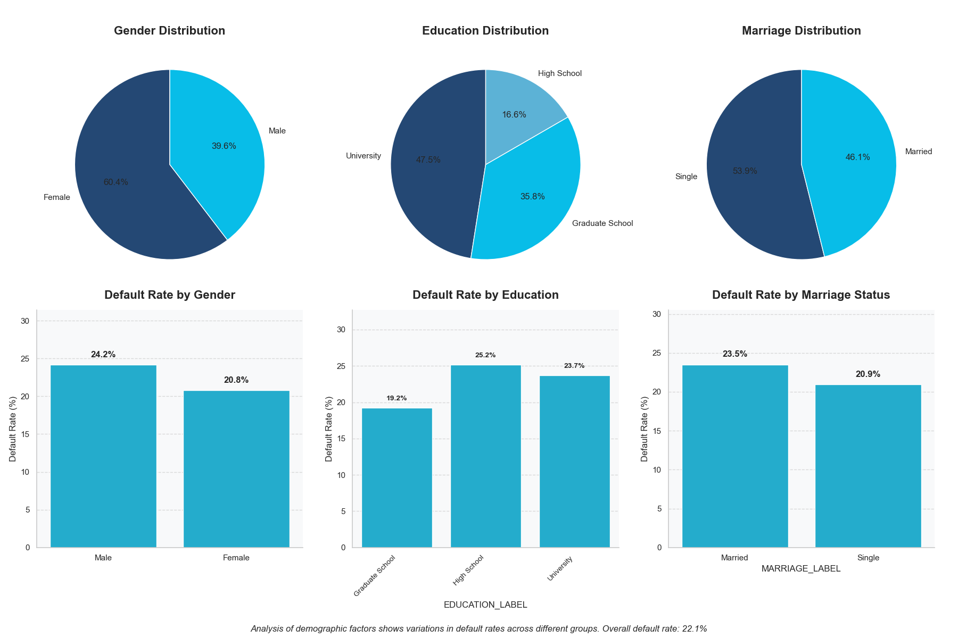
Demographic Analysis
Gender: Men exhibit ~24% default rate vs. ~21% for women; potential distinctions in debt management.
Education: Advanced degrees show higher default incidence, aligning with possible higher levels of debt from education.
Marital Status: Singles default marginally more than married customers, suggesting possible household income stability factors.
Regulatory Caveat: Certain demographic attributes may be restricted or scrutinized under fair lending regulations, hence they are not used in model.

Slide 9
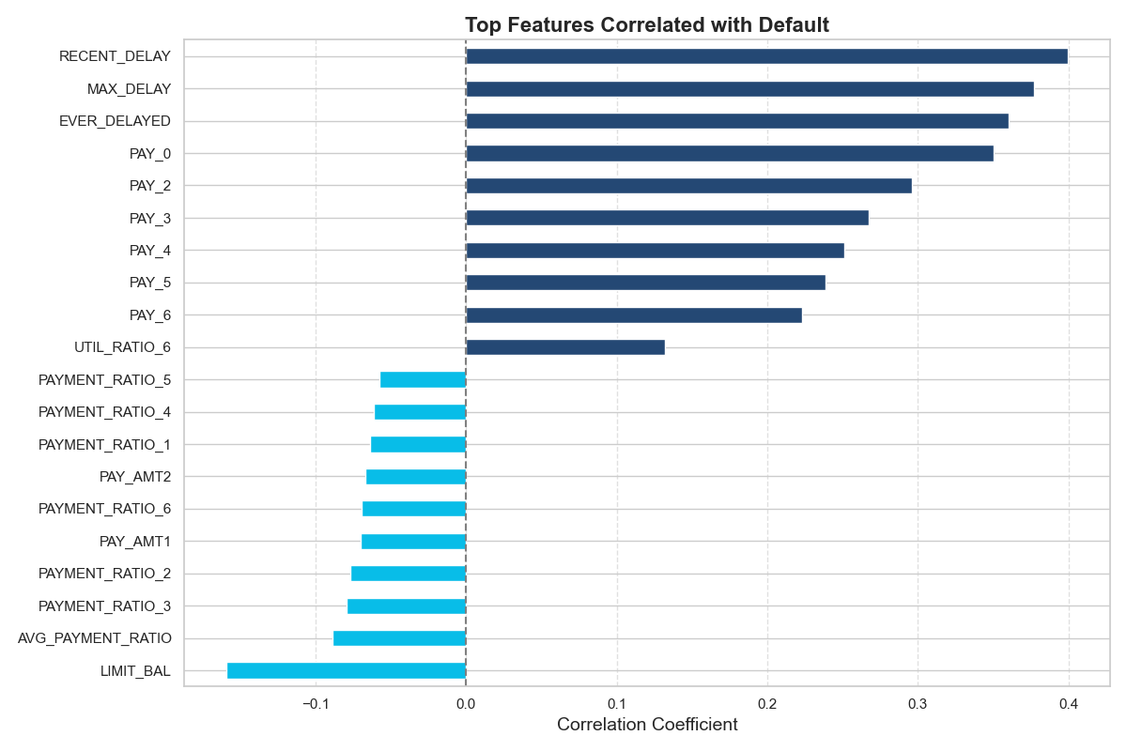
Feature Engineering
I created new features to allow for better group splitting, these include:
Behavioural Indicators:
EVER_DELAYED flags any historical missed payment.
MAX_DELAY captures the worst delay severity.
RECENT_DELAY applies heavier weights to newer delinquencies.
Utilization Metrics:
UTIL_RATIO (bill / credit limit).
PAYMENT_RATIO (actual payment / bill amount).
The variable encoding and feature engineering improve model granularity by quantifying risk patterns more precisely than raw data alone. This allows our gradient boosted model to make better splits on data paths.

Slide 10
Benchmark Model – Logistic Regression
Model theory:
Maps input features to a linear function of log-odds
Predicted default probability = 𝜎(𝛽0+𝛽1𝑋1+⋯+𝛽𝑛𝑋𝑛)σ(β 0​ +β 1​ X 1​ +⋯+β n​ X n​ ), where σ is the sigmoid function.
It assumes a roughly linear relationship between features and log-odds of default.
Caveat
The linear log-odds assumption may be too rigid for complex borrower behaviours, potentially limiting recall if defaults arise from nonlinear interactions among features (e.g., payment patterns).

Slide 11
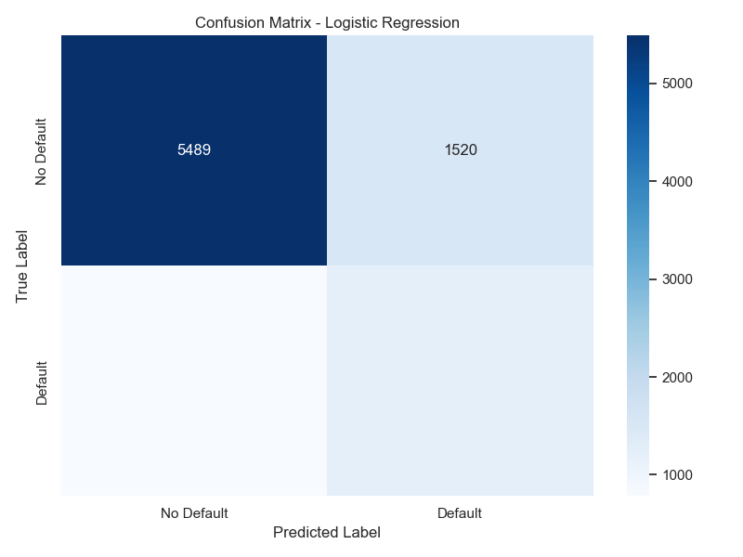
Benchmark Model – Logistic Regression
Performance in This Context
Achieved ~60% recall. This means 40% of defaulters still go undetected (false negatives).
Precision around 44%, which indicates a moderate level of false positives.
While workable as a first pass, it leaves room for improvement, especially regarding missed defaulters.

Slide 12
Optimized Model – Gradient Boosting
Model Theory
Gradient Boosting is an ensemble method that trains a sequence of weak learners (decision trees), each one correcting errors of the previous.
By iteratively adding trees, the model effectively captures nonlinear patterns and interactions.
Why It Can Excel
Nonlinear & Interaction Effects: Captures complex borrower behaviours beyond logistic regression’s linear assumption.
High Predictive Power: Often outperforms simpler models on tabular data like credit records.

Slide 13
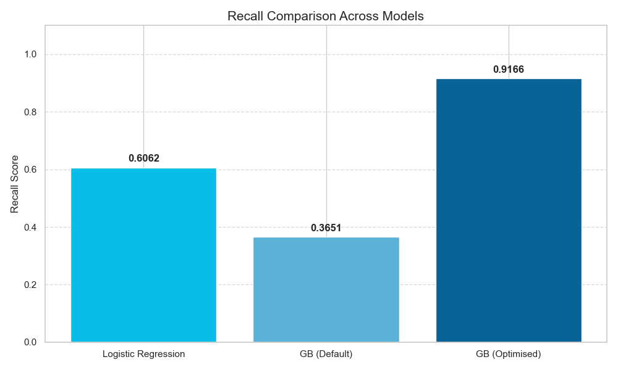
Model Comparison

Slide 14
Final Remarks
Head-to-Head Results (optimised for recall):
Logistic Regression: ~60% recall, simpler to interpret, easily validated by auditors and regulators.
Gradient Boosting (Threshold 0.5): Less recall (~36%) but high precision (~67%).
Gradient Boosting (Threshold 0.1): Maximum recall (~92%) but lower precision (~29%).
Practical Decision Factors
Business Risk Appetite: How costly are missed defaults vs. the operational burden of many false alerts?
Regulatory Environment: Stringent regulations often prefer interpretable models or require robust explainability.
Operational Capacity: High false positives can overwhelm credit officers with extra follow-ups.
Recommendation
Tune thresholds (and possibly cost functions) to balance risk of defaults against the burden of false positives.
If the firm strongly prioritizes not missing defaults (i.e., capital at risk is very high), the boosted model with a lower threshold is ideal.
For simpler, more transparent deployment, logistic regression is standard but may under-detect some high-risk accounts.

