Slide 1


NUnit Testing
By Sofiya Khan

Slide 2
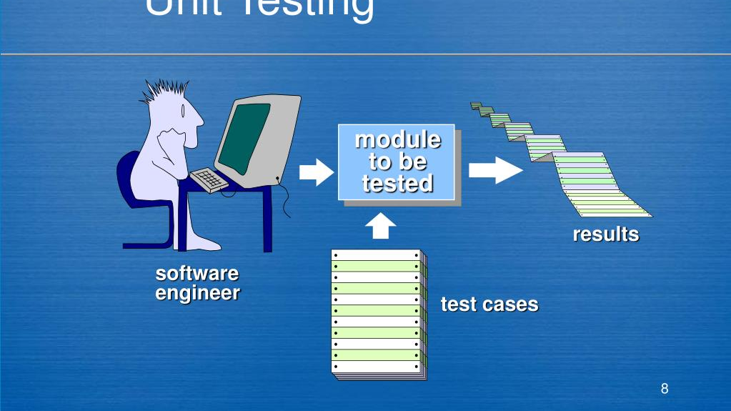
What is Unit Testing ?
A unit testing is a software testing method where individual components or functions are tested in isolation.

Slide 3
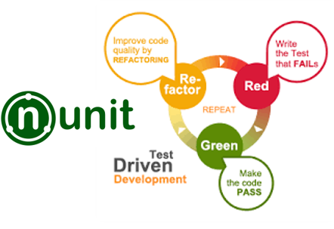
What is NUnit Testing ?
NUnit is an open-source unit testing framework for all.NET languages, enabling developers to write and run automated tests easily.

Slide 4
Attributes
[Test]: Indicates a method that is a test case.
[SetUp]: Specifies a method to run before each test executes.
[TearDown]: Specifies a method to run after each test completes.
[Ignore]: Used to skip a test method.
[TestCase]: attributes demonstrate how to run the same test with different inputs to validate various scenarios.

Slide 5
Assertions Method
Assert.AreEqual(expected, actual): Checks if two values are equal.
Assert.IsTrue(condition): Asserts that a condition is True.
Assert.IsFalse(condition): Checks if a condition is False.
Assert.IsNull(object): Asserts that the provided object is null.
Assert.IsNotNull(object): Asserts that the provided object is not null.

Slide 6
Example
[Test]
public void IsPrime_InputIs1_ReturnFalse()
{
var result = _primeService.IsPrime(1);
Assert.That(result, Is.False, "1 should not be prime");
}
}
}
using NUnit.Framework;
using Prime.Services;
namespace Prime.UnitTests.Services
{
[TestFixture]
public class PrimeService_IsPrimeShould
{
private PrimeService _primeService;
[SetUp]
public void SetUp()
{
_primeService = new PrimeService();
}

Slide 7
Advantages of Nunit
Easy to Use: NUnit provides a user-friendly interface and straightforward syntax, making it easy for developers to write and manage tests efficiently.
Parameterization Support: NUnit allows for parameterized tests using attributes like [TestCase] and [TestCaseSource], enabling the same test to run with different inputs.
Rich Assertion Library: It offers a comprehensive range of assertion methods, which makes it easier for developers to validate outcomes and ensure code quality.
Parallel Test Execution: It facilitates running tests in parallel, reducing the overall time required for test execution while maintaining reliability.

Slide 8
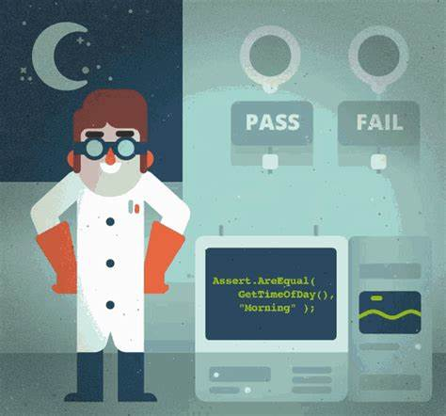
Conclusion
Overall, the NUnit framework provides a robust, user-friendly, and flexible environment for unit testing in.NET applications. Its comprehensive feature set, extensive community support, and ease of integration make it an excellent choice for developers aiming to enhance the quality and reliability of their software through automated testing.

Slide 9

Any Question ?

Slide 10

Thank You

