Slide 1
Physiological signal analysis and open science using the Julia language and associated software
Authors of the article:
George Datseris, Jacob S. Zelko
Presentation author: Sofiya Zhiltsova

Slide 2
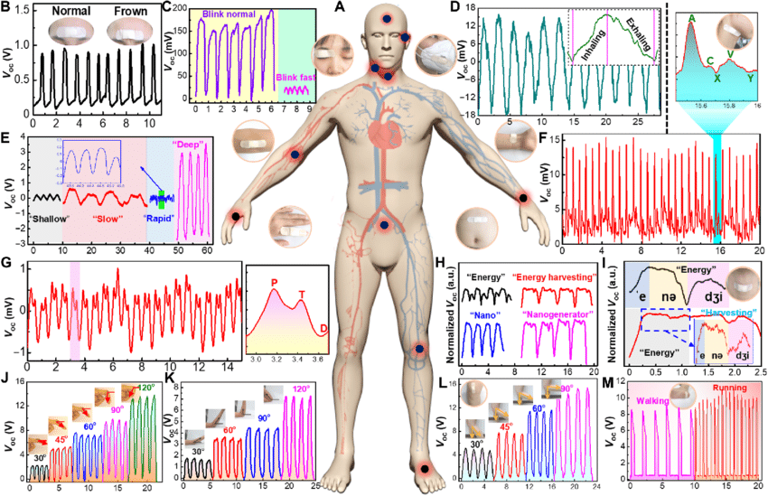
The challenges in physiological signal processing

Slide 3
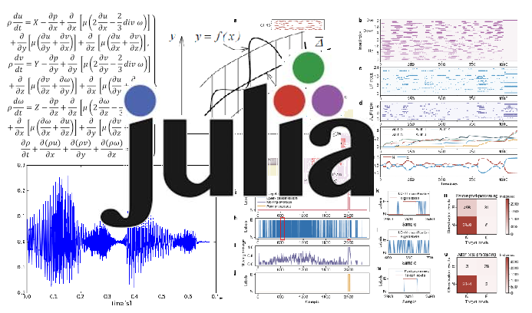
Digital signal processing capabilities in Julia

Slide 4
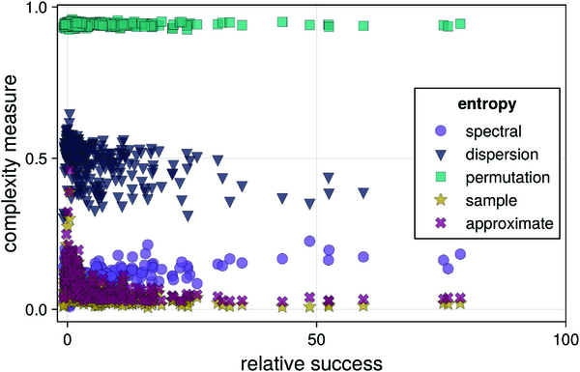
Complexity measures and their importance

Slide 5


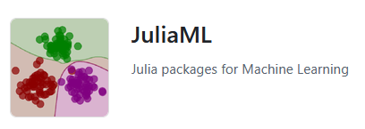

Open and reproducible science with Julia

Slide 6
Thank you for your attention

