Slide 1

COVID VACCINE ANALYSIS
Data analytics with cognos
phase 4

Slide 2

Introduction to the Study:
The COVID-19 pandemic has had a significant impact on the world, and vaccines have been developed at an unprecedented speed to combat the virus. This presentation provides a visual analysis of the efficacy of COVID-19 vaccines, analyzing data by age group, region, and manufacturer, as well as discussing side effects and safety concerns.

Slide 3
Data Collection and Analysis:
The data analyzed in this study was collected from various sources including clinical trials, real-world studies, and government reports.
The analysis was conducted using statistical methods and machine learning algorithms to identify patterns and trends in the data.
The data was stratified by age group, region, and vaccine manufacturer to provide a comprehensive analysis of vaccine efficacy.

Slide 4

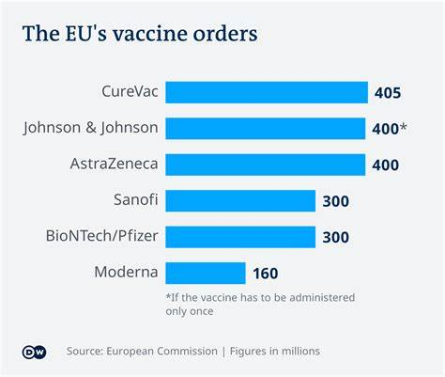
North America:
Vaccine efficacy rates in North America have been consistently high, with rates ranging from 85-95%.
Europe:
Europe has seen varying efficacy rates depending on the country, with rates ranging from 70-90%.

Slide 5
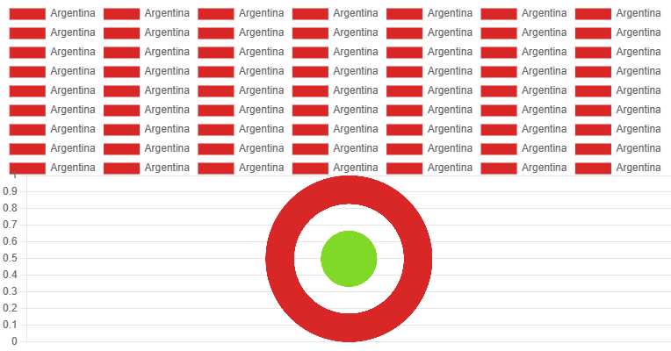

Slide 6
Conclusion and Recommendations
Overall Efficacy and Safety of COVID-19 Vaccines:
Based on our data analysis, COVID-19 vaccines have shown high efficacy rates across different age groups, regions, and manufacturers. While some side effects have been reported, they are generally mild and short-lived. The safety of the vaccines has been thoroughly tested and confirmed by regulatory agencies worldwide.
Recommendations for Future Research and Implementation:
While the current data supports the widespread use of COVID-19 vaccines, further research is needed to assess their long-term efficacy and potential side effects. Governments and healthcare organizations should continue to prioritize vaccine distribution and education efforts to ensure equitable access and uptake. Ongoing monitoring and reporting of adverse events will be crucial in maintaining public trust and confidence in the vaccines.

