Slide 1
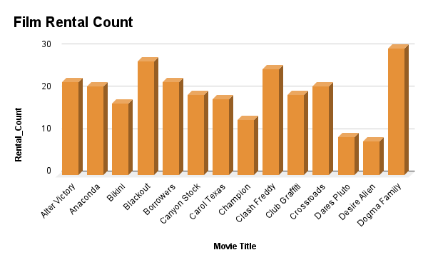
Create a query that lists each movie, the film category it is classified in, and the number of times it has been rented out.
We want to understand more about the movies that families are watching. The following categories are considered family movies: Animation, Children, Classics, Comedy, Family and Music.
The chart shows the number of times a sample of 14 movies were rented out.

Slide 2
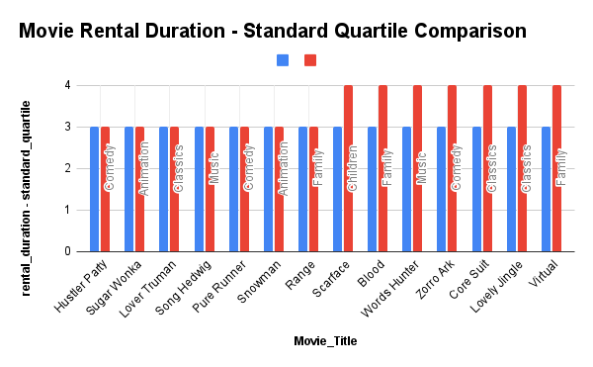
Provide a table with the movie titles and divide them into 4 levels (first_quarter, second_quarter, third_quarter, and final_quarter) based on the quartiles (25%, 50%, 75%) of the rental duration for movies across all categories
Now we need to know how the length of rental duration of the family-friendly movies compares to the duration that all movies are rented for.
The data is not very spread out to create a very fun looking visualization.
The red column indicates the standard quartile while the blue column indicates the rental duration of the movie.

Slide 3
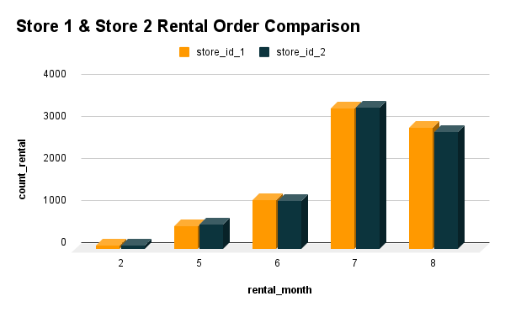
Write a query that returns the store ID for the store, the year and month and the number of rental orders each store has fulfilled for that month. Your table should include a column for each of the following: year, month, store ID and count of rental orders fulfilled during that month
We want to find out how the two stores compare in their count of rental orders during every month for all the years we have data for.
From the chart, we can see that both store have almost equal amount of order in the months movies are rented out.

Slide 4
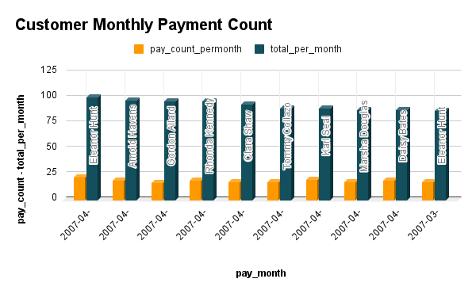
Write a query to capture the customer name, month and year of payment, and total payment amount for each month by these top 10 paying customers
We would like to know who were our top 10 paying customers, how many payments they made on a monthly basis during 2007, and what was the amount of the monthly payments.
The chart shows the top 10 paying customers and the number of times they pay in a month

