Slide 1

House Renting Application using MERN
Team members:
Saraniya B, Sofiya Rahamath A, Shareen S, Varshaa M B.Tech IT 4th year
Meenakshi College of Engineering

Slide 2
Objective
The objective of the house renting app is to revolutionize the rental experience by offering an intuitive, all-in-one platform that caters to both landlords and tenants.
It aims to simplify the entire process of renting by enabling landlords to easily list their properties with comprehensive details, including high-quality photos, accurate pricing, and up-to-date availability. For tenants, the app provides powerful search filters, allowing them to find properties based on specific preferences such as location, prize, type, and amenities.
The platform ensures a secure and transparent transaction environment through integrated payment systems, contracts, and messaging tools, fostering seamless communication between both parties.
Additionally, the app prioritizes user experience with features like virtual tours, real-time availability updates, and property reviews, helping build trust and confidence.
Overall, the goal is to enhance convenience, accessibility, and security for all users, making the house renting process faster, easier, and more reliable.

Slide 3
Problem Statement
The problem that the house renting app seeks to address is the complexity and inefficiency of the traditional house rental process. Both landlords and tenants often face challenges such as time-consuming property searches, difficulty in finding suitable rental options, lack of transparency in pricing and property details, and unreliable communication channels. For tenants, finding properties that meet their specific needs can be overwhelming and time-consuming. On the other hand, landlords struggle with effectively marketing their properties to a wide audience, handling inquiries, and managing the administrative aspects of renting.
Solution
The house renting app offers a seamless solution to the challenges faced by both landlords and tenants. It provides an easy-to-use platform with advanced search filters, allowing tenants to find properties that meet their specific needs quickly. Landlords can create detailed listings with full transparency, including photos, pricing, and availability. The app facilitates direct bookings between landlords and tenants, eliminating delays and miscommunication. With features like real-time availability updates, the app ensures a secure, efficient, and trustworthy rental experience for all users.

Slide 4
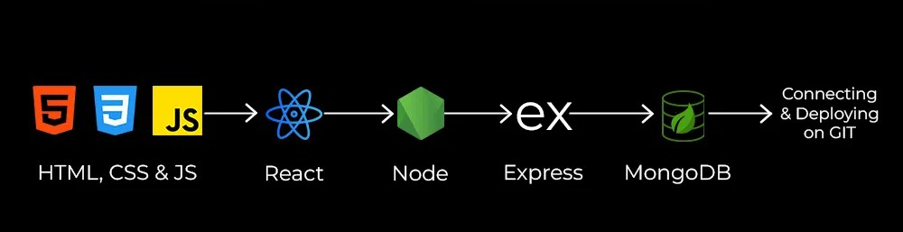
Roadmap to MERN
M - MongoDB (NoSQL database)
E - Express.js (backend framework)
R - React.js (frontend library)
N - Node.js (JavaScript runtime environment)

Slide 5


Introduction to the App
Web-based platform for finding and renting properties.
1
User-Friendly Interface
2
Efficient Communication
Connecting renters and landlords easily.
Seamless navigation and intuitive design.
3
Comprehensive Property Listings
Detailed descriptions, photos, and virtual tours for each property.

Slide 6

Key Features for Success
Streamlined search and rental processes.
Property Listings
Search Filters
Direct Communication
Details, photos, and pricing.
Refine by location, price, type, amenities.
Messaging feature for inquiries and booking.

Slide 7
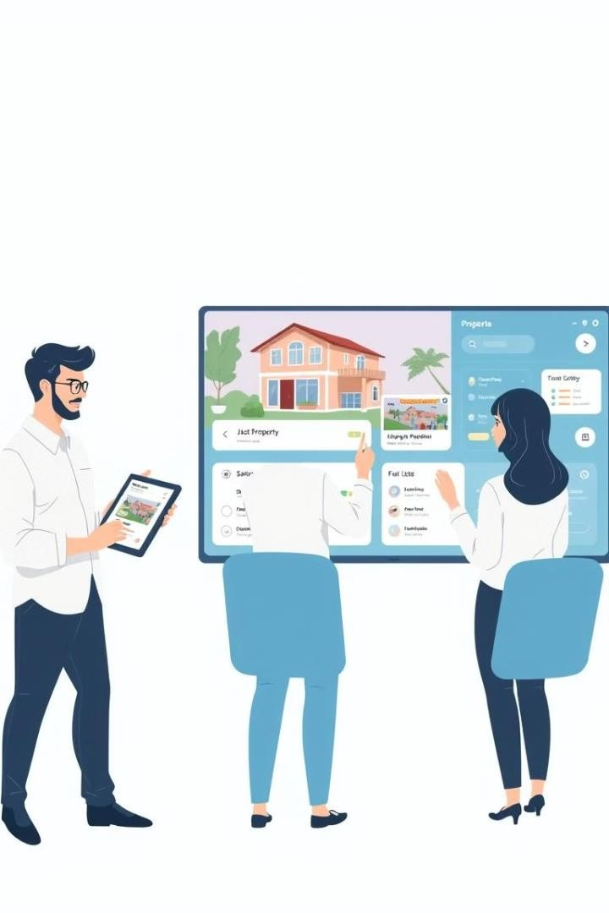
User Roles and Workflows
Distinct workflows for each user type.
User Type Functions
Renters Search, inquire, book.
Property Owners
List properties, manage inquiries.
Admins
Platform oversight, account approvals.

Slide 8

ROLE BASED ACCESS
Renter’s role:
In the house renting app, the renter's role is to search for, explore, and apply for rental properties that meet their specific needs. Renters can create a profile, set preferences based on location, budget, size, and amenities, and browse through detailed property listings. They can contact landlords directly schedule viewings or book the properties. They can browse listings, filter search results, and view detailed property descriptions, including photos, floor plans, and pricing. Renters can also check availability in real-time. Once they find a suitable property, they can apply for it.

Slide 9

ROLE BASED ACCESS
Landlord’s role:
In the house renting app, the landlord's role is to manage and list their rental properties, interact with potential tenants, and facilitate the rental process. Landlords begin by creating a profile and adding detailed listings for each property, including high-quality photos, property descriptions, pricing, and availability.
Landlords can respond to the bookings or scheduled viewings. Furthermore, landlords can help to build a trustworthy rental community. Ultimately, the landlord's role is to efficiently manage the listing, ensure the property is well-maintained, and complete the enquiring and ensuring smoothly and securely through the app.

Slide 10
Technical Architecture Overview
MERN stack for robust and scalable app.
Frontend
React.js, Bootstrap, Material UI.
React.js provides a component-based architecture for building user interfaces. Bootstrap provides a responsive and mobile-friendly framework for styling. Material UI offers a
pre-built set of components for creating modern and visually appealing interfaces.
Backend
Node.js, Express.js, MongoDB.
Node.js offers a JavaScript runtime environment for building server-side applications. Express.js provides a web application framework that simplifies routing, middleware, and API development. MongoDB offers a document-based database system that scales well with growing data requirements.

Slide 11

Database Design and
Functionality
Optimized for efficient data handling.
Users Collection
Renter and owner profiles.
Properties Collection
Details, photos, pricing.
Inquiries and Bookings
Tracks inquiries, bookings, and statuses.

Slide 12
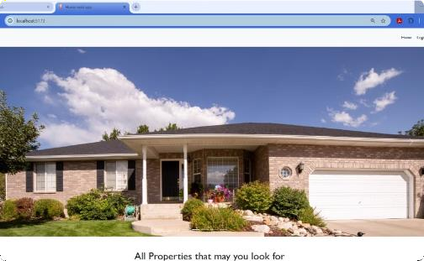
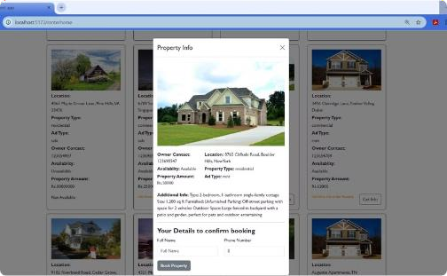
Visualizing the App's Interface
Clean and intuitive user experience.
Home Screen
The home screen of your house renting app features a clean, user-friendly interface designed for easy navigation.
Property Info
It provides a comprehensive overview of the listing, starting with the property title, location which includes a price, contact details for easy navigation.

Slide 13
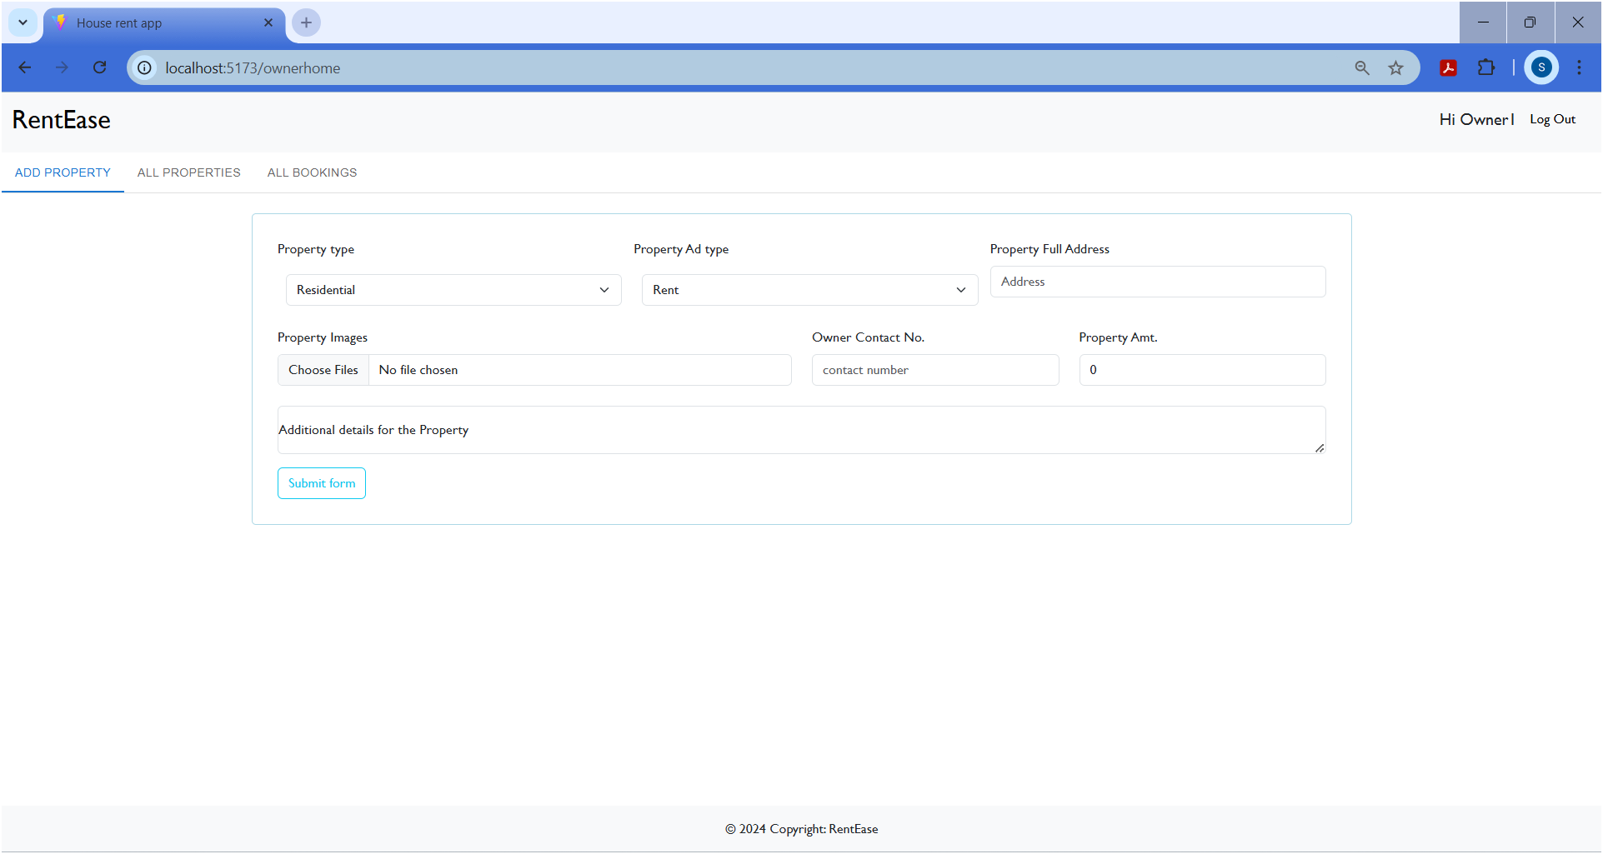
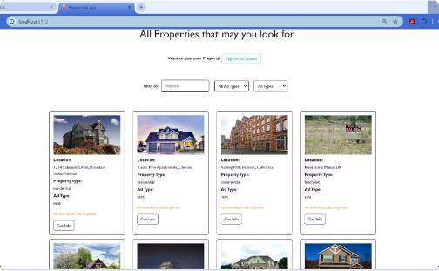
Landlord’s add property feature
The application allows property owners to manage their listings efficiently through features like adding property details (type, ad type, address, and rental amount), uploading property images, and providing additional information. It includes input fields for the owner's contact number and a clear "Submit form" button for easy data submission. The navigation bar offers quick access to "Add Property," "All Properties," and "All Bookings" sections, along with a greeting and logout option.
Renter’s page
The "All Properties" page of the rental app displays a list of available properties in a grid format, with each card showing the property’s image, location, type (residential/commercial), ad type (rent/sale), and a "Get Info" button. Users can filter properties by address, ad type, and property type. Additionally, there's an option for users to register as owners to post their own properties.

Slide 14
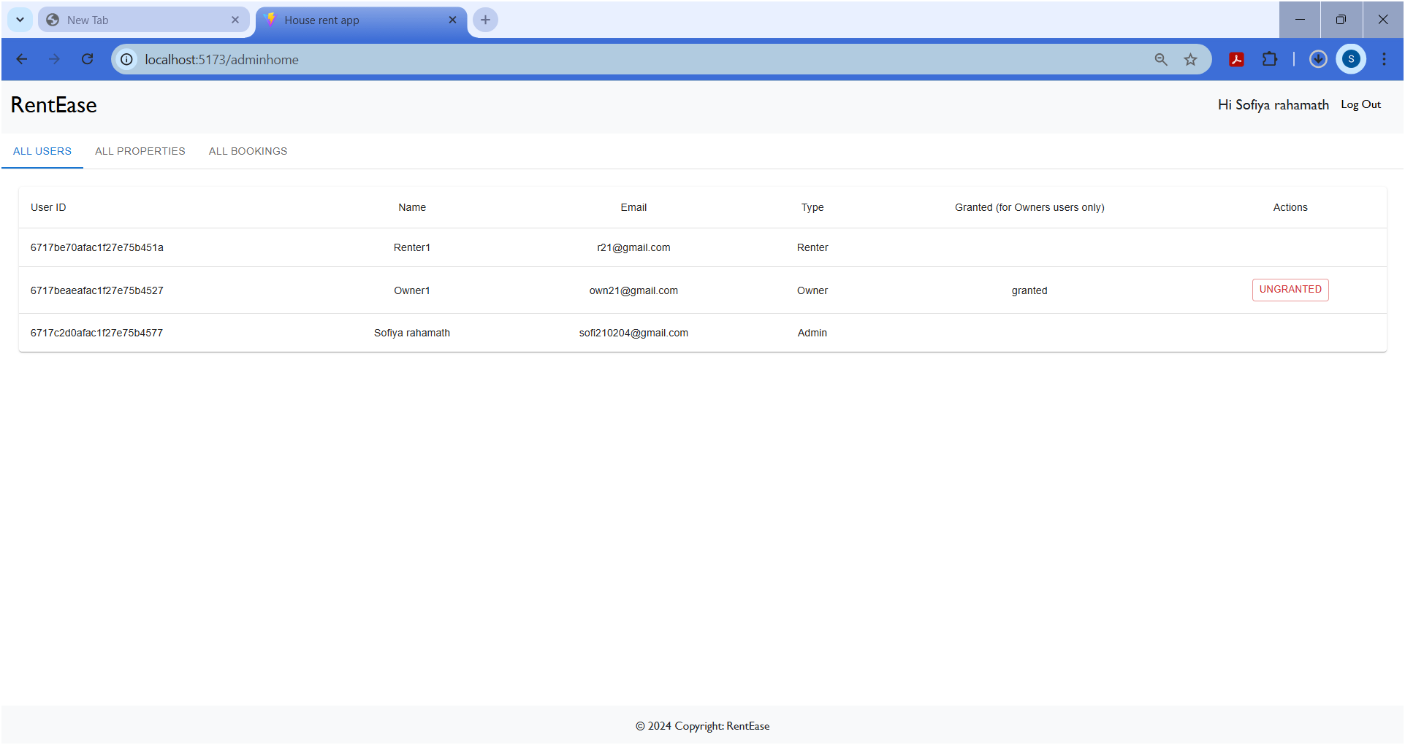
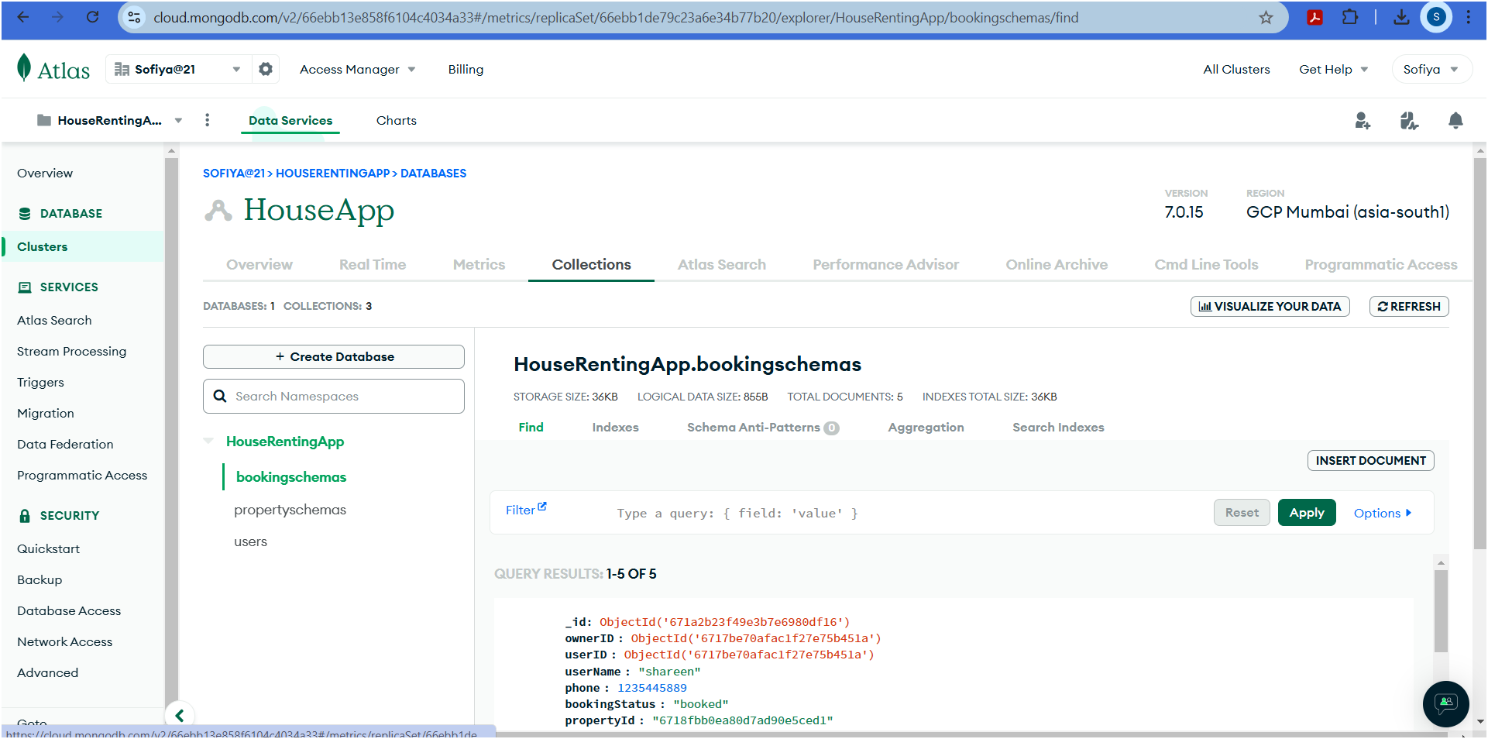
Admin panel
The admin panel of the "RentEase" application displays a user management interface with a table listing users' details, including their unique user IDs, names, email addresses, roles (Renter, Owner, Admin), and permission statuses for owners. Admins can manage permissions through an "UNGRANTED" action button. The page includes navigation links to "All Properties" and "All Bookings," along with a personalized greeting and logout option. A copyright notice is shown at the bottom for a professional touch.
Database details
The image showcases the database of the ‘House renting app’. It consists of all the users, property details and the booking history of the audience.

Slide 15
Challenges and Solutions Encountered
Overcoming obstacles for smooth operation.
Challenge: Image Uploads
Reliable storage and retrieval.
1
2
Solution: Cloud Storage
Efficient image management.
Challenge: Real-Time Notifications
Instant updates for users.
3
4
Solution: Web Sockets
Real-time communication.
Challenge: Scalability
Maintaining performance with growth.
5
6
Solution: Database Indexing
Optimized search speed.

Slide 16
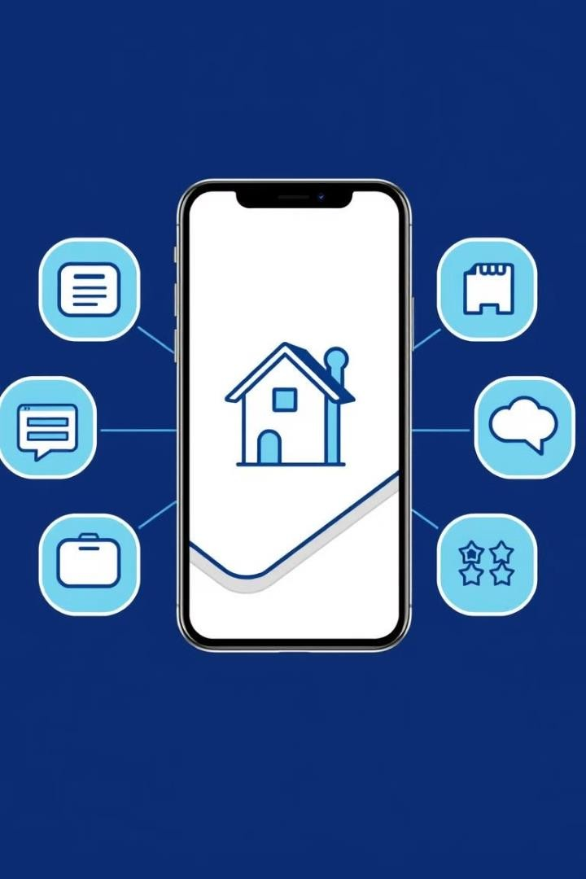



Future Enhancements
Future features for added value.
Integrated Payments
Seamless rent transactions.
AI Recommendations
Personalized property suggestions.
Real-Time Chat
Direct communication between users.

Slide 17
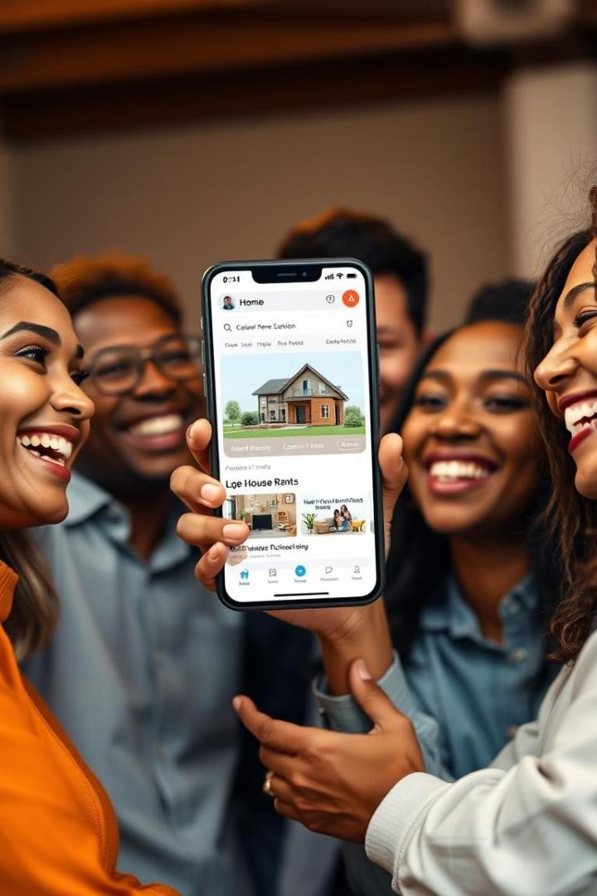

Conclusion and Benefits
Unified platform for a smooth rental experience.
Simplified Process
Efficient search, inquiry, and booking.
MERN Stack
Scalable and user-friendly technology.
Transparency and Security
Trustworthy rental experience for all.

Slide 18


