Slide 1

Using adverbs to express stance
Week 2, Lesson 3
Textbook Unit 3A

Slide 2

Lesson objectives
Recognizing and responding to ideas in a text
Expressing stance using adverbs

Slide 3

Discuss statements 1-5, to what extent you agree or disagree, and why
1. The information on the internet is generally uncensored.
2. On the internet, everyone is treated equally
3. Internet culture, sometimes known as cyberculture, is used more by men than women.
4. Powerful technology companies control people’s behavior on the internet.
5. There are strong commercial pressures on people using the internet.
This Photo by Unknown Author is licensed under CC BY-NC-ND

Slide 4
CYBERCULTURE: the artificial world of the internet. Ex1. Read the text and decide which of the following statements are true, according to the text.
1. The information on the internet is generally uncensored.
2. On the internet, everyone is treated equally
3. Internet culture, sometimes known as cyberculture, is used more by men than women.
4. Powerful technology companies control people’s behavior on the internet.
5. There are strong commercial pressures on people using the internet.

Slide 5

Ex2. Which of the following statements represents the author’s stance?
1. Cyberculture is unlike other cultures and gives its users freedom
2. Cyberculture allows a certain degree of freedom, but with certain limits
3. Cyberculture is broadly similar to other cultures because it greatly limits users’ freedom.
This Photo by Unknown Author is licensed under CC BY-SA-NC

Slide 6
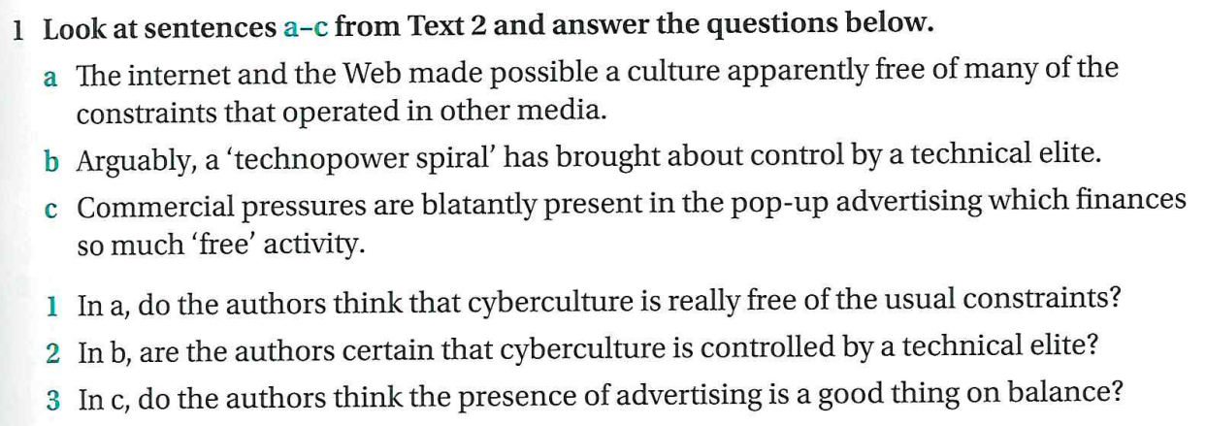
Ex.3

Slide 7
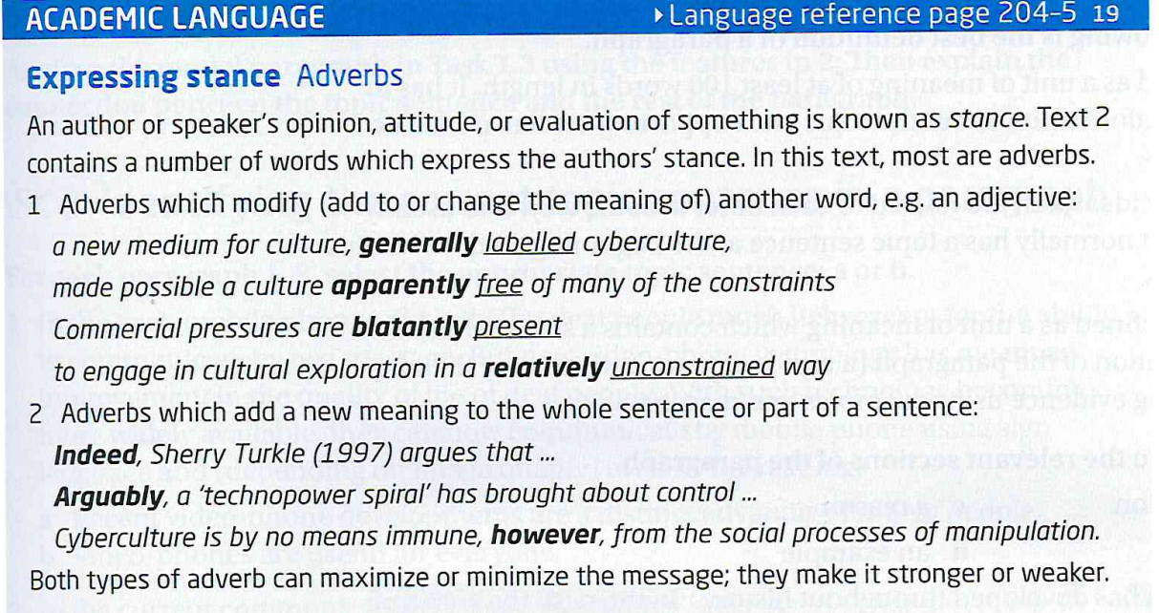

Slide 8
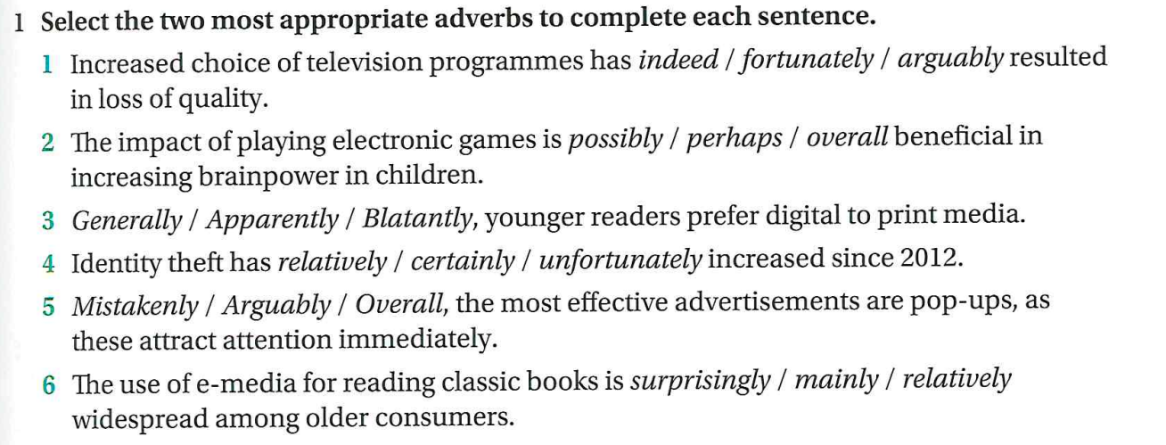

Slide 10
Critical thinking. Discuss the following questions.
Modern media have generally changed our social life for the better. (Agree/Disagree)
Studying is easier now than for people of our parents’ generation. (Agree/Disagree)

Slide 11
Lesson reflection
What new things have your learnt today?
Recall some new words you've learnt in the lesson
Is there anything you didn't understand in the activities or the text?
Could you participate in each activity?
Do you have any questions?

Slide 12
Thank you for your active participation!
See you!

