Slide 1

Crypto-currency Price Prediction with Machine Learning Big Data Parallel Processing by PySpark and Horovod Distributed Deep Learning
Project Team 5
Tso Yiu Chuen, Poon Bing Chun, Li Ka Faat, Shuyue Jia
EID: 90011533, 56200477, 55628042, 56846018
yctso4-c@my.cityu.edu.hk, bcpoon3@my-cityu.edu.hk,
verybighub@gmail.com, shuyuej@ieee.org
Codes are publicly accessible: https://github.com/verybighub/CS5488_Project

Slide 2
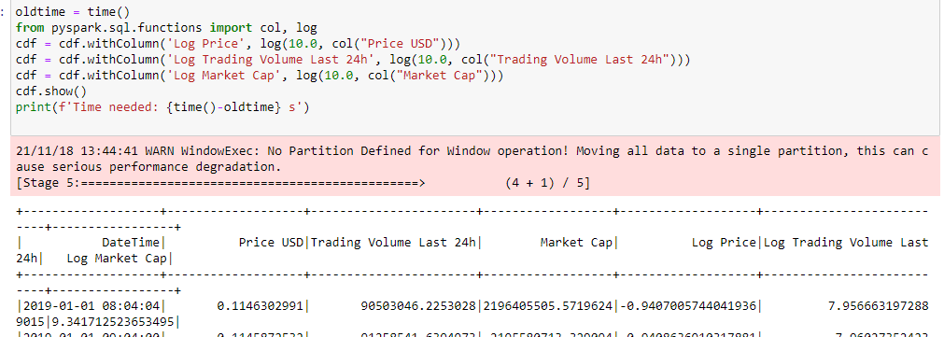

Data Preprocessing by PySpark
Data scaling
→ Use PySpark to process data
≈ twice speed compared with Pandas
→ Apply Log scale to raw data
original value is too large
Notes:
(filter the interval data we want)

Slide 3
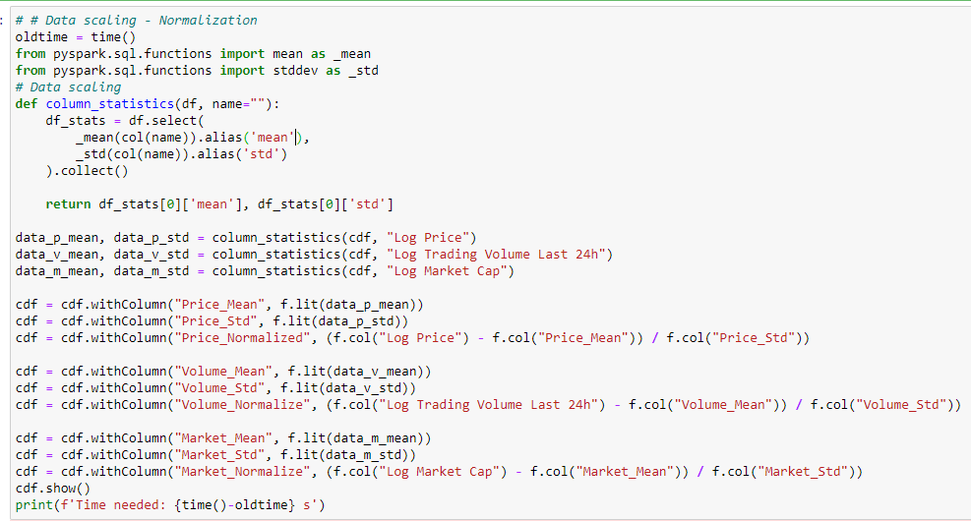
Data Preprocessing by Pyspark
Data scaling
→ Use Zero Mean and Unit Variance Normalization
Notes:
(filter the interval data we want)

Slide 4
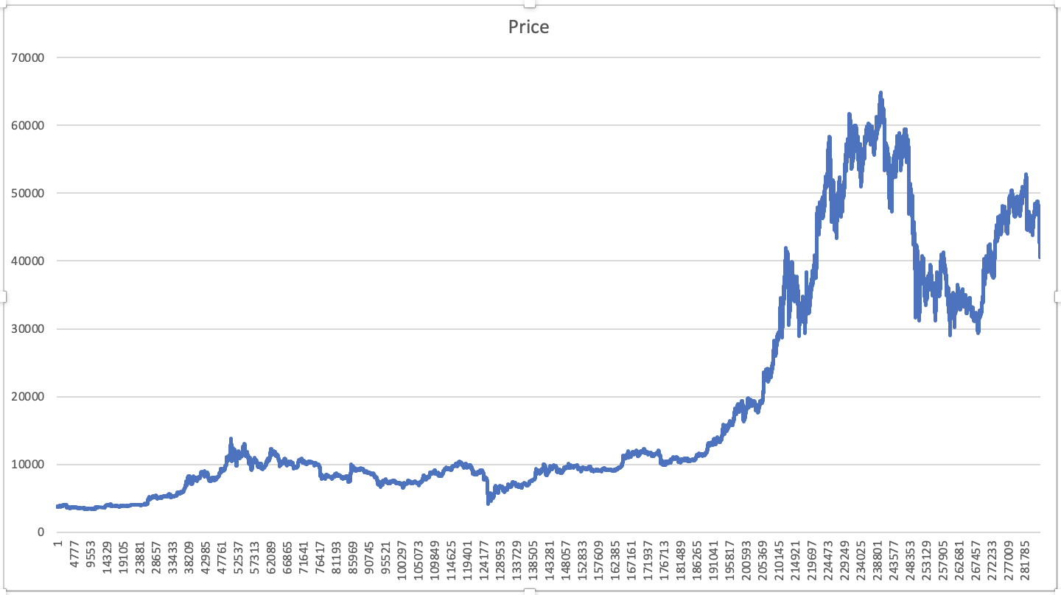
y_{(t)}
Cell’s Output
Long-term State
Forget gate
c_{(t-1)}
c_{(t)}
Input gate
Previous
States
tanh
h_{(t)}
f_{(t)}
g_{(t)}
i_{(t)}
o_{(t)}
Output gate
Short-term State
$$σ$$
tanh
$$σ$$
$$σ$$
h_{(t-1)}
LSTM Cell
Cell’s Input
x_{(t)}
Figure 1: A Long-short Term Memory
Figure 2: Currency Price through time
Reference:
Figure 1 is from Shuyue Jia’s under review paper.
"Deep feature mining via attention-based BiLSTM-GCN for human motor imagery recognition."
Currently Under review at Frontier in Neuroscience
https://arxiv.org/abs/2005.00777

Slide 5
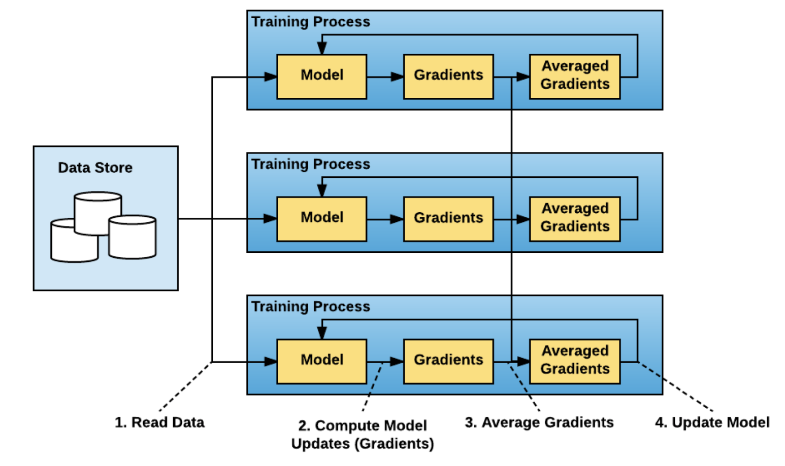
Distributed Training by Horovod
Data Parallelism:
Scale single-GPU training to many GPUs or/and machines
Figure 1: Data Parallel Distributed Training Paradigm
exchange all the gradients after trained with data
Reference: https://eng.uber.com/horovod/

Slide 6
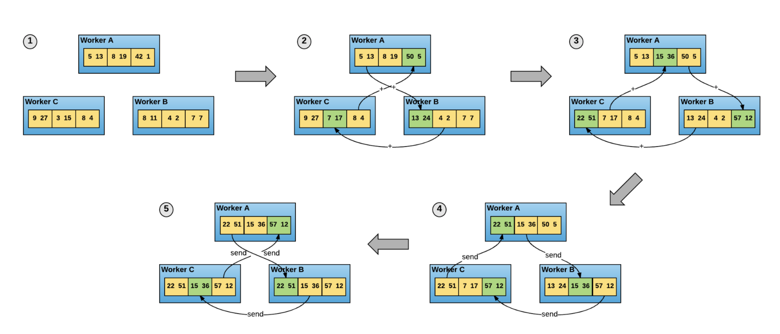
Distributed Training by Horovod
Figure 1: The ring-allreduce algorithm → exchange a part of the gradients during training
Reference: https://andrew.gibiansky.com/blog/machine-learning/baidu-allreduce/

Slide 7
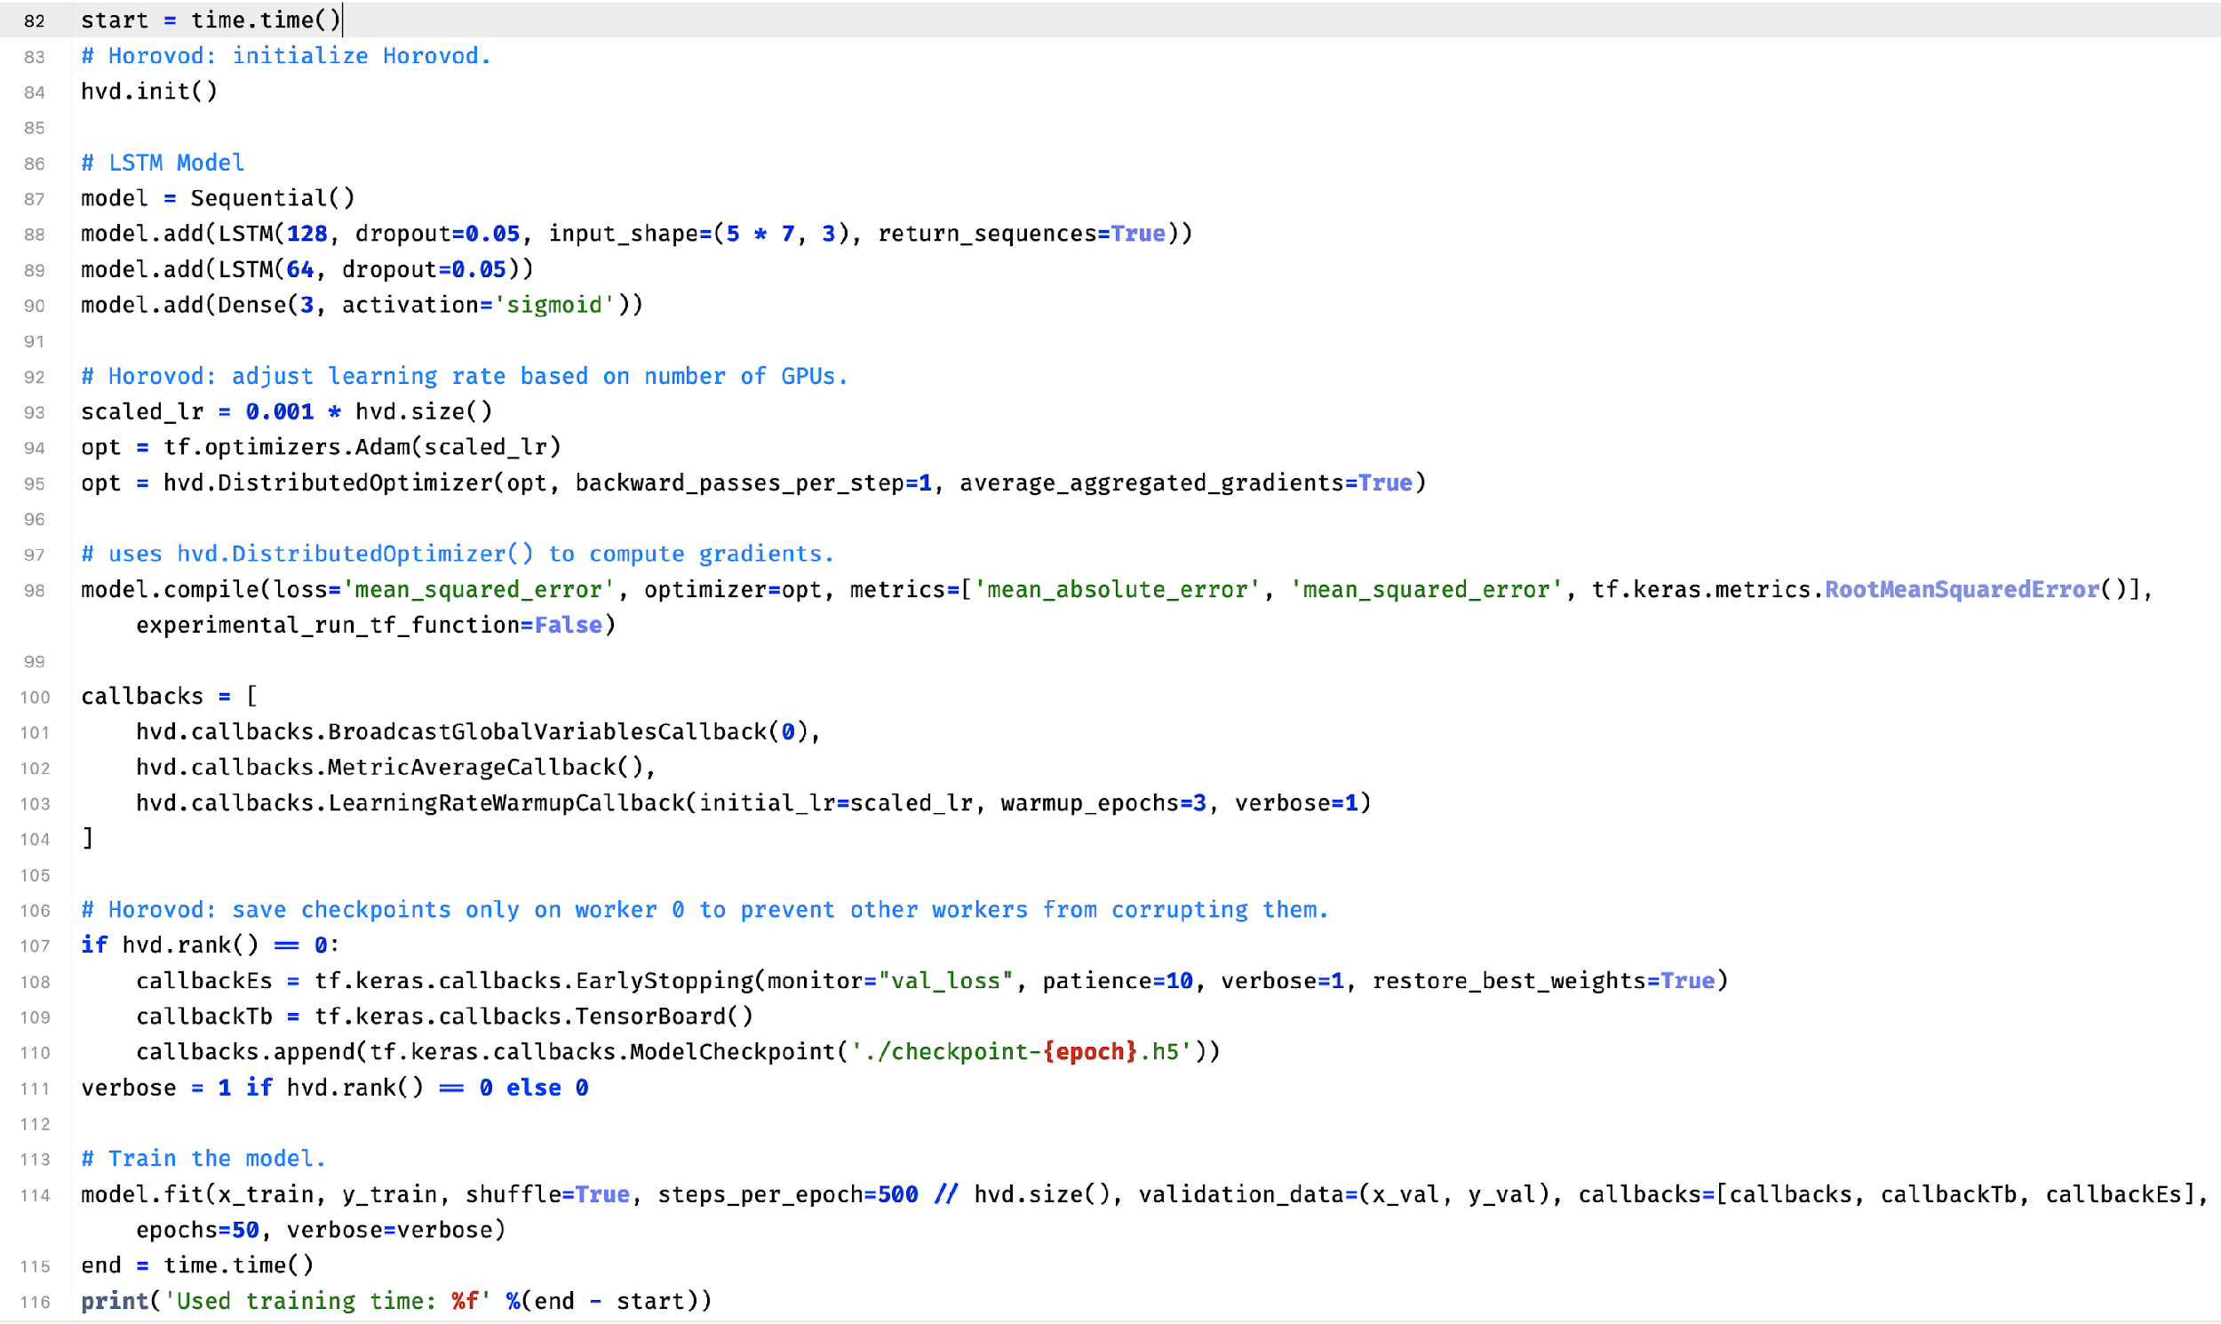
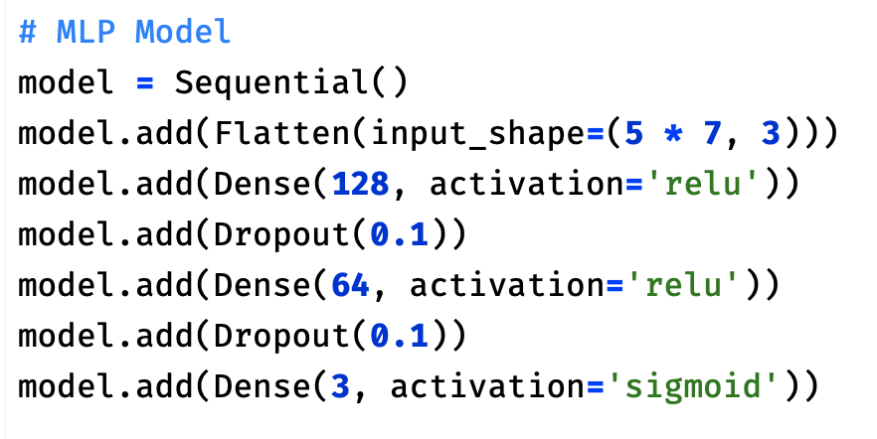
Two-layer LSTM
Three-layer
MLP
Horovod
Distributed
Training
Early Stopping
Save Metrics to Tensorboard
and save trained model
Contributions:
ML & DL Model building is achieved by POON Bing Chun.
Paper survey and price movement prediction are finished by TSO Yiu Chuen.
Part of Data pre-processing by Spark in Horovod and Horovod distributed training are performed by LI Ka Faat and me.
Reference: https://github.com/verybighub/CS5488_Project/blob/main/Model%20Logs%20and%20Results/With_Horovod.py

Slide 8
Experimental Results (Stellar Currency)
21483 Training, 1193 Validation, 1194 Testing
Method | MAE | MSE | RMSE | Training Time (s)
LSTM w/o Horovod | 0.009817 | 0.000137 | 0.011701 | 822.40
LSTM with Horovod (CPU) | 0.012009 | 0.000265 | 0.016287 | 779.77 (-42.63)
MLP w/o Horovod | 0.015290 (+0.005473) | 0.000321 (+0.000184) | 0.017924 (+0.0062223) | 40.02
MLP with Horovod (CPU) | 0.018781 (+0.006772) | 0.000454 (+0.000189) | 0.021310 (+0.005023) | 25.62 (-14.4)

Slide 9
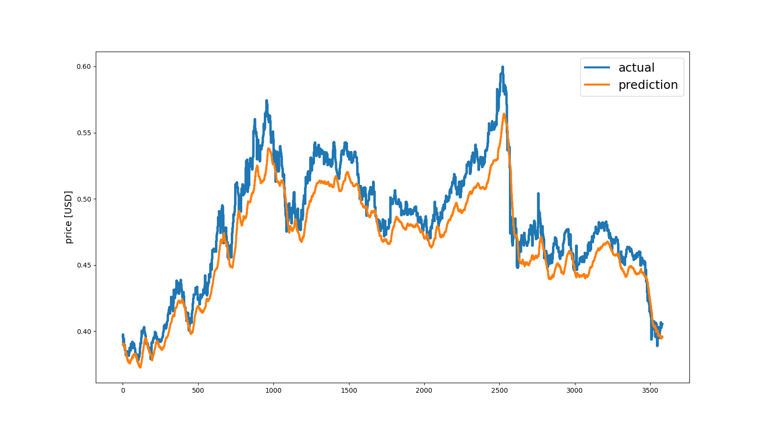
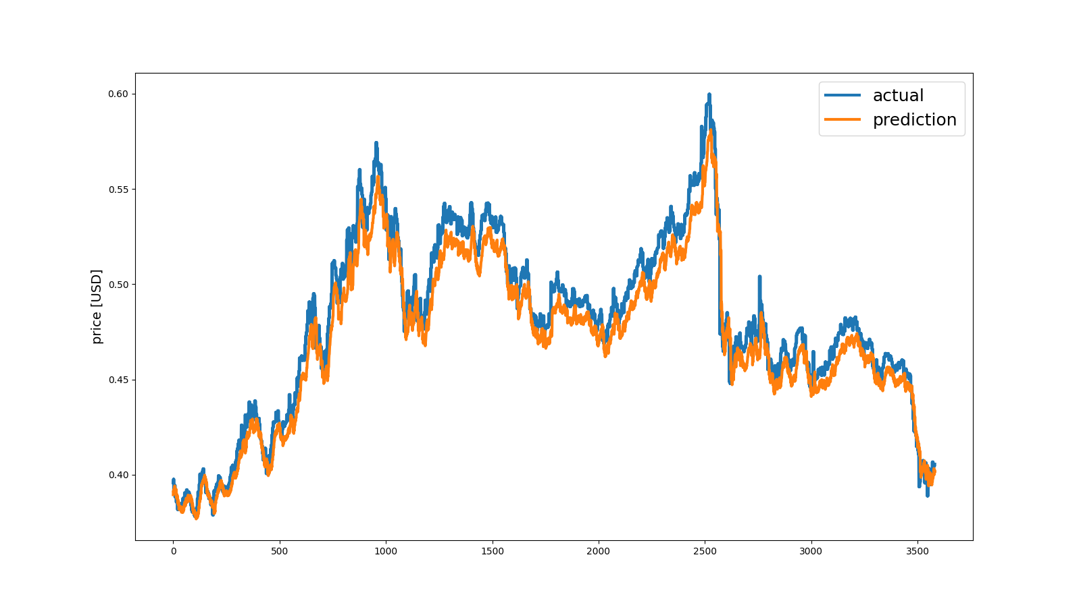
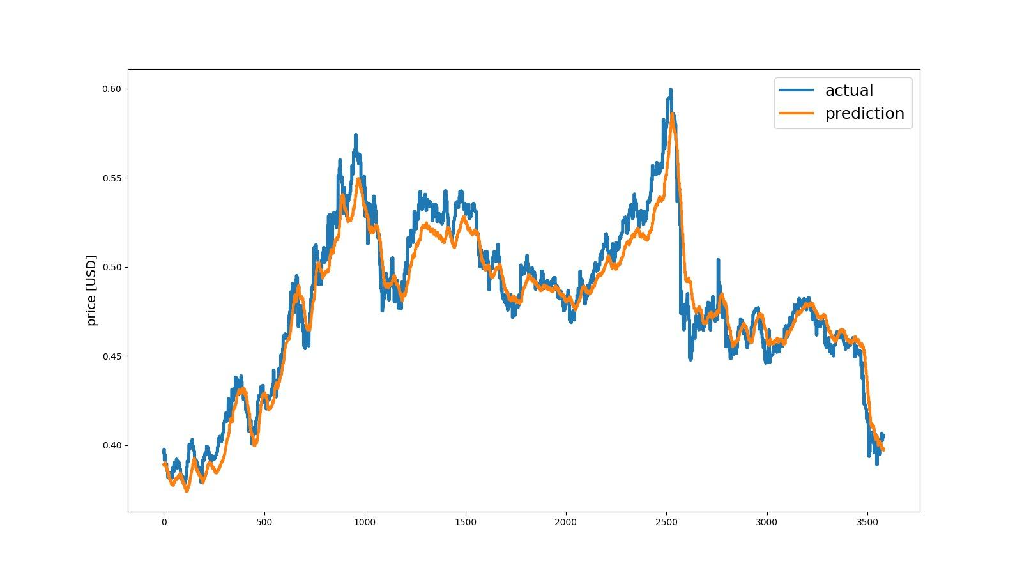
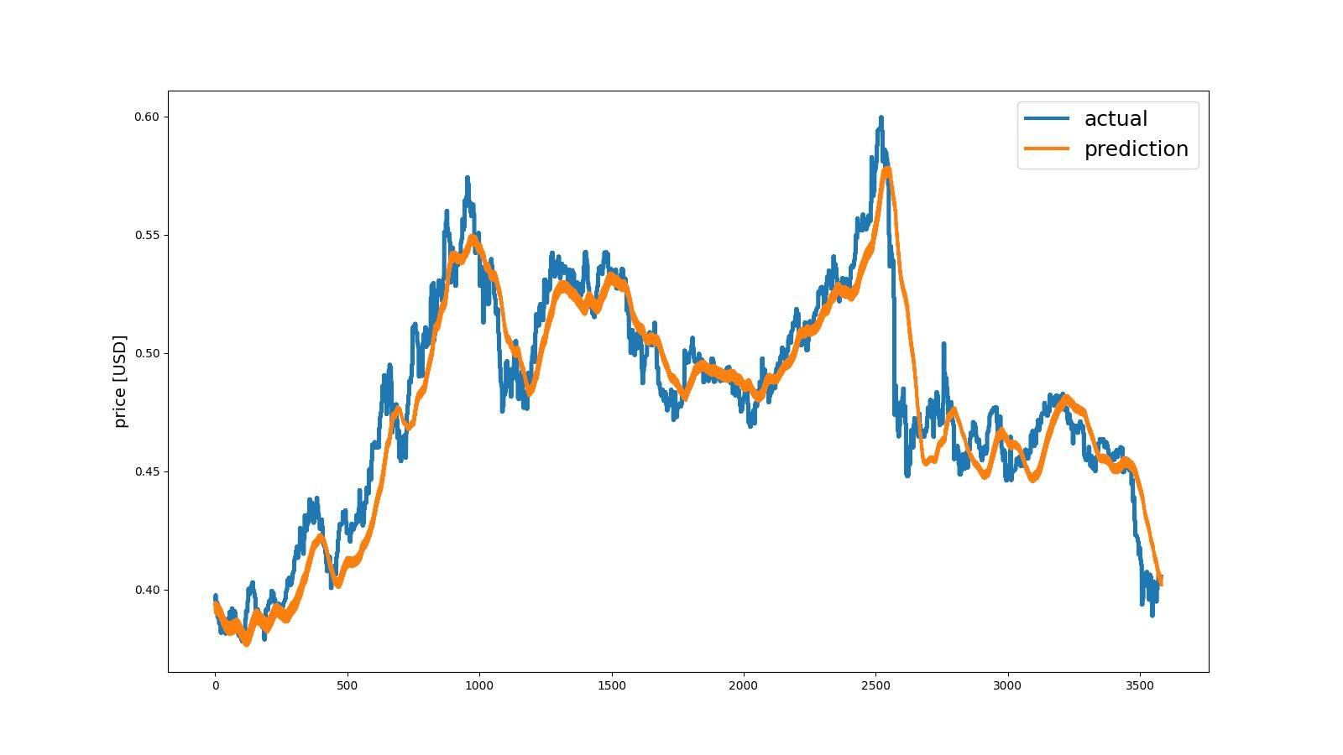
Figure 1: MLP without Horovod
Figure 2: LSTM without Horovod
Figure 3: MLP with Horovod
Figure 4: LSTM Model with Horovod

Slide 10
Future Work
Horovd On Spark (Improved Horovod Performance)
→ Train Model on Spark Clusters
→ Directly Train Model with PySpark DataFrames
→ Ease of Use

Slide 11
Future Work
Combine the Prediction with Social Media
Collect data from social media, e.g. Twitter, Facebook, etc.
Sentimental analysis
Model: Transformer
Based on public’s review on cryptocurrency
Notes:
(filter the interval data we want)

Slide 12
Conclusions
✓ Based on the sliding window approach, the LSTM model can effectively predict the price of crypto-currency with superior performances compared with MLP and other ML models.
✓ The time of data pre-processing by Spark can be as half as that by Pandas.
✓ DL modes with Horovod support can efficiently reduce training time.
Notes:
(filter the interval data we want)

Slide 13
Thanks a lot and any question?
Notes:
(filter the interval data we want)

