Slide 1
LRP based communication protocol

Slide 2
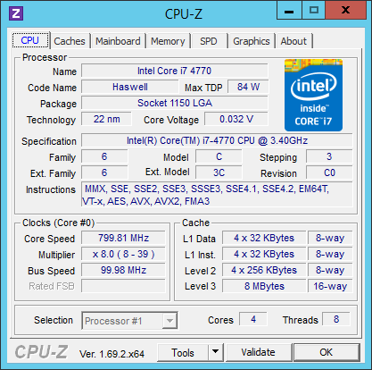
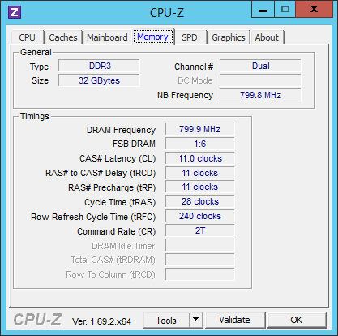
Hardware

Slide 3
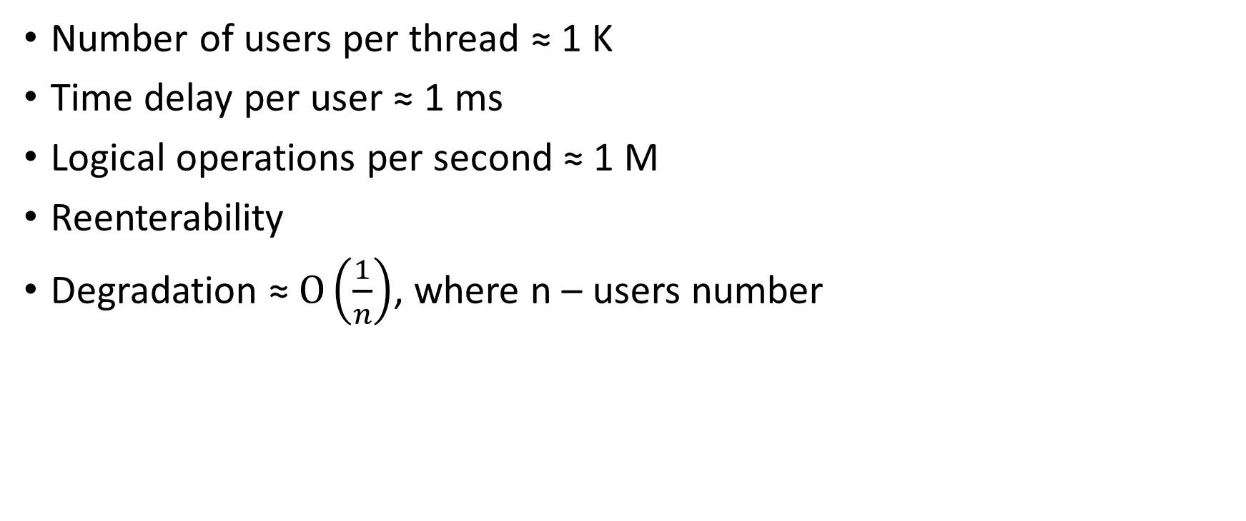
Requirements
Number of users per thread ≈ 1 K
Time delay per user ≈ 1 ms
Logical operations per second ≈ 1 M
Reenterability
Degradation ≈ $O\left(\frac{1}{n}\right)$, where n – users number

Slide 4
Enter/Leave critical section
Threads | x86 min | x86 max | x64 min | x64 max
1 | 48.1 M | 48.1 M | 53.7 M | 53.7 M
2 | 6.48 M | 6.78 M | 7.82 M | 9.06 M
3 | 2.55 M | 4.11 M | 3.10 M | 3.79 M
4 | 1.78 M | 3.71 M | 1.82 M | 2.95 M
5 | 1.28 M | 1.83 M | 1.29 M | 1.63 M
6 | 1.14 M | 1.47 M | 1.05 M | 1.29 M
7 | 0.816 M | 0.862 M | 0.833 M | 0.908 M
8 | 0.695 M | 0.771 M | 0.636 M | 0.720 M
9 | 0.677 M | 0.716 M | 0.570 M | 0.734 M
10 | 0.507 M | 0.593 M | 0.548 M | 0.608 M
11 | 0.468 M | 0.525 M | 0.457 M | 0.536 M
12 | 0.406 M | 0.443 M | 0.386 M | 0.521 M
13 | 0.386 M | 0.482 M | 0.302 M | 0.360 M
14 | 0.351 M | 0.436 M | 0.298 M | 0.382 M
15 | 0.325 M | 0.464 M | 0.258 M | 0.388 M
16 | 0.282 M | 0.318 M | 0.250 M | 0.297 M

Slide 5
TryEnter/Leave critical section
 | x86 min | x86 max | x64 min | x64 max
Enter/Leave | 48.1 M |  | 53.7 M
TryEnter/Leave | 37.0 M | 43.1 M | 46.4 M | 50.6 M
TryEnterFailed | 85.6 M | 107 M | 129 M | 158 M

Slide 6
WaitFor/Release event
Operation | X86, calls per second | X64, calls per second
WaitForRelease: min/max | 1.58 M/1.80 M | 2.53 M/3.53 M
WaitForSuccess: min/max | 2.78 M/3.74 M | 4.23 M/6.32 M
WaitForTimeout: min/max | 2.68 M/3.59 M | 4.65 M/7.11 M

Slide 7
Socket operations: read/write select

Slide 8
Socket operations: read/write select

Slide 9
Socket operations: read-write
Operation | X86 | X64
ReadFailed | 0.33 M | 2.39 M
WriteFailed | 0.41 M | 2.92 M
ReadSuccess | 0.36 M | 2.32 M
WriteSuccess | 0.060 M | 0.30 M

Slide 10
Memory copy speed
Chunk size = 4096 bytes
 | X86 | X64
Minimum (in chunks) | 5.75 M | 6.94 M
Maximum (in chunks) | 6.96 M | 8.11 M
Average (in chunks) | 6.55 M | 7.57 M

