Slide 1

SoftSpace
Your Calm Corner in a Busy World
Team Members: Gayatri Badayalya,
Jhashi Jagtap,
Pratiksha Karle
Guided by: Prof. Sujata Kullur

Slide 2
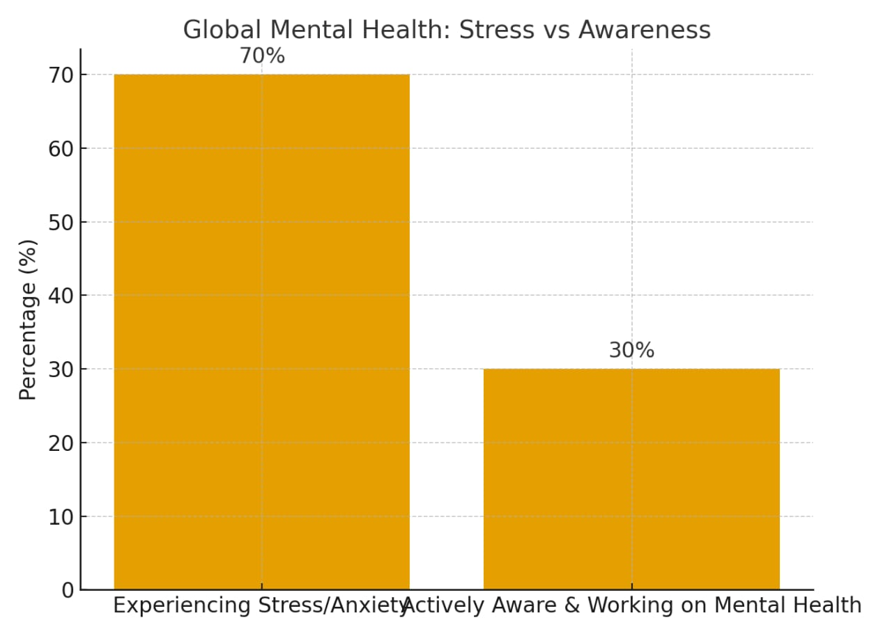
💡 Why Mental Health Matters
1 in 4 people face mental health challenges in their lifetime.
Stress and anxiety affect productivity, relationships, and overall well-being.
Poor mental health can lead to burnout, isolation, and physical illness.
Supporting mental wellness improves focus, positivity, and resilience.
“Mental health is not a luxury, it’s a necessity.”
World Health Organization & global reports 2023–24

Slide 3
⚠ Problem Statement
Rising stress, anxiety, and burnout among students & professionals.
High cost of therapy makes mental health support inaccessible.
Stigma and fear prevent people from seeking help.
Lack of simple, student-friendly, stigma-free wellness platforms.

Slide 4
🌿 Our Solution – SoftSpace
A calm, easy-to-use digital platform for mental wellness.
Combines self-care + awareness + support in one place.
Offers:
📝 Self-assessment quizzes
🧘 Guided mindful activities
🌸 Daily affirmations & positivity boosts
🌞 Wellness tips for lifestyle balance
📞 Trusted helpline & support resources
Creates a safe, stigma-free space for students & professionals.
Designed to be affordable, simple, and beginner-friendly

Slide 5
🌟 Impact & Value of SoftSpaceSoft
Space helps people practice awareness, reflection, and positivity in daily life.
It provides a safe and supportive corner for students, professionals, and anyone in need.
Unlike costly or complex apps, it is affordable, beginner-friendly, and calming.
Its simple design and relatable features make mental wellness more accessible and stigma-free.
By bridging personal self-care and professional help, SoftSpace creates lasting impact.

Slide 6
Business View
Revenue Streams:
• Therapy sessions 💬
• Workshops & webinars 🎤
• Premium membership 🌟
• Self-care kits 📂
Why SoftSpace?
• Accessible, calming, designed for youth

Slide 7
Future Scope
• Mobile app 📱
• AI-based wellness plans 🤖
• Multi-language support 🌍
• Partnerships with schools & corporates 🎓🏢

Slide 8
Conclusion
• Goal: Make wellness simple, calm, accessible
• “SoftSpace isn’t just a website—it’s a supportive space for better living.”
Tagline + Logo

