Slide 1

What is Data Science?
SSF DS-101 Overview

Slide 2
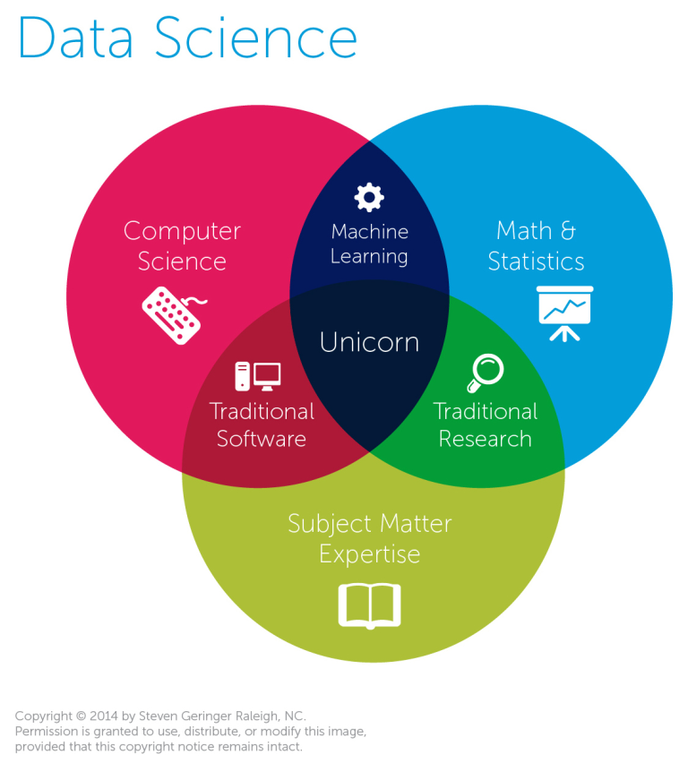
Visualizations

Slide 3

What is a Data Scientist?
Leverages existing data sources (Company CRM).
Create new data sources as needed (Web Scraping)
Extracts meaningful information and actionable insights.
Their insights drive the decision-making of the modern data-oriented business.

Slide 4
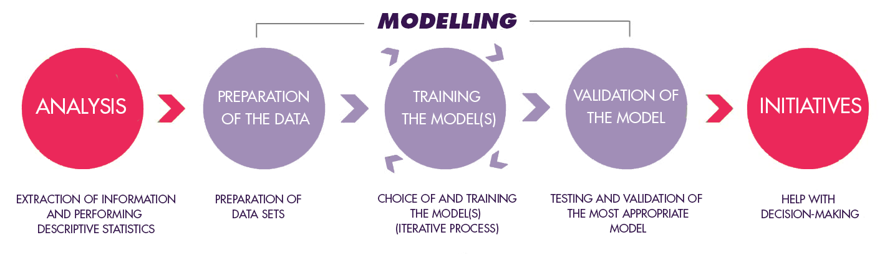
Data Science Process
Month 1 will prepare us to tackle the DS process.

Slide 5
Our Focus in Month 1
Python for DS
Work on the different data types
Iterate through data structures
Write Basic Functions
NumPy and Pandas
Be able to load dataset and understand its most basic attributes.

Slide 6

Our Goal
To facilitate your learning of the necessary Statistics and Python skills to be able to dig into a data set, develop experiments, and learn the basics around modelling.

Slide 7
Expectation
This is a comprehensive field.
We will be best served by narrowing our field, which is why we will stress the basics rather than dive into deep learning right away.

