Slide 1
Linear Regression
Continuous Supervised Learning

Slide 2
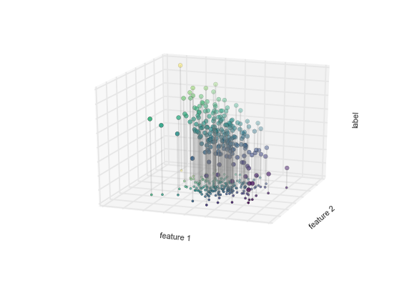
Regression
Continuous Supervised Learning
Regression is the task for modeling continuous target variables.
Example: Predicting house prices
feature 1 | feature 2
1 | 0.5
3 | 2.4
8 | 5
Label
1.5
4.6
7.5
feature 1 | feature 2
7 | 6
Prediction
?

Slide 3
Linear Regression High Level Overview
Through numerous iterations we will adjust the slopes so that we reduce the error of getting wrong predictions.
The model: ŷ = hθ(x) = θ₀x₀ + θ₁x₁ + θ₂x₂ + …
Where:
X: input features
Θ: weights model is trying to learn
Note:
Θ₀ is y intercept
X₀ is always 1 because there is no x term being multiplied by y intercept (b)
y = mx + b = θ₀x₀ + θ₁x₁
b
θ₁
θ₀

Slide 4
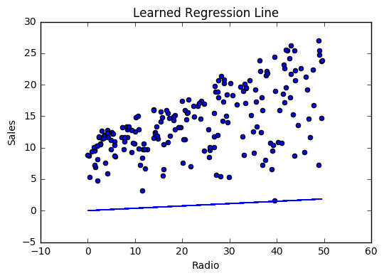
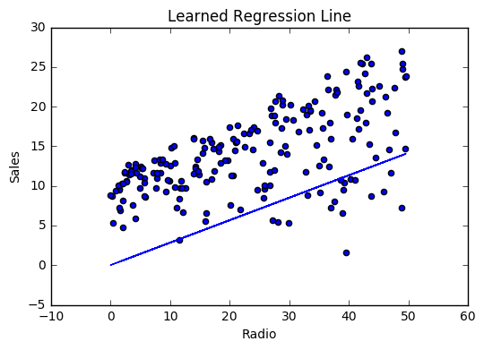
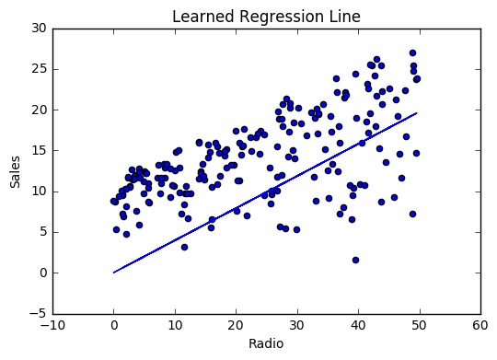

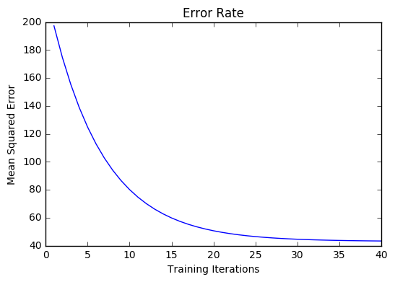
Linear Regression Visualized
The model: ŷ = hθ(x) = θ₀x₀ + θ₁x₁ + θ₂x₂ + …
Through numerous iterations we will adjust the slopes so that we reduce the error of getting wrong predictions.
Model will learn parameters with the least error

Slide 5
Mean Square Error

Slide 6
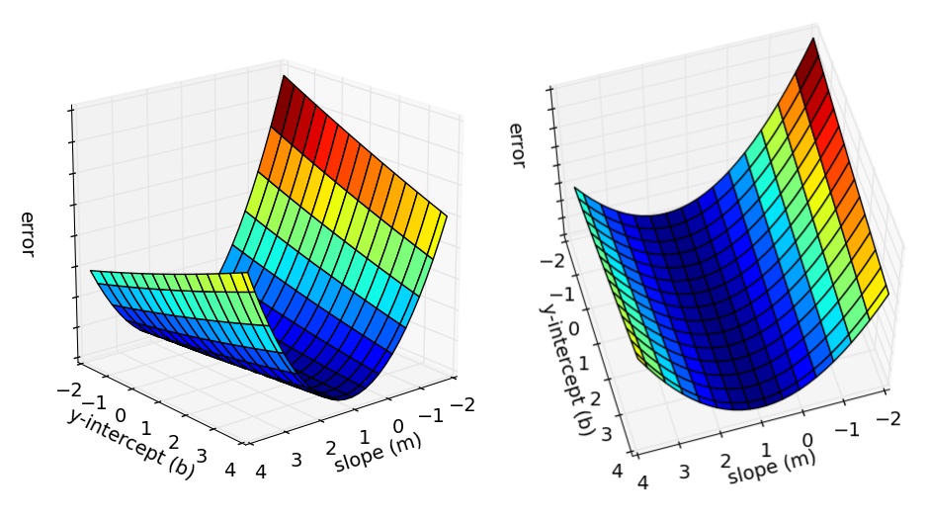
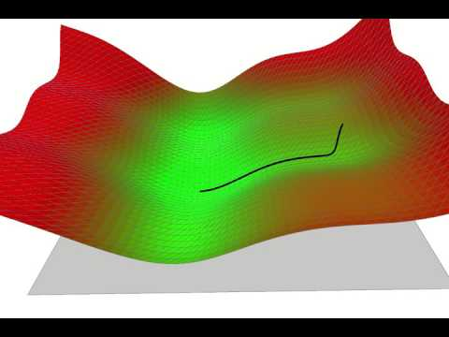
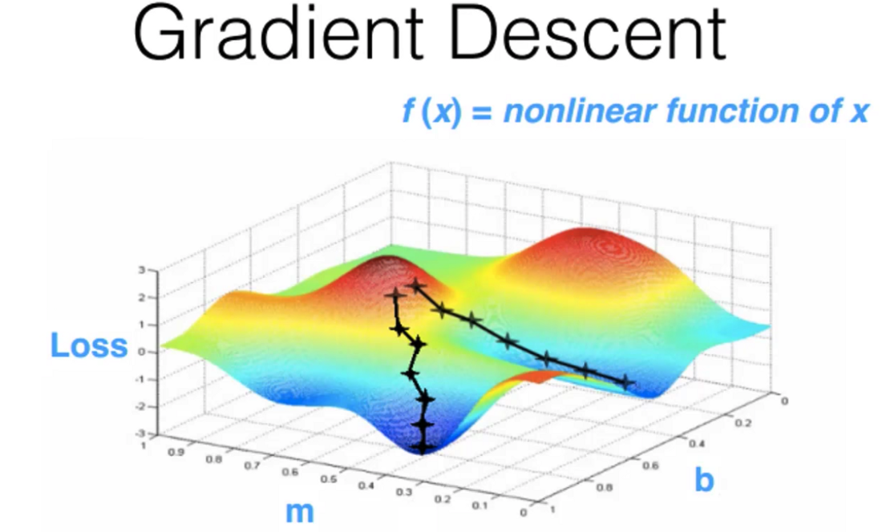
Way To Minimize Error Function ( Gradient Descent )
What y-intercept (b) and slope (m) has the least amount of error?
Global minima (least error)
Local minima

Slide 7
Resources:
Resources:
Regression Resource 1
Regression Resource 2
Mean Squared Error Explanation
Video Series On Regression
Online Resources:
Data Science Handbook
Remember this class is going to be more of an application based class rather than diving deep into machine learning
Notes:
Gradient Descent - https://mccormickml.com/2014/03/04/gradient-descent-derivation/
Gradient Descent implementation - https://youtu.be/uwwWVAgJBcM?t=1538
Ensembling - https://medium.com/analytics-vidhya/snapshot-ensembles-leveraging-ensembling-in-neural-networks-a0d512cf2941

