Slide 1
Model Training
Tuning, Training and Evaluation

Slide 2
Steps to Training a Model
Import Processed Data
Split Data into Train and Test
X_train and y_train
X_test and y_test
Fit Model on X_train and y_train
Predict Target on X_Test
Evaluate Model
Compare your predictions to y_test

Slide 3
Split The Data

Slide 4
Splitting Dataset
Think of your data as a limited resource.
You can spend some of it to train your model (i.e. feed it to the algorithm).
You can spend some of it to evaluate (test) your model.
But you can’t reuse the same data for both!

Slide 5
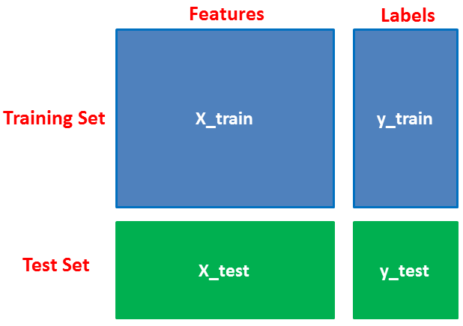
Splitting Dataset
80%
Think of your data as a limited resource:
You can spend some of it to train your model (i.e. feed it to the algorithm)
You can spend some of it to evaluate (test) your model
But you can’t reuse the same data for both!
20%
Therefore, you should have separate training and test subsets of your dataset.
Code:
from sklearn.model_selection import train_test_split # import the library
X_train, X_test, y_train, y_test = train_test_split(X, y, test_size = 0.20) # split data
Note:
X - is capitalized because it is a matrix (2D array with rows and columns
y - is not capitalized because it is a vector ( 1D array with only rows )
train_test-split documentation

Slide 6
Splitting Dataset
If you evaluate your model on the same data you used to train it, your model could be very overfit and you wouldn’t even know!
A model should be judged on its ability to predict new, unseen data.

Slide 7
Splitting Dataset
Training sets are used to fit and tune your models. Test sets are put aside as "unseen" data to evaluate your models.
You should always split your data before doing anything else.
This is the best way to get reliable estimates of your models’ performance.
After splitting your data, don’t touch your test set until you’re ready to choose your final model!

Slide 8
Fit The Model

Slide 9
Fitting The Model
We fit an estimator to be able to predict the classes/values to which unseen samples belong.
This is the training/learning aspect of the model.
The LinearRegression estimator instance is first fitted to the model; that is, it must learn from the model. This is done by passing our training set to the fit method.
In scikit-learn, an estimator is a Python object that implements the methods fit(X_train, y_train) and predict(X_test)
Code:
from sklearn.linear_model import LinearRegression # import the library to access the estimators class/blueprint
model = LinearRegression(fit_intercept=True) # create an instance of the model class/blueprint with specific hyper-parameters
model.fit(X_train, y_train) # fit the estimator/model
Note: The estimator’s constructor takes the model’s hyper-parameters.
Linear regression documentation

Slide 10
Model Parameters vs Hyperparameters?
The key distinction is that model parameters can be learned directly from the training data while hyperparameters cannot.

Slide 11
Model Parameters
Model parameters are learned attributes that define individual models
e.g. regression coefficients
The model: ŷ = hθ(x) = θ₀x₀ + θ₁x₁ + θ₂x₂ + …
Through numerous iterations the correct coefficients will be learned directly from the training data. While the model is being fitted, it’ll will adjust the slopes so that we reduce the error of getting wrong predictions.

Slide 12
Hyperparameters
Hyperparameters express "higher-level" structural settings for algorithms. They are decided before fitting the model because they can't be learned from the data, although we can perform an exhausted search to find hyper-parameters that make the model most performant and accurate.
e.g. fit_intercept, whether to calculate the intercept for this model
e.g. learning rate
e.g. strength of the penalty used in regularized regression
e.g. the number of trees to include in a random forest
Resource:
How to search for hyper-parameters

Slide 13
Predict Using Fitted Model

Slide 14
Prediction Using The Model
Now you can use the fitted model to predict values based off of unseen observations
Code:
predictions = model.Predict(X_test) # prediction labels array using fitted model algorithm
Linear regression predict documentation

Slide 15
Evaluate The Model

Slide 16
Compare your predictions to y_test
We can assess how accurate the predictions are, using different strategies.
R2 score code:
from sklearn.metrics import r2_score # import the library to evaluate predictions
score = r2_score(y_test, predictions)
R2 score documentation

Slide 17
Key Terminology
Model - A set of patterns learned from data.
Algorithm - A specific ML process used to train a model.
Training data - The dataset from which the algorithm learns the model.
Test data - A new dataset for reliably evaluating model performance.
Features - Variables (columns) in the dataset used to train the model.
Target variable - A specific variable you’re trying to predict.
Observations - Data points (rows) in the dataset.
Model Parameters - Learned attributes that define individual models. i.e. regression coefficients
Hyper Parameters - Expresses "higher-level" structural settings for algorithms that can't be learned from the data

Slide 18
Let’s Get Coding!

