Slide 1
Model Performance Increase

Slide 2
Pipelines

Slide 3
Pipelines
Think of a Pipeline object as production line of transforming X_train and y_train before eventually fitting the model.
Import
Data
Normalize
Data
Other
Transformations
Fit
Model
With Transformed Data

Slide 4
Normalization

Slide 5
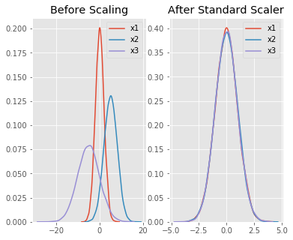
Normalization
The goal of normalization is to change the values of numeric columns in the dataset to a common scale, without distorting differences in the ranges of values.
For machine learning, every dataset does not require normalization. It is required only when features have different ranges.
The idea behind the normalization function StandardScaler() is that it will transform your data such that its distribution will have a mean value 0 and standard deviation of 1.
Given the distribution of the data, each value in the dataset will have the sample mean value subtracted, and then divided by the standard deviation of the whole dataset
Notes:
Resource:
https://medium.com/@urvashilluniya/why-data-normalization-is-necessary-for-machine-learning-models-681b65a05029

Slide 6
Cross Validation

Slide 7
Why Cross Validation
One disadvantage of using a holdout set for model validation is that we have lost a portion of our data to the model training.
When we use test_train_split(), a certain amount of the dataset does not contribute to the training of the model. This is not optimal, and can cause problems – especially if the initial set of training data is small.
Cross Validation will allow us to use all of the dataset to train and test so that we are not creating models based on a static split of data.
Static meaning not changing which will not allow us to use all of the data to train on.
Notes:
Talk about what static means

Slide 8
Definition Of Cross Validation
Cross-validation is a technique for evaluating ML models by training several ML models on subsets of the available input data and evaluating them on the complementary subset of the data.
Use cross-validation to detect overfitting, ie, failing to generalize a pattern.

Slide 9
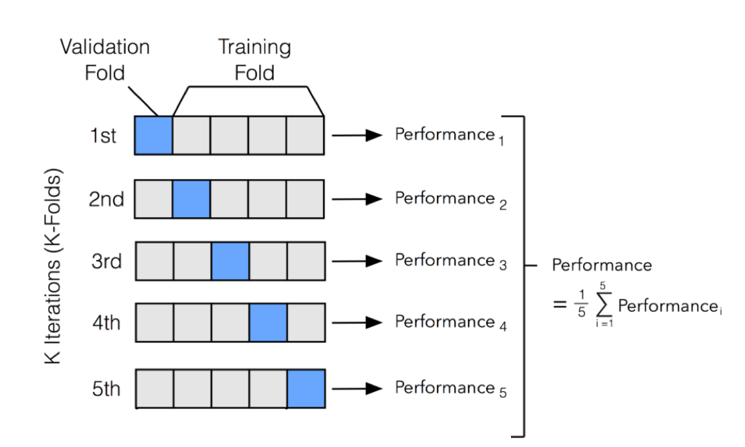
Cross-Validation
Notes:
Cross-validation is a method for getting a reliable estimate of model performance using only your training data.
There are several ways to cross-validate. The most common one, 10-fold cross-validation, breaks your training data into 10 equal parts (a.k.a. folds), essentially creating 10 miniature train/test splits.

Slide 10
Cross-Validation
Steps for 10-fold cross-validation:
Split your data into 10 equal parts, or "folds".
Train your model on 9 folds (e.g. the first 9 folds).
Evaluate it on the 1 remaining "hold-out" fold.
Perform steps (2) and (3) 10 times, each time holding out a different fold.
Average the performance across all 10 hold-out folds.
The average performance across the 10 hold-out folds is your final performance estimate, also called your cross-validated score.
Notes:
Because you created 10 mini train/test splits, this score is usually pretty reliable.

Slide 11
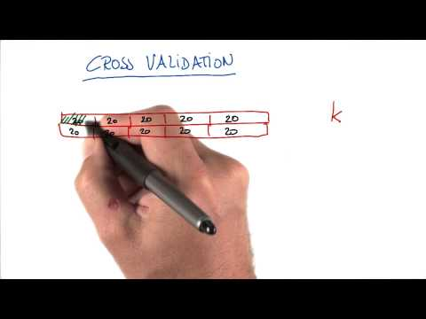
Video On Cross Validation

Slide 12
Grid Search CV
But Wait There’s More!

Slide 13
Grid Search Cross Validation
A Grid Search Cross Validation is an Exhaustive search over specified hyper-parameter values for an estimator.
Essentially we perform cross validation, except now we perform and exhausted search on possible values for specific hyper-parameter values.
Each set of hyper-parameter values will be run under multiple folds of cross validation to ensure that we find the proper set of values for specific hyper-parameters to find the best possible choice of hyper-parameters for model

