Slide 1
Classification
Discrete Supervised Learning Using The Logistic Regression Model / Estimator

Slide 2
Supervised Learning
Each observation must be labeled with a "correct answer."
Only then can you build a predictive model because as the model “learns” the data, its predictions are being tested against those labels, aka "supervising" it.

Slide 3
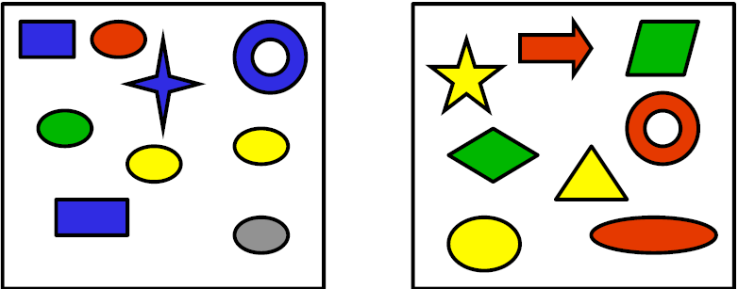
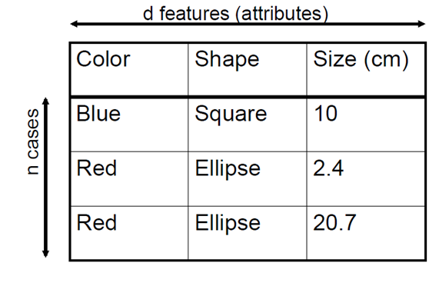

Classification
Discrete Supervised Learning:
Classification is the task for modeling categorical (a.k.a. "class") target variables.
Binary classification
Multi-class classification
Example: Predict spam emails
Type 1
Type 2
Label
Type 1
Type 1
Type 2
Yellow | Circle | 5
?

Slide 4
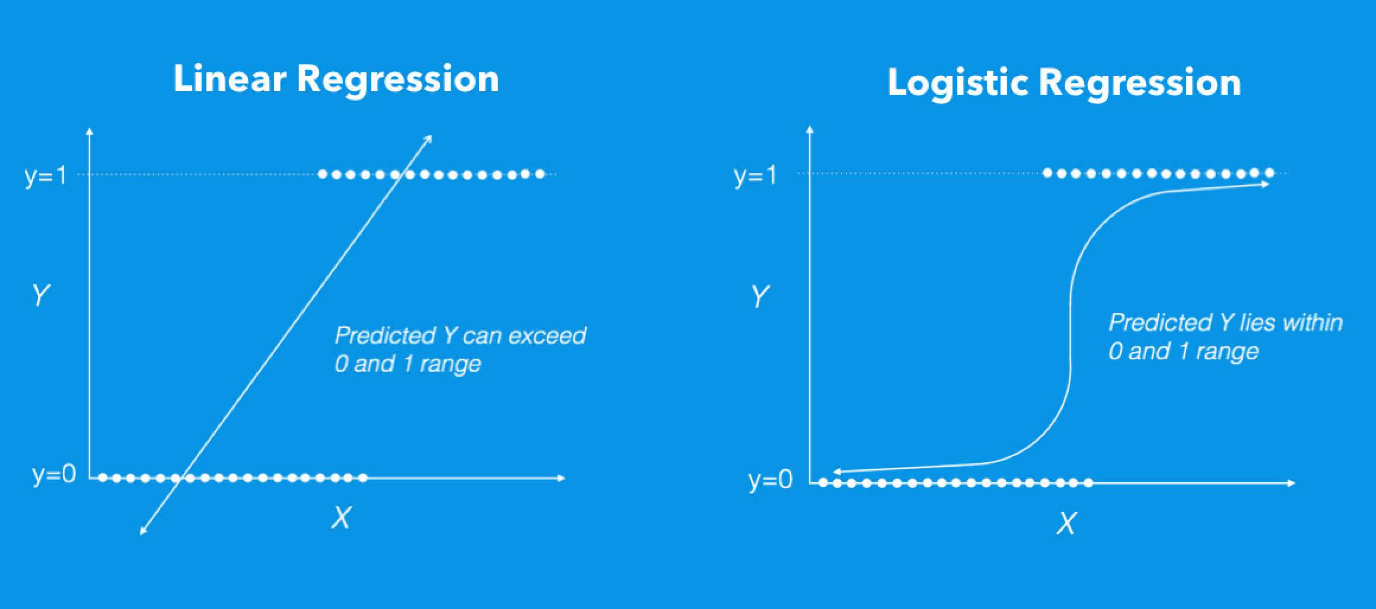
Logistic Regression High Level Overview
Through numerous iterations we will adjust the slopes so that we reduce the error of getting wrong predictions.
The model: ŷ = sigmoid( hθ(x) ) = sigmoid( θ₀x₀ + θ₁x₁ + θ₂x₂ + … )
Where:
X: input features
Θ: weights model is trying to learn
Note:
Θ₀ is y intercept
X₀ is always 1 because there is no x term being multiplied by y intercept (b)

Slide 5
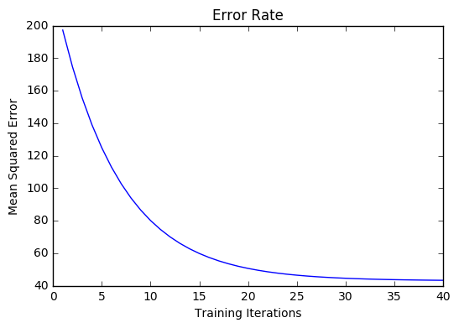
Linear Regression Visualized
The model:
ŷ = sigmoid( hθ(x) ) = sigmoid( θ₀x₀ + θ₁x₁ + θ₂x₂ + … )
Through numerous iterations we will adjust the slopes so that we reduce the error of getting wrong predictions.
Model will learn parameters with the least error

Slide 6
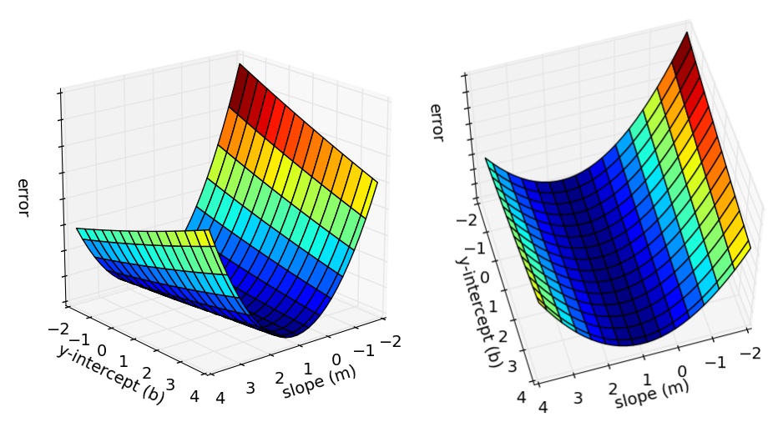
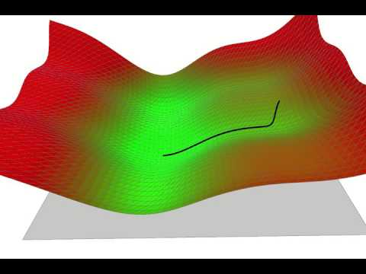
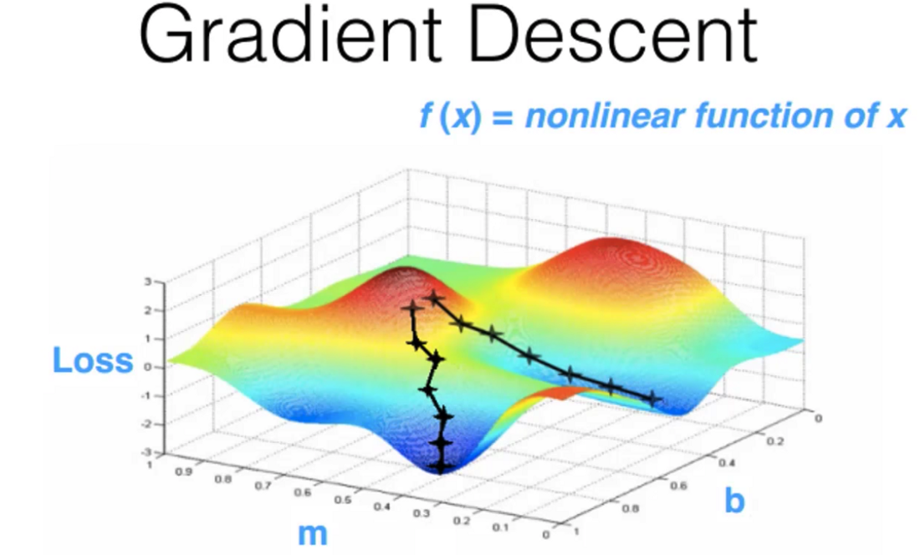
Way To Minimize Error Function ( Gradient Descent )
What y-intercept (b) and slope (m) has the least amount of error?
Global minima (least error)
Local minima

Slide 7
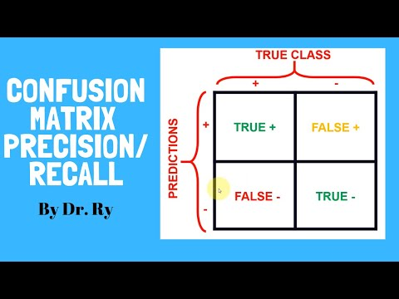
Evaluating Model With Confusion Matrix

Slide 8
Resources:
Resources:
Understanding classification
ROC curve video explanation
Online Resources:
Data Sscience Handbook
Remember this class is going to be more of an application based class rather than diving deep into machine learning
Notes:
Gradient Descent - https://mccormickml.com/2014/03/04/gradient-descent-derivation/
Gradient Descent implementation - https://youtu.be/uwwWVAgJBcM?t=1538
Ensembling - https://medium.com/analytics-vidhya/snapshot-ensembles-leveraging-ensembling-in-neural-networks-a0d512cf2941

