Slide 1
Alternative Regression Algorithms
Using Regularization

Slide 2
The Basic Flow Of Linear Regression
Predict or Inference
hypothesis function hθ​(x) = θ0 + θ1​x1​ + θ2​x2​ + θ3​x3​ +⋯+ θnxn​
Error or Loss
Cost function
Train or Learn
Gradient Descent function
Notes:
hθ​(x)=θ0​+θ1​x1​+θ2​x2​+θ3​x3​+⋯+θn​xn​
In order to develop intuition about this function, we can think about \theta_0θ0​ as the basic price of a house, \theta_1θ1​ as the price per square meter, \theta_2θ2​ as the price per floor, etc. x_1x1​ will be the number of square meters in the house, x_2x2​ the number of floors, etc.
Types of math used:
Linear algebra to do mainly matrix math, Statistics
Statistics provide many ways to measure Error, Loss or Cost
Calculus used with Gradient Descent
Provide example of how you go through a model,
Guess the answer
See how well you guest
Adjust the Theta

Slide 3
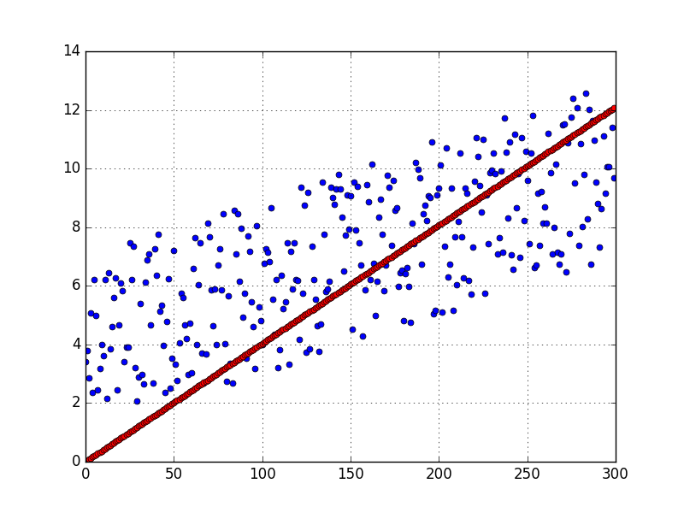
Why Linear Regression is Flawed
Simple linear regression models fit a "straight line". In practice, they rarely perform well.
Their main advantage is that they are easy to interpret and understand.

Slide 4
Why Linear Regression is Flawed
Simple linear regression suffers from two major flaws:
It's prone to overfit with many input features
It cannot easily express non-linear relationships
Resource for the expressing non-linear relationships (scroll down to validation curves section)
Let's take a look at how we can address the first flaw.

Slide 5
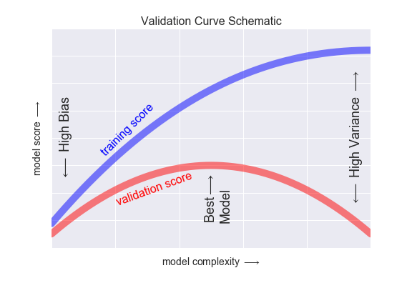
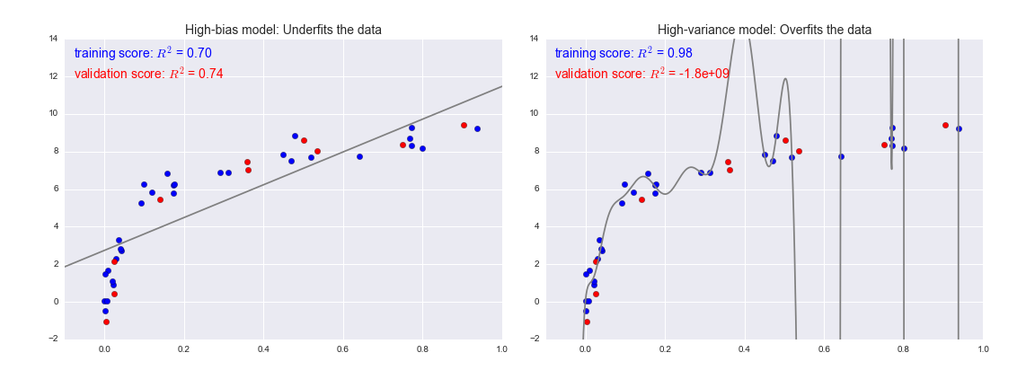
Understanding High Bias (underfit model) and High Variance (overfit model)
High-bias models, the performance of the model on the validation set is similar to the performance on the training set.
High-variance models, the performance of the model on the validation set is far worse than the performance on the training set.
Reference

Slide 6
Regularization in Machine Learning
Extreme example of overfitting:
Let's say you have 100 observations with 100 features in your training dataset.
If you fit a linear regression model with all of those 100 features, you can perfectly "memorize" the training set (high bias).
Each coefficient would simply memorize one observation. This model would have perfect accuracy on the training data, but perform poorly on unseen data (high variance).
It hasn’t learned the true underlying patterns; it has only memorized the noise in the training data.

Slide 7
Regularization in Machine Learning
Regularization is a technique used to prevent overfitting by artificially penalizing model coefficients.
It can discourage large coefficients (by dampening them).
It can also remove features entirely (by setting their coefficients to 0).
The "strength" of the penalty is tunable.

Slide 8
Regularization in Machine Learning continued...
Basic Idea:
When slope of a feature(s) is steep then the prediction for the target variable is very sensitive to relatively small changes specific to that feature(s)
When slope of a feature(s) is not steep (small) then the prediction for the target variable is much less sensitive to relatively small changes specific to that feature(s)
Regularization will alter the cost function by adding a new term to the least squares error equation, which will inturn will alter the slopes (weights) of each feature ensuring that we are not overfitting.

Slide 9
Regularized Regression Algos
There are 3 common types of regularized linear regression algorithms
Lasso Regression (L1 Regularization)
Ridge Regression (L2 Regularization)
Elastic-Net (Combination of L1 and L2 Regularization)

Slide 10
Ridge Regression

Slide 11
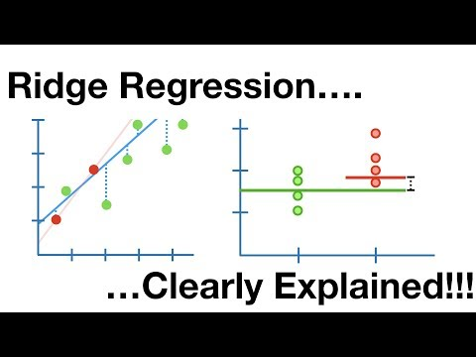
Ridge Regression
Notes:
L2 Regularization aka Ridge Regularization
This add regularization terms in the model which are function of square of coefficients of parameters.
Coefficient of parameters can approach to zero but never become zero

Slide 12
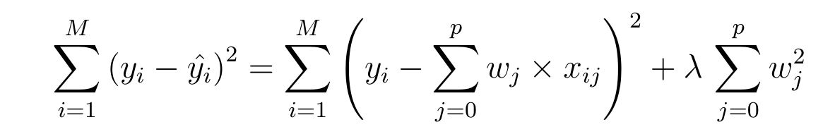
Ridge Regression Key Points
Cost function for ridge regression:
Y intercept term is not included when calculating the penalty
In short ridge regression offers feature shrinkage to prevent overfitting!
Ridge regression penalizes the squared size of coefficients
λ must be between 0 and positive infinity
The larger the value of λ, the prediction becomes less sensitive to specific features, meaning coefficients pushed asymptomatically closer to zero
The optimal λ, "strength" of the penalty, should be searched using cross validation grid search
Notes:
L2 Regularization aka Ridge Regularization
This add regularization terms in the model which are function of square of coefficients of parameters.
Coefficient of parameters can approach to zero but never become zero

Slide 13
Lasso Regression

Slide 14
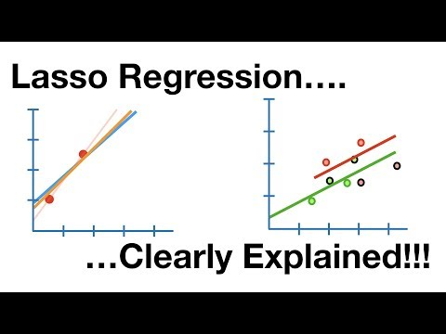
Lasso Regression
Notes:
L1 Regularization aka Lasso Regularization
This add regularization terms in the model which are function of absolute value of coefficients of parameters.
Coefficient of parameters can become zero

Slide 15
Lasso Regression
The BIG difference between Ridge and Lasso regression is that ridge regression can only shrink slopes asymptotically close to zero, while lasso can shrink slopes all the way to zero. Meaning lasso can ultimately can completely remove some features from the model.
Notes:
L1 Regularization aka Lasso Regularization
This add regularization terms in the model which are function of absolute value of the coefficients of parameters.
The coefficient of the parameters can be driven to zero as well during the regularization process.
Hence this technique can be used for feature selection and generating more parsimonious model

Slide 16
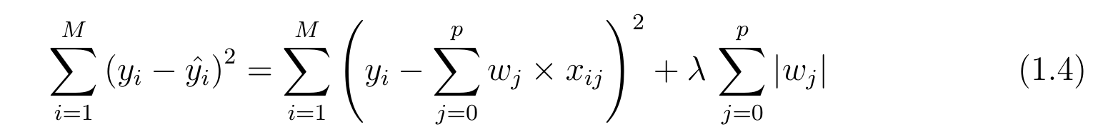
Lasso Regression Key Points
Cost function for lasso regression:
Y intercept term is not included when calculating the penalty
In short Lasso regression offers feature shrinkage to prevent overfitting!
Lasso offers automatic feature selection because it can completely remove some features by setting those feature coefficients to zero.
Lasso regression penalizes the absolute size of coefficients
λ must be between 0 and positive infinity
The larger the value of λ, the prediction becomes less sensitive to specific features, meaning coefficients pushed to become zero.
The optimal λ, "strength" of the penalty, should be searched using cross validation grid search
Notes:
L1 Regularization aka Lasso Regularization
This add regularization terms in the model which are function of absolute value of the coefficients of parameters.
The coefficient of the parameters can be driven to zero as well during the regularization process.
Hence this technique can be used for feature selection and generating more parsimonious model

Slide 17
Ridge Versus Lasso Regression

Slide 18
Which One Should We Use?
Lasso performs better at reducing variance in models that contain a lot of useless features. Lasso can make the final model equation easier and simpler to interpret due to its ability to completely remove some features by setting those feature coefficients to zero.
Ridge performs better when most features are useful.
Use Elastic-Net Regression when we don’t know if we have many useful or useless features.

Slide 19
Elastic-Net Regression

Slide 20
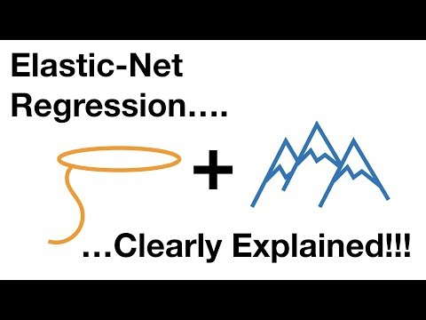
Elastic-Net Regression

Slide 21
Elastic-Net
Cost function for Elastic Net regression:
1
2
Elastic-Net is a compromise between Lasso and Ridge. We will use this technique when the dataset has lots of features and we don’t know in advanced if each feature is useful or useless to the performance.
Elastic-Net penalizes a mix of both absolute and squared size.
The ratio of the two penalty types, λ₁ and λ₂, should be searched using cross validation grid search
Notes:
Combination of the above two such as Elastic Nets
This add regularization terms in the model which are combination of both L1 and L2 regularization

Slide 22
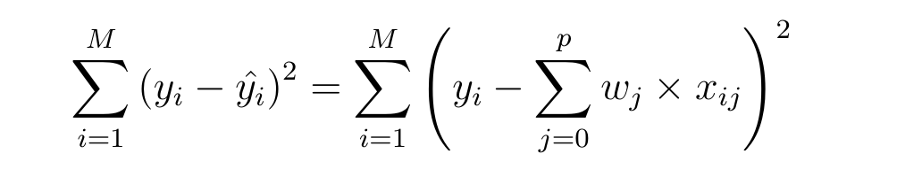
Regularization Fits Using Different Cost Functions
Cost function for simple linear model:
Cost function for ridge regression:
Cost function for lasso regression:
Cost function for Elastic Net regression:
1
2

