Slide 1
CDN Video Uploader – Connect
Connect to FTP
FTP host:
nl01.upload.cdn13.com
FTP username:
iskren.ivanov
FTP password:
••••••••••••••••
✓
Remember me
Connect

Slide 2
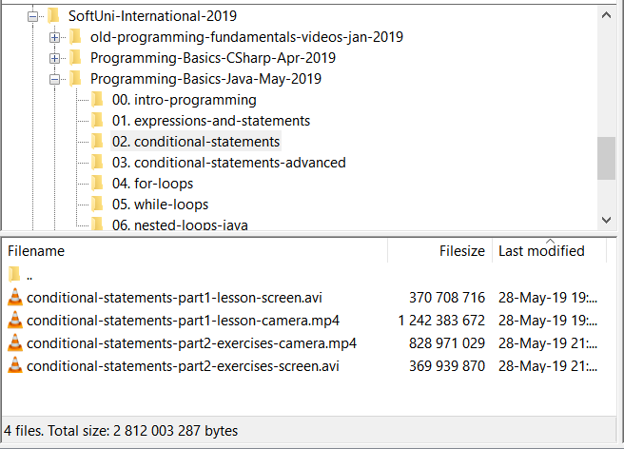



CDN Video Uploader
Remote FTP folders and files
Upload queue
/videos-org/SoftUni-International-2019/Programming-Basics-Java-May-2019/02. conditional-statements/
Drag and Drop Video Files Here to Upload
or
Choose Files to Upload …
Nakov-csharp-conditional-statements.avi (107 min @ 1080p, 943 MB)
Status: converting to 720p MP4 …
46 %
Nakov-csharp-loops.avi (182 min @ 1080p, 1344 MB)
Status: Uploading Nakov-csharp-loops_720p.mp4 …
21 %
asp.net-auth-Kenov.avi (203 min @ 1080p, 1691 MB)
Status: Waiting …
0 %
[23-Oct-2020 20:48] Uploading Nakov-csharp-conditional-statements-720p.mp4 to /videos-org/SoftUni-International-2019/Programming-Basics-Java-May-2019: scp Nakov-csharp-conditional-statements-720p.mp4 iskren.ivanov@nl01.upload.cdn13.com:/videos-org/SoftUni-International-2019/Programming-Basics-Java-May-2019
[23-Oct-2020 20:51] Transcoding Nakov-csharp-loops.avi to 720p: ffmpeg -i Nakov-csharp-conditional-statements.avi -vf scale -1:720 -quality good -c:v libx264 Nakov-csharp-conditional-statements-720p.mp4
[23-Oct-2020 21:05] Transcoding Nakov-csharp-loops.avi to 240p: ffmpeg -i Nakov-csharp-conditional-statements.avi -vf scale -1:240 -quality good -c:v libx264 Nakov-csharp-loops-240p.mp4

Slide 3


CDN Video Uploader
Remote FTP folders and files
Upload queue
/videos-org/SoftUni-International-2019/Programming-Basics-Java-May-2019/02. conditional-statements/
Drag and Drop Video Files Here to Upload
or
Choose Files to Upload …
Nakov-csharp-conditional-statements.avi (107 min @ 1080p, 943 MB)
Status: Completed.
copy video link
Link:
https://11461-1.b.cdn12.com/Programming-Ba...master.m3u8
Nakov-csharp-loops.avi (182 min @ 1080p, 1344 MB)
Status: Completed.
Link:
https://11461-1.b.cdn12.com/Programming-Ba...master.m3u8
asp.net-auth-Kenov.avi (203 min @ 1080p, 1691 MB)
Status: Completed.
Link:
https://11461-1.b.cdn12.com/Programming-Ba...master.m3u8
[23-Oct-2020 20:48] Uploading Nakov-csharp-conditional-statements-720p.mp4 to /videos-org/SoftUni-International-2019/Programming-Basics-Java-May-2019: scp Nakov-csharp-conditional-statements-720p.mp4 iskren.ivanov@nl01.upload.cdn13.com:/videos-org/SoftUni-International-2019/Programming-Basics-Java-May-2019
[23-Oct-2020 20:51] Transcoding Nakov-csharp-loops.avi to 720p: ffmpeg -i Nakov-csharp-conditional-statements.avi -vf scale -1:720 -quality good -c:v libx264 Nakov-csharp-conditional-statements-720p.mp4
[23-Oct-2020 21:05] Transcoding Nakov-csharp-loops.avi to 240p: ffmpeg -i Nakov-csharp-conditional-statements.avi -vf scale -1:240 -quality good -c:v libx264 Nakov-csharp-loops-240p.mp4

