Slide 1


Slide 2


Тhe cloudberries
Georgi Tarkalanov Dev Lead
Dilyan Dimov QA Engineer
Toni Kolev DevOps Continuous Integration Setup
Bozhidar Boshnakov Project Manager / Supervisor
Tsvetomir Pavlov QA Engineer
Stanislav Todorov QA Team Lead
Svilen Savov QA Engineer

Slide 3


Wikiberry
+
Berries involved: Stanislav Todorov Bozhidar Boshnakov

Slide 4
Cloudberry coverage packages
01
02
03
04
99.9% Manual test cases (69 tests)
Business critical features (25) - execution time ~<1min!
UI tests (43)
Grande automation package (71)
Berries involved: Dilyan Dimov Georgi Tarkalanov
Svilen Savov Stanislav Todorov
Tsvetomir Pavlov

Slide 5
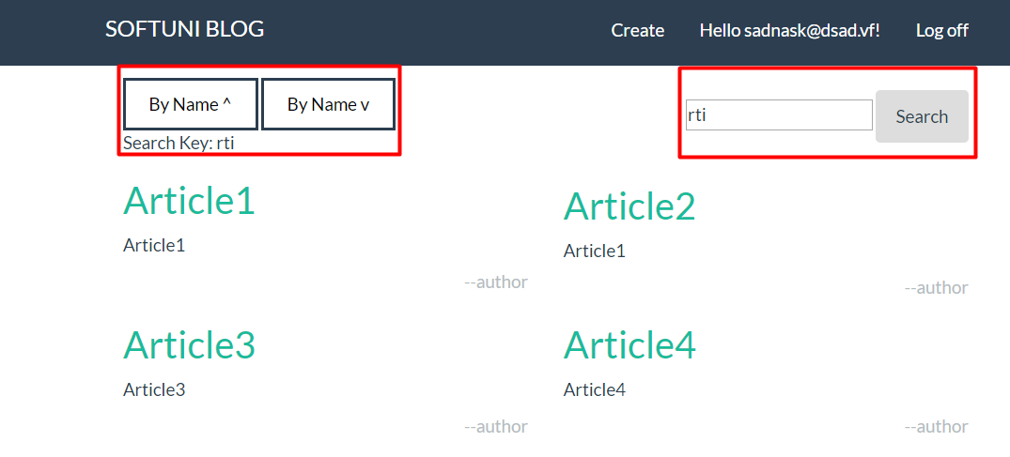
Blog extensions
01
02
Search – Working with partial match in title and body fields
A-Z sorting options
Berry involved: Georgi Tarkalanov

Slide 6

TeamCity
Berries involved: Toni Kolev Georgi Tarkalanov

