Slide 1
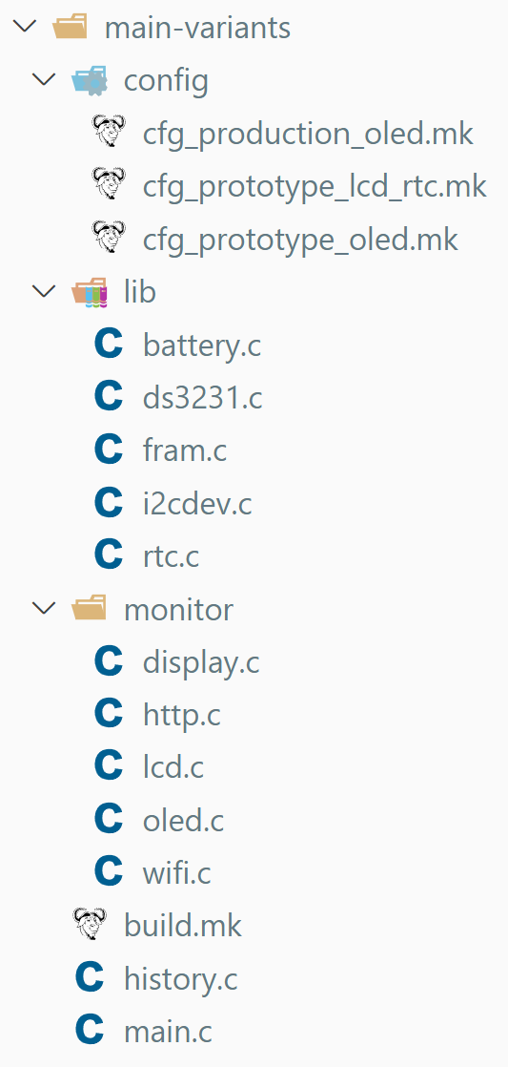

Slide 2
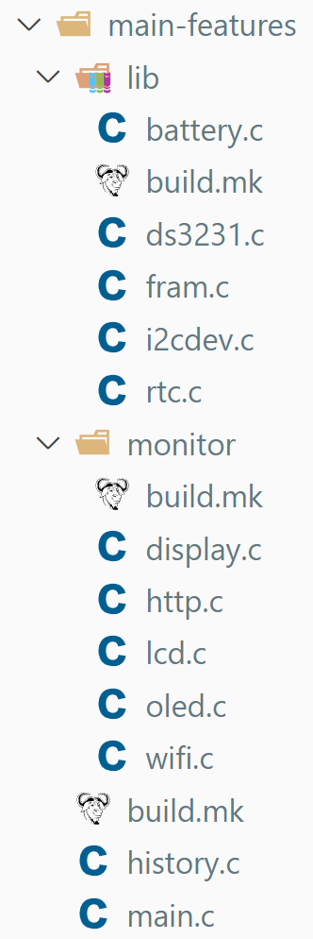
Battery
Libraries
RTC
FRAM
FRAM
RTC
Monitor
Display
HTTP Server
LCD
OLED
Wi-Fi
Anesthesia Device
History
Anesthesia Device

