Slide 1
‌BlockChain
Farid Dehgan
Tabriz Open Software Talks
March 2018

Slide 2
Outline
Blockchain
Why?
Applications
Smart Contract
Proof of work
Proof of Stake
Proof of Importance
Proof of Capacity
Tools

Slide 3
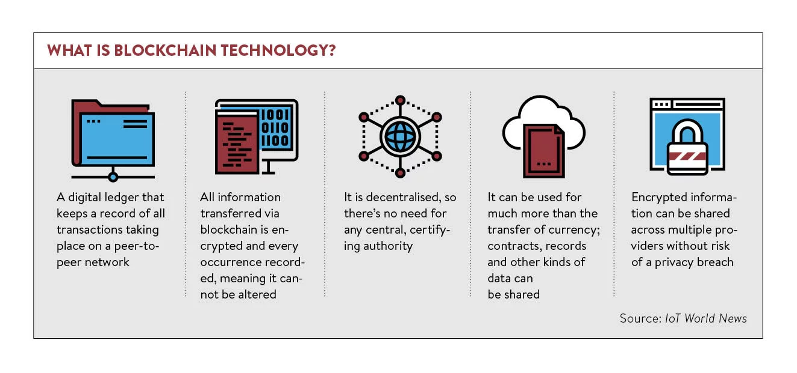
BlockChain

Slide 4
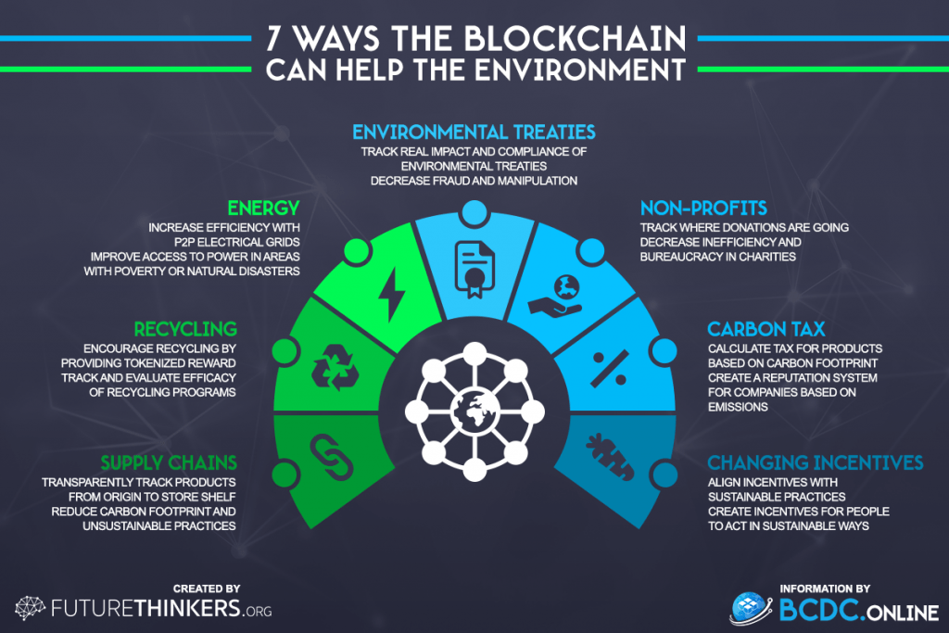

Slide 5
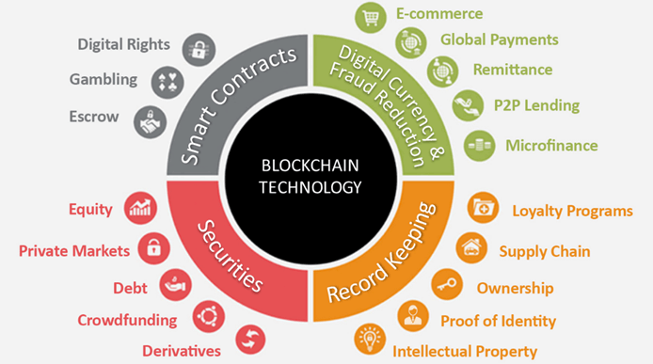
Applications

Slide 6
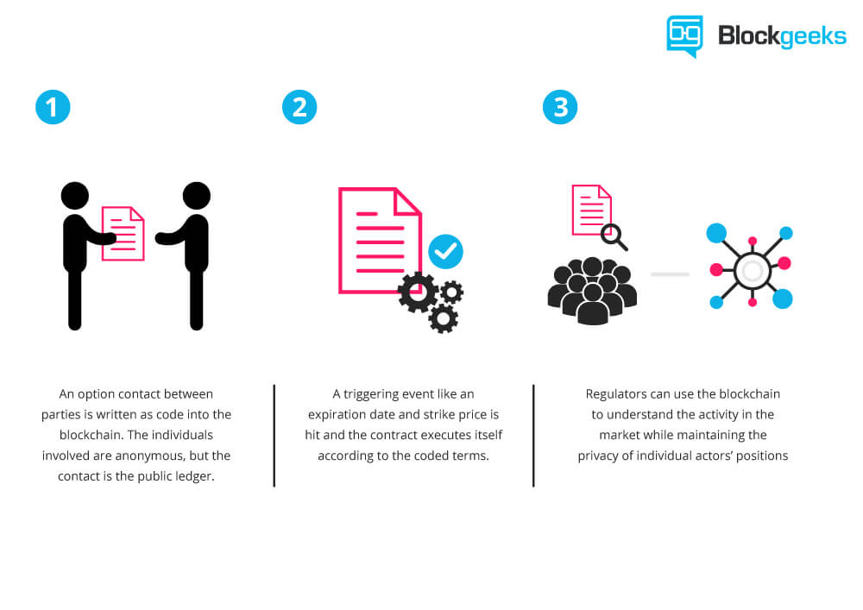
Applications

Slide 7
Applications

Slide 8
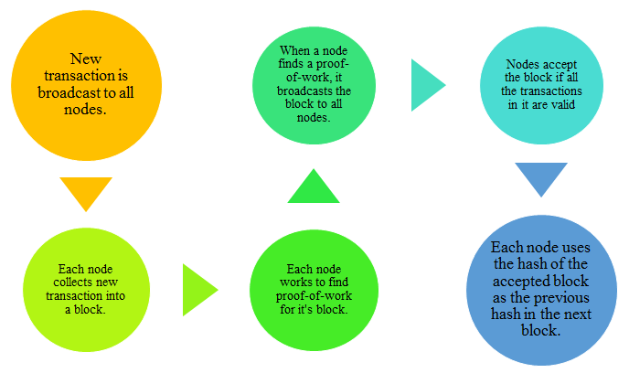
Proof of Work

Slide 9
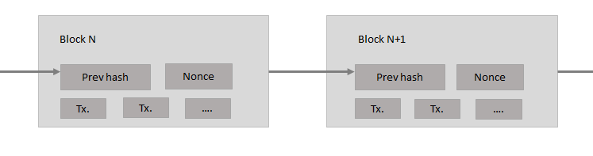
Proof of Work

Slide 10
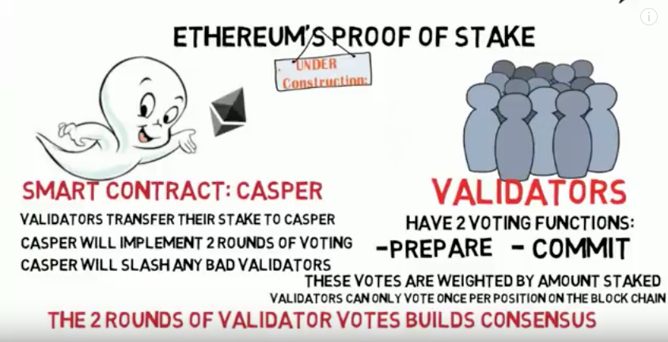
Proof of Stake

Slide 11
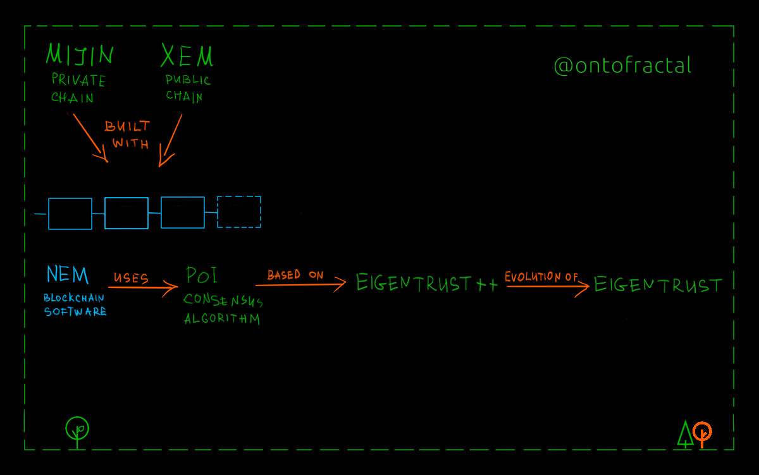
Proof of Improtance

Slide 12
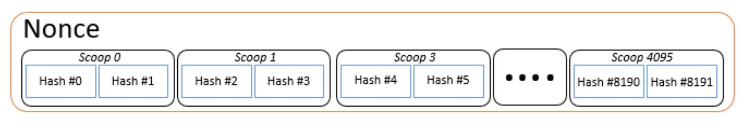
Proof of Capacity

Slide 13
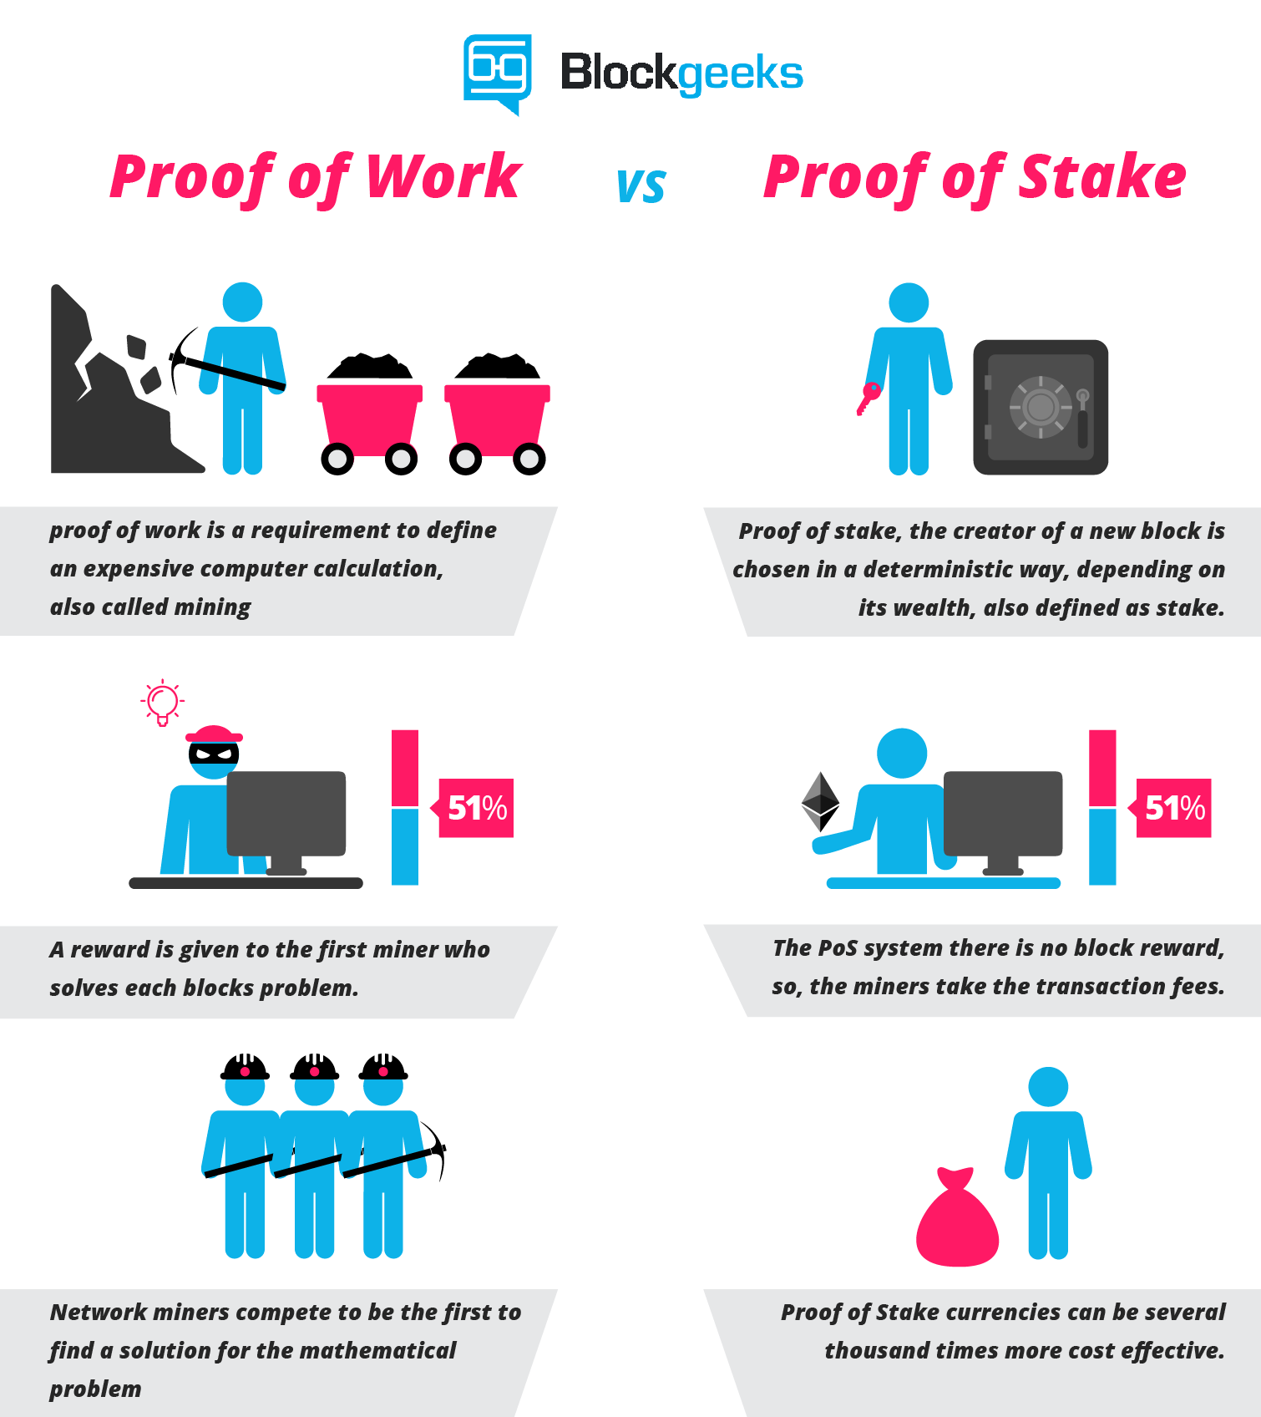
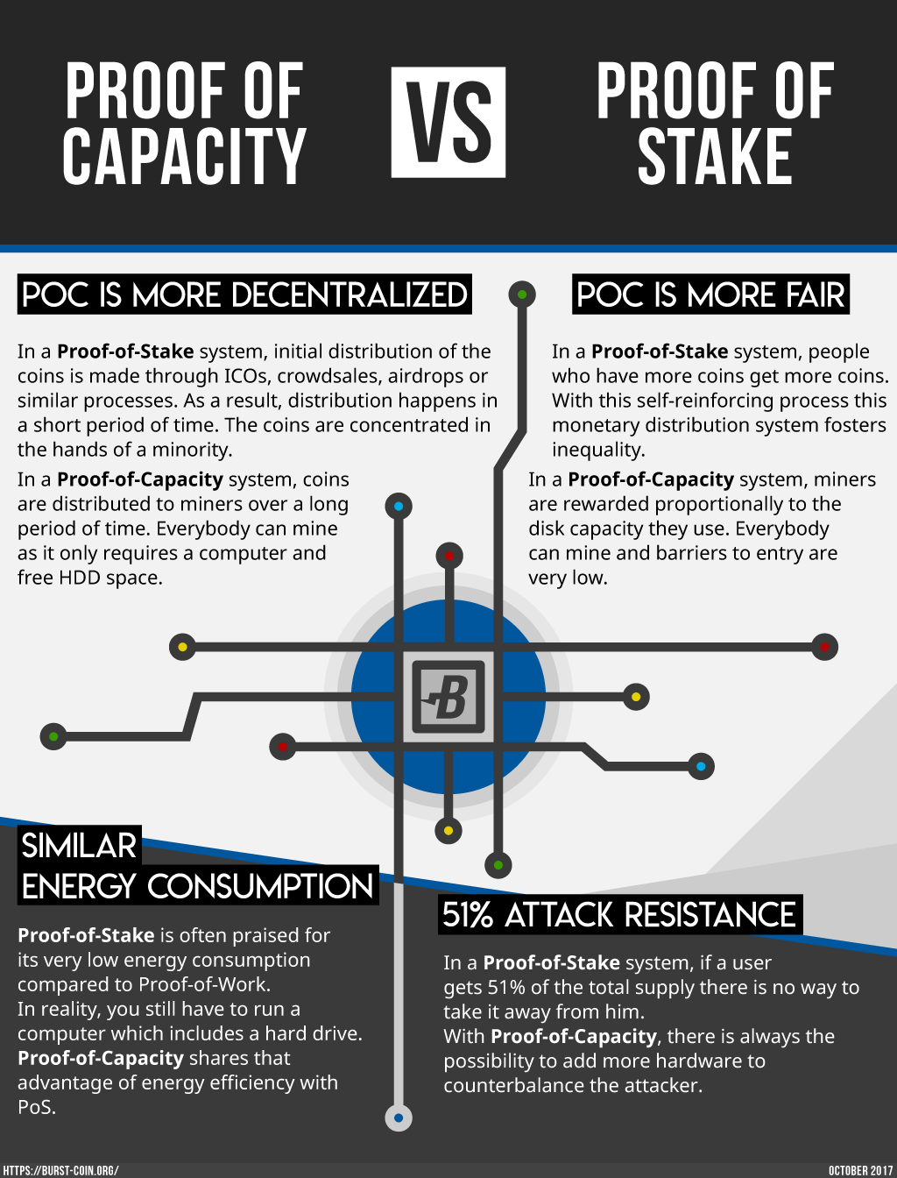
Applications

Slide 14
Platforms
Solidity
Truffle
Embark
Web3.js
Meteor

Slide 15


