Slide 1
Bluetooth DES Chat
By Shen Lu, Eyerus Assefa, Chengbin Hu
Department of Computer Science
University of South Florida, Tampa, Florida

Slide 2
Framework
Point to point connection – bluetooth connection
Authentication – random numbers
Key Managemnet - Diffie-hellman Key exchange
Triple DES Encryption

Slide 3
Authentication
By using random numbers.
Initiator
The second party
K(r)
K(r+1)

Slide 4
Key Management
Diffie-hellman key exchange
Generate sessionKey1
Generate sessionKey2
Initiator
The second party
K(sessionKey1)
K(sessionKey2)
Session key = f(sessionKey1,sessionKey2)

Slide 5
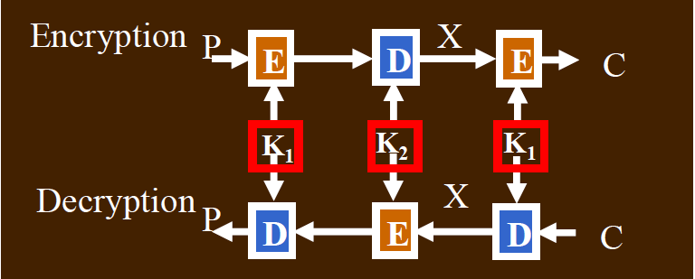
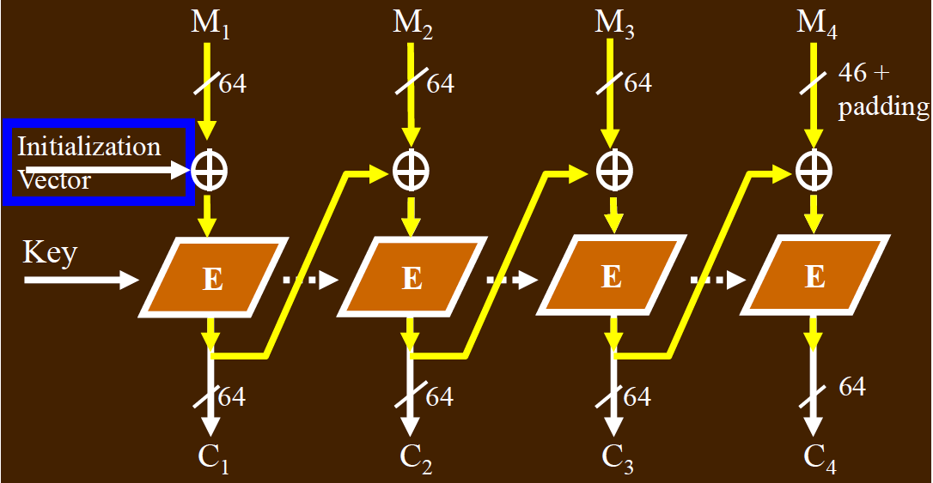
Triple DES
Triple DES + CBC + PK5Padding

Slide 6
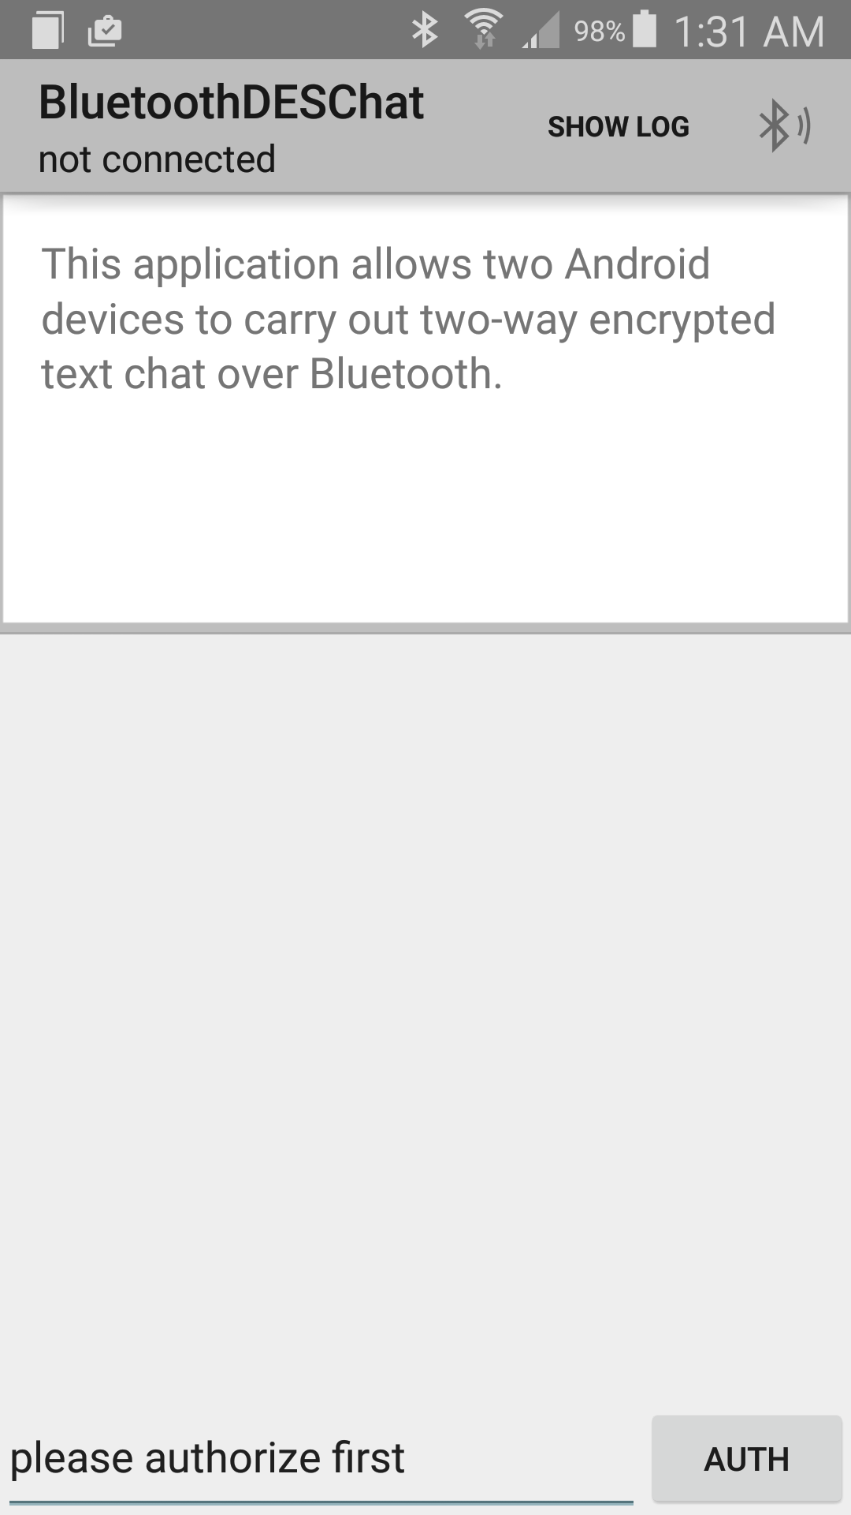
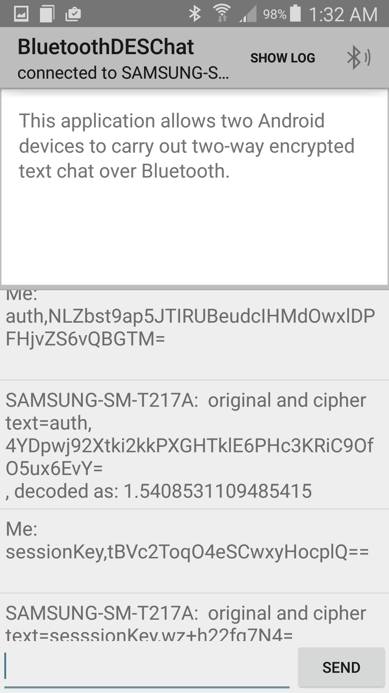
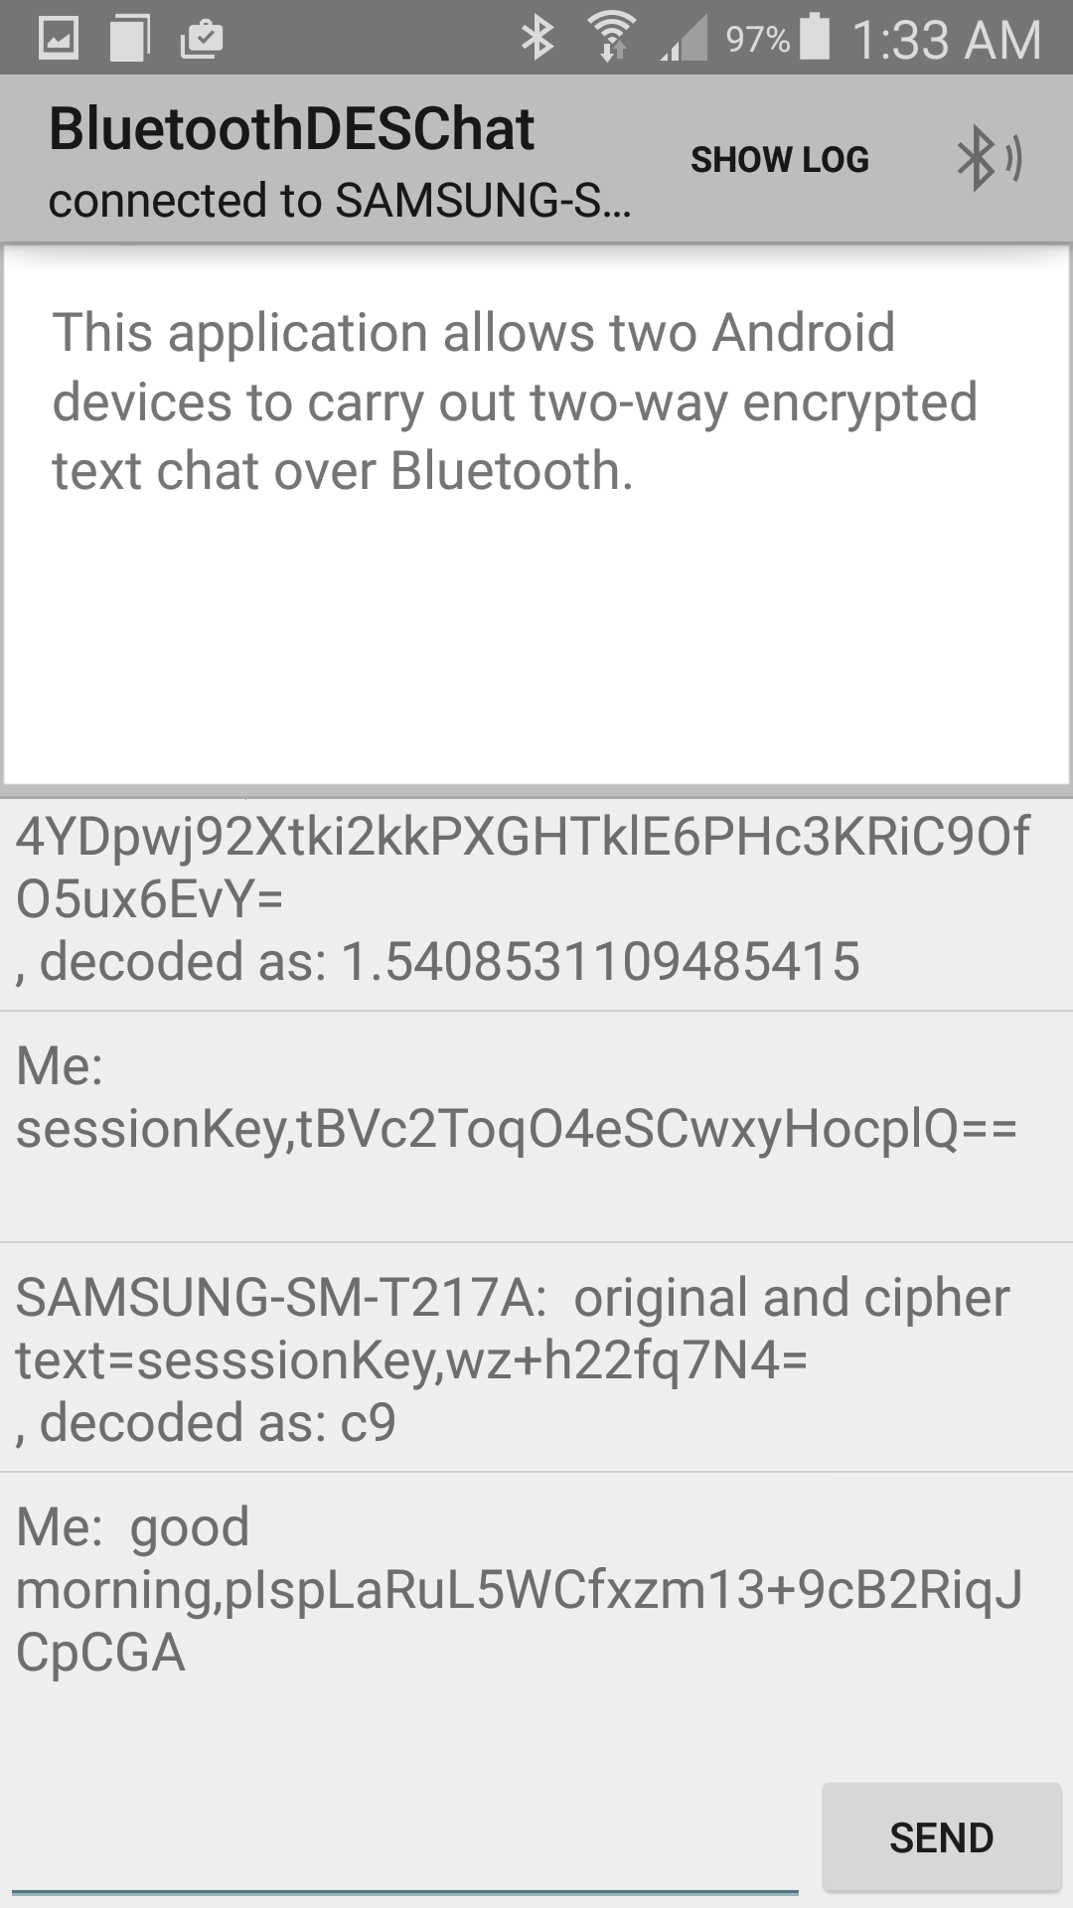
Performance
Authentication with
Two Messages
Do Authentication First
Start Chatting
Key Exchange with
Two Messages

Slide 7

Q & A
Bluetooth DES Chat – Secure your conversation !

