Slide 1

Public Health Care Service
Public Health Needs to Serve the Public - Medical care is under fingertips

Slide 2
PROJECT DESCRIPTION
Help people to get serious about their health issues by showing the statistics of the diseases.
Help people to understand their health issues through case studies, videos and books
Help people to make deep understanding of their symptoms by influencing advance search through professional keywords and summaries.
Aggregate reliable sources to provide rich and accurate information in health care.

Slide 3
OUR MISSION
Awareness of health issues
Millions of people are suffering from health issues.
People need to get serious about their health issues
People need to realize how easy it is to fix health issues.
An easy access to medical science
Medical Science is understandable to everybody.
Medical care is under fingertips.

Slide 4
OUR SERVICE
It provides medical knowledge-base through reliable sources to help people understand their health issues.
We aggregate several data sources, such as medical journals and clinical knowledge-base to train recommendation models, keyword extraction models, summarization models, video understanding models, and web crawling models through machine learning.
Users can query their symptoms through this service to obtain health related solutions in the forms which are easy for them to use, such as case studies, videos, and reference books.
Users can also perform advance search with the help of the recommended medical terms, such as keywords and summary which are extracted from the selected publication.

Slide 5
INDUSTRY SUMMARY
In the United States, each year, health care industry makes $115 billion dollars in sales.
NEWYORK, July 18 (Reuters) - The rate of Americans who are uninsured will rise to 8.9% over the next decade from 7.7% in 2024
According to WTW’s ( Willis Towers Watson) Global Medical Trends Survey, Health care cost increases
the cost of medical care benefits in the U.S.: increase to 8.9% in 2024, compared with 8.2% in 2023.
Globally, the cost increase will ease slightly to 9.9% after hitting a record high of 10.7% in 2023
It will increase again in the coming few years.
Nearly three-fifths of insurers expect higher or significantly higher increases over the subsequent three years following 2024.

Slide 6
Research shows that consumers in this industry primarily focus on the following factors, when people need this service:
Pain signals. When the pain is strong enough to bother daily lives, people will need this service.
The difficulty of making appointments with medical doctors. When people are suffering from the pain and cannot get treatment immediately, they need this service.
Medical insurance is expensive. When people are suffering from the pain and have no medical insurance, they need this service.

Slide 7
GOALS
Long Term
Provide early diagnosis and treatment with zero cost.
Short Term
Provide an ad-hoc health tracker for everybody

Slide 8
MARKET SUMMARY
Based on the death rate statistics at National Center for Disease Control, majority of the death happen in population with no insurance or no time to use insurance (working class).
As of Q3 2023, the uninsured rate in the United States was 7.7%, which is the lowest since 2001.
As of 2024, a Gallup poll found that over half of US adults identify as middle class or upper-middle class. Working-class people have no time to see doctors and to use their insurance.

Slide 9
CUSTOMER SUMMARY
Potential users of this service:
all the people who are having health issues,
especially middle-class people who have no time to see doctors and
lower-class people who have no health insurance.
172 million customers
The estimated number of potential clients in the US is half of the population, which is about 172 million (172,832,029.00).

Slide 10
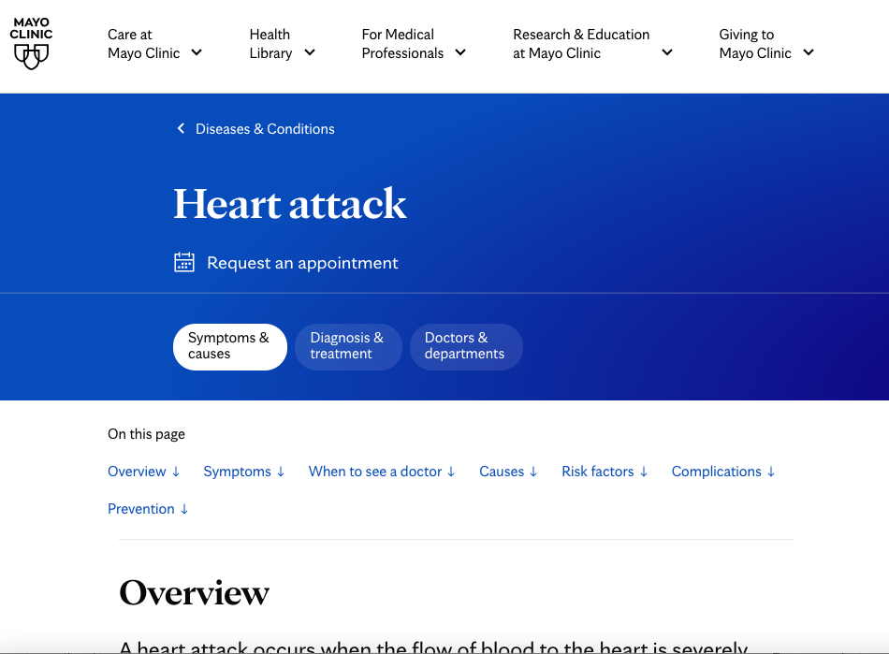
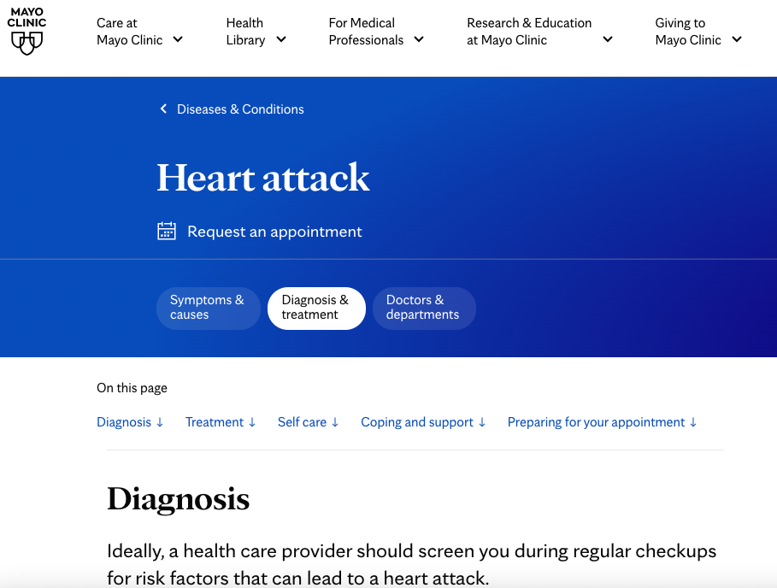
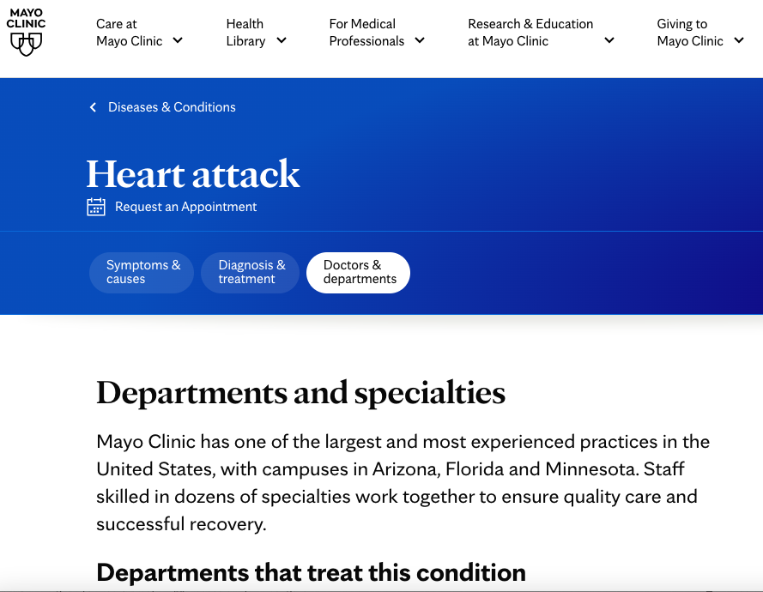
Existing Services – Mayo Clinic
Symptoms
Diagnosis
Specialties
https://www.mayoclinic.org/diseases-conditions/heart-attack/symptoms-causes/syc-20373106

Slide 11
Existing Services
Harvard
https://www.health.harvard.edu/heart-health/chest-pain-a-heart-attack-or-something-else
Johns Hopkins
https://www.hopkinsmedicine.org/health/conditions-and-diseases/heart-attack
Cleveland Clinic
https://my.clevelandclinic.org/health/diseases/16818-heart-attack-myocardial-infarction
WebMD
https://www.webmd.com/heart-disease/coronary-artery-disease

Slide 12
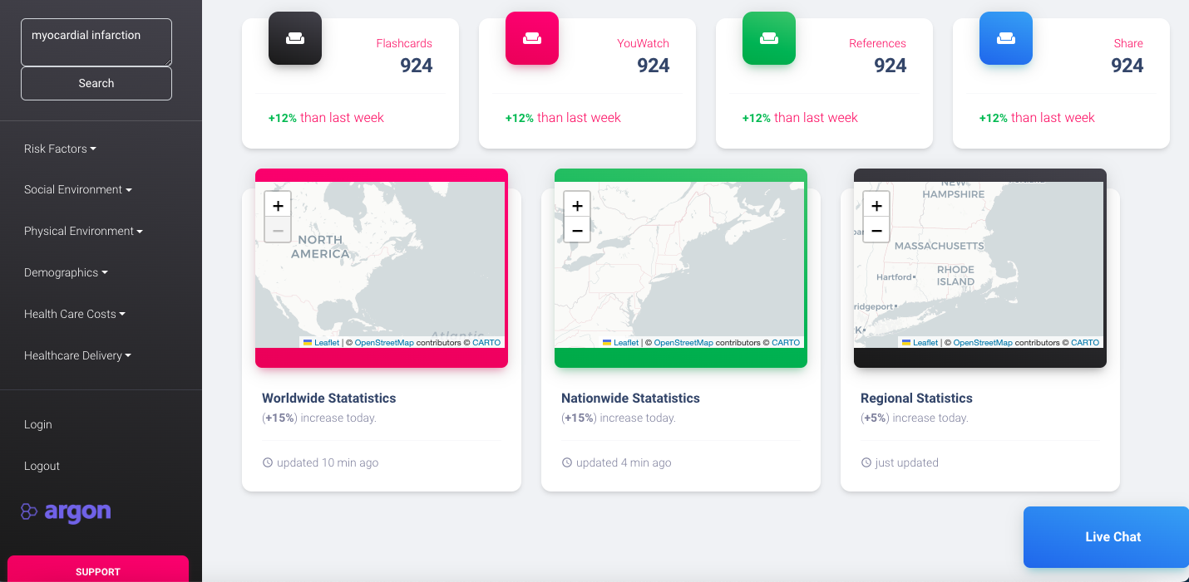
Prototype built with NEJM Publications
Case Studies
Videos
Books
Sharing
Search
Stats
Live Chat

Slide 13

Extracted Keywords
Extracted Summary
Case Study Details
Advance Search
Recommended Case Studies

Slide 14
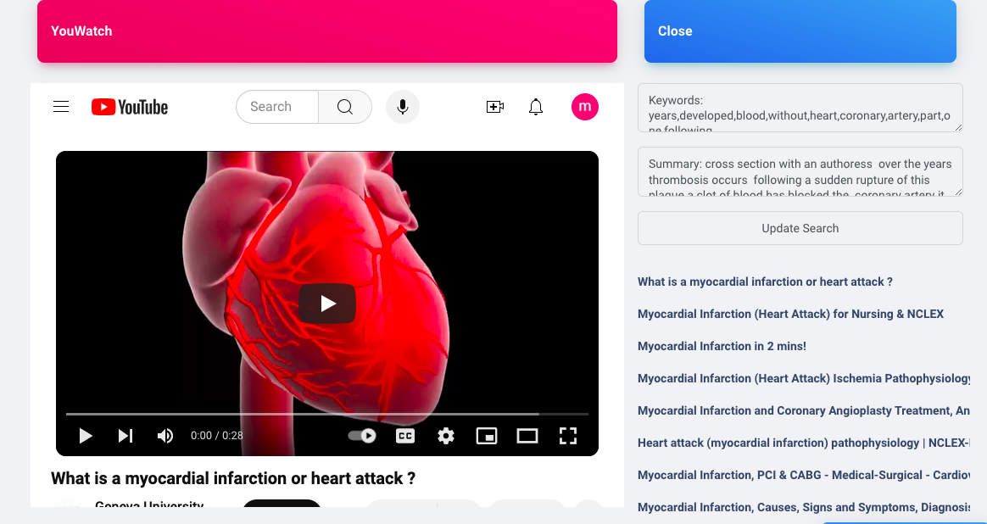
Extracted Keywords
Extracted Summary
Video Details
Advance Search
Recommended Video

Slide 15
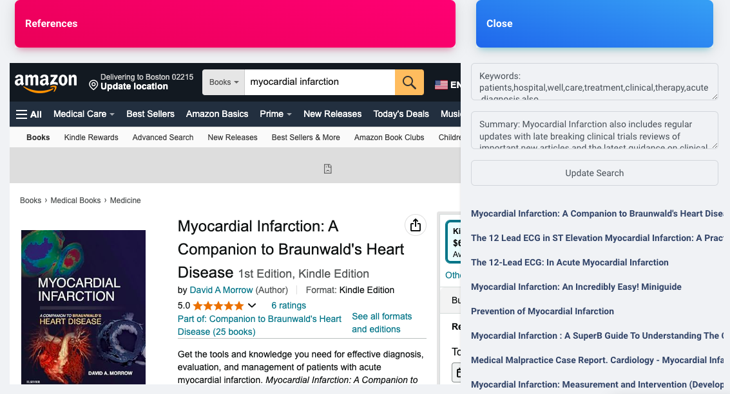
Extracted Keywords
Extracted Summary
Book Details
Advance Search
Recommended Books

Slide 16

New Post
Current User’s posts

Slide 17
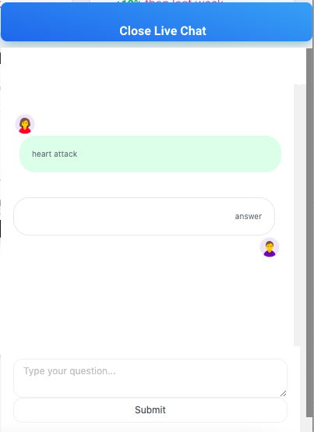

Slide 18
AN EXTENSION OF EXISTING RESEARCH
Lu, Lucy M., and Richard S. Segall. "Extract Clinical Lab Tests from Electronic Hospital Records Through Featured Transformer Model." IJPHIMT vol.10, no.1 2024: pp.1-18. https://doi.org/10.4018/IJPHIMT.336529. https://www.igi-global.com/pdf.aspx?tid=336529&ptid=278136&ctid=4&oa=true&isxn=9781683182368

