Slide 1


Node.js Web Server
HTTP, Servers, Clients
Ivaylo Kenov
Technical Trainer
Software University
https://softuni.bg

Slide 2
Table of Contents
Overview of Node.js
IDE setup
Modules
Basic Web Server
The Request Object
The Response Object
Routing Requests
Additional Tools

Slide 3
Overview of Node.js
Why Node is good?

Slide 4
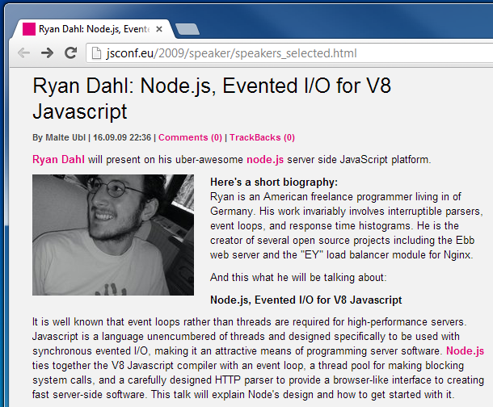
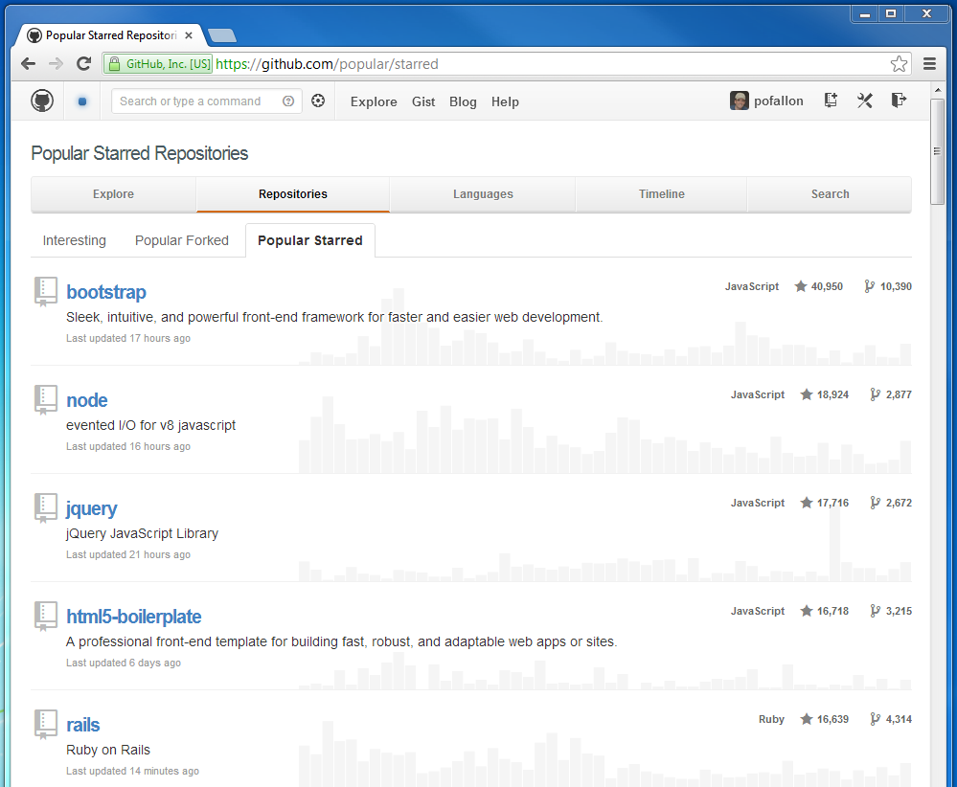
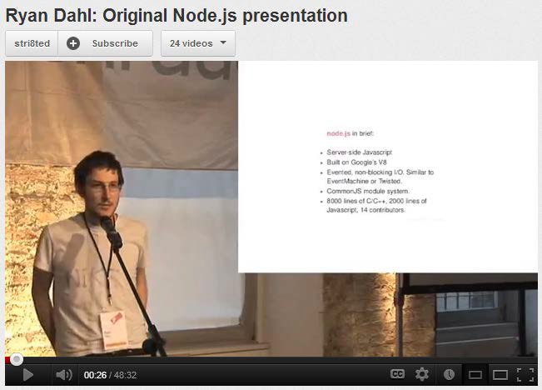
Overview of Node.js
Background

Slide 5
Why Node.js
Node.js is written in JavaScript
One language on the server and the client
Full control of the server capabilities
Asynchronous and fast
One of the fastest web servers
Popular among developers
Perfect for microservices

Slide 6
Building Blocks of Node.js
Node.js
libuv – high-performance I/O library
V8 – Google Chrome’s JavaScript engine
JavaScript -> C++
Installation
Go to http://nodejs.org
Install latest version (6.5.0 or above)
Run Command Prompt and type "node"

Slide 7
Our first Node.js script
Hello World? No? OK!

Slide 8
NPM Init
Go to a folder of your choice
Open CMD and type "npm init"
Follow the instructions
Type "npm install standard --save-exact"
Go to the created 'package.json' file and add
"engine": "6.5.0",
"scripts": {
"start": "node index.js“
},

Slide 9
Configuring Visual Studio Code
If you want to use VS Code
Download from https://code.visualstudio.com/
Follow instructions for Node.js (jsconfig and typings) https://code.visualstudio.com/docs/runtimes/nodejs
Install the Standard code checker https://marketplace.visualstudio.com/items?itemName=chenxsan.vscode-standardjs
Add 'index.js' file
Hit F5
Or use another IDE ☺

Slide 10
The Event Loop
The Core Node Component

Slide 11
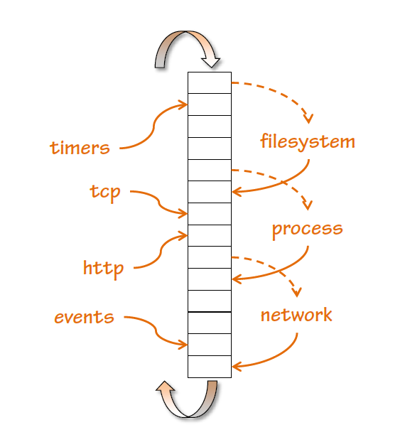
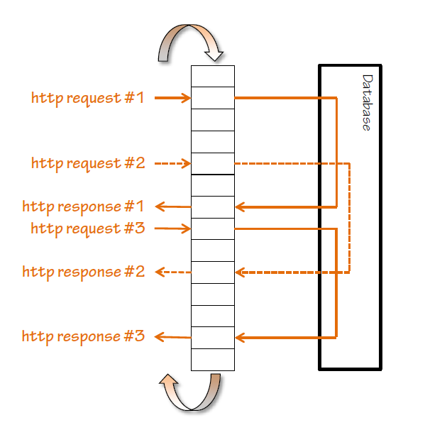
The Event Loop

Slide 12
Asynchronous Code
The synchronous way
var conn = getDbConnection(connectionString);
var stmt = conn.createStatement();
var results = stmt.executeQuery(sqlQuery);
for (var i=0; i<results.length; i++) {
// print results[i];
}

Slide 13
Asynchronous Code
The Node.js asynchronous way
getDbConnection(connectionString, function(err, conn) {
conn.createStatement(function(err, stmt) {
var results = stmt.executeQuery(sqlQuery);
results.on('row', function(result) {
// print result
});
});
});

Slide 14
Asynchronous Code
Conventions
The function callback is the last parameter in the async call
Error is the first parameter in the callback
Always check errors and handle them correctly!
var handleResults = function(error, results) {
// if error is undefined…
// do something with the results
}
getStuff(inputParam, handleResults);

Slide 15
Using Modules
Making Our App Modular

Slide 16
How To Use Modules
Modules are used with "require“
You can require built-in and custom made modules
var first = require('first');
var Second = require('second');
var justPart = require('largeModule').justPart;
var propertyResult = 2 + first.property; // export variable
var functionResult = first.function() * 3; // export function
var second = new Second(); // export object
console.log(justPart()); // export part of object

Slide 17
Built-in Modules
They come with Node.js
Can be required with a string identifier
Commonly used modules
fs, http, crypto, os
More at https://nodejs.org/api/
var fs = require('fs');

Slide 18
Your Modules
Each .js file in the project folder is a module
Can be required with a file system semantics
When required the file extension is not needed
var data = require('./data'); // in same directory
var a = require('./other/a'); // in child directory
var b = require('../lib/b'); // in parent directory's child
var justPart = require(‘./data’).part; // just part of module

Slide 19
Your Modules
You export the module by using "module.exports"
// first.js
var count = 2;
var doIt = function(i, callback) { … }
module.exports.doIt = doIt;
module.exports.someVar = 'result';
// second.js
var one = require('./first');
one.doIt(23, function (err, result) {
console.log(result);
});
console.log(one.someVar);
console.log(one.count); // invalid

Slide 20
Third-Party Modules
Installed from Node Package Manager (NPM)
Run "npm install module --save-exact"
Can be required with the module name
Some modules have command line tools
Run "npm install –g module"
For example 'express', 'mocha'
Run only "npm install", if you want to restore the packages

Slide 21
Node.js Web Server
Let's start the fun!

Slide 22
What Do the Web Servers Do? (Again)
All physical servers have hardware
The hardware is controlled by the operating system
Web servers are software products that use the operating system to handle web requests
Web servers serve Web content
These requests are redirected to other software products (ASP.NET, PHP, etc.), depending on the web server settings

Slide 23
NodeJS Web Server
Require the 'http' module
Create server function (createServer)
Request/Response wrapper objects
Listen function (specifies port and IP (host))
Headers are objects (keys are lowercased)
{
'content-length': '123',
'content-type': 'text/plain',
'connection': 'keep-alive',
'accept': '*/*'
}

Slide 24
NodeJS Web Server
Basic server implementation
http://nodejs.org/api/http.html
let http = require('http')
http
.createServer((req, res) => {
res.writeHead(200, {
'Content-Type': 'text/plain'
}) // return success header
res.write('My server is running! ^_^') // response
res.end() // finish processing current request
})
.listen(1234);

Slide 25
The Request Wrapper
The Request wrapper
http.IncommingMessage class
Implements the Readable Stream interface
Properties
httpVersion – '1.1' or '1.0'
headers – object for request headers
method – 'GET', 'POST', etc.
url – the URL of the request

Slide 26
The Response Wrapper
The Response wrapper
http.ServerResponse class
Implements the Writable Stream interface
Methods
writeHead(statusCode, [headers])
let body = 'hello world'
res.writeHead(200, {
'Content-Length': body.length, // not always valid
'Content-Type': 'text/plain',
'Set-Cookie': ['type=master', 'language=javascript']
});

Slide 27
The Response Wrapper
Methods
write(chunk, [encoding])
end()
Always call the methods in the following way
writeHead
write
end
res.writeHead('Hello world!') // default encoding: utf8

Slide 28
Route Requests
URL Parsing modules
'url' and 'querystring'
both have parse method
let url = require('url')
console.log(url.parse('/status?name=ryan'))
// logs
// {
// href: '/status?name=ryan',
// search: '?name=ryan',
// query: { name: 'ryan' },
// pathname: '/status'
// }

Slide 29
Additional Tools
Helper Modules

Slide 30
Bower
Package manager for client-side libraries
Run "npm install –g bower" and then "bower init"
Then you can run "bower search jquery"
Or install it with "bower install jquery –save-dev"
If you want to restore packages, run "bower install"
Configuration is in '.bowerrc' file
More information here https://bower.io/docs/config/

Slide 31
Yeoman
Easy application scaffolding
Run "npm install –g yo"
Then you need a generator
Run "npm install –g generator-express"
Then just create an app with "yo express"
Contains a lot of predefined project generators
MEAN, AngularJS, Express, etc.

Slide 32
Gulp
Gulp is a Node.js task runner
Run "npm install –g gulp" and then "npm install gulp"
It can runs different tasks, based on configuration
Concatenate and minify JavaScript/CSS files
Compile SASS/LESS/Stylus
Run jshint, csshint
Run Unit Tests
Deploy to Git, Cloud, etc.
And many more (sky is the limit)
Other famous runners are Grunt and WebPack

Slide 33
Gulp
Popular Gulp tasks
gulp-jshint – checks JavaScript for errors
gulp-uglify – minifies JavaScript
gulp-concat – concatenates files
gulp-minify-css – minifies CSS
gulp-minify-html – minifies HTML
gulp-rename – renames files
del – deletes files
gulp-inject – injects files into the HTML

Slide 34
Gulp
Popular Gulp tasks
Create 'gulpfile.js' at the root of the project
Write tasks and run 'gulp default'
gulp.task('scripts', function () {
del.sync(['build/alljs*']);
return gulp.src(config.appJsSrc)
.pipe(uglify())
.pipe(concat('alljs.min.js')
.pipe(gulp.dest('build'));
});
gulp.task('default', ['scripts'], function () { });

Slide 35








JavaScript Frameworks – Node.js Development
https://softuni.bg/trainings/1434/node-js-development-september-2016

Slide 36

The Trainer
Ivaylo Kenov
Various job titles at the same time:
Mathematical competitions champion
Full Stack Technical Trainer
Senior Software Developer
Solutions Architect & Technical Lead
Owner of a Software Company
{Insert Jot Title Here}
Contacts
https://github.com/ivaylokenov
https://facebook.com/ivaylo.kenov
https://linkedin.com/in/kenov

Slide 37
License
This course (slides, examples, demos, videos, homework, etc.) is licensed under the "Creative Commons Attribution-NonCommercial-ShareAlike 4.0 International" license
Attribution: this work may contain portions from
"End-to-end JavaScript Applications" course by Telerik Academy under CC-BY-NC-SA license

Slide 38




Free Trainings @ Software University
Software University Foundation – softuni.org
Software University – High-Quality Education, Profession and Job for Software Developers
softuni.bg
Software University @ Facebook
facebook.com/SoftwareUniversity
Software University @ YouTube
youtube.com/SoftwareUniversity
Software University Forums – forum.softuni.bg

