Slide 1
Lesson 12 UML Fundamentals(3)—
Class Diagram
12.1 Introduction of class
12.2 Extend mechanism of UML
12.3 Relationship between classes
12.4 Classes for analysis
12.5 Class diagram
12.6 OO design principle
12.7 Object diagram
12.8 Conclusion

Slide 2
12.1.1 Definition of class
A description of a set of objects that share the same attributes, operations, relationships, and semantics. Generally, a class is rendered as a rectangle including three parts: name, attributes, and operations
  A class is effectively a template from which objects are created (instantiated).
Customer
Name
name
operations
address
attributes
CreditRating()
GetName()
GetAddress()
……
Grammar of a Class property
[Visibility] Name [Multiplicity][:Type][=Initial Value][{Property}]

Slide 3
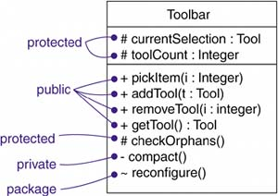


12.1.2 – Visibility & Scope
Visibility
used to specify whether a feature can be used by other classifiers
Public: +
Protected: #
Private: -
Package ~
Information hiding
Scope – instance OR static
Used to specify whether each instance of the classifier has its own distinct value of the feature or whether there is just a single value of the feature shared by all instances of the classifier
  Instance -- Attribute values may vary between instances
  Method invocation may affect the instance’s state
  static -- Attribute values are equal for all instances
  Method invocation does not affect the instance’s state

Slide 4
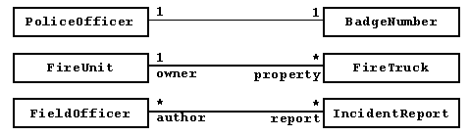
12.1.3 – Multiplicity
Multiplicity
The number of instances a class may have
Is a specification of the range of allowable cardinalities an entity may assume
Expressed in the upper-right corner
Multiplicity can also be used to an attribute by writing a suitable expression in brackets just after the attribute name
1
controlRod
NetworkController
3
consolePort: Port[2..*]

Slide 5
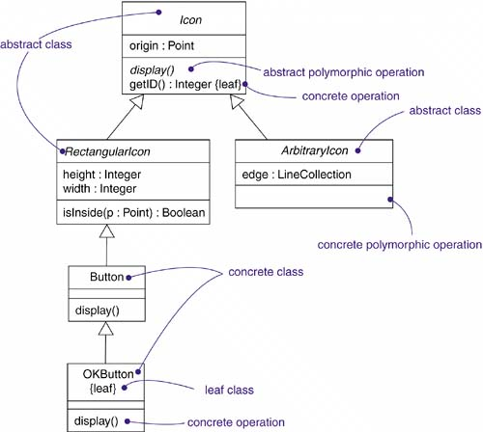
12.1.4 Property adornment
Abstract, leaf
Polymorphic
→ an operation is polymorphic, which means that, in a hierarchy of classes, you can specify operations with the same signature at different points in the hierarchy. An operation in a child class overrides the behavior of a similar operation in the parent class. When a message is dispatched at run time, the operation in the hierarchy that is invoked is chosen polymorphically-that is, a match is determined at run time according to the type of the object

Slide 6
12.1.4 Property adornment
static
The operation does not have an implicit parameter for the target object; it behaves like a traditional global procedure.
query
Execution of the operation leaves the state of the system unchanged. In other words, the operation is a pure function that has no side effects.
sequential
Callers must coordinate outside the object so that only one flow is in the object at a time. In the presence of multiple flows of control, the semantics and integrity of the object cannot be guaranteed.
guarded
The semantics and integrity of the object is guaranteed in the presence of multiple flows of control by sequentializing all calls to all of the object's guarded operations. In effect, exactly one operation at a time can be invoked on the object, reducing this to sequential semantics.

Slide 7
12.1.4 Property adornment
concurrent
The semantics and integrity of the object is guaranteed in the presence of multiple flows of control by treating the operation as atomic
Multiple calls from concurrent flows of control may occur simultaneously to one object on any concurrent operation, and all may proceed concurrently with correct semantics
concurrent operations must be designed so that they perform correctly in case of a concurrent sequential or guarded operation on the same object.

Slide 8
12.1. 5 Name
  Every class must have a name that distinguishes it from other classes
    A name is a textual string
      A name alone → simple name
      A name prefixed by the name of the package where the class lives → qualified name
Temperature Sensor
Business Rules:: FraudAgent
Customer
java::awt::Rectangle
Student
Theoretically, a class name may contain any number of letters, numbers, and certain punctuation marks (except some special ones such as double colon)
Practically, it is short nouns or noun phrase that is from the vocabulary of the system you are modeling. Typically, the first letter of each word will be capitalized

Slide 9
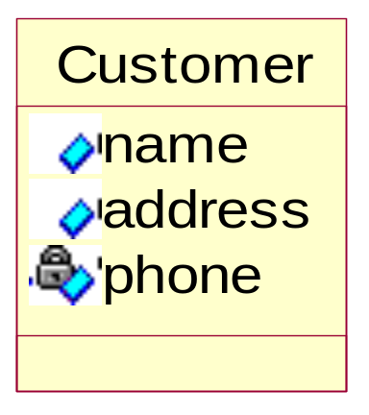
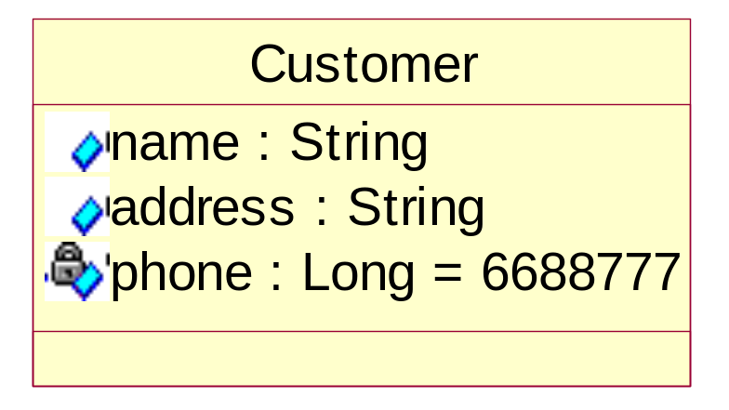
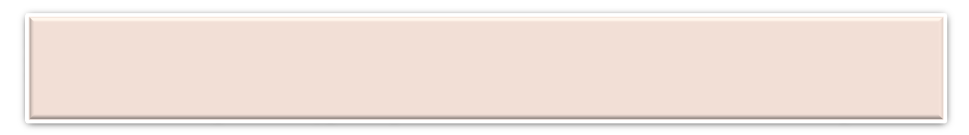
12.1.6 Attribute
Is a named property of a class that describes a range of values that instances of the property may hold→ used to represent the state of an object
The number of attributes is not limited →A class can have any number of attributes or even no attributes at all
Attributes may be drawn showing only their names, or, further be stated with its class and possibly a default initial value
Name
Attribute
Theoretically, an attribute name may be text, just like a class name
Practically, it is short nouns or noun phrase that represents some properties of its enclosing class. Typically, the first letter of each word will be capitalized

Slide 10
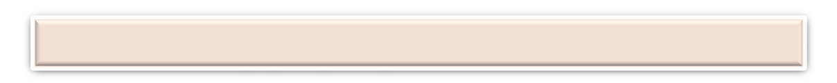
12.1.6 Attribute
Syntax of an attribute
[visibility] name [‘:’ type] [‘[ ’multiplicity]‘]’][‘=’initial-value]
[property-string { ‘,’ property-string} ]
origin
+ origin
origin : Point
name : String [0…1]
origin : Point = (0,0)
id : Integer { readonly}
The readonly property is the same as const in C++

Slide 11

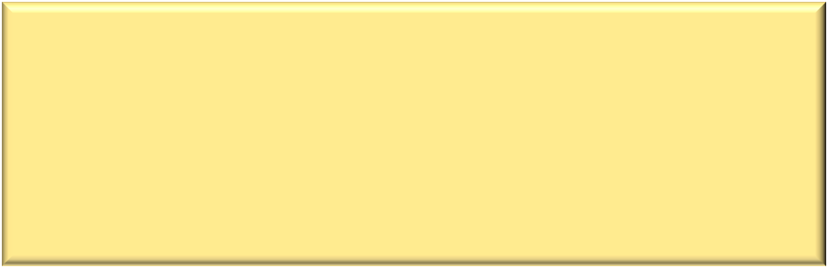
12.1.7 Operation
Is the implementation of a service that can be requested from any object of the class to affect behavior → used to modify, retrieve the attributes or execute some action == Function
A class may have any number of operations or no operations
Operations may show only their names, or further type, default value……
[visibility] name [‘( ’parameter-list ‘)’][ ‘:’return-type]
[property-string { ‘,’ property-string} ]
display
For each parameter:
[direction] name: type [=default-value
+ display
Set(n: Name, s: String)
in: may not be modified
out: may be modified to communicate information to the caller
inout: the input parameter that can be modified
getID( ) : Integer
Restart( ) {guarded}

Slide 12
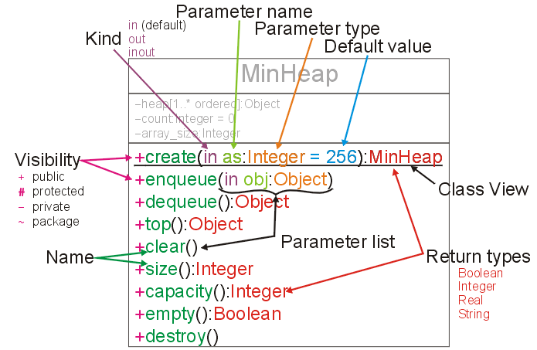
12.1.8 – An example of Class

Slide 13
12.2 Extensibility mechanisms of UML
Why?? UML is just a general-purpose modeling language. To make the language suitable for your specific problem domain, allow to customize and extend the UML by
  adding new building blocks
  creating new properties
  specifying new semantics
Extensibility mechanisms of UML
  stereotype
  tagged value
  constraint

Slide 14
12.2.1 stereotype
The nomenclature is derived from the original meaning of stereotype used in printing . Generally, the stereotype should be made before formal printing. And then, batch production is conducted based on the stereotype.
Stereotype is used to create new model elements derived from the existing ones. → But that have specific properties that are suitable for your problem domain. Represented as:
  <<xxx>>
Similar to extending the vocabulary of UML
Can just be used for the defined basic construction blocks including: Thing, relationship, diagram. Concretely, stereotype can be used on all types of model elements, including:
  Class, node, component, note, relationship, package, operation,…
Pre-defined stereotypes
  《interface》 (from class) ; 《subsystem》( from package)……
Notes:
三种扩展机制：

Slide 15
12.2.2 Tagged value
Allow to extend the properties of a UML building block to create new information in the specification of that element.
Are properties for specifying keyword-value pairs of model elements, where the keywords are attributes. Represented as:
  ｛Name=“Tom”｝
If the tagged value is BOOLEAN type, it can be omitted and the default value is TRUE. Otherwise, an explicit value must be given.
Tagged values can be defined for existing model elements, or for individual stereotypes, so that everything with that stereotype has that tagged value.
A tagged value is not equal to a class attribute!
Instead, you can regard a tagged value as being a metadata, since its value applies to the element itself and not to its instances

Slide 16
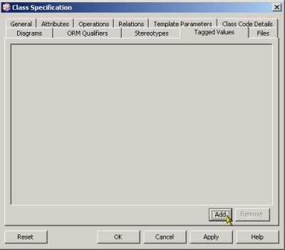
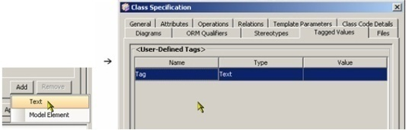
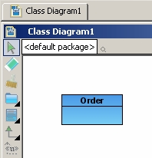
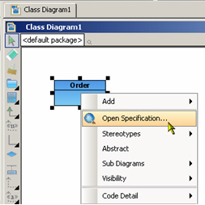
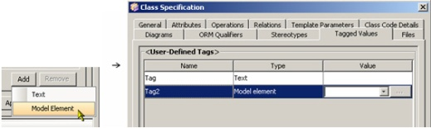
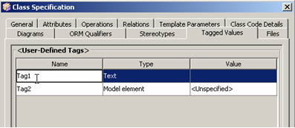
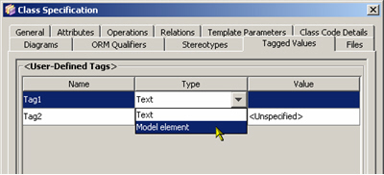
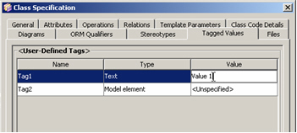
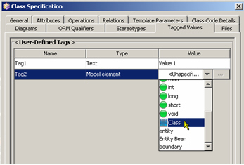
12.2.2 Tagged value – An example
Two types of
tagged value:
Text
Model element
Define a class
Open specification
Tagged value Tab
Specify and change the value and the type

Slide 17
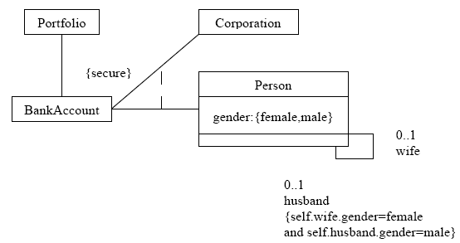
12.2.3 Constraint
Allow to extend the semantics of a UML building block by adding new rules, or modifying existing ones.
Specifying semantics and/or conditions that must be held true at all times for the elements, dependency, and annotation of a model
Graphically, a constraint is rendered as a string enclosed by brackets, which is placed near the associated element(s), or connected to the element(s) by dependency relationships.
  {……}
  {……}
Constraint Description
Constraint Validation
Notes:
约束是用文字表达式表示的语义限制，它应用于元素。约束显示在｛｝内，可以直接放在图中或者独立出来。约束可以是UML预定义的，也可以之自定义的。描述约束的语言可以是正式的数学符号、OCL语言、伪代码或自然语言。如果这种语言是非正式的，那么它的解释也是非正式的，并且要由人来解释。即使约束由一种正式语言来表示，也不意味着它自动为有效约束。
UML constraints
In UML models, a constraint is an extension mechanism that enables you to refine the semantics of a UML model element. A constraint refines a model element by expressing a condition or a restriction in a textual statement to which the model element must conform.
An example of a constraint is a condition such as an attribute having a specific value. A constraint must be enforced in the design of a system. You specify the condition or restriction in the body of the constraint.
Typically, constraints do not have names. Instead, they are identified by the contents of their bodies. Some commonly used constraints are identified by names so that the contents of their bodies do not have to be repeated. The XOR constraint is applied when more than one association has a common connection to one class.
You can specify the language that you use to write the body of a constraint so that others who read the constraint can more easily understand its condition or restriction. You can write the body of a constraint in the following languages: Natural languages such as English
Programming languages
Mathematical notations
Object Constraint Language (OCL)
For more information about OCL, read the Unified Modeling Language (UML) specification that is available on the Object Management Group (OMG) Web site. In general, syntax for the body or body language properties is not enforced.
A constraint is displayed as text enclosed in braces ({}) and appears in a rectangle with a folded upper-right corner.
You can add constraints to your model for the following purposes:
In models that depict software systems, constraints represent conditions or restrictions that you can find no other way to model.
In models that depict time-critical software systems, constraints provide a statement about the relative or absolute value of time during an interaction.
The constraints in a model can appear in any type of UML diagram as well as in freeform diagrams.
Constraint validation
You can validate a constraint. The level of validation that occurs depends on the type of constraint being validated. There are three types of constraints:
A constraint with the «metaConstraint» stereotype applied
A constraint defined in a profile
A constraint that does not have the «metaConstraint» stereotype applied and is not defined in a profile
The syntax and the expression of a constraint are validated if the constraint has the «metaConstraint» stereotype applied to it or if it is defined in a profile.
Only the syntax of a constraint is validated if it does not have the «metaConstraint» stereotype applied to it and it is not defined in a profile.

Slide 18
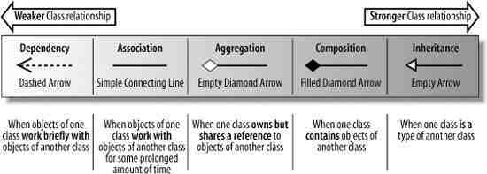
12.3 Relationships between classes
Can UML just model classes with simple attributes and operations????
  No!!!
Relationship
  A relationship is a connection among things.
Relationships in OO modeling
  Inheritance → generalization
  Dependency
  Association
      Composition
      Aggregation

Slide 19
12.3.1 Dependency
A dependency is a using relationship, specifying that a change in the specification of one thing may affect another thing that uses, but not the reverse. → A class needs to know about another class to use objects of that class.
  Rendered as a dashed line, directed to the thing that is depended on
Is a model-level relationship and not a run-time relationship —Need to investigate the model definition of the client element for possible changes if that of the supplier element is changed.
In most cases, the plain, unadorned dependency is sufficient
However, to specify a shade of meaning, a number of stereotypes is defined to be applied to dependency relationship

Slide 20
Type | Stereotype | Description
Abstraction | «Abstraction»
 | «derive» | The client (e.g., attribute value, link) may be computed from the supplier(s)
 | «refine» | The client element(s) are at a “later” semantic level than the supplier(s)
 | «trace» | The client elements “trace” to the suppliers. Typically used for levels of requirements
 | «realize» | The client model element is an implementation of the supplier model element, and the supplier model element is the specification.
Binding | «bind» | Connects given actual parameters to template parameters to create model elements from templates.
Substitution | «substitute» | The client element can replace (under some circumstances) the supplier
Usage | «call» | The client (an operation) may call the supplier (an operation)
 | «create» | The client (a classifier) may create instances of the supplier (a classifier)
 | «instantiate» | Operations of the client (a classifier) may create instances of the supplier (a classifier)
 | «send» | The client (an operation) sends the supplier (a signal)
 | «use» | The client element somehow “uses” the supplier
Notes:
There are four types of dependency relationship: Abstraction, Binding, Substitution, Usage. Sometimes, Realize is regarded as a separate type and thus there are five types of dependency relationships.

Slide 21
12.3.1.1 Dependency – Realization
Is a relationship between two model elements, in which one model element (the client) realizes (implements or executes) the behavior that the other model element (the supplier) specifies.
A interface is realized by a set of classifiers that provide its implementation.
A collaboration instance contains the objects and messages that are needed to implement the behaviors that a use case specifies.
<<interface>>
Comparable
isEqual(String) : Boolean
Hash() : Integer
…
realization
Special notation
Comparable
String
isEqual(String) : Boolean
Hash() : Integer
…

Slide 22
12.3.2 Association – Basic
Is a structural relationship. Used to specify the objects of one thing are connected to objects of another.
Some basic adornments:
  a name,
  role at each end of the association
  multiplicity at each end of the association
multiplicity
Association name
Job
Company
*
1..*
Person
employer
Role name

Slide 23
12.3.2.1 Association – with association class
Properties for describing association details
  Association class
  Qualifier
  Navigation
  Visibility
  Constraints – ordered / set / bag / ordered set / list OR sequence /readonly
Association class: To specify the properties of the association itself. It can be seen as a class with association properties or an association with class properties
multiplicity
Association name
Company
*
Job
1..*
Person
employer
Job
boss
Role name
0..1
Manages
Salary
worker
Association class
self-association

Slide 24

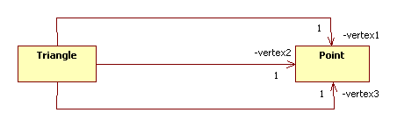


12.3.2.2 Association with qualifier
If the multiplicity of an endpoint is more than one, then how are the associated objects are distinguished?
  For example, a triangle contains three vertices:
How will these vertices be distinguished? Vertex 1, 2, and 3? Vertex 0, 1, and 2? Vertex A, B, and C?
Surely, we can specify their names if we used three associations instead of one:
By adding a qualifier to the opposite endpoint of the association, UML allows us to specify how to name multiple associated objects
Notes:
限定关联是一种特殊的关联类型。
一般来说show和ticket是1..n的关系。
限定了演出时间和座位号之后，可以确定一张特定的票。

Slide 25
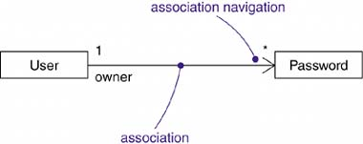
12.3.2.3 association with Navigation
Specifying that an association is navigable is a statement that, given an object at one end, you can easily and directly get to objects at the other end, usually because the source object stores some references to objects of the target.
Unless otherwise specified, navigation across an association is bidirectional

Slide 26
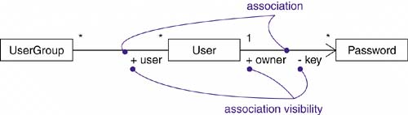
12.3.2.4 Association with Visibility
Given an association between two classes, objects of one class can see and navigate to objects of the other unless otherwise restricted by an explicit statement of navigation.
To limit the visibility across that association relative to objects outside the association, four levels of visibility for an association end can be specified
Public
Private
Protected
Package

Slide 27
12.3.2.5 Association with Constraints
Constraint Name | Description
ordered | Specifies that the set of objects at one end of an association are in an explicit order
set | The objects are unique with no duplicates
bag | The objects are nonunique, may be duplicates
ordered set | The objects are unique and ordered
list or sequence | The objects are ordered, may be duplicates
readonly | A link, once added from an object on the opposite end of the association, may not be modified or deleted. The default in the absence of this constraint is unlimited changeability

Slide 28
12.3.3 Aggregation
An aggregation relationship depicts a classifier as a part of, or as subordinate to, another classifier
Data flows from the whole classifier (the aggregate) to the part. A part classifier can belong to more than one aggregate classifier and it can exist independently of the aggregate.
The classifiers don’t need to have the same lifetime
Polygon
A variant of the "has a" association relationship
An aggregation can be named and have the same adornments that an association can. However, an aggregation may not involve more than two classes
1
Polygon
Contains
3..*
points
Point
aggregation

Slide 29
12.3.4 Composition
Represents whole–part relationships and is a form of aggregation.
Specifies that the lifetime of the part classifier is dependent on the lifetime of the whole classifier → a strong life cycle dependency between instances of the container class and instances of the contained class(es)
Window
1
1
1
2
Scrollbar
1
Title
1
Body
Slider
Header
Panel
composition

Slide 30

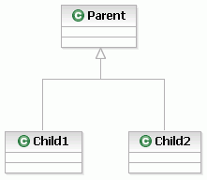
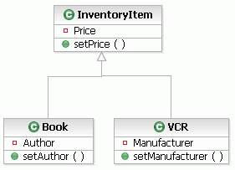
12.3.5 Generalization
Indicates that one of the two related classes (the subtype) is considered to be a specialized form of the other (the super type) and super type is considered as 'Generalization' of subtype
Also known as the inheritance or “is a” relationship: human beings are a subtype of simian, which are a subtype of mammal, ……
The child may even add new structure and behavior, or it may override the behavior of the parent.
Instances of the child may be used anywhere instances of the parent apply
Notes:
Oak橡树、Elm榆树、Birch桦树

Slide 31
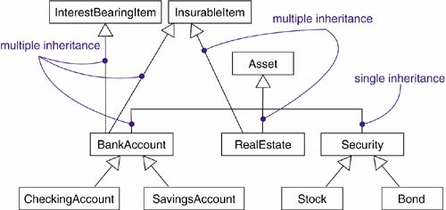
12.3.5 Generalization -- Multiple
Multiple inheritance!!
Run into problems if a child has multiple parents whose structure or behavior overlap
Multi-inheritance can be replaced by delegation, in which a child inherits from only one parent and then uses aggregation to obtain the structure/behavior of more subordinate parents

Slide 32
12.3.5 Constraints for generalization relationships
Constraint name | description
Complete | Specifies that all children in the generalization have been specified in the model (although some may be elided in the diagram) and that no additional children are permitted
Incomplete | Specifies that not all children in the generalization have been specified (even if some are elided) and that additional children are permitted
Disjoint | Specifies that objects of the parent may have no more than one of the children as a type. For example, class Person can be specialized into disjoint classes Man and Woman.
Overlapping | Specifies that objects of the parent may have more than one of the children as a type. For example, class Vehicle can be specialized into overlapping subclasses LandVehicle and WaterVehicle (an amphibious vehicle is both).
The latter two constraints apply only in the context of multiple inheritance. You’ll use disjoint to show that the classes in a set are mutually incompatible; a subclass may not inherit from more than one. You’ll use overlapping to indicate that a class can multiply inherit from more than one class in the set.

Slide 33
12.3.6 Abstract class & Interface
Abstract class
  Can’t be instantialized directly
  Usually the methods in an abstract class are declaration without implementation.
  The abstract class name is written in italics in UML
Interface
  Is a stereotype of class << interface >>
  An interface is a collection of operations that are used to specify a service of a class or a component
  In UML, there is not any attribute included in interface, just operation declaration
Notes:
在abstract class方式中，Demo可以有自己的数据成员，也可以有非abstarct的成员方法，而在interface方式的实现中，Demo只能够有静态的不能被修改的数据成员（也就是必须是static final的，不过在interface中一般不定义数据成员），所有的成员方法都是abstract的。从某种意义上说，interface是一种特殊形式的abstract class。 从编程的角度来看，abstract class和interface都可以用来实现"design by contract"的思想。但是在具体的使用上面还是有一些区别的。 首先，abstract class在Java语言中表示的是一种继承关系，一个类只能使用一次继承关系。但是，一个类却可以实现多个interface。也许，这是Java语言的设计者在考虑Java对于多重继承的支持方面的一种折中考虑吧。 其次，在abstract class的定义中，我们可以赋予方法的默认行为。但是在interface的定义中，方法却不能拥有默认行为，为了绕过这个限制，必须使用委托，但是这会 增加一些复杂性，有时会造成很大的麻烦。 在抽象类中不能定义默认行为还存在另一个比较严重的问题，那就是可能会造成维护上的麻烦。因为如果后来想修改类的界面（一般通过abstract class或者interface来表示）以适应新的情况（比如，添加新的方法或者给已用的方法中添加新的参数）时，就会非常的麻烦，可能要花费很多的时间（对于派生类很多的情况，尤为如此）。但是如果界面是通过abstract class来实现的，那么可能就只需要修改定义在abstract class中的默认行为就可以了。 同样，如果不能在抽象类中定义默认行为，就会导致同样的方法实现出现在该抽象类的每一个派生类中，违反了"one rule，one place"原则，造成代码重复，同样不利于以后的维护。因此，在abstract class和interface间进行选择时要非常的小心。

Slide 34
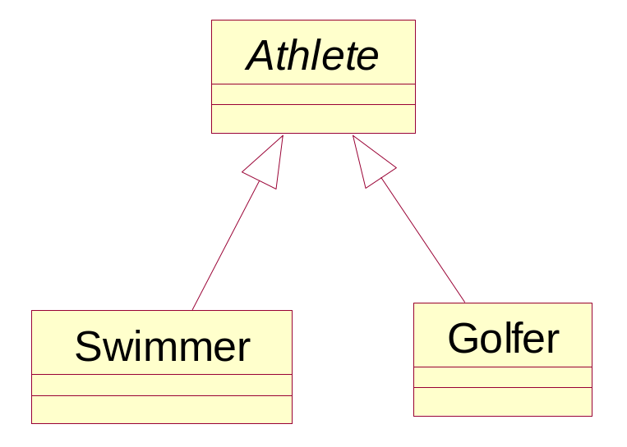
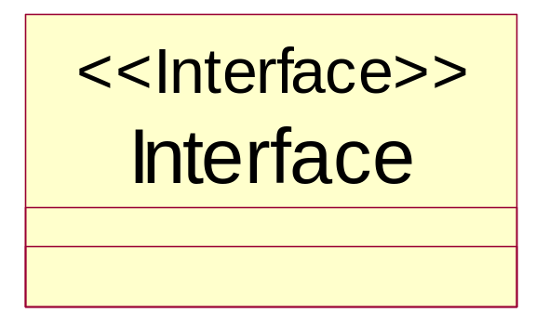
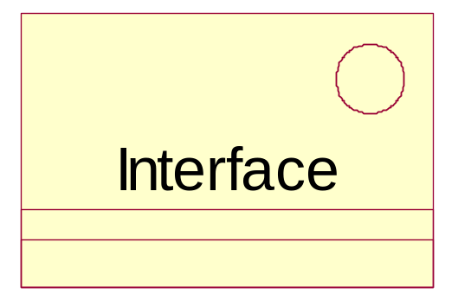
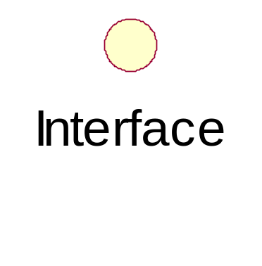
12.3.6 Abstract class & Interface
Icon形式
Label形式
Decoration形式

Slide 35
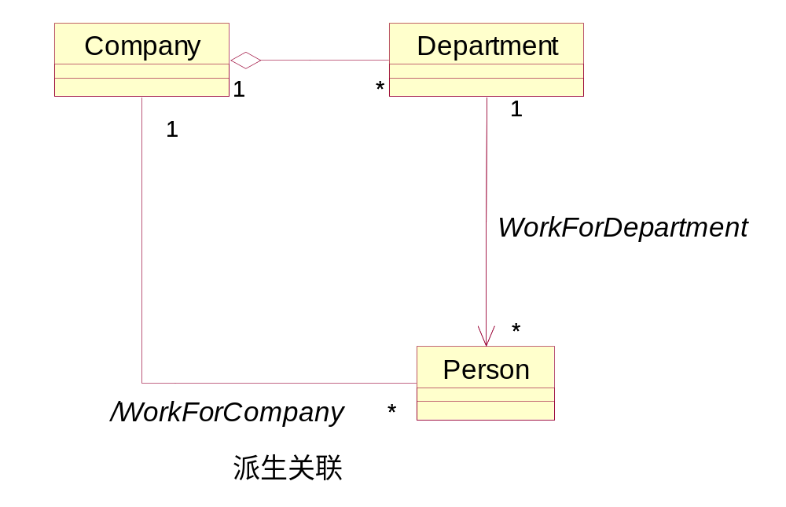
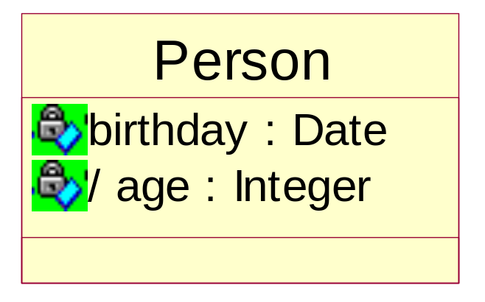
12.3.7 Derived attribute and derived association
is calculated from the value of other model attributes and associations in the diagram——The age can be calculated from the birth date
Before derived attributes and derived association, a “/” should be added
During code generation, there is not code generated for derived attribute and derived association. It help maintain the data consistence by specifying which attriutes/associations are derived
Notes:
不需要用户输入两次。。。年龄、生日

Slide 36
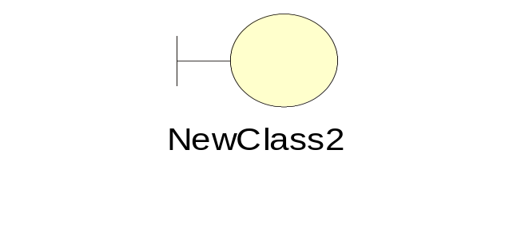
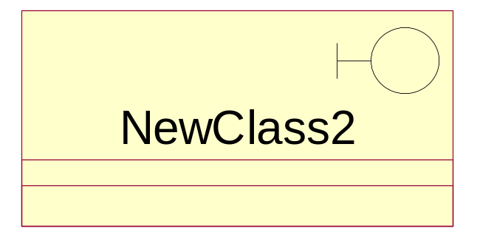
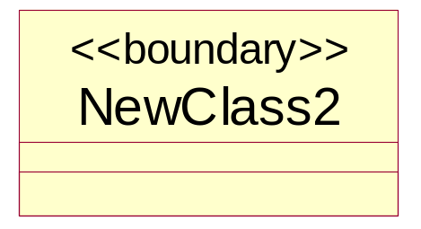
12.4.1 Class for analysis– boundary class
A boundary class models the interaction between one or more actors and the system .
Represents an interface between the system and some entity outside the system. Its role is to mediate the exchange of information with the outside world, and to insulate the system from changes in its surroundings
Form, dialog box, report, class representing communication protocol（such as TCP/IP）, class for directly interacting with external device/external system
Use case 1
Boundary class
How to determine boundary class??
By analyzing with use case!

Slide 37
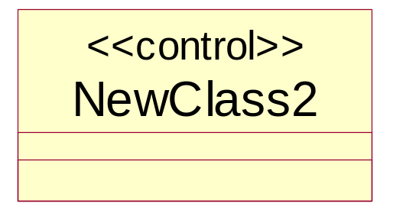
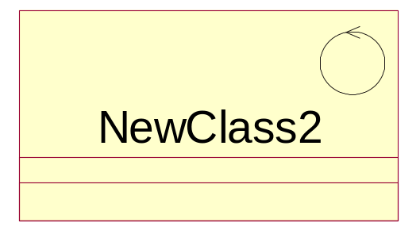
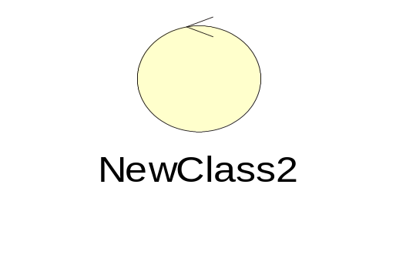
12.4.2 Class for analysis– Control class
Models the coordination and sequencing of other objects in the system
monitor main events and control flows by designating work to other classes.
Generally, for each use case, there is a control class to control the event sequence of the use case.
Similar to the boundary class, several use cases can share a control class
Usually, the other classes don’t send too many messages to the control class. The control class sends messages to other classes.

Slide 38
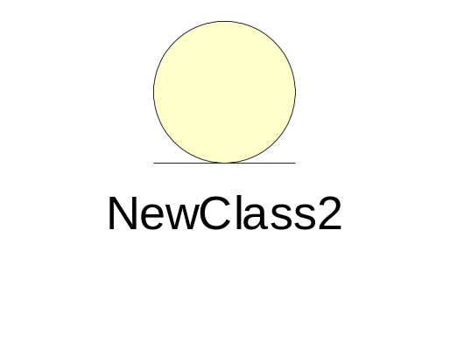
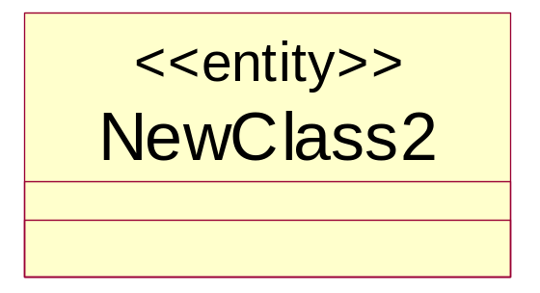
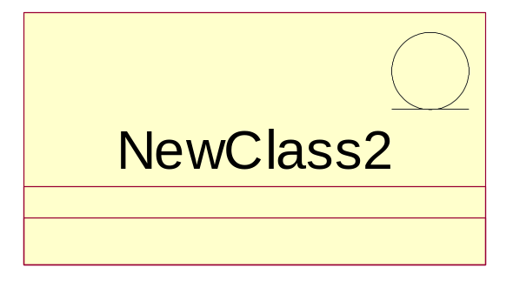
12.4.3 Class for analysis– Entity class
Represents the persistent information in a system
  Classes that store information about an employee or student. This is information that exists in database, or files for a long time
How to find entity class??
By event flow and interaction diagram
Named with domain term
Generally, there is a corresponding table in database for each entity class, and each word segment represents an attribute of the entity class
However, it is not imperative that the entity class is related to the table one by one

Slide 39
12.5 Class Diagram
Describes the structure of a system by showing the system's classes, their attributes, and the relationships between the classes; Is a STATIC view of system
A class diagram shows:
  Packages (sub-packages of our package diagram)
  Classes
    Attributes
    Methods
  Interfaces
  Collaborations
  Dependency, Generalization, Relationships
Not only the static relationships between classes are described, but the system behavior is also described

Slide 40
12.5.1 Three Levels of Class Diagrams
Differentiated by the amount of detail they contain
  Conceptual (Domain) Model
  Analysis (Specification)
  Implementation
Notes:
We can create three levels of class diagrams which are differentiated by the amount of detail they contain.
We start with initial analysis to create a high-level conceptual or domain model of the application. This typically contains just classes and maybe a few attributes.
At the analysis (specification) level, we complete all the major attributes, the public methods and understand the class relationships and their cardinalities.
At the implementation level, we have translated all the relationships and cardinalities to data structures, and have identified additional classes necessary for implementation.

Slide 41
12.5.1 From Domain to Analysis (Specification)
Author
Book
Patron
Book
written by
-isbn:string
-title:string
id
name
age
isbn
title
author
-name:string
1..5
*
1
Checks Out
Patron
BookCopy
OutDate
Returned
Fines
-id:int
-name:string
/age:int
1
-copy_num : int
1..*
0..5
represented
by
Checks Out
-OutDate:Date
-Returned:Date
/Fines:Currency

Slide 42
12.5.1 From Analysis (Specification) to Implementation
Author
Book
written by
-isbn:string
-title:string
-name:string
1..5
*
Author
Book
-name:string
-isbn:string
-title:string
~writtenby[5]: Author
- writtenby :List<Book>

Slide 43
12.5.1 From Implementation to Code
Author
-name:string
public class Author {
private String name;
private List<Book> writtenby;
}
public class Book {
private String isbn;
private String title;
Author writtenby[5];
}
- writtenby :List<Book>
Book
-isbn:string
-title:string
~writtenby[5]: Author

Slide 44
12.5.2 Tricks for constructing class diagrams
Primary methods：
  Noun identification
  Use-case identification —— determine the class candidate according to the nouns used in use case
  CRC – class / responsibility / collaboration –determine the class according to the responsibility it will act as.
  Analyze the classes according to the boundary class, control class, and entity class.
Other methods
  Determine the classes by using the domain analysis results
  Determine classes by referring to design pattern
  Determine classes by using guide principles of a certain software development process such RUP. There are some detailed steps to illustrate how to find classes
Notes:
根据名词确定类的例子：
根据CRC分析法确定类的例子：
根据边界、控制、实体划分确定类的例子：

Slide 45
  12.5.2.1 Noun identification
Identify candidate classes by picking all the nouns and noun phrases out of a requirements specification of the system.
Discard candidates which are inappropriate for any reason, renaming the remaining classes if necessary
What kinds of things are classes?
Tangible or ‘real-world’ things: book, copy, course
Roles: library member, student, director of studies
Events: arrival, leaving, request
Interactions: meeting, intersection

Slide 46
12.5.2.1 Noun identification –An example
Teaching management system is a system used by the students, teachers and managers for course management, selection, schedule and scoring.
Class：
  Student
  Teacher
  Manager
  Course

Slide 47
12.5.2.2 Use-case Identification Method
Essentially, use case is a form of describing the system. Thus it is convenient to identify the classes by use case description
The following questions can help identify use case:
  What entities are used in use case description?
  What entities will be used for completing the use case？
  What information will be generated and saved during use case execution？
  What is the needed input of each role associated with the use case？
  What is the generated output to each associated role by the use case ？
  What hardware is needed for the use case execution？

Slide 48
12.5.3 CRC Analysis method(1)
The contribution of CRC(Class、Responsibilities、Collaboration) is that it facilitate designers to focus on OOT by separating them from thinking process
CRC Card：
  Class name :
  Responsibilities: is anything that a class knows or does. For example, students have names, addresses, and phone numbers. These are the things a student knows. Students also enroll in seminars, drop seminars, and request transcripts. These are the things a student does. The things a class knows and does constitute its responsibilities
  Collaborators: is something or somebody that the Class should collaborate/interact with.

Slide 49
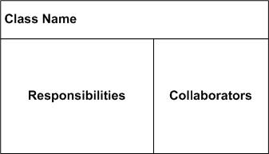
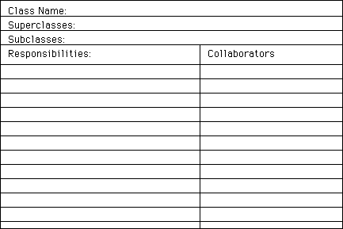
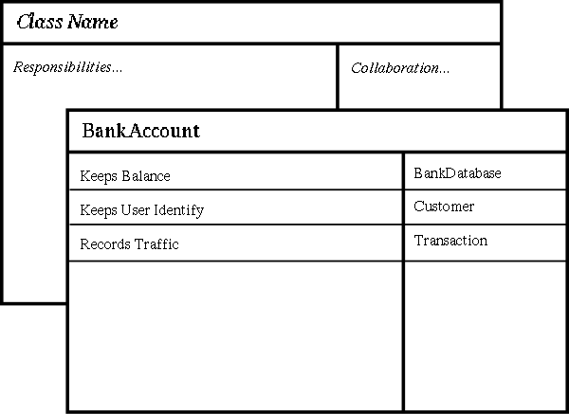
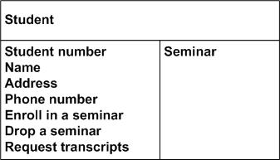
12.5.3 CRC Analysis method

Slide 50
12.5.3 Construction Process based CRC
Set up a Group: composed of developers, domain experts, and an OOT facilitator. In the initial Analysis phase there should be two or three domain experts. As the project moves more in to the design phase, some of the domain experts can be replaced with developers. There should always be at least one domain expert in the group to clarify an question that arise about the behavior of the system.
Prepare the Cards: The exact format of the card can be customized to the preferences of the group, but the minimal required information is the name of the class, it's responsibilities and the collaborators.

Slide 51
12.5.3 Construction Process based CRC
Creating class
  Find all of the nouns and verbs in the problem statement. The nouns are a good key for class, and the verbs → responsibilities
  Use this information for the basis of a brainstorming session and identify all the class that you see. Remember in a brainstorming session there should be no or little discussion of the ideas. Record them and filter the results after the brainstorming.
  After the classes have been chosen pass out cards and assign the class to the member of the group. Each person should be responsible for at least one class. They are the owner of that class for the session. Each person records the name of their class on a card. One class per card.

Slide 52
12.5.3 Construction Process based CRC
Responsibilities
  Once a reasonable set of classes have be assigned to the group, responsibilities can be added. Add responsibilities that are obvious from the requirements or the name of the class.
Scenario execution
  These are the heart of the CRC card session. Scenarios are walk-throughs of the functions of the system in detail. Take required functionality from the requirements document and use this as a scenarios. Start with scenarios that are part of the systems normal operation first, and then exceptional scenarios, like error recover, later.

Slide 53
12.5.4 Steps for building class diagram
Determine the system requirement by analyzing the problem
Determine classes and their semantics, attributes, responsibility, and operation
Determine the relationships between the classes and represent them with association, generalization, aggregation, composition and dependency
Refine the obtained classes and their relationships, and solve the problems such as naming conflict, function overlapping, etc.
Draw the class diagram and give some explanation

Slide 54
12.6 Design principles of OO Modeling
Open/Closed Principle，OCP
Liskov Substitution Principle，LSP
Dependency Inversion Principle，DIP
Interface Segregation Principle，ISP

Slide 55
12.6.1 Open/Closed Principle，OCP
OCP：open for extension, but close for modification
Two ways used:
  Bertrand Meyer’s idea was that once completed, the implementation of a class could only be modified to correct errors; new or changed features would require that a different class be created. That class could reuse coding from the original class through inheritance.
    advocates implementation inheritance. Implementation can be reused through inheritance but interface specifications need not be. The existing implementation is closed to modifications, and new implementations need not implement the existing interface.

Slide 56
12.6.1 Open/Closed Principle，OCP
  Polymorphic OCP: Refer to the use of abstracted interfaces, where the implementations can be changed and multiple implementations could be created and polymorphically substituted for each other.
  advocates inheritance from abstract base classes. Interface specifications can be reused through inheritance but implementation need not be. The existing interface is closed to modifications and new implementations must, at a minimum, implement that interface
Implementation of OCP：
  Unchanged abstraction level：Must not be changed
  Changed implementation level：change and extension are finished in implementation level

Slide 57
12.6.2 Liskov Substitution Principle，LSP
  if S is a subtype of T, then objects of type T in a program may be replaced with objects of type S without altering any of the desirable properties of that program

Slide 58
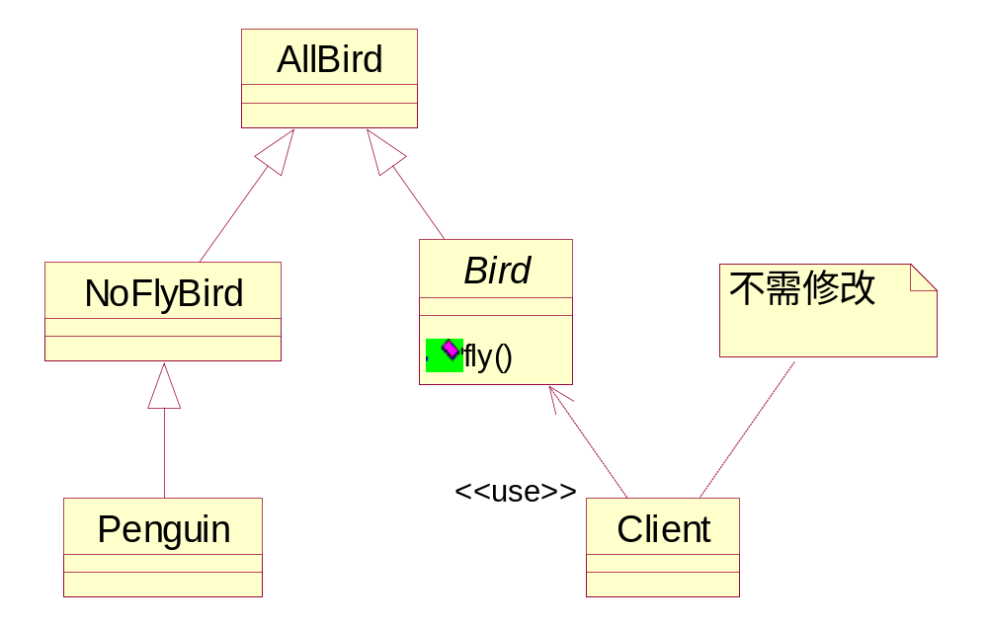
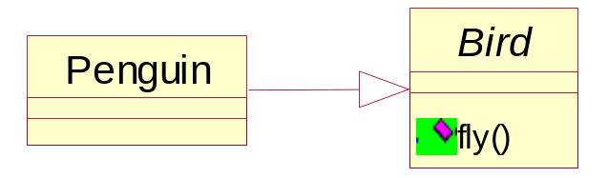
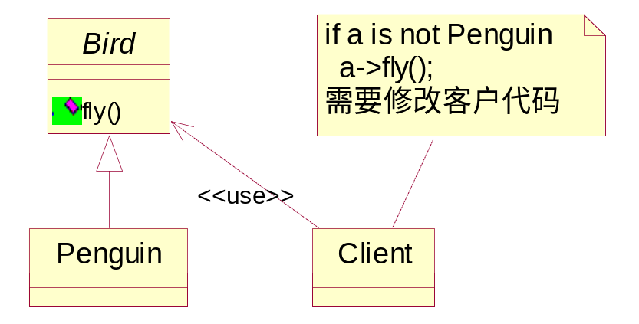
12.6.2 LSP example： penguin can’t fly
Penguin belongs to bird……
However, the bird can fly, the penguin can’t fly……
Notes:
举一个例子：生物学的分类体系中把企鹅归属为鸟类。我们模仿这个体系，设计出这样的类和关系。
类“鸟”中有个方法fly，企鹅自然也继承了这个方法，可是企鹅不能飞阿，于是，我们在企鹅的类中覆盖了fly方法，告诉方法的调用者：企鹅是不会飞的。这完全符合常理。但是，这违反了LSP，企鹅是鸟的子类，可是企鹅却不能飞！需要注意的是，此处的“鸟”已经不再是生物学中的鸟了，它是软件中的一个类、一个抽象。
有人会说，企鹅不能飞很正常啊，而且这样编写代码也能正常编译，只要在使用这个类的客户代码中加一句判断就行了。但是，这就是问题所在！首先，客户代码和“企鹅”的代码很有可能不是同时设计的，在当今软件外包一层又一层的开发模式下，你甚至根本不知道两个模块的原产地是哪里，也就谈不上去修改客户代码了。客户程序很可能是遗留系统的一部分，很可能已经不再维护，如果因为设计出这么一个“企鹅”而导致必须修改客户代码，谁应该承担这部分责任呢？（大概是上帝吧，谁叫他让“企鹅”不能飞的。^_^）“修改客户代码”直接违反了OCP，这就是OCP的重要性。违反LSP将使既有的设计不能封闭！

Slide 59
12.6.3 Dependency Inversion Principle(DIP)
High-level modules should not depend on low-level modules. Both should depend on abstractions. →
Abstractions should not depend upon details. Details should depend upon abstractions. → implementation
The goal is to decouple high-level components from low-level components such that reuse with different low-level component implementations becomes possible
Separating high-level and low-level components into separate packages/libraries
Interface oriented programming – Behavior/services required by the high-level component are owned by, and exist within the high-level component's package. Their implementation requires that the low-level component packages depend upon the high-level component for compilation, thus inverting the conventional dependency relationship.

Slide 60
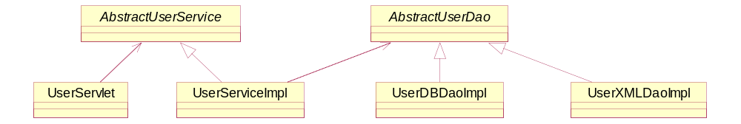
12.6.3 Realization of DIP
Explicit hierarchy
  Example：WEB Application ，Web Service，Business Transaction, DAO
Depend on abstraction：all the dependency relationship are based on abstract class or interface, not on concrete class
  Any class cannot be derived from concrete class
  Any variable cannot point to or refer to concrete class
  Any method cannot override the implemented one of its base class

Slide 61
12.6.4 Interface Segregation Principle，ISP
Don’t impose the user to depend on the interfaces they don’t utilize.
  It is better to use several special interfaces than to use a general interface
It is not necessary for an interface to provide many functions. Contrarily, an interface should provide only one service function.

Slide 62
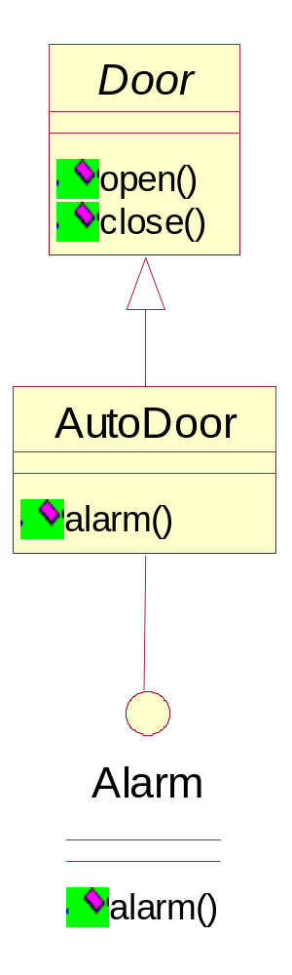



12.6.4 Example of ISP
Door / Alarm Door
Initial Req.：the door can open and close，AutoDoor is a special door
New Req.：The door can alarm

Slide 63



12.7 Object Diagram
Shows a complete/partial view of the structure of a modeled system at a specific time.
Focuses on some particular set of object instances and attributes, and the links between the instances.
A correlated set of object diagrams provides insight into how an arbitrary view of a system is expected to evolve over time

Slide 64
12.8 Conclusion
Class diagram is most important diagram in UML, which is of strong and rich semantics
There are association, aggregation, composition, generalization, dependency relationship between classes
Association is an important type of relationship in class diagram. There are also several important concepts related to it: association name, association role, association class, roles on association, qualifier association, self-association, 2-association, N-association, etc.
Association class is used to describe the characteristics of association
Qualifier association is the association with the specified qualifier. It is used to determine the object or object set of the other side when given in one side.

Slide 65
12.8 Conclusion (cont’)
Derived attribute or derived association are the attribute or association that can be derived from other attributes or associations. There is no code generated for derived attributes and associations
Abstraction class and interface give the abstract mechanism for OO design
Stereotype is a pretty important extension mechanism in UML. It is stereotype that makes UML so powerful and flexible
Boundary class, control class and entity class are analysis stereotypes of Class
Class diagram can be divided into conceptual, specification, and implementation level, which are used in different development stage

Slide 66
12.8 Conclusion (cont’)
It is a difficult task to determine the class of a system during OO analysis and design. There are some heuristic rules for helping finding the classes. However, there is no mature method to determine all the classes
Domain analysis is an effective method for finding the classes
OO design should obey some principles, such as OCP, LSP, DIP and ISP.
Object diagram is the instance of class diagram. It is a snapshot of the system detailed state at a certain time. It is not commonly used in practice.

Slide 67

A Quiz

Slide 68


Slide 69


