Slide 1



FUTSA
A FUTSAL BOOKING AND MANAGEMENT SYSTEM

Slide 2

Team Members
Saroj Aryal
Suraj Gautam
Amrit Adhikari
Chiranjibi Ranabhat
SUPERVISED BY
Er. Bhesh Bahadur Thapa

Slide 3
Contents
Background
Problem Statement
Objectives
Feature
Design
Demo
Outcome
Notes:
Big data is a fast emerging topic among both industry and academia, it is featured by 3Vs: Volume, Variety and Velocity. Volume is size of data. Variety is different type of data industry generating i.e. structured, semi-structured and unstructured. Velocity is the speed data is generating. The main challenge for big data is that how to extract required information within given time limit.
Therefore, several big data processing tools emerge, like Hadoop[1] and Storm. Hadoop is mostly used for off-line data processing, whereas Storm is adequate for on-line stream process. Nowadays,more data-intensive applications and technologies require online massive data processing instead of traditional store then-process system with minimum latency.

Slide 4
Background
Increasing Popularity of Futsal.
Rising demand for futsal pitches.
Limitation of traditional bookings methods.
Customer Dissatisfaction and Potential Revenue Loss
Need for a Modern Booking and Management System
Notes:
Big data is a fast emerging topic among both industry and academia, it is featured by 3Vs: Volume, Variety and Velocity. Volume is size of data. Variety is different type of data industry generating i.e. structured, semi-structured and unstructured. Velocity is the speed data is generating. The main challenge for big data is that how to extract required information within given time limit.
Therefore, several big data processing tools emerge, like Hadoop[1] and Storm. Hadoop is mostly used for off-line data processing, whereas Storm is adequate for on-line stream process. Nowadays,more data-intensive applications and technologies require online massive data processing instead of traditional store then-process system with minimum latency.

Slide 5
Problem Statement
Inefficient Booking process
Challenges in pitch management
Need of streamlined Booking System
Comprehensive Pitch and League Management

Slide 6
Objectives
To develop a user-friendly mobile and web application for futsal booking
To enhance futsal experience for players and facility owners
To create a comprehensive system for futsal pitch and league management

Slide 7
Features
Map view for locating futsal
Online Futsal booking
Event creation by futsal and user registering team.
Event Request by players and futsal make bid on it.
Secure payment integration

Slide 8
Design

Slide 9
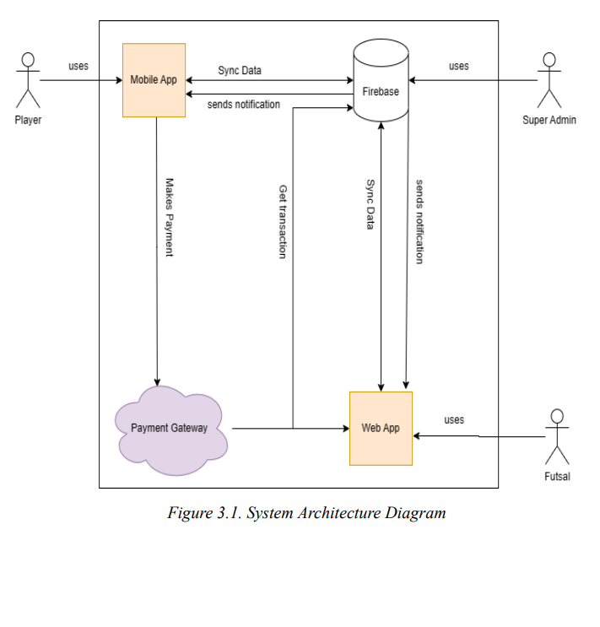
System Architecture

Slide 10
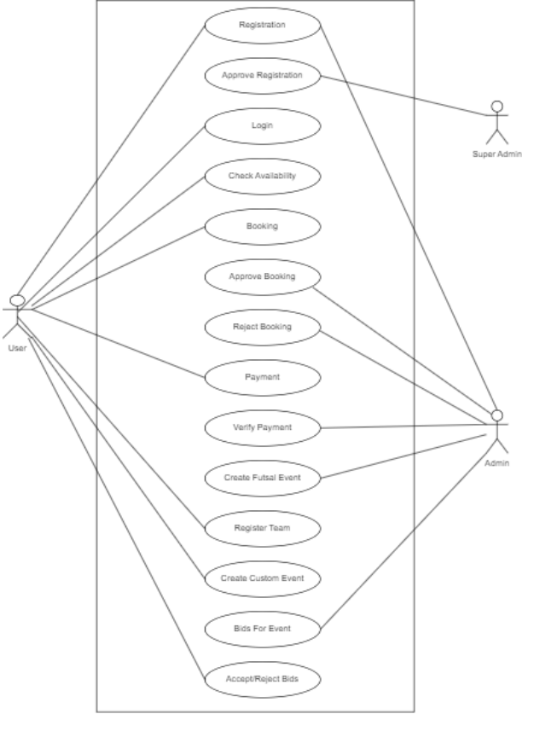
Use Case Diagram

Slide 11
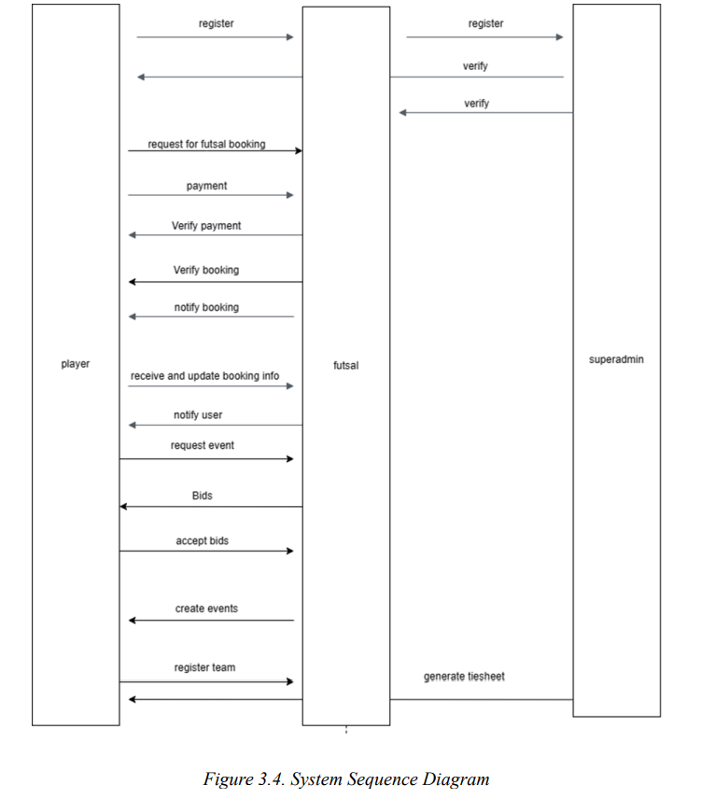
Sequence Diagram

Slide 12
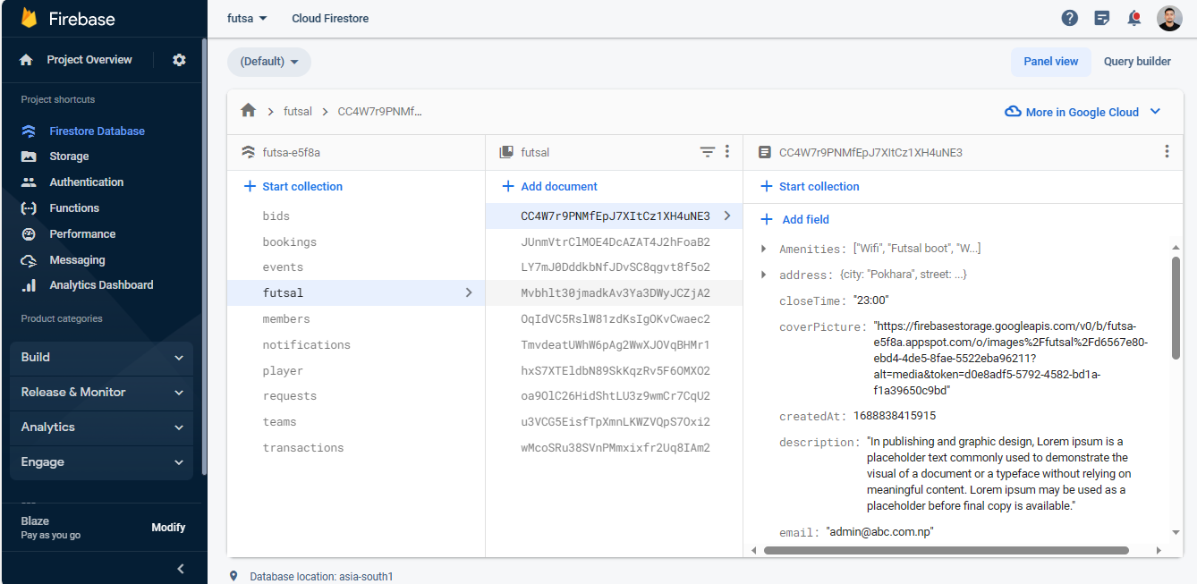
Firestore Database

Slide 13
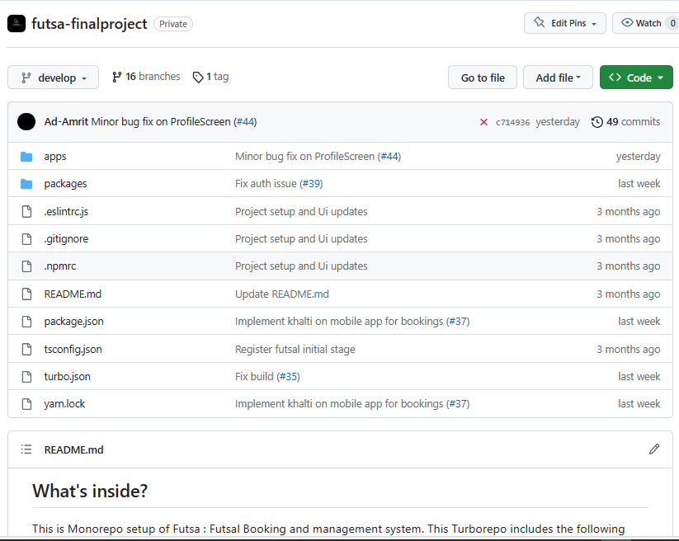
Required Tools and Libraries
React Js
React Native
Firebase
Material UI
Khalti API
Google Maps API
Github
Docker
Vercel

Slide 14
Demo

Slide 15
Future work
Nepali language interface.
Provide backup and recovery of data.
Provides a better user interface for users.
Proper event management and details can be added.
User and roles management for futsal.

Slide 16
Conclusion
The FUTSA project aims to modernize the futsal industry.
It streamlines booking and improve user experience.
Future enhancement and marketing efforts will make it even more valuable for futsal enthusiasts and businesses.

Slide 17
Any Questions ?

Slide 18

Thank You !!!

