Slide 1

Progressive Gallery
v20

Slide 2
Overview
definition
user picture gallery
architecture (patterns)
release
ASAP ☺
plug-in plug-out
zero-configuration
progressive (instant) loading
~ November ‘17
flow: left to right & top to bottom

Slide 3
Core
Pic 1
Pic 2
Pic 3
Pic 4
Pic 5
Pic 6
The core idea here is to provide SQL Server-like functionality if it comes to reading data from Nonclustered Index, i.e. read data from partially read index while scanning other parts of index.
In terms of Progressive Gallery, load partially discovered miniatures of pics while looping the rest of the content.
This icon will let you switch one way or the other between miniatures & full-sized pictures.

Slide 4


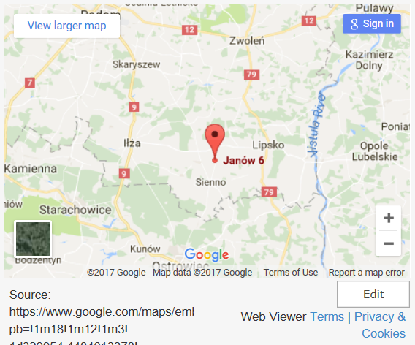
Pic 1
Some description of the above picture.
Comment 1
Comment 2
If you click on a certain picture, popup will display itself like in “Where do we come from ?” showing a full picture, description of the picture and comments on that picture.
Google Maps map will be shown with a picture location next to the picture itself.
You will be able to add as many comments as you like.

Slide 5
Thank you for your attention ☺

