Slide 1

NU-Newsletter
CS301
Software Engineering Project
Group Members:
Ajinkya Bedekar
Aman Garg
Biren Sharma
Shantanu Bahuguna
Yogesh Sharma

Slide 2
Introduction
CS301
The purpose of this project is to build a dynamic web content management system to manage monthly news in university (nu-newsletter) which will ease the news management team.
The main purpose of this project is to provide the more user friendly website for NU Newsletter which can be easily managed by admin and contents can be updated by editors.

Slide 3
Novelty
CS301
It provides a solution for the problem where editor had to tell the changes to be made and web site handler had to add it to code. Now website is more dynamic in nature. Now, admin can easily make changes accordingly.

Slide 4
Sophistication
CS301
This website will give editor a scope to edit or add content on website themselves. Earlier all this job involved a coder who used to take content from editor and used to add to website. But now with help of this new website editor, designer will be helped a lot as they will be having ability to accomplish their task up to their full satisfaction without coding.

Slide 5
Application
The main aim of our project was increasing efficiency by using new technique available. In previous web available a technical person who knows coding could only add the content in the web but now any layman from the team can post the news to the web which is very easy, user friendly and efficient. It can be also used as any other content management system.

Slide 6
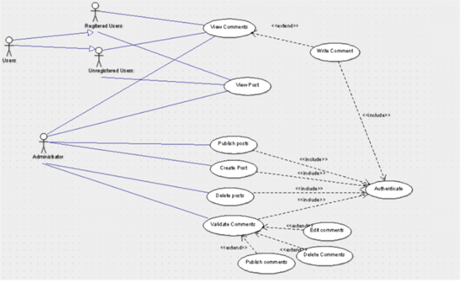
Use Case
CS301

Slide 7
Tools & Technology Used
CS301
Sl.no | Activity | Name of Technology Used
1 | SRS | IEEE SRS Template, Lucid chart, star UML and Argo UML
2 | Local Hosting | XAMPP server
3 | UML | Lucid chart, star UML and Argo UML
4 | Design Doc | Lucid chart, star UML and Argo UML
5 | Coding & Editing | Visual Studio Code editor
6 | Live hosting | Microsoft Internet Information Services TCO NU

Slide 8
Continue…
CS301
7 | Version control | GitHub
8 | Front-End | HTML, CSS, JavaScript and Bootstrap
9 | Back-end | PHP
10 | API | Times of India
11 | Software metric | PHPLOC
12 | Database | MySQL database
13 | Generating Documentation | Doxygen
14 | Communication | WhatsApp Group and Gmail

Slide 9
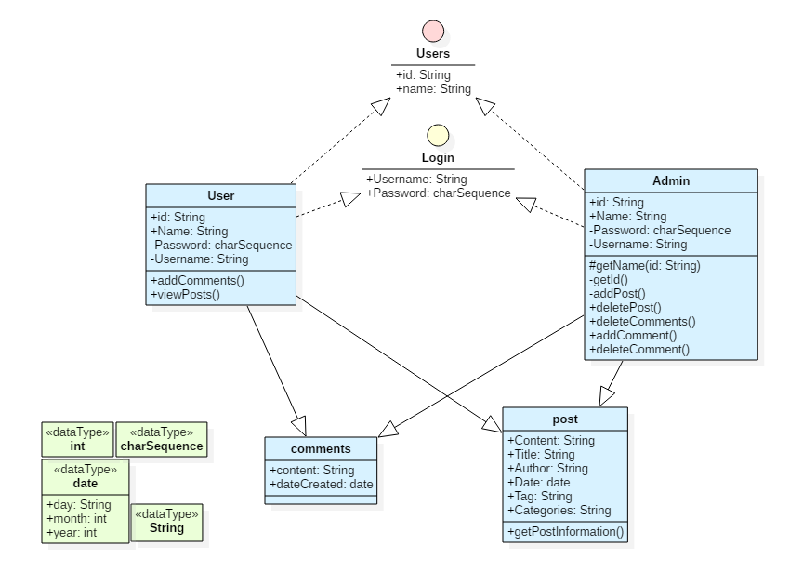
Class Diagram
CS301

Slide 10
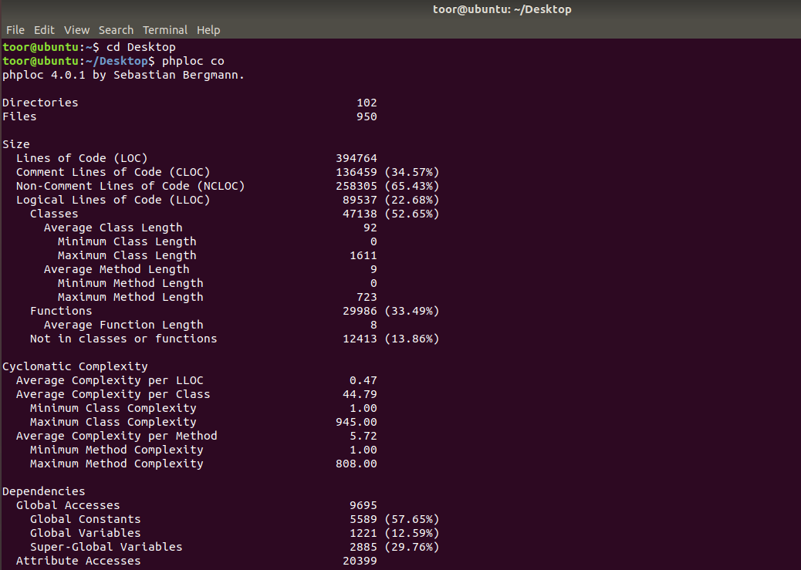
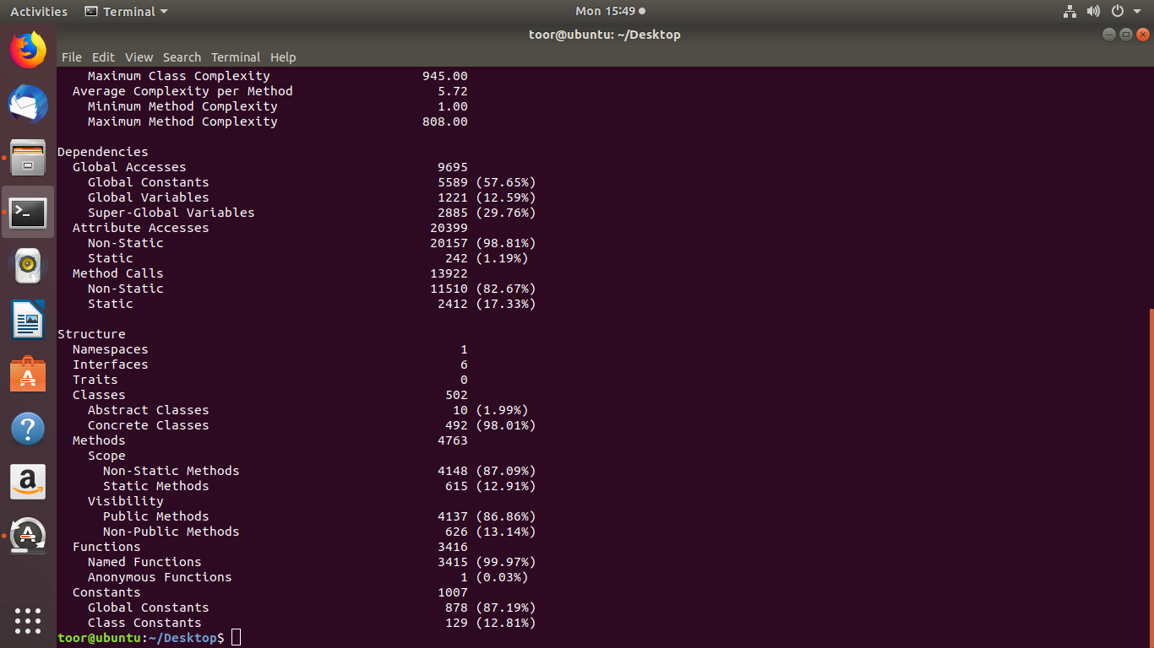
Coding Metrics
CS301

Slide 11
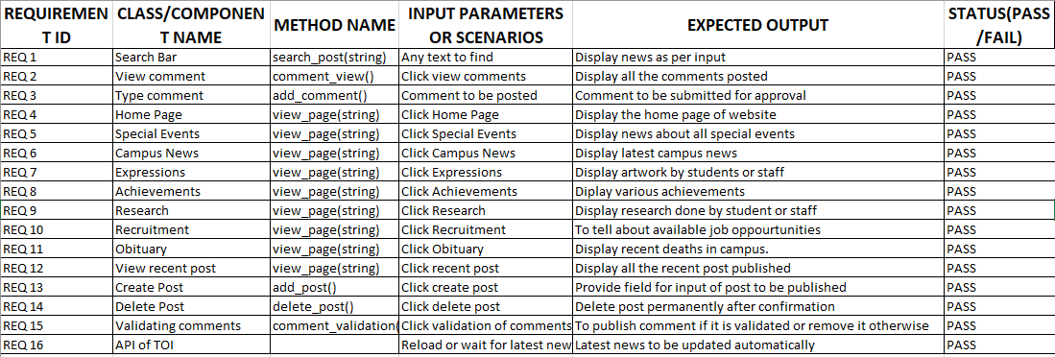
Test Plan
CS301

Slide 12
THANK YOU!!!
CS301

