Slide 1
GO: DOWNLOAD AND INSTALL
Go to: https://golang.org/dl/
Choose the suitable Go for your operating system
Install Go by some basic steps
Verify the installation by the following command in cmd: go version

Slide 2
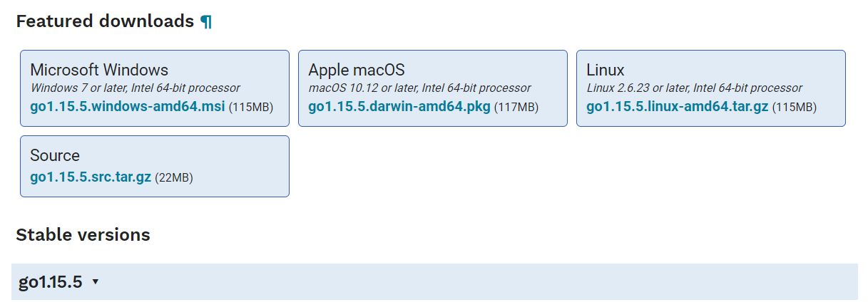
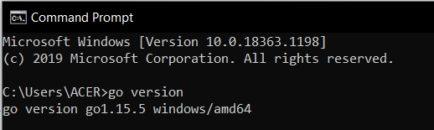
Golang for different operating systems
Checking the version after installation

Slide 3
Get started with Go
Building a Hello, World program

Slide 4
1. Open cmd, cd to your home directory: cd %HOMEPATH%
2. Create a hello directory:
mkdir hello
cd hello
3. In your text editor, create a file name hello.go to put in some lines of code below:
package main // package: way to group functions
import “fmt” //standard library for formatting text
// a main function to print a message to the console
func main() {
fmt.Println("Hello, World!")
}

Slide 5
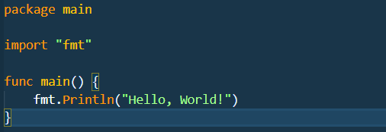
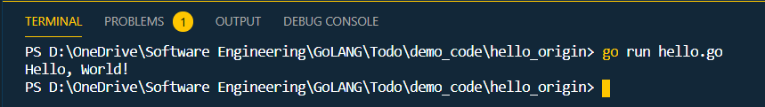

Slide 6
Package
Call code in an external package

Slide 7
You can look for a package that has functions that you can use in your code
Visit pkg.go.dev and search for a “quote” package
Choose the rsc.io/quote package
On the Document tab, under the Index, we’ll use the Go function

Slide 8
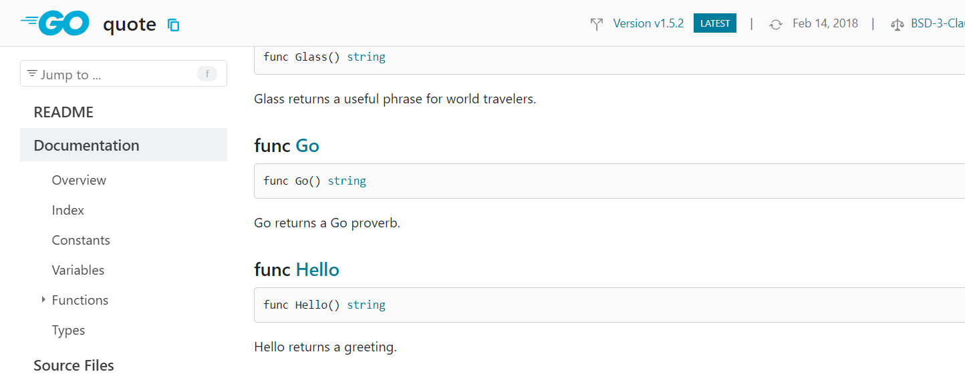
Note: You can use pkg.go.dev site to find published modules that you can use it for your code (Packages are published in modules - like rsc.io/quote )

Slide 9
In your Go code, import the rsc.io/quote package and add a call to its Go function.
1. Change your hello.go program like this in below:
package main
import "fmt"
import "rsc.io/quote"
func main() {
fmt.Println(quote.Go())
}

Slide 10
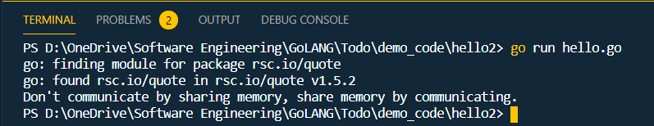
A go mod file lists the specific modules and versions providing those packages.
1. To create a go.mod file, run the: go mod init command, giving it the name (here, just use "hello"):
2. Run your code to see the message generated by the function you're calling.

Slide 11
Create a Go module
Start a module that others can use

Slide 12
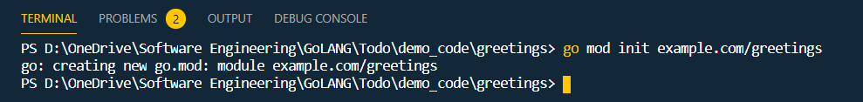
Open terminal and cd to your home directory: cd %HOMEPATH%
Make a greetings directory: mkdir greetings cd greetings
Using go mod init example.com/greetings to create a go.mod file
The go mod init command creates a go.mod that identifies your code as a module that might be used from other code.

Slide 13
4.In your text editor, create a file in which to write your code and call it greetings.go.
5.Paste the following code into your greetings.go file and save the file.
package greetings
import "fmt"
// Hello returns a greeting for the named person.
func Hello(name string) string {
// Return a greeting that embeds the name in a message.
message := fmt.Sprintf("Hi, %v. Welcome!", name)
return message
}

Slide 14
Call your code from another module
Write your code and execute as an application

Slide 15
In the text editor, create a file called hello.go like this:
package main
import (
"fmt"
"example.com/greetings"
)
func main() {
// Get a greeting message and print it.
message := greetings.Hello(“Bob")
fmt.Println(message)
}

Slide 16
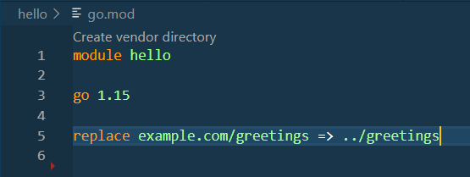
2. Run the cmd: go mod init hello
3. Edit the hello module to use the unpublished greetings module
You need to use the module on your local file system
3.1. In the hello directory, open the go.mod file, change to look like this:

Slide 17

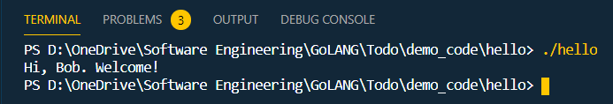
3.2. run go build to locate the module and add it as a depedency to the go.mod file
3.3. In the hello directory, run the hello executable create by go build:

Slide 18
Error handling
Return and handle an error

Slide 19
1.In greetings/greetings.go, replace the code with lines below:
package greetings
import (
"errors"
"fmt"
)
// Hello returns a greeting for the named person.
func Hello(name string) (string, error) {
// If no name was given, return an error with a message.
if name == "" {
return "", errors.New("empty name")
}
// If a name was received, return a value that embeds the name
// in a greeting message.
message := fmt.Sprintf("Hi, %v. Welcome!", name)
return message, nil
}

Slide 20
2. In your hello/hello.go file, paste the following code to yours:
3. Run the cmd: go run hello.go and check the result
package greetings
import (
"errors"
"fmt"
)
// Hello returns a greeting for the named person.
func Hello(name string) (string, error) {
// If no name was given, return an error with a message.
if name == "" {
return "", errors.New("empty name")
}
// If a name was received, return a value that embeds the name
// in a greeting message.
message := fmt.Sprintf("Hi, %v. Welcome!", name)
return message, nil
}

Slide 21
Random
Return a random greeting

Slide 22
1. In the greetings/greetings.go, replace your code like below:
package greetings
import (
"errors"
"fmt"
"math/rand"
"time"
)
// Hello returns a greeting for the named person.
func Hello(name string) (string, error) {
// If no name was given, return an error with a message.
if name == "" {
return name, errors.New("empty name")
}
// Create a message using a random format.
message := fmt.Sprintf(randomFormat(), name)
return message, nil
}
=> Next page

Slide 23
1. In the greetings/greetings.go, replace your code like below:
// init sets initial values for variables used in the function.
func init() {
rand.Seed(time.Now().UnixNano())
}
// randomFormat returns one of a set of greeting messages. The returned
// message is selected at random.
func randomFormat() string {
// A slice of message formats.
formats := []string{
"Hi, %v. Welcome!",
"Great to see you, %v!",
"Hail, %v! Well met!",
}
// Return a randomly selected message format by specifying
// a random index for the slice of formats.
return formats[rand.Intn(len(formats))]
}

Slide 24
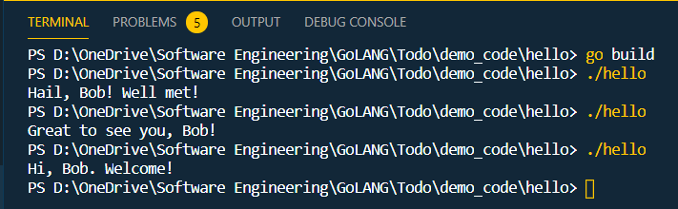
2. In the hello/hello.go run the command to check the result:

Slide 25
Return greetings
For multiple people

Slide 26
1. In the greetings/greetings.go, paste your code like this:
package greetings
import (
"errors"
"fmt"
"math/rand"
"time"
)
// Hello returns a greeting for the named person.
func Hello(name string) (string, error) {
// If no name was given, return an error with a message.
if name == "" {
return name, errors.New("empty name")
}
// Create a message using a random format.
message := fmt.Sprintf(randomFormat(), name)
return message, nil
}
=> Next page

Slide 27
// Init sets initial values for variables used in the function.
func init() {
rand.Seed(time.Now().UnixNano())
}
// randomFormat returns one of a set of greeting messages. The returned
// message is selected at random.
func randomFormat() string {
// A slice of message formats.
formats := []string{
"Hi, %v. Welcome!",
"Great to see you, %v!",
"Hail, %v! Well met!",
}
// Return one of the message formats selected at random.
return formats[rand.Intn(len(formats))]
}

Slide 28
2. In the hello/hello.go, paste your code like this:
package main
import (
"fmt"
"log"
"example.com/greetings"
)
func main() {
// Set properties of the predefined Logger, including
// the log entry prefix and a flag to disable printing
// the time, source file, and line number.
log.SetPrefix("greetings: ")
log.SetFlags(0)
// A slice of names.
names := []string{"Gladys", "Samantha", "Darrin"}
=> Next page

Slide 29
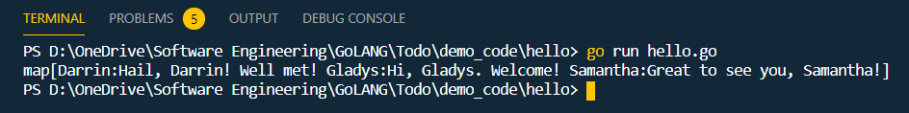
// Request greeting messages for the names.
messages, err := greetings.Hellos(names)
if err != nil {
log.Fatal(err)
}
// If no error was returned, print the returned map of
// messages to the console.
fmt.Println(messages)
}
3. At hello/hello.go, run hello.go to confirm that the code works.

Slide 30
Testing
Add a test for greetings

Slide 31
In greetings directory, create a file called greetings_test.go. Ending a file’s name with _test.go tells the command that this file contains test functions
In greetings_test.go, paste in these codes:
package greetings
import (
"testing"
"regexp"
)
// TestHelloName calls greetings.Hello with a name, checking
// for a valid return value.
func TestHelloName(t *testing.T) {
name := "Gladys"
want := regexp.MustCompile(`\b`+name+`\b`)
msg, err := Hello("Gladys")
if !want.MatchString(msg) || err != nil {
t.Fatalf(`Hello("Gladys") = %q, %v, want match for %#q, nil`, msg, err, want)
}
}
=> Next page

Slide 32
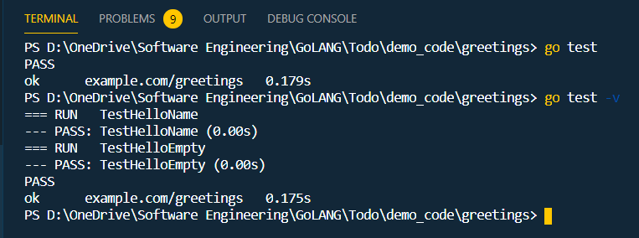
// TestHelloEmpty calls greetings.Hello with an empty string,
// checking for an error.
func TestHelloEmpty(t *testing.T) {
msg, err := Hello("")
if msg != "" || err == nil {
t.Fatalf(`Hello("") = %q, %v, want "", error`, msg, err)
}
}
3. At cmd greetings directory, run the go test command the see the result:

Slide 33
4. Break the greetings.Hello function to view a failing test
In the greetings/greetings.go paste the following codes:
// Hello returns a greeting for the named person.
func Hello(name string) (string, error) {
// If no name was given, return an error with a message.
if name == "" {
return name, errors.New("empty name")
}
// Create a message using a random format.
// message := fmt.Sprintf(randomFormat(), name)
message := fmt.Sprint(randomFormat())
return message, nil
}

Slide 34
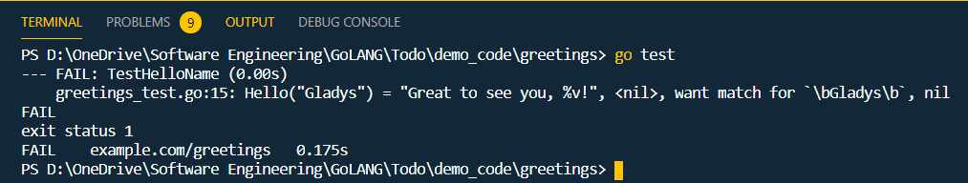
5. At cmd in the greetings directory, run go test to execute the test:

Slide 35
THE END, THANKS FOR WATCHING

